Slide 1
Git for Java
Lê Thị Thùy Trang – SSE – Jul 2018

Slide 2
Preparation

Slide 3
Preparations
You have to learn some main concepts before joining in the workshop.
Git is a Distributed Version Control System: introduction
Visualized basic Git features: link
Working with local repository:
Add & Commit changes
Checkout
Branch
Modify source tree: rebase, merge, stash, reset, revert, cherry-pick
Permanently mark historical points: tag
Working with remote repository
Clone
Fetch, pull, pull --rebase
Push
Git workflows: link

Slide 4
Agenda
Course overview
Course objectives
Main contents
Q&A
Exercise
Assignment

Slide 5
Course overview

Slide 6
Course overview
Common features of Git
Understand Git workflow
Practice in common Git strategies
Use a Git client application and Git repository: SourceTree, BitBucket

Slide 7
Course Objectives

Slide 8
Objectives
Trainees know common features of Git
Trainees understand Git features by practicing on some strategies with BitBucket and SourceTree
Trainees understand every Git workflows
Trainees can use Git in an actual project without further guidance.

Slide 9
Main contents

Slide 10
Index
What is Git?
Common features
Git workflows
A Git repository and a Git client: BitBucket and SourceTree
Common strategies
Notes:
spring.datasource.validationQuery = SELECT 1
# Hibernate ddl auto (create, create-drop, update): with "update" the database
# schema will be automatically updated accordingly to java entities found in
# the project
spring.jpa.hibernate.ddl-auto = validate

Slide 11
What is Git?
Distributed
Version Control System

Slide 12
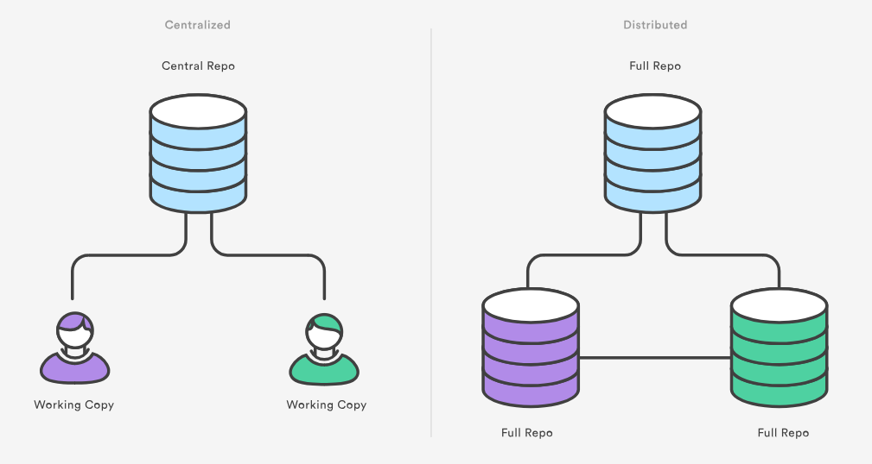
What is Git?

Slide 13
Common features
Working with local repository:
Checkout
Add & Commit changes
Branch
Modify source tree: rebase, merge, stash, reset, revert, cherry-pick
Permanently mark historical points: tag
Working with remote repository
Clone
Fetch, pull, pull --rebase
Push

Slide 14
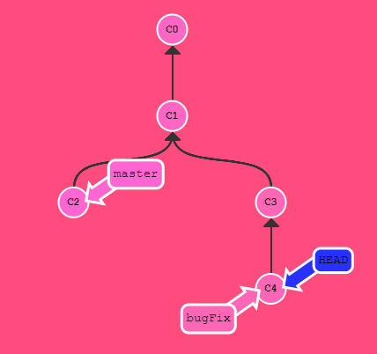
Common features: Local repository
Checkout: git checkout
Notes:
We can consider branch (master or feature,…), HEAD as pointers on a tree
Checkout: move the pointers around

Slide 15
Common features: Local repository
Add & Commit changes:
git add / Staging
git commit

Slide 16
Common features: Local repository
Create branch:
git branch

Slide 17
Common features: Local repository
Modify source tree:
git merge
git rebase
git rebase -i: pick, change order, edit
git stash
git reset
git revert
git cherry-pick

Slide 18
Common features: Local repository
Permanently mark historical points: git tag

Slide 19
Common features: Remote repository
Copy remote repository to local: git clone

Slide 20
Common features: Remote repository
Update local repository from remote repository:
git fetch
git pull = fetch + merge
git pull --rebase = fetch + rebase

Slide 21
Common features: Remote repository
Push local repository to remote repository:
git push

Slide 22
Git workflows
Recipes – how to use Git (in a specific project)
Based on project context

Slide 23
Git workflows
Common workflows:
Centralized
Feature Branch

Slide 24
Git workflows: Centralized
Developers work on their local repositories
Developers, if needed, rebase / merge their work into origin/master branch
Developers push their work to origin/master

Slide 25
Git workflows: Centralized
Transitioning teams off of SVN
For small teams

Slide 26
Git workflows: Feature branch
Developers develops features on branches
Developers can push their work to central repository for backup
Feature branch will be merged/rebased into master branch after being finished.

Slide 27
Git workflows: Feature branch
Master branch never contains broken code
Promotes collaboration with team members

Slide 28
Git workflows: others
Gitflows, Forking
Pull requests: not a basic Git feature

Slide 29
Git repositories and Git clients
BitBucket, GitHub, GitLab,… Git repositories personal hosting
SourceTree, Tortoise Git, bash git

Slide 30
Common strategies
Ignore files / folder: .gitignore
Resolve conflict: how to read a conflicting file
Have to add & commit changes (eg. fixing bugs) while working on something else: stash & stash pop
Change file name: git mv
Modify commits (content & comment): git rebase –I
Modify commit metadata (date): git commit --amend --date=1987
...

Slide 31
Q&A

Slide 32
Exercise

Slide 33
Assignment

