Slide 1
Message Queue
Bao Nguyen – PSE
Duy Bui - SSE
07 - 2018

Slide 2
Agenda
What is message queue
Review
Message queue objective
Demo
Discussion with some scenarios
Q&A
Examination
References

Slide 3
What is message queue

Slide 4
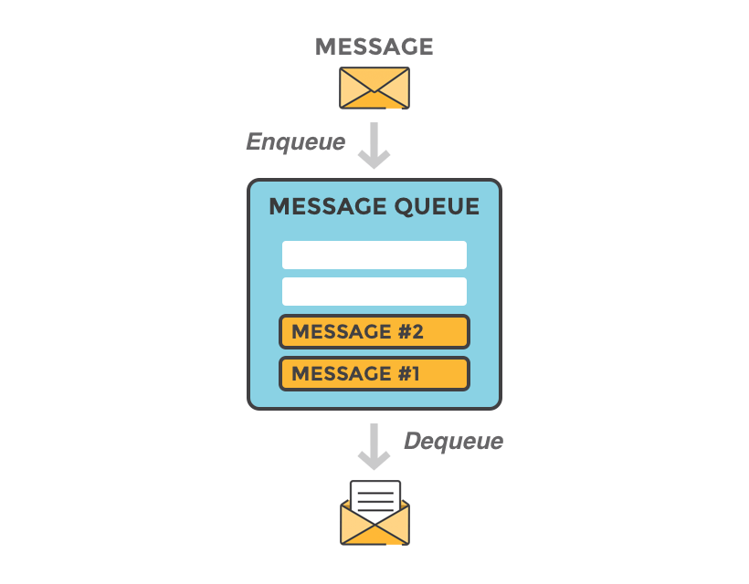
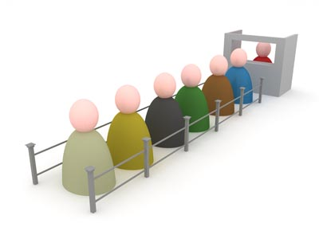
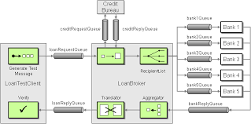
What is Message Queue
“A message queue is a form of asynchronous service-to-service communication used in serverless and microservices architectures. Messages are stored on the queue until they are processed and deleted. Each message is processed only once or multi consumer depend on type of Queue. Message queues can be used to decouple heavyweight processing, to buffer or batch work, and to smooth spiky workloads.”

Slide 5
Review

Slide 6
Some definitions
Message
Queue
Enqueue
Dequeue
Acknowledgement
Publish - Subscribe
DLQ
Delivery

Slide 7
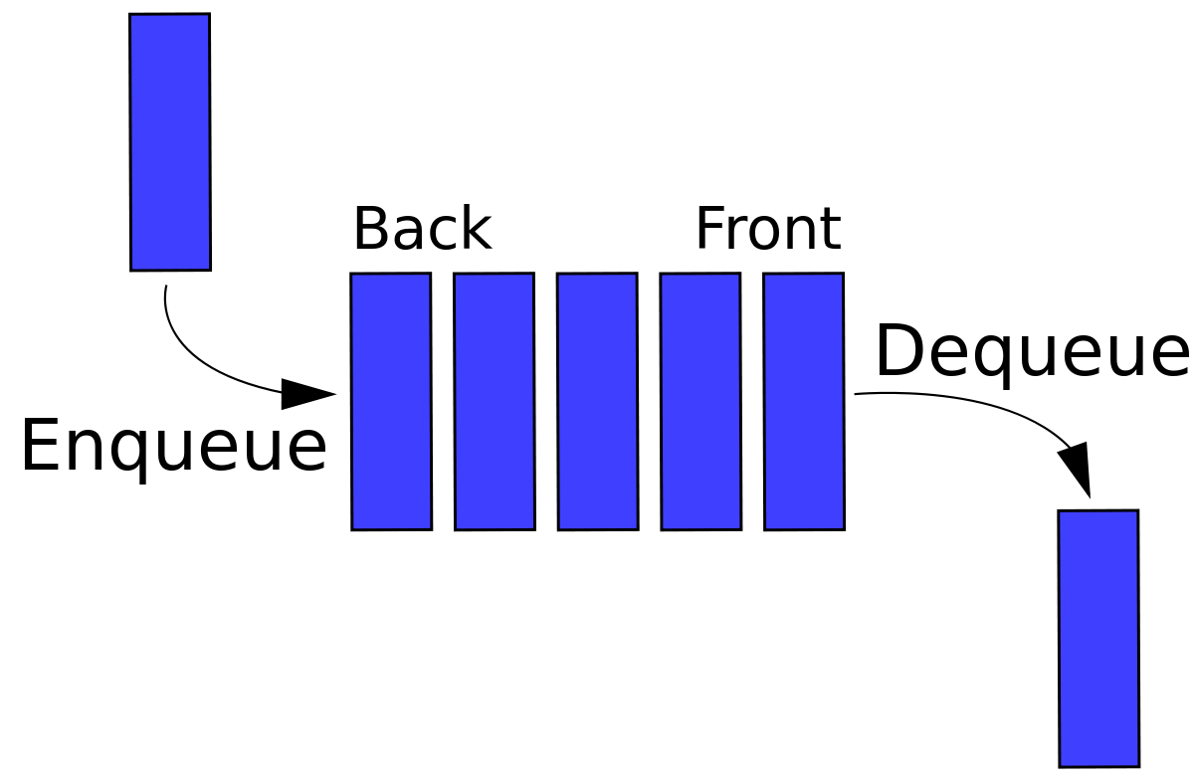
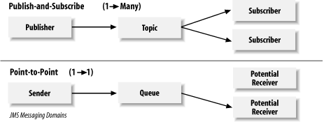
Some definitions
Queue
Consumer
ACK

Slide 8
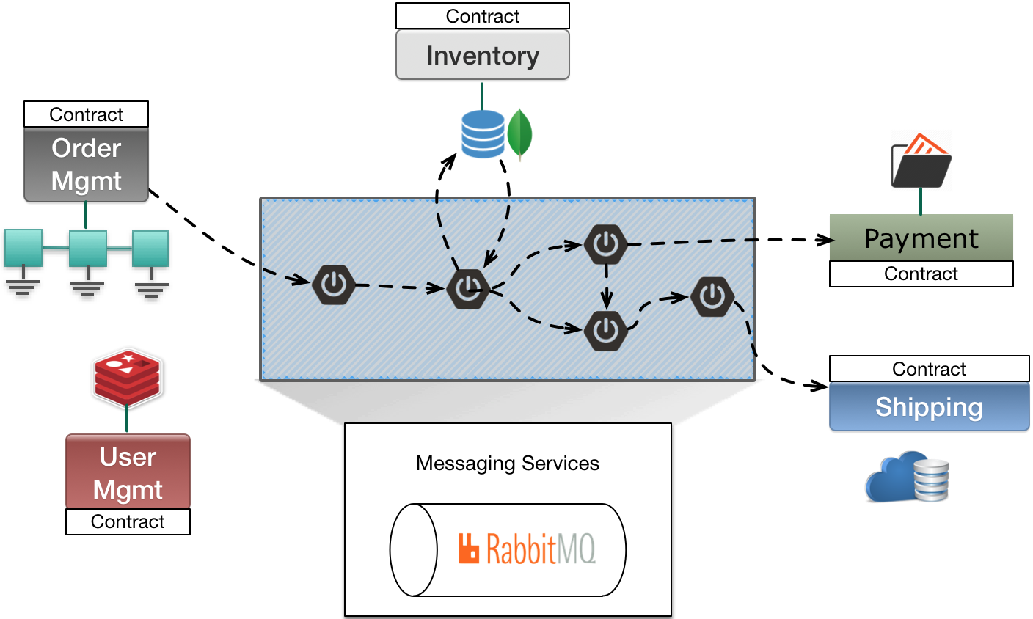
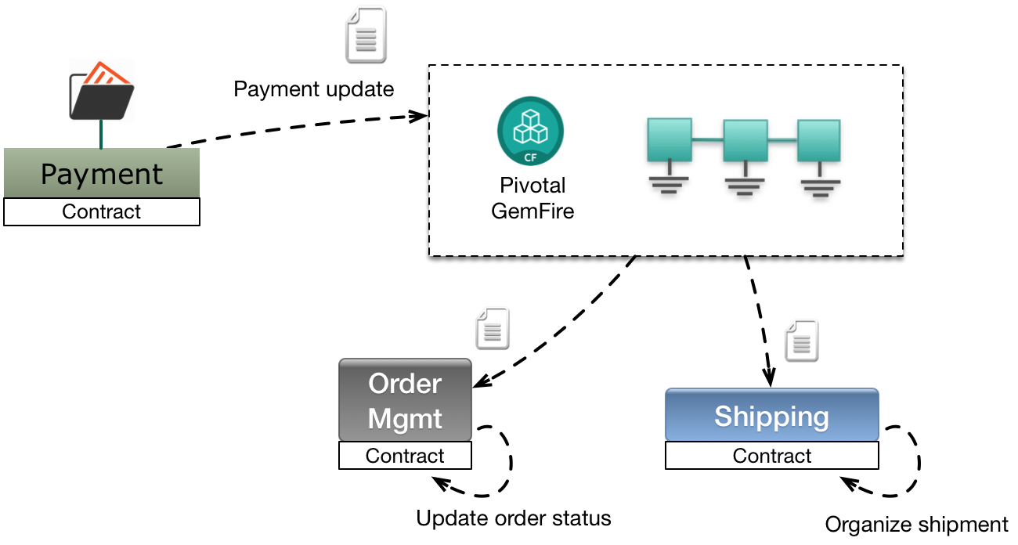
Objective
“This course make participants an expert in using Message queue(Rabbit MQ as example), how queue work, when we use queue, and how to design system integration use Queue.”

Slide 9
Demo

Slide 10
Discussion

Slide 11
Rules
3 scenarios for discussion
Time for each scenario : 10’ (Group discussion + presentation)
Require 3 groups
Group discussion: 5’
Presentation: 5’
Why do you choose this solution?
What are the disadvantages in your solution?

Slide 12
Scenarios
Export Excel file with large data and send email (attach file) to Client
We focus to discuss about design and implementation (assume all others condition is ok)
Client click button to request
System handle request and process export excel
System send email to client
Ticket booking system
How to solve the “seat choosing” process.
Game log system (desktop game)
Collect log from gamer pc

Slide 13
Q&A

Slide 14
Examination

Slide 15
References

Slide 16
Scenarios
Internet
https://content.pivotal.io/blog/messaging-patterns-for-event-driven-microservices
https://dzone.com/articles/the-developers-guide-to-collections-queues
https://dzone.com/articles/comparing-publish-subscribe-messaging-and-message
https://dzone.com/articles/you-probably-dont-need
https://dzone.com/articles/java-message-system-introduction

