Slide 1
Spring Boot in Action
Lê Thị Thùy Trang – SSE – May 2018

Slide 2
Preparation

Slide 3
Preparations
You have to learn some main concepts before joining in the workshop.
We recommend you to do all the tutorials listed in the next slide. By doing them, you will have knowledge of
IoC & DI concept in Spring boot application development
How to build a spring boot app by using Spring Initializr / STS
How to develop REST APIs with Spring Boot
Integrate with database server by using JPA/Hibernate
How to do REST API unit testing in Spring Boot application
Integrate with Spring Actuator
Quick understanding: Building Microservices with Spring Boot, Second Edition (can use trial account)
Introduction
Before You Begin (2)
Lesson 1: exclude 1.5
Lesson 2: exclude 2.7, 2.8
Lesson 4: exclude 4.5, 4.6, 4.7
Lesson 5: 5.1, 5.2
Lesson 11: 11.1, 11.2
Lesson 12: exclude 12.8, 12.9, 12.10
To have more in-depth knowledge of Spring Boot, we recommend you to read the Spring Boot in action book. You should read the below section first to have good understanding of Spring Boot. (The other chapters you can read later on)
Foreword
Preface
About this book
Chapter: 1, 2, 3, 4, 8

Slide 4
Useful Tutorials
AOP understanding
DI vs IoC understanding
How to initialize Spring Boot application (Part II.3 only)
How to create an embedded server & Rest API then Execute it
How to integrate with DB using Spring Data JPA
Testing Tutorial: unit test with mocked services & integration test
Actuator Integration
Spring Boot in Action – Craig Walls
How to building microservice with Spring Boot

Slide 5
Agenda
Course overview
Course objectives
Main contents
Appendix: Keywords & Techniques
Q&A
Exercise
Assignment

Slide 6
Course overview

Slide 7
Course overview
Sharing some useful features of Spring Boot
Sharing keywords and techniques to apply and learn Spring Boot
Small exercise and assignment to verify our understanding

Slide 8
Course Objectives

Slide 9
Objectives
Trainees understand main concepts of Spring Boot, and be able to build a Spring Boot application (web / REST APIs) from scratch without support
Trainees can utilize Spring Boot strength: configuration
Trainees can apply: unit test, security, spring-data-jpa into Spring Boot application
Trainees know how to host Spring Boot application
Trainees can work with Spring Boot in real-world project without any additional training

Slide 10
Main contents

Slide 11
Big questions
What’s Spring?
Why Spring?
Why not Spring?
Why Spring… again?
How does it look like?

Slide 12
what’s SPRING?
Notes:
How many of you using Spring for an actual project?

Slide 13
Spring idea
Application framework
Integration of many technologies
Consistent programming style

Slide 14
Spring components
A combo of
Web
Data access
Caching
Security
Cloud
and so on

Slide 15
Spring core concepts
What’re they?

Slide 16
Spring core concepts
AOP
Aspect Oriented Programming
DI
Dependency Injection

Slide 17
AOP
adding behavior to existing code
without modifying that code
Notes:
AOP is not very important because it’s too much theoretical
AOP – decorator pattern
Just remember – one does its own task, no need to care about everyone else, or more seem-smart “SOLID principle”
However, just for fun:
AOP vs OOP: aspect vs class => concept of program structure
Aspect: particular part or feature
Concepts:
Aspect: 2 approaches – schemma / annotation
Joint point: method execution in Spring
Advice: around, before, after, etc. -> interceptor in Spring
Pointcut: advice vs pointcut expression vs matched joint points
Introduction
Target object: adviced object, proxied object in Spring
AOP proxies
Weaving: compile/load/runtime, Spring at runtime

Slide 18
AOP sample
Lets see sample: aop-advice-annotation
A Java annotation to log the execution time of a method
@LogExecutionTime
Notes:
Compare profiler & AOP

Slide 19
Dependency Injection
Before
public class StudentService {
private StudentRepository studentRepository;
public StudentService() {
this.studentRepository = new StudentRepository();
}
public List<Student> getAllStudents() {
List<Student> students = studentRepository.findAll();
return students;
}
}

Slide 20
Dependency Injection
After (1 of 3 ways: setter, constructor, and field)
@Service
public class StudentService {
@Autowired
private StudentRepository studentRepository;
public List<Student> getAllStudents() {
List<Student> students = studentRepository.findAll();
return students;
}
}

Slide 21
Dependency Injection
how HELPFUL?

Slide 22
Dependency Injection
Implementation switchable
Testable (injectable -> isolatable)
AOP
Notes:
Implementation switchable: various loggers

Slide 23

Dependency Injection
Class instances are managed by Spring: beans
When we need them, just tell Spring, then let Spring do anything necessary to prepare them

Slide 24
Ambiguous terminology usage
Dependency Injection (DI)
Vs
Inversion of Control (IoC)

Slide 25
Ambiguous terminology usage
Dependency Injection (DI)
Vs
Inversion of Control (IoC)
IoC: idea of inverting flow of application – work with contracts
DI: one of patterns implementing IoC
Notes:
IoC:
A common framework characteristic
The control is inverted: user-defined method is called by framework, not by user code
DI: a pattern that implements IoC
Constructor, Setter, Interface
Spring supports Constructor & Setter
Constructor is preferred ‘cos setter may never be called
Spring 4.3 and greater: in some cases, no need for an explicit constructor injection
Spring now: field, constructor, setter

Slide 26

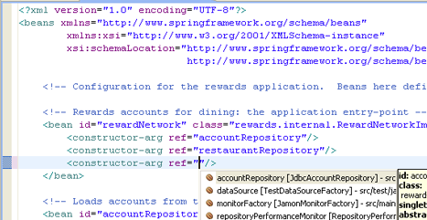
Why not Spring?
Before Spring Boot
Component code - easier
Configuration - headache
Notes:
Headache:
Numbers of xml files
Hard to debug

Slide 27
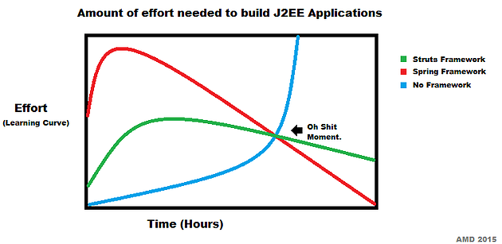

Why not Spring?
Before Spring Boot
Where I gave up on the dream

Slide 28
Why Spring …again?
LEAVE IT TO ME
SPRING BOOT

Slide 29
what spring boot DOES?

Slide 30
What’s Spring Boot
Stand-alone Spring applications
Say goodbye to web container: Tomcat, Jboss, etc.
Say hello to embedded server: Tomcat, Jetty, Undertow
Possible to say hello again if you want
Quick start with useful starter packages data, security, health check, logging, test, etc.
Auto-configuration as much as possible -> say goodbye to xml
Notes:
View project hello-spring-boot as a sample:
Configuration: @RestController, @Service, etc.
Starter: web (default: embedded Tomcat server, logger, etc.)
Project structure

Slide 31
Why’s Spring Boot
Sample hello-spring-boot:
Quick to initialize project: from http://start.spring.io/
Notes:
Initialize project:
Web-base: http://start.spring.io/
I like my style (using dependencyManagement, Main.java) so I start from my base project

Slide 32
Why’s Spring Boot
Sample hello-spring-boot:
Starter dependencies: spring-boot-starter-* (web, data-jpa, security): rest API, data access, JWT

Slide 33
Why’s Spring Boot
Sample hello-spring-boot:
Auto configuration: rest API, datasource (database access)
Notes:
Manually configure for scanning: @ComponentScan(basePackages="somepackage.*“)
Command-line arguments
JNDI attributes from java:comp/env
JVM system properties
Operating system environment variables
Randomly generated values for properties prefixed with random.* (referenced when setting other properties, such as `${random.long})
An application.properties or application.yml file outside of the application
An application.properties or application.yml file packaged inside of the application
Property sources specified by @PropertySource
Default properties
This list is in order of precedence. That is, any property set from a source higher in the list will override the same property set on a source lower in the list.
Externally, in a /config subdirectory of the directory from which the application is run
Externally, in the directory from which the application is run
Internally, in a package named “config”
Internally, at the root of the classpath
Again, this list is in order of precedence
If you have both application.properties and application.yml side by side at the same level of precedence, properties in application.yml will override those in application.properties

Slide 34
Why’s Spring Boot
Sample hello-spring-boot:
Standalone server / Self-contained runnable application / Fat jar

Slide 35
Why’s Spring Boot
Sample hello-spring-boot:
Create a custom configuration: log version of Tomcat
If embedded server is Tomcat
If log-tomcat-version is not disable
Change behavior without modification on code

Slide 36
Why’s Spring Boot
Sample hello-spring-boot:
Actuator: take a look into application at runtime
actuator/health: health check
actuator/info
View all configuration: /actuator/configprops
Use another port to expose actuator
Notes:
Actuator:
Expose configuration, environment, made decisions, metrics (memory usage, data source, etc.), and so on.
Access via web endpoint or shell interface (SSH, etc.)

Slide 37
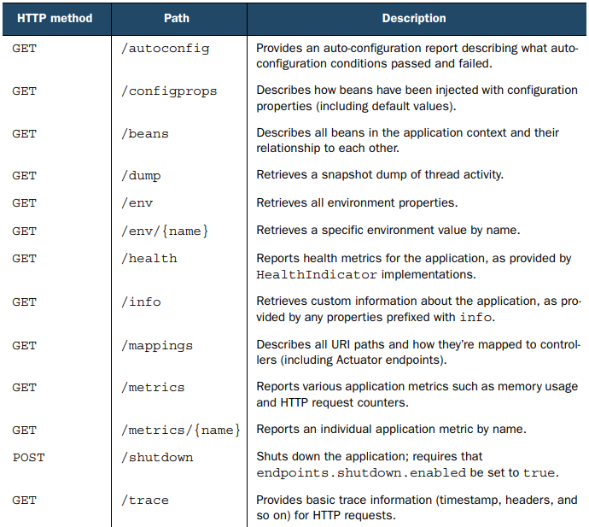
Why’s Spring Boot

Slide 38
How’s Spring Boot - Testing
Unit test
Integration test: @RunWith(SpringJUnit4ClassRunner.class), @SpringBootTest
Isolate tested module - mocking supporting: @MockBean
Notes:
@RunWith is given SpringJUnit4ClassRunner.class to enable Spring integration testing

Slide 39
How’s Spring Boot - Deployment
Web container vs standalone server: war vs jar
Database: validate, auto generate DDL, evolve database using flyway
Cloud: portable (VMs, AWS, Pivotal Cloudfoundry)
Notes:
spring.datasource.validationQuery = SELECT 1
# Hibernate ddl auto (create, create-drop, update): with "update" the database
# schema will be automatically updated accordingly to java entities found in
# the project
spring.jpa.hibernate.ddl-auto = validate

Slide 40
Q&A

Slide 41
Appendix: Keywords & Techniques
To discover Spring Boot

Slide 42
Recommended sites
Tutorials with explanation & some advice: baeldung
Quick tutorial & related useful resources - official: spring.io
Technical review & explanation: martinfowler
Shortcut to an overview of application: online course
To have fun with Spring in microservice & cloud: Spring Microservices (Rajesh RV)

Slide 43
My own experience
Learn general concepts
Find related Spring plugins/starters
Configure

Slide 44
Example
Apply Spring Security & OAuth2
Learn general concept of OAuth2 on official site
Search for Spring OAuth2 plugin(s)
Search for user guide(s) and try to configure

Slide 45
Exercise

Slide 46
Assignment

Slide 47
Resources
Trainees walk through all following milestones
Trainees upload source code to a BitBucket account
After 5th milestone, trainees deploy artifacts to testing server
Examiners will check these result
Trainees are passed 5/5 milestones passed

Slide 48
Milestones
Using Initializr create a REST service that:
Read data from MySQL
Return json objects
Implement a REST service that
Receive user id, return user name (1)
Receive user id, return user membership start date (2)
Receive user id, return user (id, name, start_date, loyal_point), with loyal_point = (today – start_date + 1) * 5 (3)
Integrate security by JWT without touching legacy code
Manage username/password of an administrator account, and a moderator account in DB
Apply JWT to authorize user
Apply Spring security to configure: all users can use (1), only admin & mod can use (2), only admin can use (3)
Implement test:
Integration test for DB connection – is it possible to connect, can read & write
Unit test for Service that get data from from Repository, perform some logical calculation, and return abstract data
Unit test for REST API – does it return expected JSON
Implement healthcheck API for service

