Slide 1
VinDr-CXR: An open dataset of chest X-rays with radiologist’s annotations
Team members: Nguyễn Lê Anh Quân
Lý Hoàng Thuận
Phan Thành Nhân

Slide 2
Overview about VinDr-CXR
VinDR-CXR datasets
More about labeling process
-Introduction
-Background & Summary,
-Problem occur
-What happen with previous datasets?
-About dataset
-What make it special?
-Labeling data
-The data characteristics.
-Categories.
-Data record.

Slide 3
Introduction:
About 100,000 DICOM chest X-Ray pics were collected from 2 of the biggest hospital in VN (H108, HMUH).
In this data set contain 15,000 pics.
Annotated by 17 experienced radiologists with 22 local labels of rectangles surrounding abnormalities and 6 global labels of suspected diseases.

Slide 4
Background & Summary
-Computer-aided diagnosis (CAD) systems for chest radiographs (Chest X-ray or CXR) recently achieved great success thanks to the availability of large labeled datasets and the recent advances of high-performance supervised learning algorithms. These systems can reach the expert-level performance in classifying common lung diseases and related findings with CNN.
-Training a CNN heavily relies on high quality datasets of annotated images.

Slide 5
Problem occur:
It is costly and time-consuming to build such datasets due to several constraints:
Medical data are hard to retrieve from hospitals or medical centers.
Physician’s time is precious.
The annotation of medical images requires a consensus of several expert readers to overcome human bias.
It lacks an efficient labeling framework to manage and annotate large-scale medical datasets.

Slide 6
What happen with previous datasets?
-Most of existing CXR datasets depend on :
+Automated rule-based labelers that either use keyword matching (e.g. CheXpert3 and NIH labelers) or an NLP model (e.g. CheXbert) to extract disease labels from free-text radiology reports.
=>These tools can produce labels on a large scale but, at the same time, introduce a high rate of inconsistency, uncertainty, and errors.

Slide 7
Hold on!!!
-The report-based approaches only associate a CXR image with one or several labels in a predefined list of findings and diagnoses without identifying their locations.
-There are a few CXR datasets that include annotated locations of abnormalities but they are either too small for training deep learning models (JSRT) or not detailed enough (PadChest).
-The interpretation of a CXR is not all about image-level classification.
=>More important is about localize the abnormalities on the image.

Slide 8
VinDR-CXR datasets

Slide 9
About:
-VinDr-CXR dataset from more than 100,000 raw images in DICOM format that were retrospectively collected from the Hospital 108 (H108) and the Hanoi Medical University Hospital (HMUH).
-The published dataset consists of 18,000 postero-anterior (PA) view CXR scans that come with both the localization of critical findings and the classification of common thoracic diseases.

Slide 10
What make it special?
-Annotated by a group of 17 radiologists with at least 8 years of experience for the presence of 22 critical findings (local labels) and 6 diagnoses (global labels); each finding is localized with a bounding box.
-The training set :15,000 scans and the test set: 3,000 scans.
-Each image in the training set was independently labeled by 3 radiologists, while the annotation of each image in the test set was even more carefully treated and obtained from the consensus of 5 radiologists.

Slide 11
Labeling data:
-The labeling process was performed via an in-house system called VinLab , which was built on top of a Picture Archiving and Communication System (PACS).
-The labels of the test set was temporarily retain for the purpose of holding a CXR analysis competition on an open platform launch in December of 2020.
-Labels was suggested by a committee of the most experienced radiologists from the two hospitals.
-The selection of these labels took into account two factors:
+They are prevalent.
+They can be differentiated on CXRs.

Slide 12
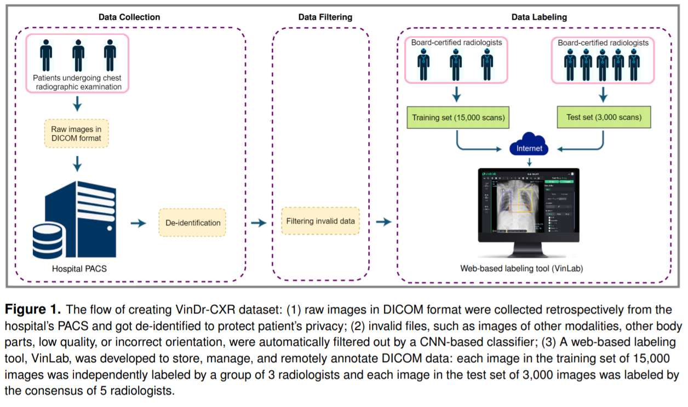

Slide 13
More about labeling process

Slide 14
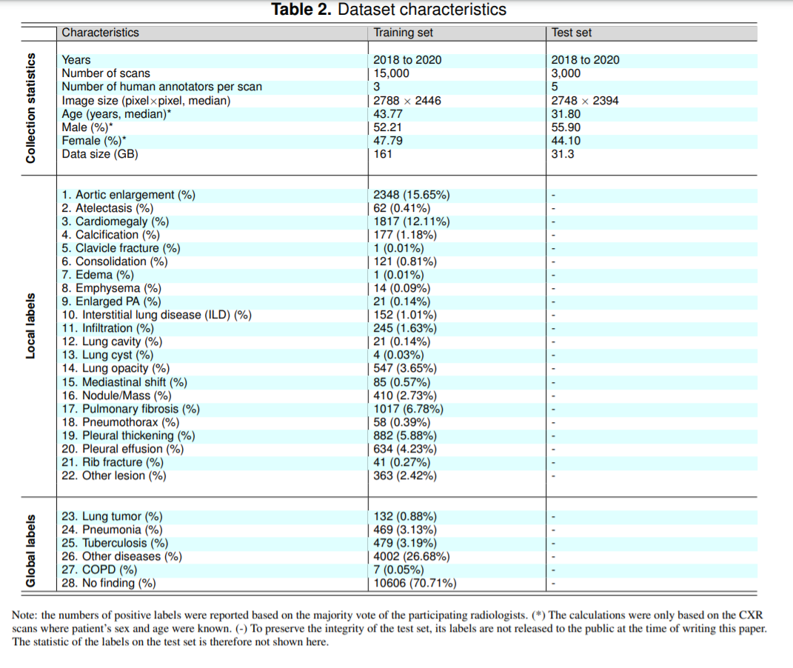
Summarize the data characteristics

Slide 15
Categories:
More about labeling process:
These labels were divided into 2 categories:
Local labels (1-22) and global labels (23-28). The local labels marked with bounding boxes that localize the findings.
Global labels reflect the diagnostic impression of the radiologist

Slide 16
All data has been verified carefully
-Each sample in the training set was assigned to 3 radiologists for annotating in a blind fashion.
-For the test set, 5 radiologists involved into a two-stage labeling process:
First stage, each image was independently annotated by 3 radiologists.
In the second stage, 2 radiologists, who have a higher level of experience, review the annotations from first stage and communicated with each other in order to decide the final labels.

Slide 17
Result:
-Once the labeling has been completed, the labels of 18,000 CXRs were exported in JavaScript Object Notation (JSON) format.
-Contents and organized the annotations are parsed in the form of a single comma-separated values (CSV) file.
-CSV file that contains labels, bounding box coordinates, and their corresponding image IDs.
-For the training set, each sample comes with the annotations of three different radiologists.

Slide 18
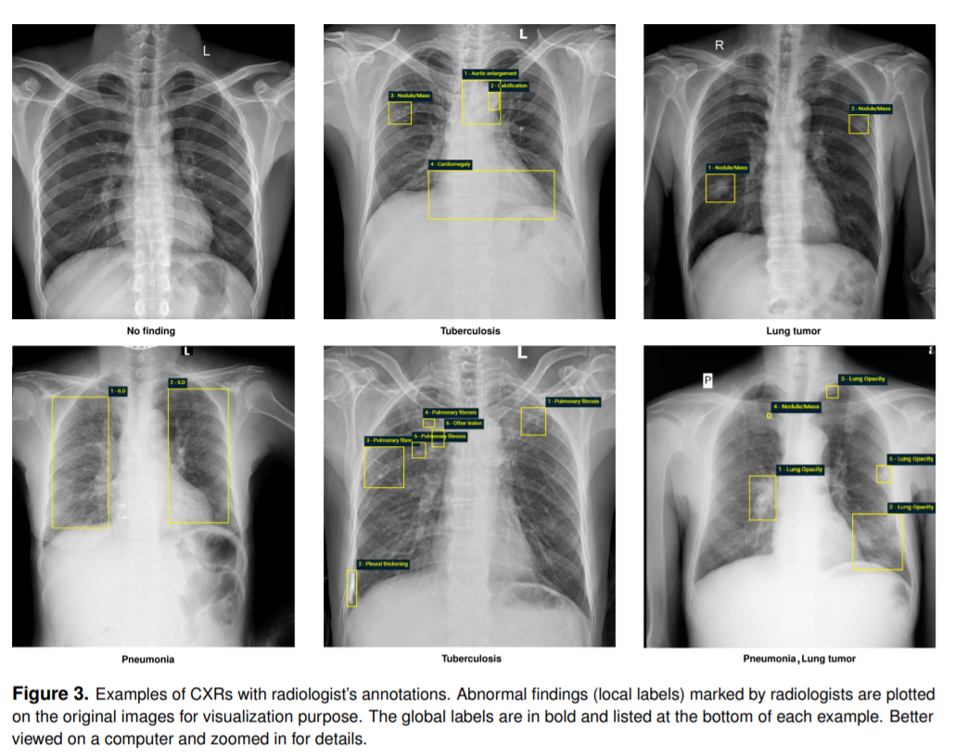

Slide 19
Data record:
-The VinDr-CXR dataset has been submitted to The Cancer Imaging Archive (TCIA) for public download. It is also accessible at: https://vindr.ai/datasets/cxr/ .
-Specifically, each image ID has a vector of multiple labels corresponding to different pathologies, in which positive ones “1” and negative ones “0”.
-Training set were provided in a CSV file, annotations_train.csv.
-Each row represents a bounding box contain: image ID (image_id), radiologist ID (rad_id), label’s name (class_name), and bounding box coordinates (x_min, y_min, x_max, y_max).
-The identities of the 17 radiologists is in (rad_id).
-The image-level labels were stored in different file, “image_labels_train.csv”, with the following: Image ID (image_id), radiologist ID (rad_ID), and global labels (labels).

Slide 20
Technical Validation
-All data has been de-identification.
-All DICOM meta-data was parsed and reviewed to ensure all individually identifiable health information of the patients has been removed .
-Pixel values of all CXR scans were also carefully examined.

