Slide 1
VinDr-CXR: An open dataset of chest X-rays with radiologist’s annotations
Team members: Nguyễn Lê Anh Quân
Lý Hoàng Thuận
Phan Thành Nhân

Slide 2
About VinDR-CXR datasets
About.
The flow of creating dataset.
Dataset information
Label
Inside dataset file

Slide 3
About VinDR-CXR datasets
About:
-Data set annotated by a group of 17 radiologists with at least 8 years of experience for the presence of 22 critical findings (local labels) and 6 diagnoses (global labels); each finding is localized with a bounding box. The training set of 15,000 scans and the test set of 3,000 scans.
-Dataset contributors:
+The dataset was created by assembling de-identified Chest X-ray studies provided by two hospitals in Vietnam: the Hospital 108 and the Hanoi Medical University Hospital.​

Slide 4
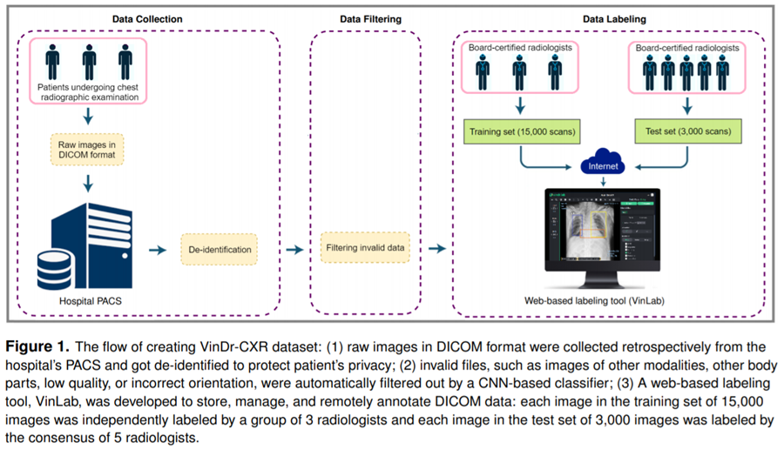
About VinDR-CXR datasets
The flow of creating dataset:

Slide 5
Dataset information
Label
Inside dataset file

Slide 6
Dataset information:
Label
-The dataset comprises 18,000 postero-anterior (PA) CXR scans in DICOM format, which were de-identified to protect patient privacy. All images were labeled by a panel of experienced radiologists for the presence of 14 critical radiographic findings as listed below:​
0 - Aortic enlargement​
1 - Atelectasis
2 - Calcification​
3 - Cardiomegaly
​4 - Consolidation​
5 - ILD
6 - Infiltration​
7 - Lung Opacity​
8 - Nodule/Mass​
9 - Other lesion
10 - Pleural effusion
11 - Pleural thickening
​12 - Pneumothorax​
13 - Pulmonary fibrosis​
14 - No finding​

Slide 7
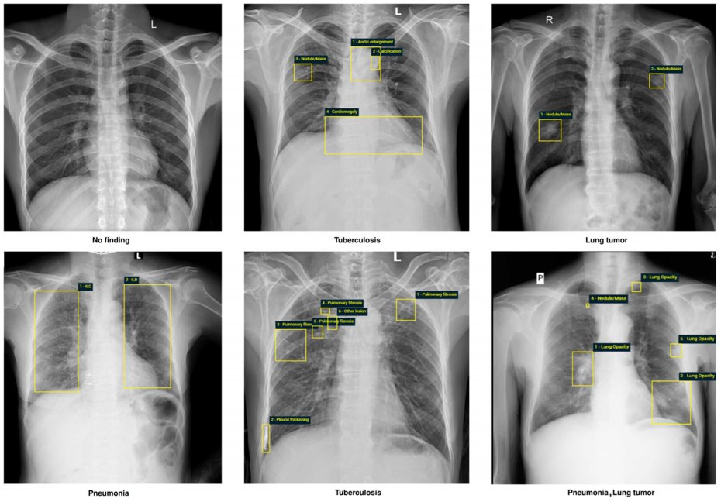
Dataset information:

Slide 8
Dataset information:
Inside dataset file:
-train.csv - the train set metadata, with one row for each object, including a class and a bounding box. Some images in both test and train have multiple objects.​
Columns:​
image_id - unique image identifier​
class_name - the name of the class of detected object (or "No finding")​
class_id - the ID of the class of detected object​
rad_id - the ID of the radiologist that made the observation​
x_min - minimum X coordinate of the object's bounding box​
y_min - minimum Y coordinate of the object's bounding box​
x_max - maximum X coordinate of the object's bounding box​
y_max - maximum Y coordinate of the object's bounding box​

