Slide 1

Case Study Impact of COVID-19 on ABC Company’s Parcel Delivery Business
Group 7

Slide 2
Objective and Approach
🧭 Project Objectives
- Analyze how the COVID-19 pandemic impacted ABC Company’s parcel delivery business.
- Highlight the impact on peak season, customer segments, and revenue.
- Provide insightful recommendations for future strategic decisions.
🔍 Methodology
- Descriptive analysis by year and week (2019 vs 2020)
- Customer segmentation: New, Lost, Stable, High Growth
- Comparison: Peak vs non-peak season

Slide 3
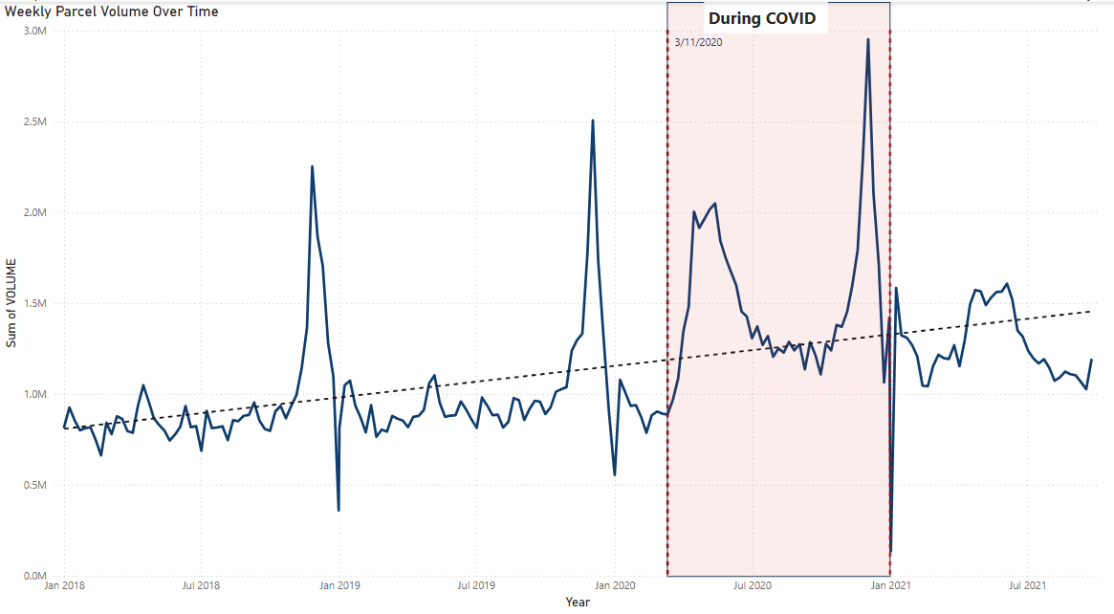

Business Overview

Slide 4
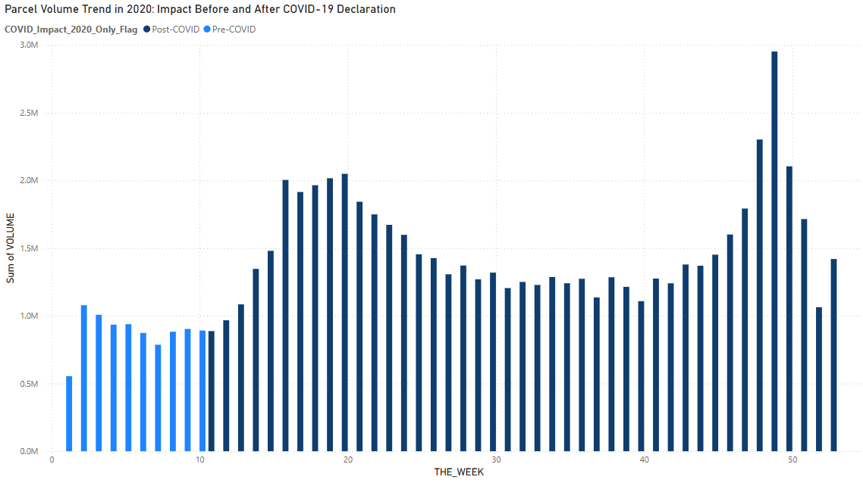
Impact before and after COVID-19 Declaration

Slide 5
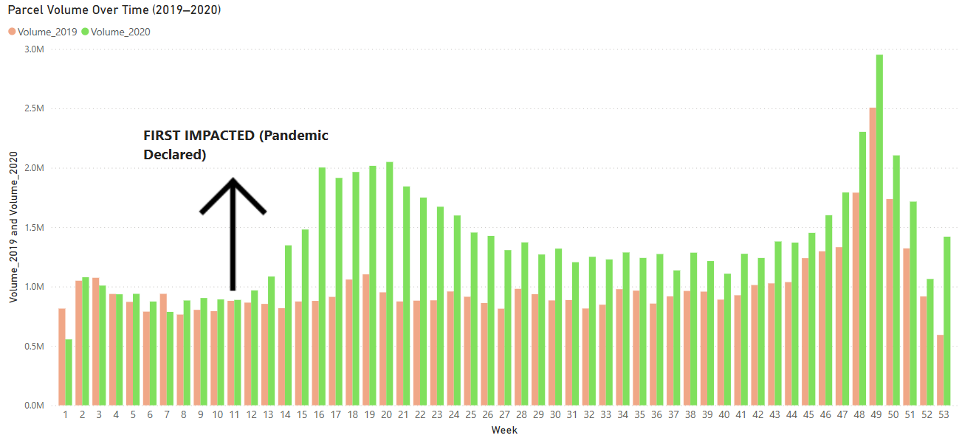
First impact of COVID-19

Slide 6
First impact of COVID-19
There was a significant increase in parcel volume starting from week 12
→ A clear sign of booming e-commerce demand

Slide 7
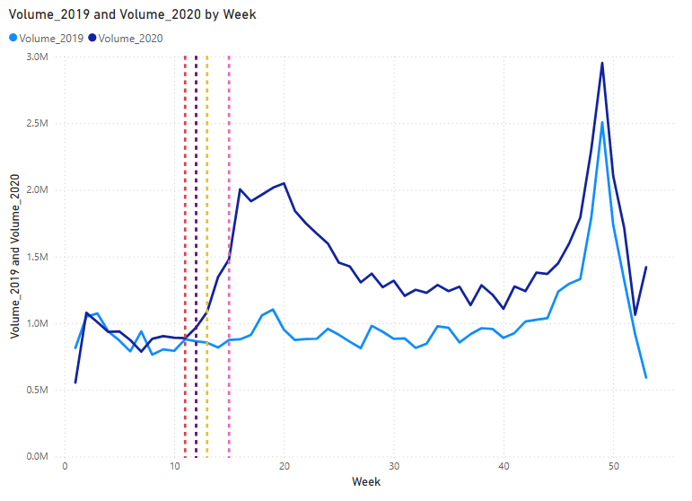
COVID Timeline vs Volume Spike
Legend | Event Label | Year | Month | Week | Day
 | Pandemic Declared | 2020 | March | 11 | 11
 | WFH Urged | 2020 | March | 12 | 16
 | Border Restriction | 2020 | March | 12 | 18
 | Covid Delivery Standard Began | 2020 | March | 13 | 23
 | C.E.R.B Launched | 2020 | April | 15 | 6
Volume spiked dramatically following a sequence of major COVID events.
The pandemic was declared in Week 11. WFH Urged and Border Restriction triggered a sharp increase in parcel volume starting from Week 12.
In Week 13, the COVID Delivery Standard was introduced to ensure safer deliveries and Week 15, the launch of C.E.R.B. provided financial support, both contributing to sustained growth in parcel volume during the pandemic.
→ This marks the turning point toward e-commerce reliance

Slide 8
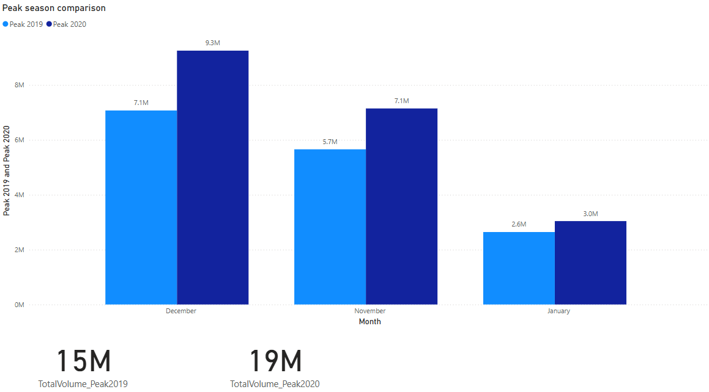

Peak Season Analysis (2019 vs 2020)
Parcel volume during the 2020 peak season increased by 26.48% compared to 2019, with December and November showing the most significant growth, highlighting the surge in online shopping demand driven by the pandemic

Slide 9
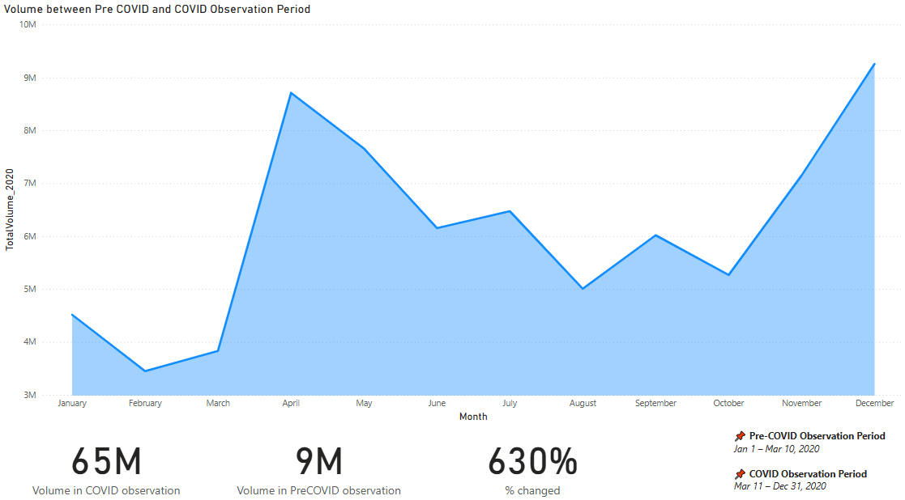
Peak Season Analysis (Pre-COVID and COVID Observation Period )
After March 11 (Week 11), parcel volume surged dramatically, rising from 9M during the pre-COVID period to 65M post-COVID, marking a 630% increase. This highlights the pandemic's significant role in accelerating parcel demand

Slide 10
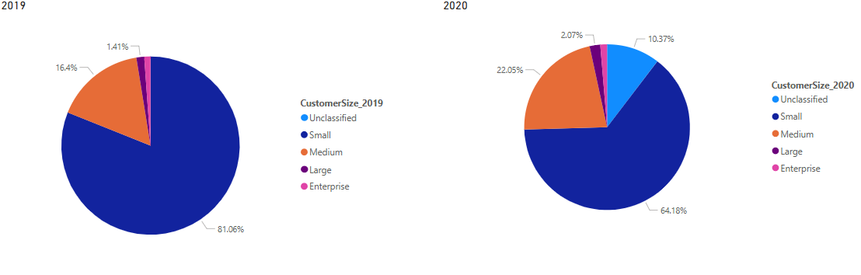
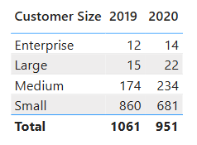
Customer Segment Analysis
From 2019 to 2020, there was a noticeable shift in customer size: the Small segment declined while Medium and Large segments grew, indicating customer upgrades and a diversification in the client base

Slide 11
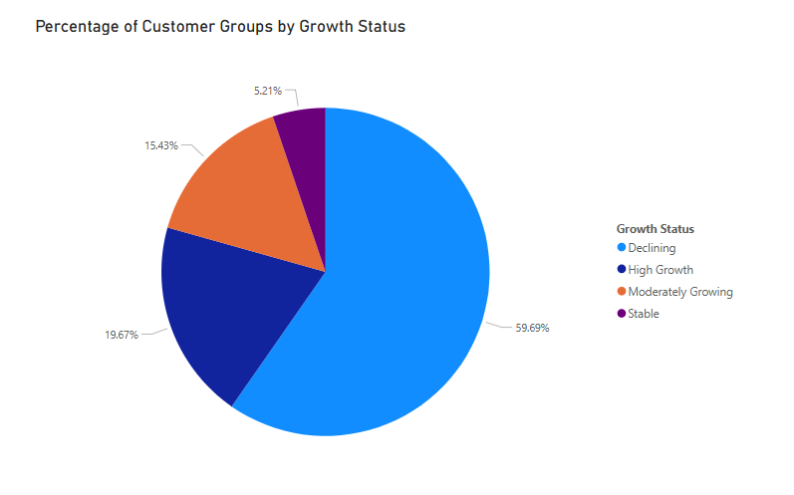
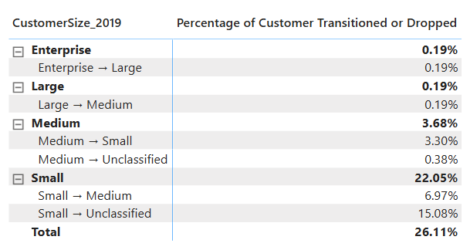
Customer Segment Analysis
Nearly 60% of customers were in decline, with the Small segment accounting for the highest drop-off. This suggests retention challenges and emphasizes the need to focus on sustaining growth and reducing churn

Slide 12
Customer Segment Analysis
Customer shift observed from small to medium segment → 87% of new customers in 2020 upgraded from small size
High proportion of declining customers (59.7%) → Signals risk of churn and post-COVID instability
- Only 19.7% in high growth group → Opportunity to nurture and retain this valuable segment

Slide 13
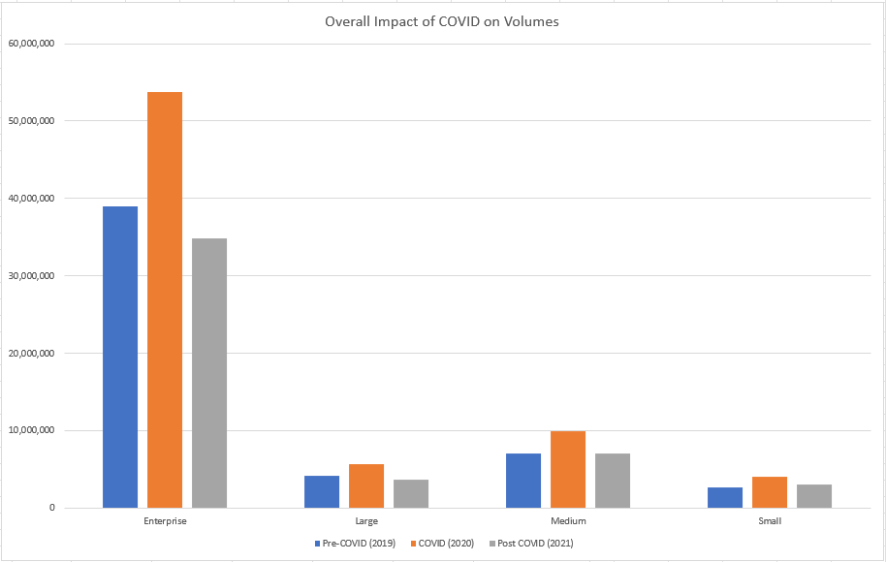
Revenue Estimation

Slide 14
Key Findings & Insights
⚡ Parcel volume surged from Week 12 (2020) as lockdowns began and e-commerce demand accelerated
📊 2020 peak season volume increased by 26.48% compared to 2019
💰 Estimated revenue rose proportionally, reflecting strong commercial impact
📈 High-growth customers represented only 19.7% but contributed significantly to volume
👥 Small segment dominated in size but had the highest attrition rate
❌ 59.7% of customers declined in activity post-COVID, signalling retention challenges

Slide 15
Recommendations
📊 Focus on Retaining Small Customers
📈 Invest in High-Growth Segments
👥 Expand Medium Customer Base

Slide 16
Thank you

