Slide 1

Case Study Impact of COVID-19 on ABC Company’s Parcel Delivery Business
Group 7: Anh Quan Bui, Mai Anh Hoang, Ha Dung Nguyen

Slide 2
Objective and Approach
🧭 Project Objectives
- Analyze how the COVID-19 pandemic impacted ABC Company’s parcel delivery business.
- Highlight the impact on peak season, customer segments, and revenue.
- Provide insightful recommendations for future strategic decisions.
🔍 Methodology
- Descriptive analysis by year and week (2019 vs 2020)
- Customer segmentation: New, Lost, Stable, High Growth
- Comparison: Peak vs non-peak season

Slide 3
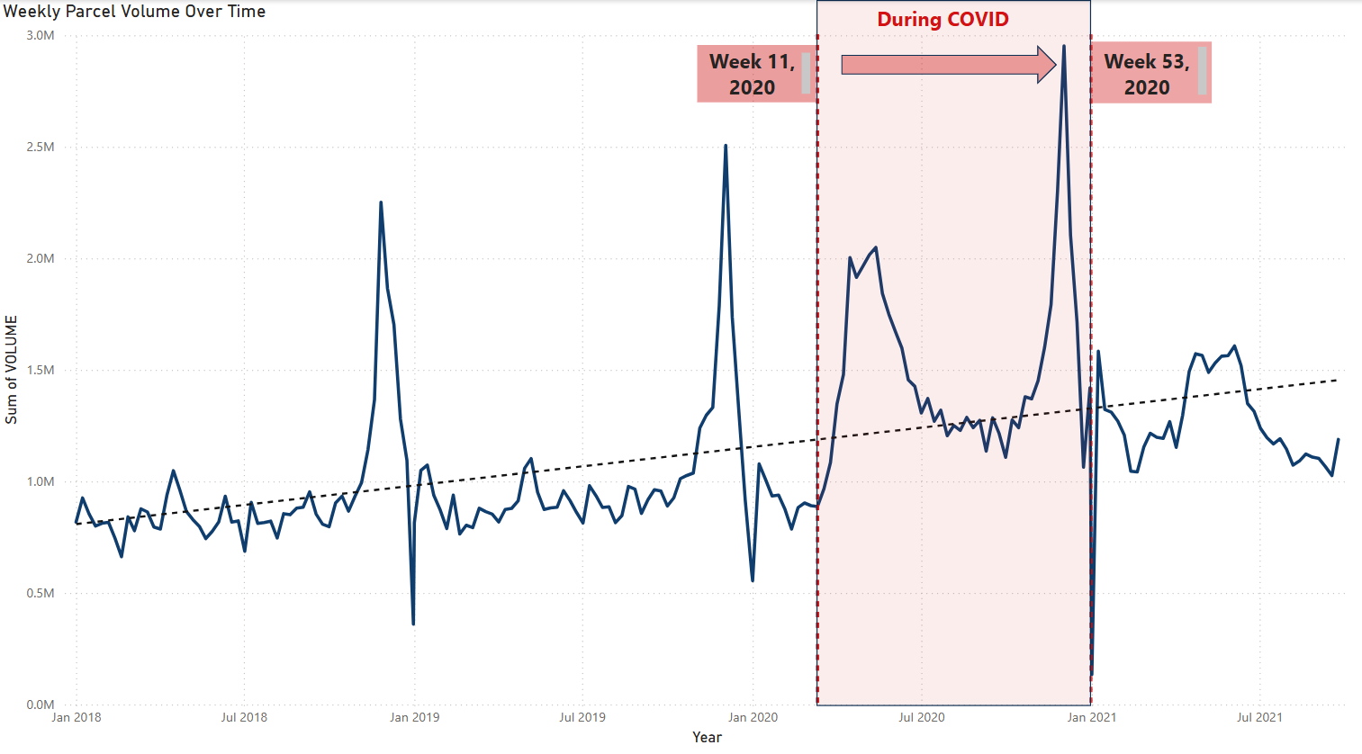

Business Overview

Slide 4
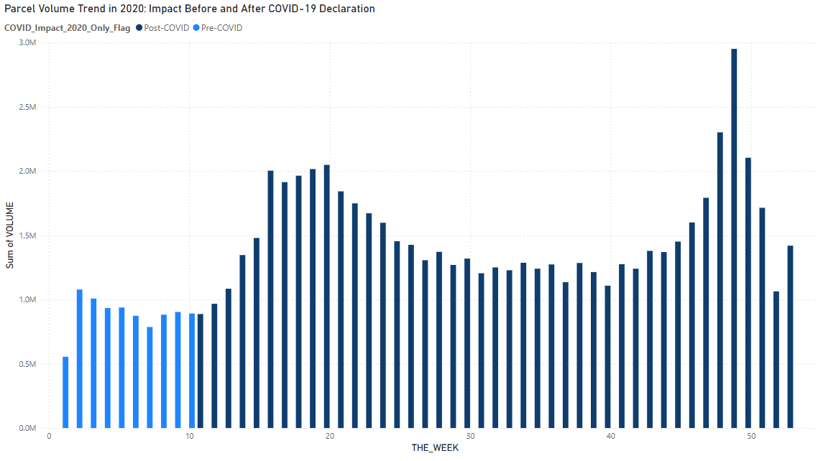
Impact before and after COVID-19 Declaration
Volume surged starting Week 12, aligning with WHO pandemic declaration.
Pre-COVID weeks show consistent but lower parcel volume.
Post-COVID period shows a steep and sustained rise, reflecting increased reliance on deliveries.
Lockdown measures triggered a behavioral shift, especially toward online shopping.
ABC Company quickly absorbed the spike, indicating operational scalability.

Slide 5

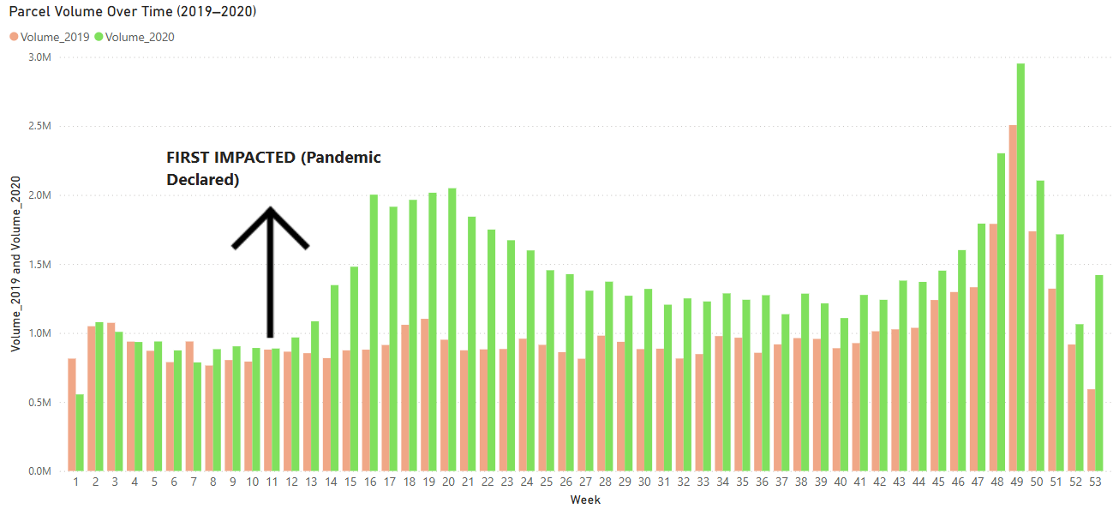


First impact of COVID-19
Week 10-11
Initial uncertainty and slight decline in volumes as businesses assessed situation
Week 12
Dramatic volume increase as lockdowns implemented and e-commerce adoption surged
Week 13-16
Sustained growth pattern establishing new baseline demand levels

Slide 6
First impact of COVID-19
There was a significant increase in parcel volume starting from week 12
→ A clear sign of booming e-commerce demand

Slide 7
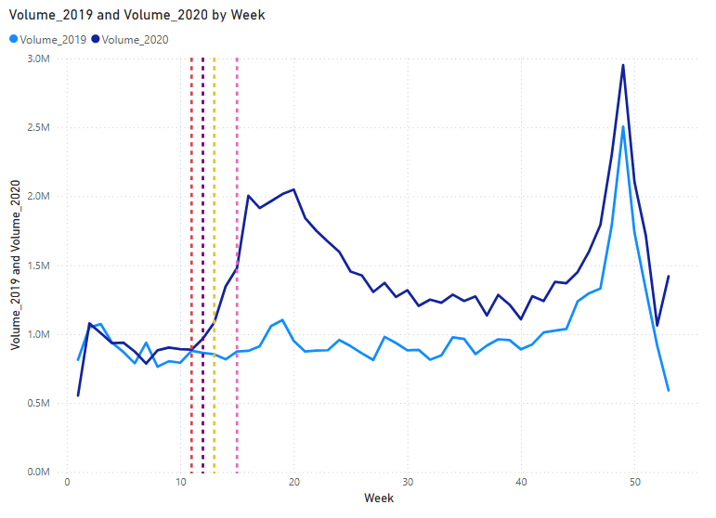
COVID Timeline vs Volume Spike
COVID Timeline vs Volume Spike
Legend | Event Label | Year | Month | Week | Day
 | Pandemic Declared | 2020 | March | 11 | 11
 | WFH Urged | 2020 | March | 12 | 16
 | Border Restriction | 2020 | March | 12 | 18
 | Covid Delivery Standard Began | 2020 | March | 13 | 23
 | C.E.R.B Launched | 2020 | April | 15 | 6
Volume spiked dramatically following a sequence of major COVID events.
The pandemic was declared in Week 11. WFH Urged and Border Restriction triggered a sharp increase in parcel volume starting from Week 12.
In Week 13, the COVID Delivery Standard was introduced to ensure safer deliveries and Week 15, the launch of C.E.R.B. provided financial support, both contributing to sustained growth in parcel volume during the pandemic.
→ This marks the turning point toward e-commerce reliance

Slide 8
COVID Timeline vs Volume Spike
Volume increased significantly from Week 12, right after WHO’s pandemic declaration and nationwide lockdown.
→ This marks the turning point toward e-commerce reliance.

Slide 9
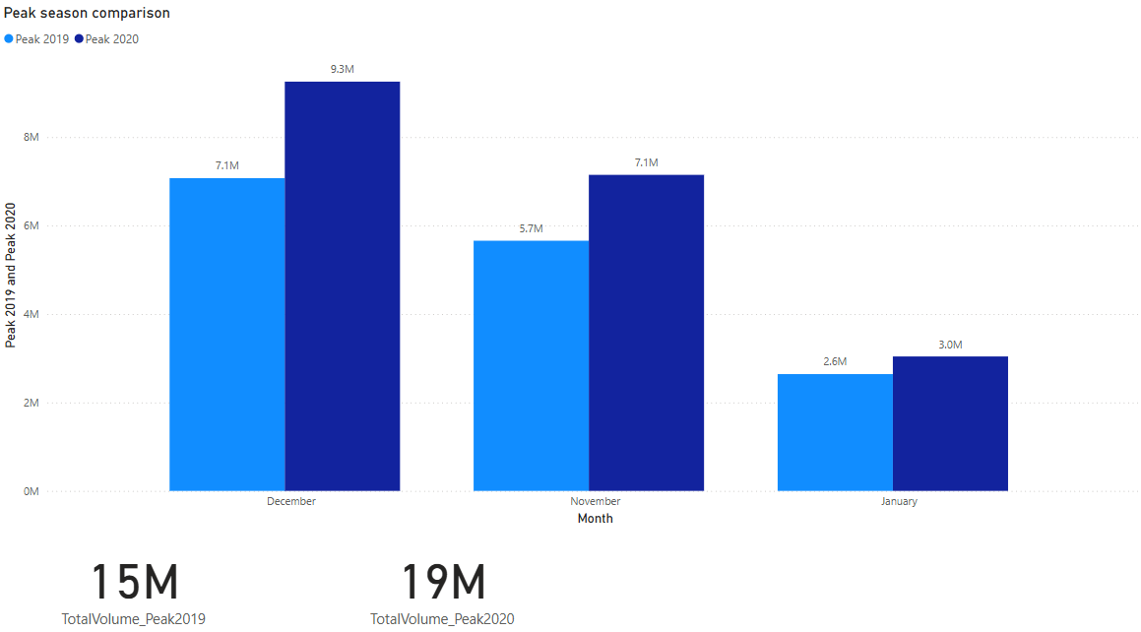

Peak Season Analysis (2019 vs 2020)
26.48% Increase in Volume
December and November saw the highest parcel influx.
Driving Forces
Pandemic-driven online shopping fueled this peak demand.
Operational Challenges
Logistics had to scale quickly to meet
heightened expectations.

Slide 10
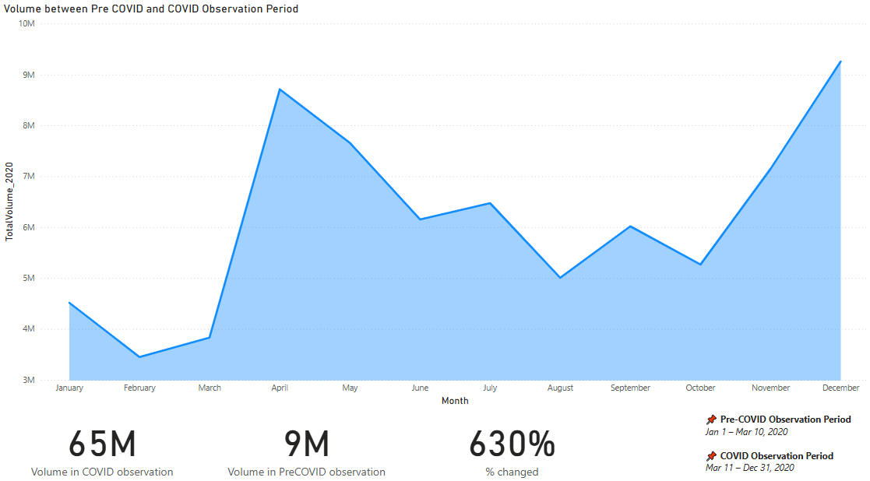
Peak Season Analysis (Pre-COVID and COVID Observation Period )
During COVID
Pre COVID
Pre-COVID vs Post-COVID Volume
Implications
Parcel volume soared from 9 million to 65 million weekly.
The surge stressed delivery networks.
This reflects a staggering 630% increase attributable to pandemic pressures.
Prompted urgent adaptations for capacity and safety protocols.

Slide 11
Peak Season Analysis
→ COVID accelerated the e-commerce peak season, leading to a sharp increase in parcel demand

Slide 12
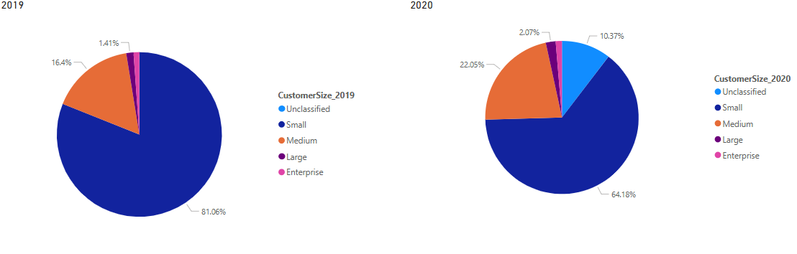
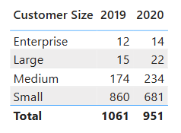
Customer Segment Analysis
Small Segment Decline
Fewer small customers in 2020 compared to 2019.
Medium & Large Growth
Upsizing trends and client diversification evident.

Slide 13
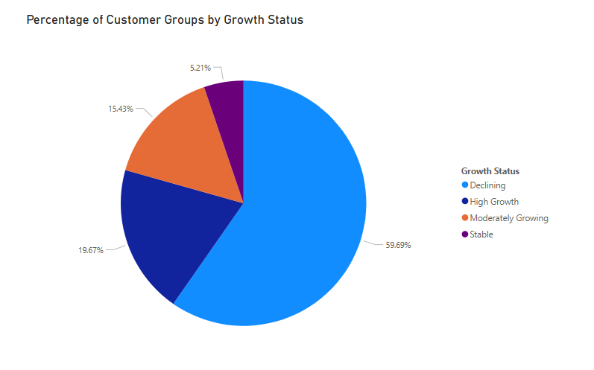
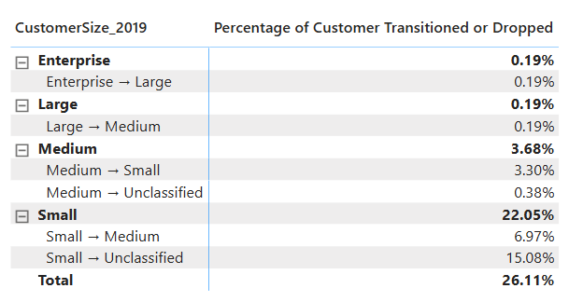
Customer Segment Analysis
High Customer Decline
Retention Challenges
Nearly 60% of customers declined, mostly small segment.
Focus needed on reducing churn and sustaining growth

Slide 14
Customer Segment Analysis
Customer shift observed from small to medium segment → 87% of new customers in 2020 upgraded from small size
High proportion of declining customers (59.7%) → Signals risk of churn and post-COVID instability
- Only 19.7% in high growth group → Opportunity to nurture and retain this valuable segment

Slide 15
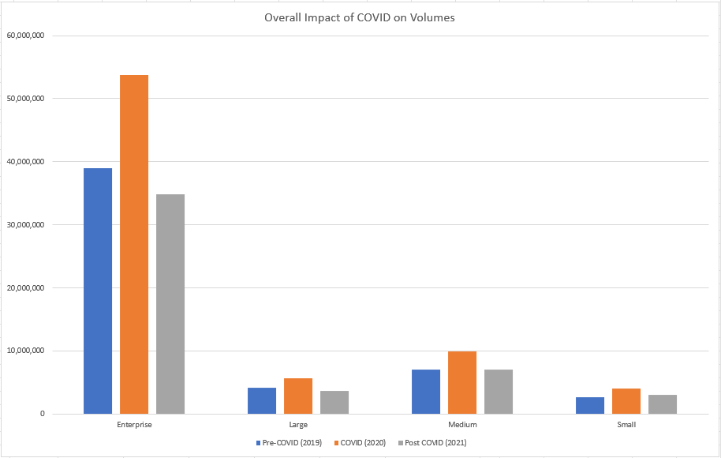
Revenue Estimation
Enterprise customers drove the highest volume and revenue across all three periods.
Revenue peaked in 2020 (COVID period) across all segments, especially in Enterprise and Medium.
Post-COVID (2021) saw a decline, but volumes remained above pre-COVID levels in most segments.
Medium segment showed the most consistent growth, indicating potential for long-term retention.
Small segment had the lowest revenue but remained stable, with limited impact from COVID.

Slide 16
Key Findings & Insights
⚡ Parcel volume surged from Week 12 (2020) as lockdowns began and e-commerce demand accelerated
📊 2020 peak season volume increased by 26.48% compared to 2019
💰 Estimated revenue rose proportionally, reflecting strong commercial impact
📈 High-growth customers represented only 19.7% but contributed significantly to volume
👥 Small segment dominated in size but had the highest attrition rate
❌ 59.7% of customers declined in activity post-COVID, signalling retention challenges

Slide 17
Recommendations
📊 Focus on Retaining Small Customers
📈 Invest in High-Growth Segments
👥 Expand Medium Customer Base

Slide 18
Thank you

