Slide 1

Case Study Impact of COVID-19 on ABC Company’s Parcel Delivery Business
Group 7: Anh Quan Bui, Mai Anh Hoang, Ha Dung Nguyen

Slide 2
Objective and Approach
🧭 Project Objectives
- Analyze how the COVID-19 pandemic impacted ABC Company’s parcel delivery business.
- Highlight the impact on peak season, customer segments, and revenue.
- Provide insightful recommendations for future strategic decisions.
🔍 Methodology
- Descriptive analysis by year and week (2019 vs 2020)
- Customer segmentation: New, Lost, Stable, High Growth
- Comparison: Peak vs non-peak season

Slide 3
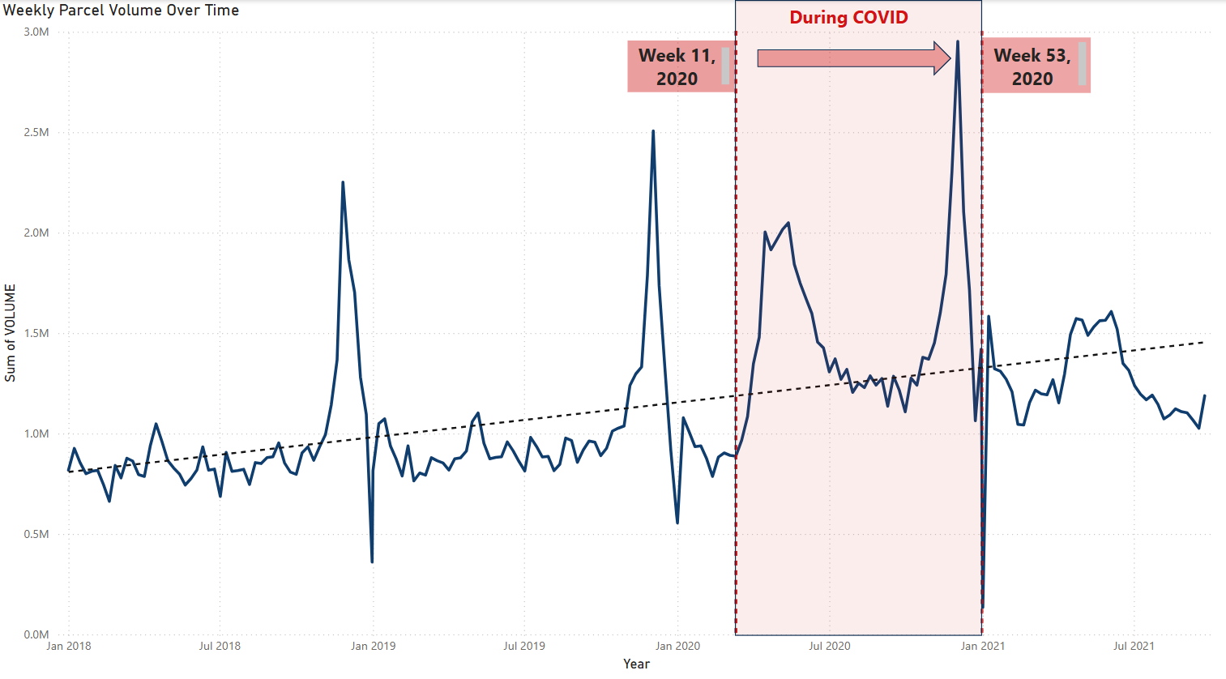

Business Overview

Slide 4
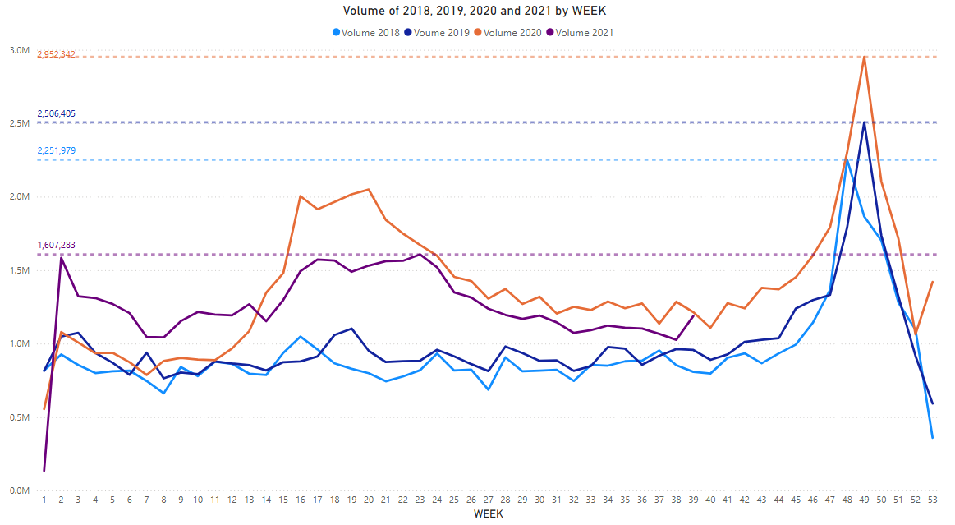
Business Overview
Weekly parcel volumes were stable from 2018 to 2019, then surged sharply in 2020 and 2021.
Pandemic-driven demand sustained higher parcel volumes during peak weeks, transforming delivery needs across subsequent years

Slide 5
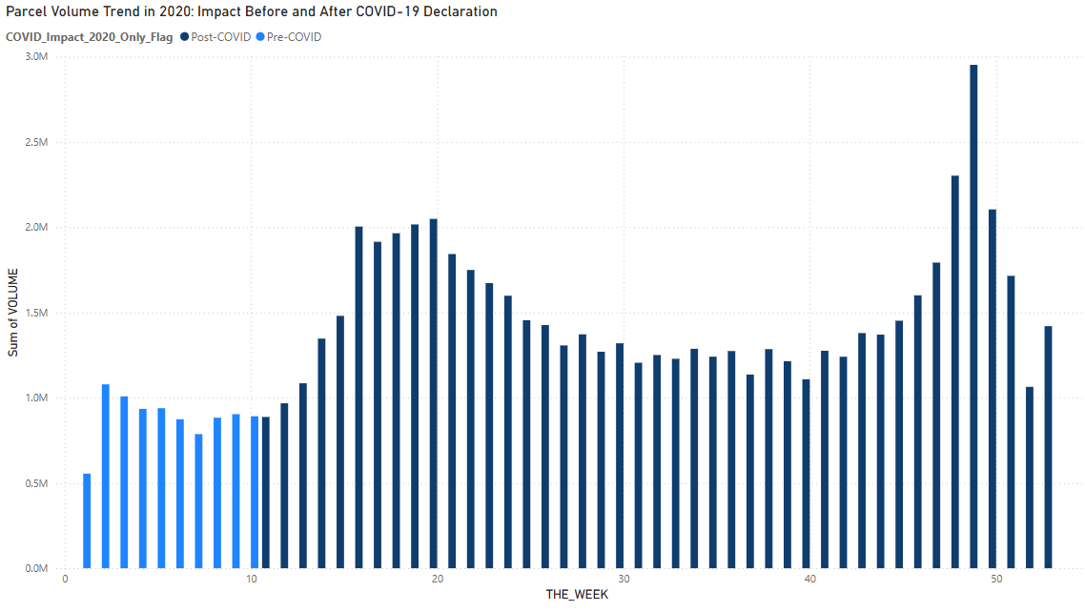
Impact before and after COVID-19 Declaration
Volume surged starting Week 12, aligning with WHO pandemic declaration.
Pre-COVID weeks show consistent but lower parcel volume.
Post-COVID period shows a steep and sustained rise, reflecting increased reliance on deliveries.
Lockdown measures triggered a behavioral shift, especially toward online shopping.
ABC Company quickly absorbed the spike, indicating operational scalability.

Slide 6

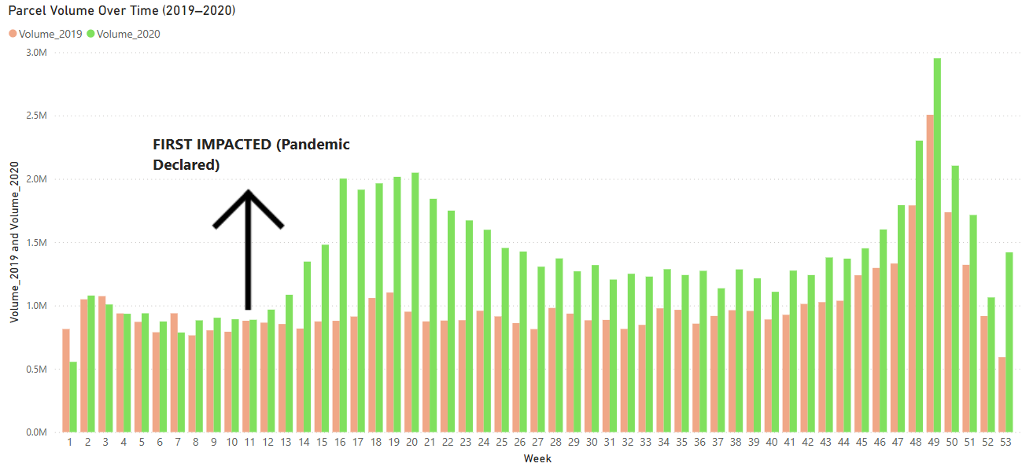


First impact of COVID-19
Week 10-11
Initial uncertainty and slight decline in volumes as businesses assessed situation
Week 12
Dramatic volume increase as lockdowns implemented and e-commerce adoption surged
Week 13-16
Sustained growth pattern establishing new baseline demand levels

Slide 7
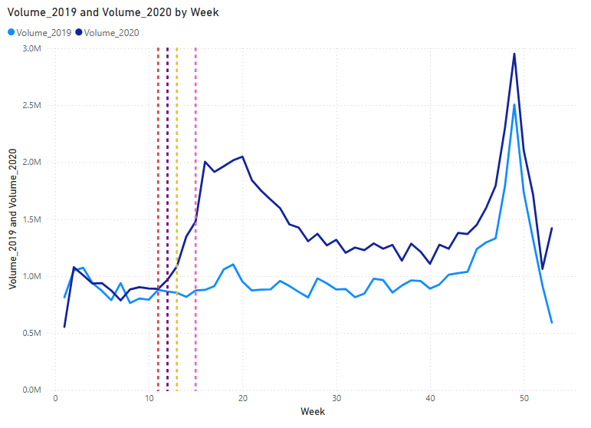
COVID Timeline vs Volume Spike
Legend | Event Label | Year | Month | Week | Day
 | Pandemic Declared | 2020 | March | 11 | 11
 | WFH Urged | 2020 | March | 12 | 16
 | Border Restriction | 2020 | March | 12 | 18
 | Covid Delivery Standard Began | 2020 | March | 13 | 23
 | C.E.R.B Launched | 2020 | April | 15 | 6
1
Pandemic Declared (Week 11)
Marked the start of major behavioral shifts elevating parcel demand.
2
Work From Home Encouraged (Week 12)
Triggered immediate increase in online shopping and parcel volume.
3
Border Restrictions Implemented (Week 12)
Further accelerated parcel reliance amid limited mobility.
4
COVID Delivery Standard Initiated (Week 13)
Ensured safe, contactless delivery, supporting volume sustainability.
5
C.E.R.B Launch (Week 15)
Financial aid bolstered consumer spending, reinforcing volume increases.
Key insight: Pandemic events were pivotal in shifting e-commerce reliance.

Slide 8
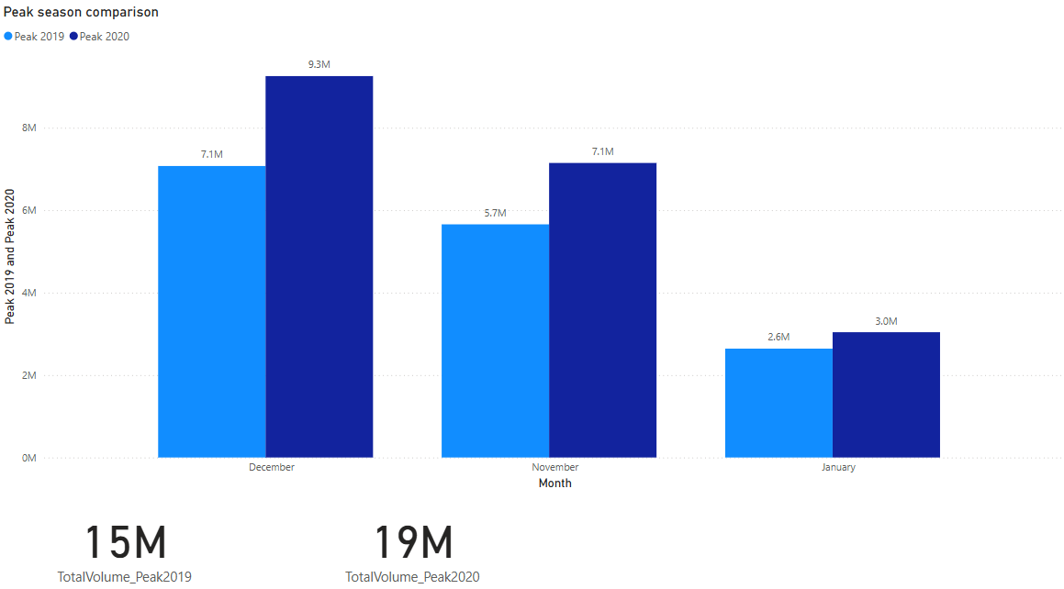

Peak Season Analysis (2019 vs 2020)
26.48% Increase in Volume
December and November saw the highest parcel influx.
Driving Forces
Pandemic-driven online shopping fueled this peak demand.
Operational Challenges
Logistics had to scale quickly to meet
heightened expectations.

Slide 9
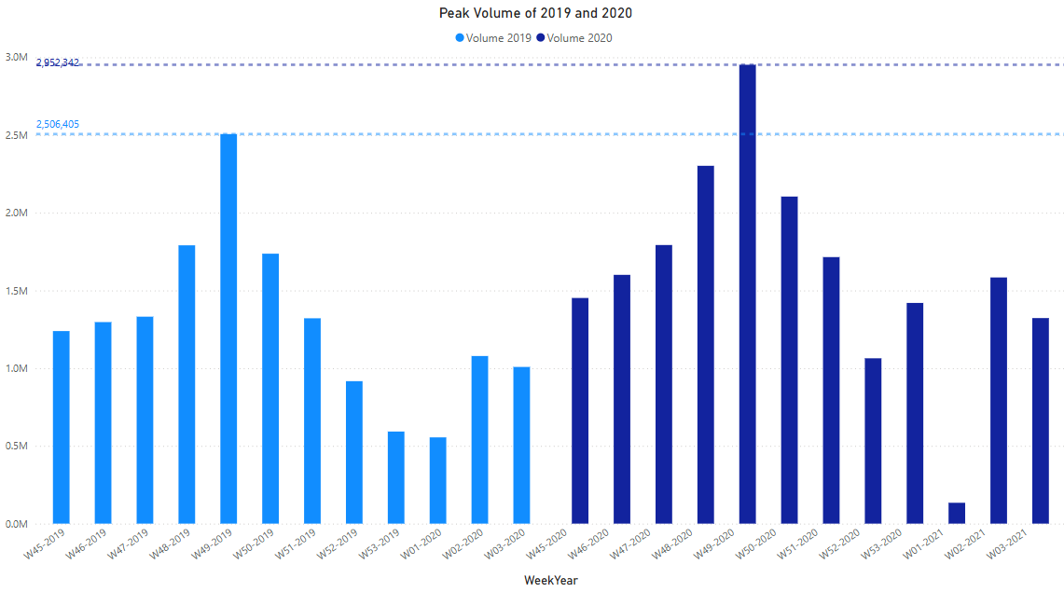
Peak Season Analysis (2019 vs 2020)
2020 Peak Season Volume
Parcel volume nearly reached 3 million at week 49, vastly exceeding 2019.
Sustained Growth
Volumes remained elevated beyond 2020, signaling lasting behavioral shifts.
Impact of Online Shopping
Spike reflects accelerated e-commerce and delivery demands amid the pandemic.

Slide 10
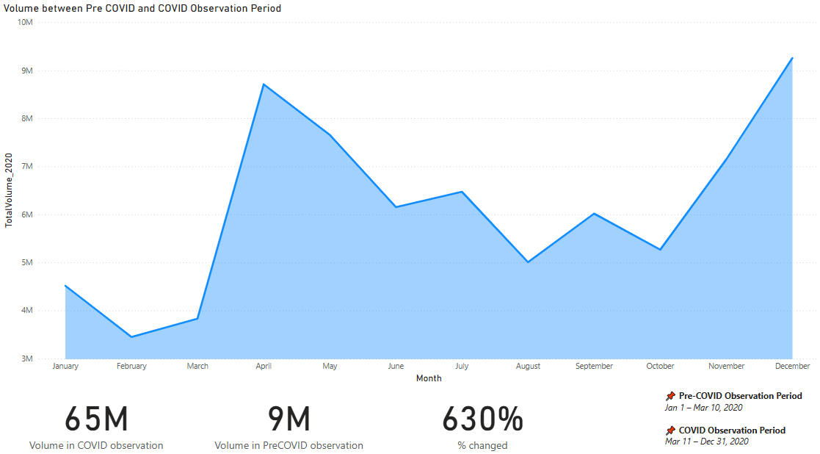
Peak Season Analysis (Pre-COVID and COVID Observation Period )
During COVID
Pre COVID
Pre-COVID vs Post-COVID Volume
Implications
Parcel volume soared from 9 million to 65 million weekly.
The surge stressed delivery networks.
This reflects a staggering 630% increase attributable to pandemic pressures.
Prompted urgent adaptations for capacity and safety protocols.

Slide 11
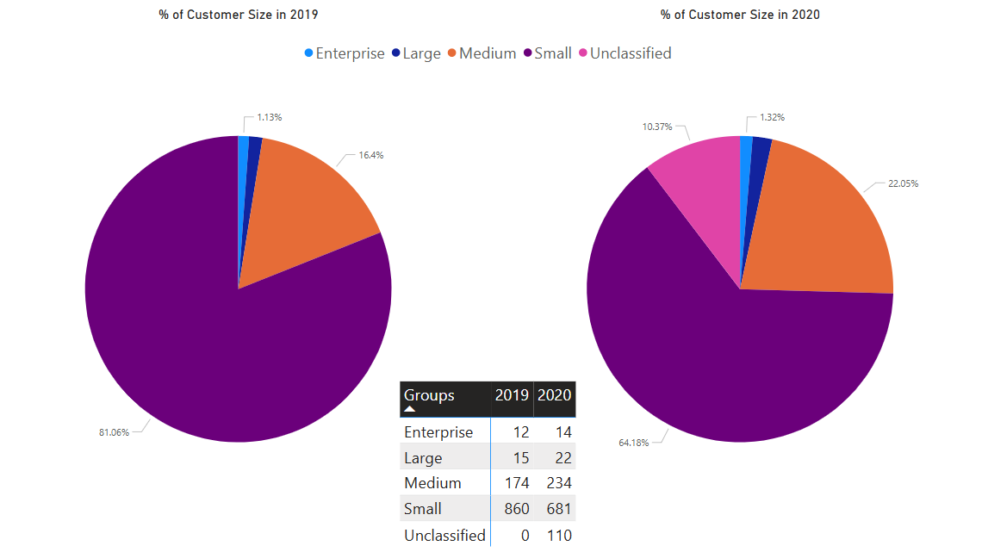
Customer Segment Analysis
Small Segment
Medium and Large Segments
Experienced a decline in customer numbers during 2020 compared to 2019
Showed growth with upsizing trends and client diversification

Slide 12
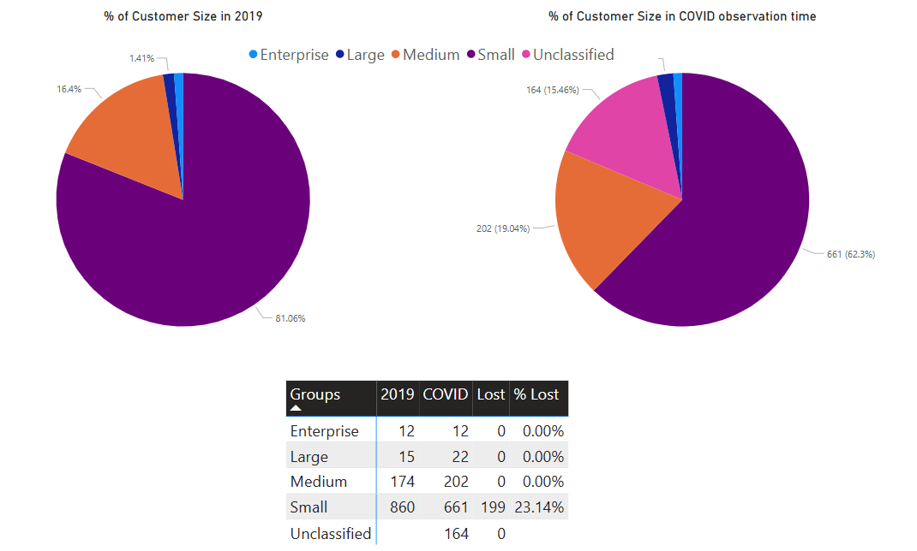
Customer Segment Analysis
Small Segment Loss
23.14% of 2019 small customers
were not retained during COVID period
Medium to Enterprise Stability
These segments showed zero
customer attrition in the same period

Slide 13
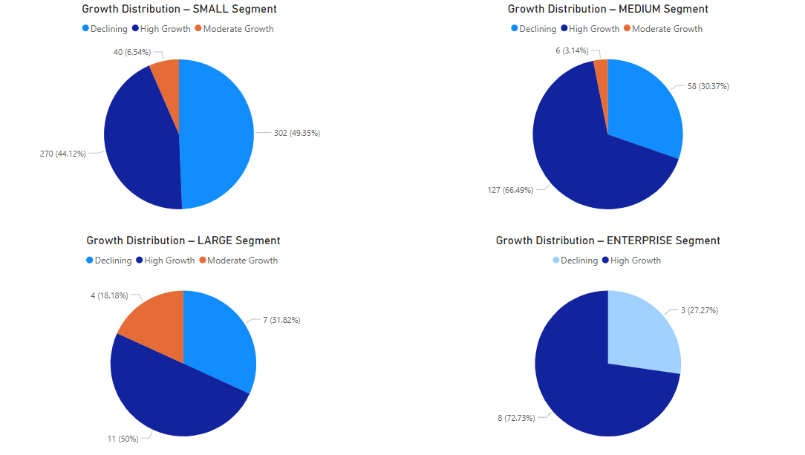
Customer Segment Analysis
High-Growth Customers
Declining Customers
Resilience seen across all segments with pockets of strong growth.
Prominent in Medium and Enterprise segments during COVID.

Slide 14
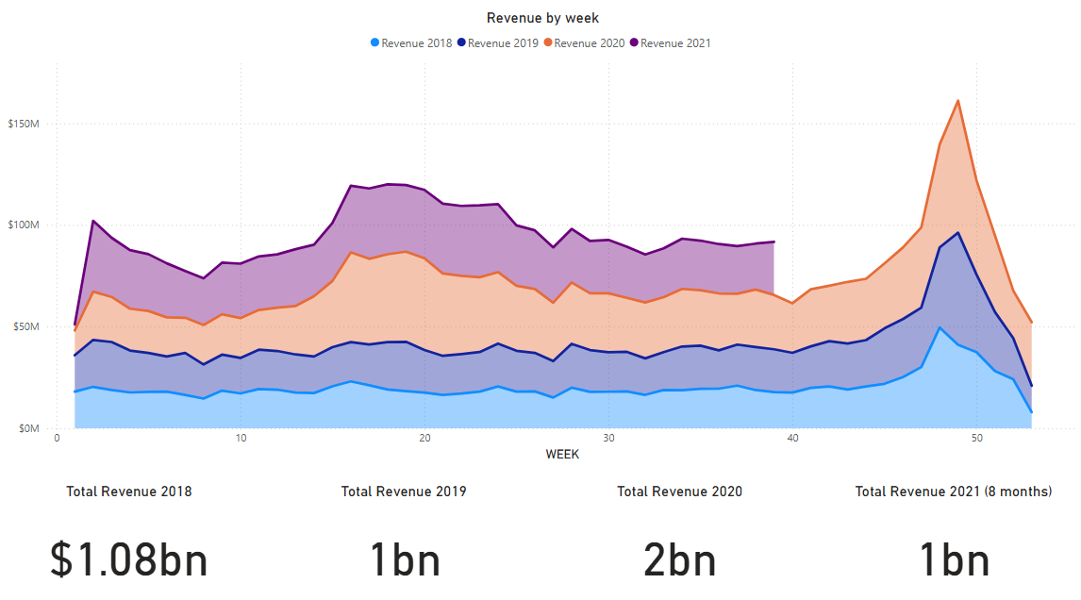
Revenue Estimation
Revenue surged in 2020, doubling to $2 billion due to COVID-driven parcel demand.
In 2021, $1 billion in revenue was achieved in 8 months, indicating sustained growth momentum.
This trend reflects increased consumer reliance on parcel delivery services during the pandemic.

Slide 15
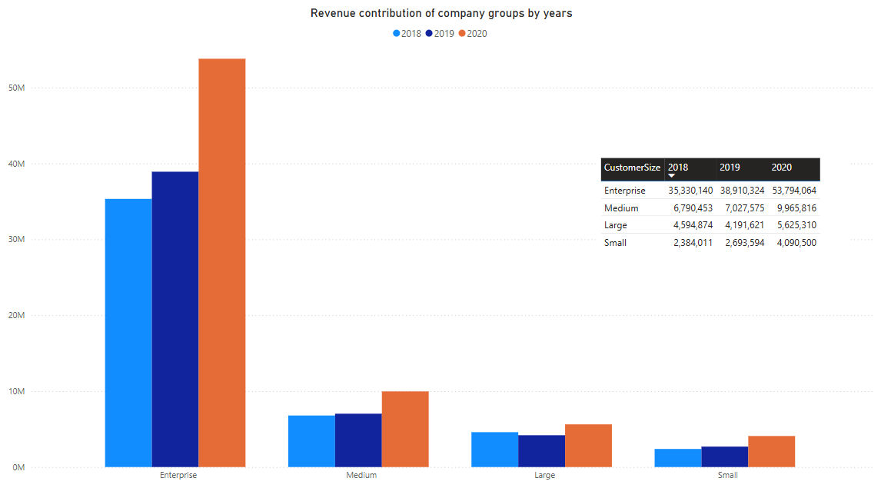
Revenue Estimation
Enterprise Segment
Consistent top revenue contributor
with sharp 2020 increases.
Medium Segment
Showed steady growth, reflecting
broader parcel adoption.
Small Segment
Lowest revenue but maintained
stability throughout pandemic.

Slide 16
Key Findings & Insights
⚡ Parcel volume surged from Week 12 (2020) as lockdowns began and e-commerce demand accelerated
📊 2020 peak season volume increased by 26.48% compared to 2019
💰 Estimated revenue rose proportionally, reflecting strong commercial impact
📈 High-growth customers contributed significantly to volume
👥 Small segment dominated in size but had the highest attrition rate

Slide 17
Recommendations
📊 Focus on Retaining Small Customers
📈 Invest in High-Growth Segments
👥 Expand Medium Customer Base

Slide 18
Thank you

