Slide 1

Case Study Impact of COVID-19 on ABC Company’s Parcel Delivery Business
Group 7

Slide 2
Objective and Approach
🧭 Project Objectives
- Analyze how the COVID-19 pandemic impacted ABC Company’s parcel delivery business.
- Highlight the impact on peak season, customer segments, and revenue.
- Provide insightful recommendations for future strategic decisions.
🔍 Methodology
- Descriptive analysis by year and week (2019 vs 2020)
- Customer segmentation: New, Lost, Stable, High Growth
- Comparison: Peak vs non-peak season
- Tools: Jupyter Notebook, Power BI, Excel

Slide 3
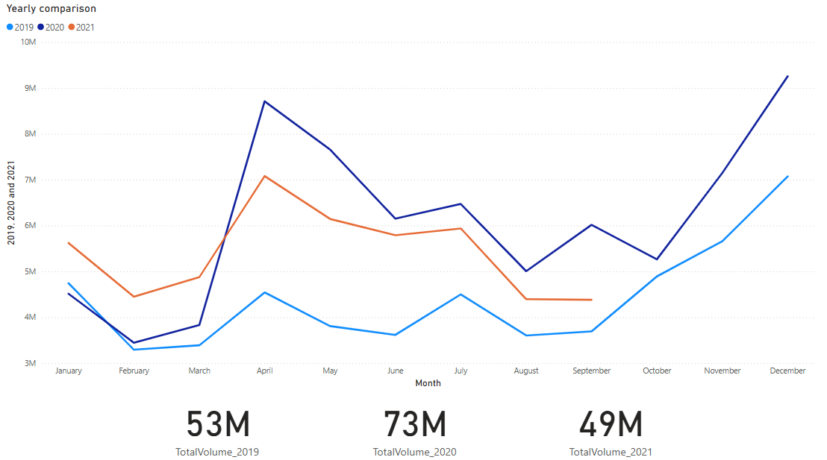
Business Overview

Slide 4
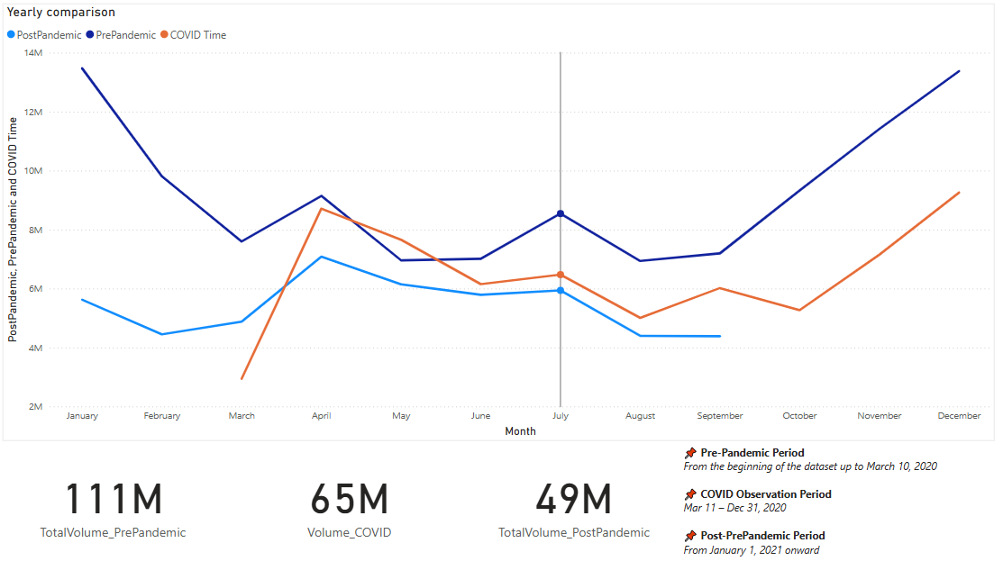
Business Overview

Slide 5
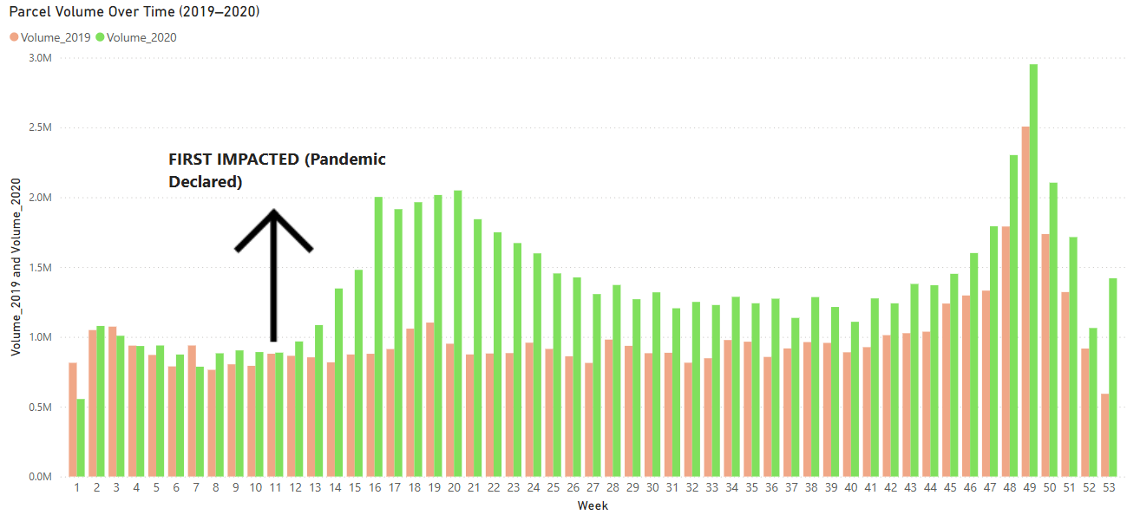
First impact of COVID-19

Slide 6
First impact of COVID-19
There was a significant increase in parcel volume starting from week 12
→ A clear sign of booming e-commerce demand

Slide 7
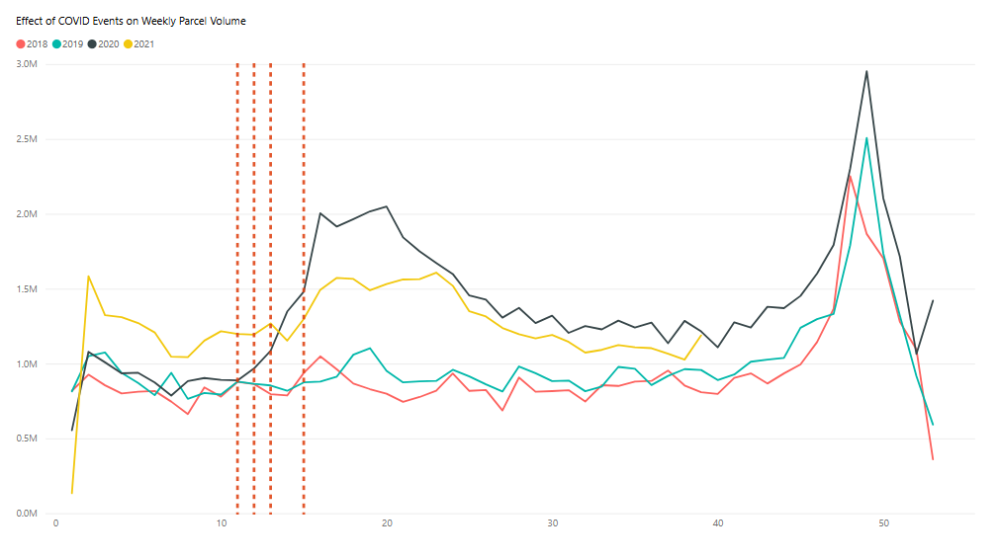
COVID Timeline vs Volume Spike

Slide 8
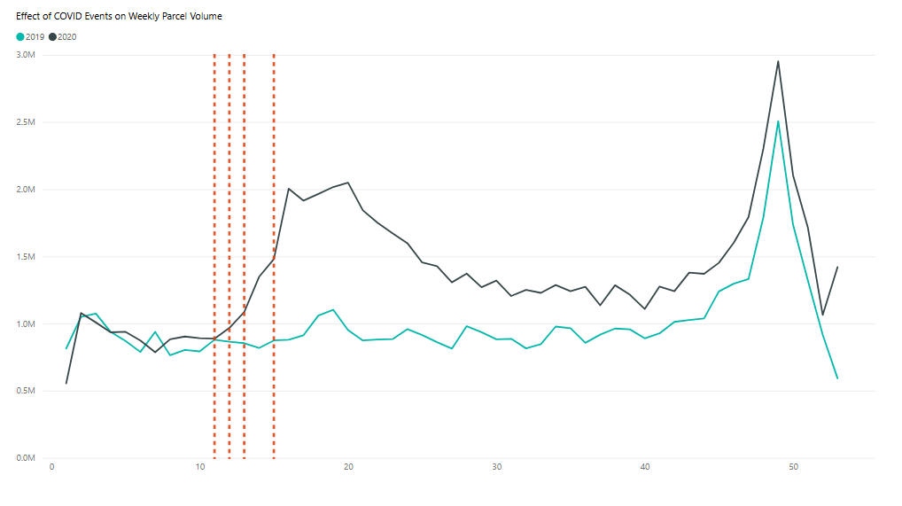
COVID Timeline vs Volume Spike
Event_Label | Year | Quarter | Month | Day
Pandemic Declared | 2020 | Qtr 1 | March | 11
WFH Urged | 2020 | Qtr 1 | March | 16
Border Restriction | 2020 | Qtr 1 | March | 18
Covid Delivery Standard Began | 2020 | Qtr 1 | March | 23
C.E.R.B Launched | 2020 | Qtr 2 | April | 6

Slide 9
COVID Timeline vs Volume Spike
Volume increased significantly from Week 12, right after WHO’s pandemic declaration and nationwide lockdown.
→ This marks the turning point toward e-commerce reliance.

Slide 10
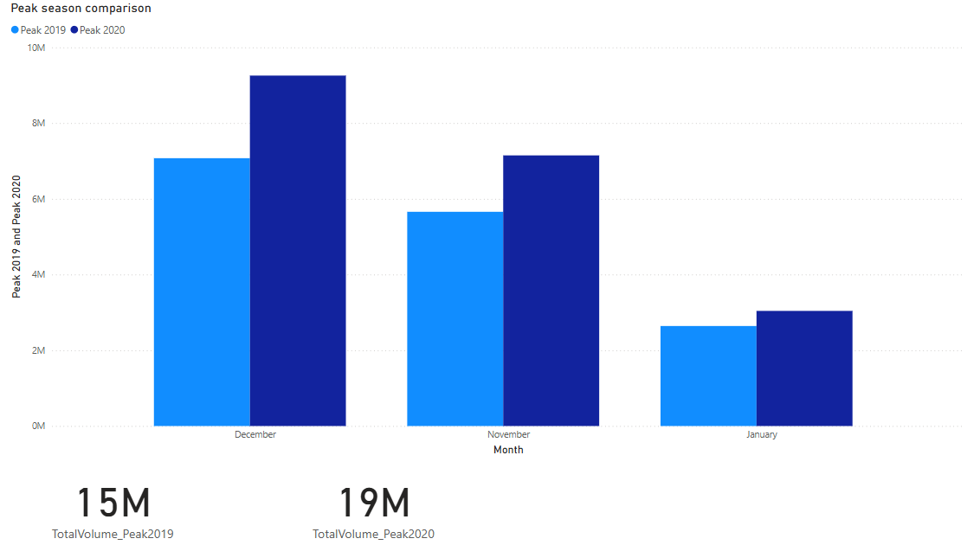
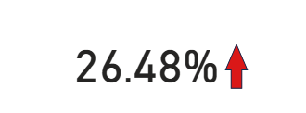
Peak Season Analysis (2019 vs 2020)

Slide 11
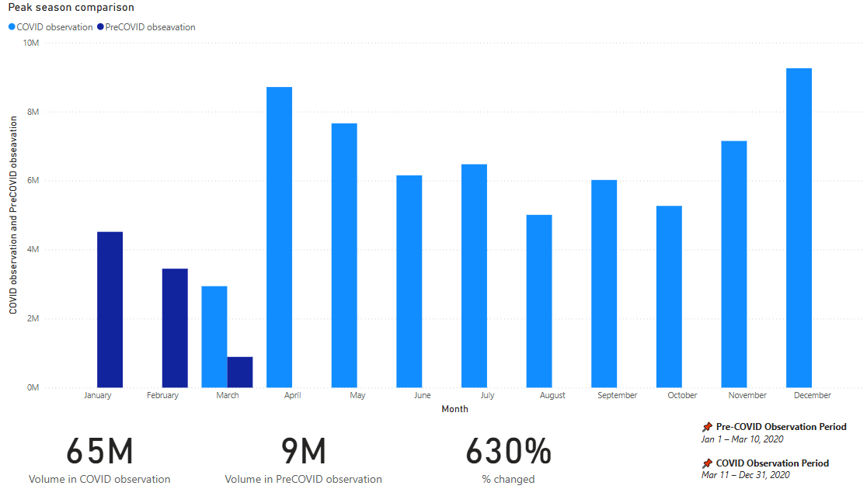
Peak Season Analysis (Pre-COVID and COVID Observation Period )

Slide 12
Peak Season Analysis
→ COVID accelerated the e-commerce peak season, leading to a sharp increase in parcel demand

Slide 13
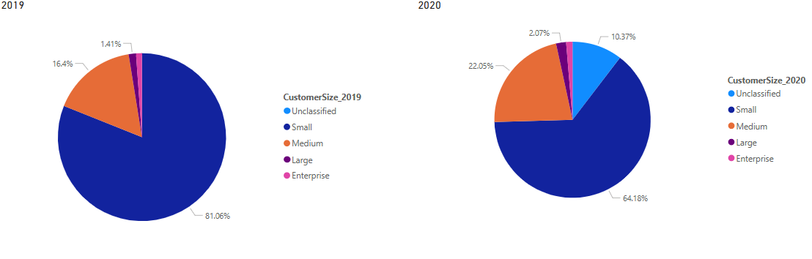
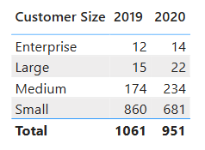
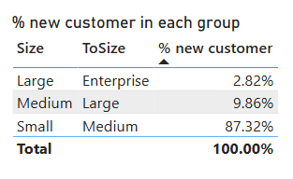
Customer Segment Analysis

Slide 14
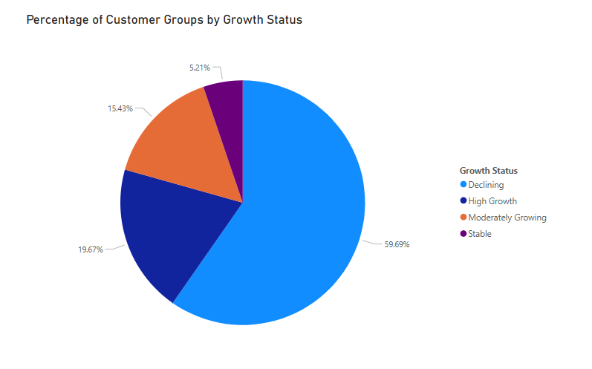
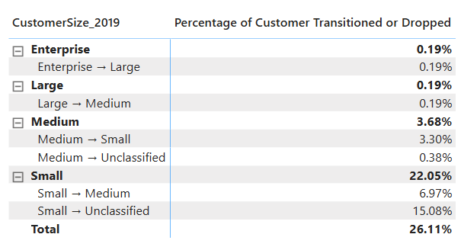
Customer Segment Analysis

Slide 15
Customer Segment Analysis
Customer shift observed from small to medium segment → 87% of new customers in 2020 upgraded from small size
High proportion of declining customers (59.7%) → Signals risk of churn and post-COVID instability
- Only 19.7% in high growth group → Opportunity to nurture and retain this valuable segment

Slide 16
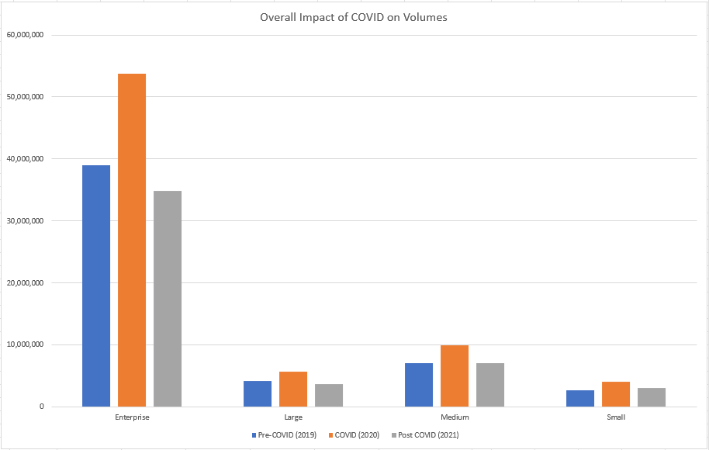
Revenue Estimation

Slide 17
Key Findings & Insights
⚡ Parcel volume surged from Week 12 (2020) as lockdowns began and e-commerce demand accelerated
📊 2020 peak season volume increased by 26.48% compared to 2019
💰 Estimated revenue rose proportionally, reflecting strong commercial impact
📈 High-growth customers represented only 19.7% but contributed significantly to volume
👥 Small segment dominated in size but had the highest attrition rate
❌ 59.7% of customers declined in activity post-COVID, signalling retention challenges

Slide 18
Recommendations
📊 Focus on Retaining Small Customers
📈 Invest in High-Growth Segments
👥 Expand Medium Customer Base

Slide 19
Thank you

