Slide 1
Cross-Site Scripting Attack (XSS)

Slide 2
Outline
The Cross-Site Scripting attack
Reflected XSS
Persistent XSS
Damage done by XSS attacks
XSS attacks to befriend with others
XSS attacks to change other people’s profiles
Self-propagation
Countermeasures

Slide 3
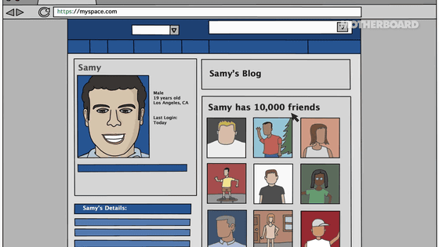
Story
On October 4th, 2005, Samy Kamkar placed a worm, a small piece of JavaScript code, in his profile on the Myspace social network site. Twenty hours later, the worm had infected over one million users, who unknowingly added Samy to their friend lists and also displayed a string "but most of all , samy is my hero" in their profile pages. The attack exploited a type of vulnerability called Cross-Site Scripting (XSS).
XSS vulnerabilities have been reported and exploited since the 1990s. Many web sites suffered from this type of attacks in the past, including Twitter, Facebook, YouTube, etc. According to a 2007 report, as many as 68% of websites are likely to have XSS vulnerabilities, surpassing the buffer-overflow vulnerability to become the most common software vulnerability.

Slide 4
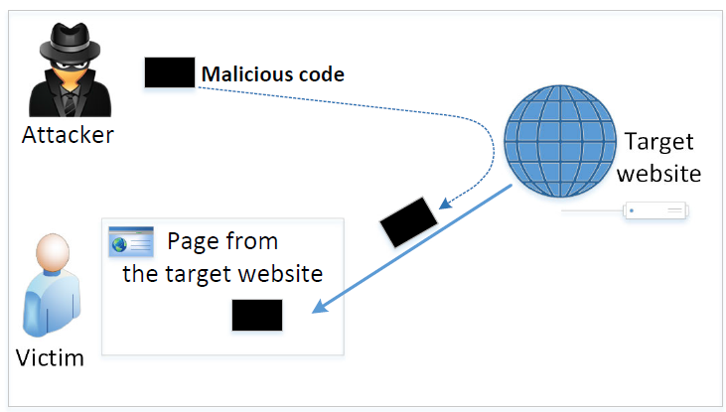
The Cross-Site Scripting Attack
In XSS, an attacker injects his/her malicious code to the victim’s browser via the target website.
When code comes from a website, it is considered as trusted with respect to the website, so it can access and change the content on the pages, read cookies belonging to the website and sending out requests on behalf of the user.
Basically, code can do whatever the user can do inside the session.

Slide 5
Types of XSS Attacks
Non-persistent (Reflected) XSS Attack
Persistent (Stored) XSS Attack

Slide 6
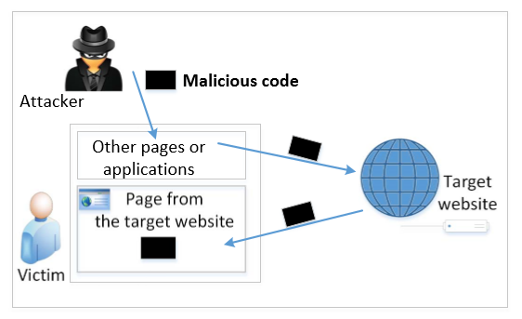
Non-persistent (Reflected) XSS Attack
If a website with a reflective behavior takes user inputs, then :
Attackers can put JavaScript code in the input, so when the input is reflected back, the JavaScript code will be injected into the web page from the website.
Notes:
Many websites take input from the user,conduct some activities and then send response to the user in a web page, with the original user input included on the response (i.e the user input is reflected back)

Slide 7
Non-persistent (Reflected) XSS Attack
Assume a vulnerable service on website : http://www.example.com/search?input=word, where word is provided by the users.
Now the attacker sends the following URL to the victim and tricks him to click the link: http://www.example.com/search?input=<script>alert(“attack”);</script>
Once the victim clicks on this link, an HTTP GET request will be sent to the www.example.com web server, which returns a page containing the search result, with the original input in the page. The input here is a JavaScript code which runs and gives a pop-up message on the victim’s browser.

Slide 8
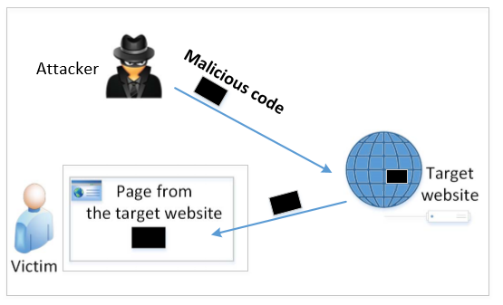
Persistent (Stored) XSS Attack
Attackers directly send their data to a target website/server which stores the data in a persistent storage.
If the website later sends the stored data to other users, it creates a channel between the users and the attackers.
Example : User profile in a social network is a channel as it is set by one user and viewed by another.

Slide 9
Persistent (Stored) XSS Attack
These channels are supposed to be data channels.
But data provided by users can contain HTML markups and JavaScript code.
If the input is not sanitized properly by the website, it is sent to other users’ browsers through the channel and gets executed by the browsers.
Browsers consider it like any other code coming from the website. Therefore, the code is given the same privileges as that from the website.

Slide 10
Damage Caused by XSS
Web defacing: JavaScript code can use DOM APIs to access the DOM nodes inside the hosting page. Therefore, the injected JavaScript code can make arbitrary changes to the page. Example: JavaScript code can change a news article page to something fake or change some pictures on the page.
Spoofing requests: The injected JavaScript code can send HTTP requests to the server on behalf of the user. (Discussed in later slides)
Stealing information: The injected JavaScript code can also steal victim’s private data including the session cookies, personal data displayed on the web page, data stored locally by the web application.

Slide 11
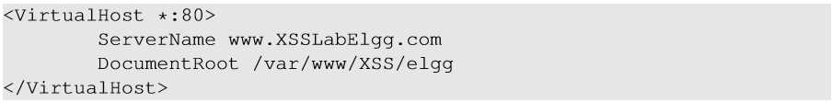
Environment Setup
Elgg: open-source web application for social networking with disabled countermeasures for XSS.
Elgg website : http://www.xsslabelgg.com
The website is hosted on localhost via Apache’s Virtual Hosting, defined in /etc/apache2/sites-available/000-default.conf

Slide 12
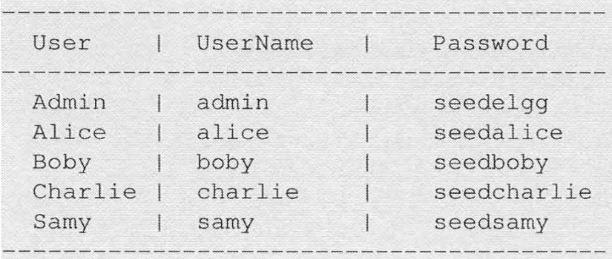
Environment Setup
Several user accounts have been created on Elgg

Slide 13
Attack Surfaces for XSS attack
To launch an attack, we need to find places where we can inject JavaScript code.
The input fields are potential attack surfaces wherein attackers can put JavaScript code.
If the web application doesn’t remove the code, the code can be triggered on the browser and cause damage.
In our task, we will insert our code in the “Brief Description” field, so that when Alice views Samy’s profile, the code gets executed with a simple message.

Slide 14
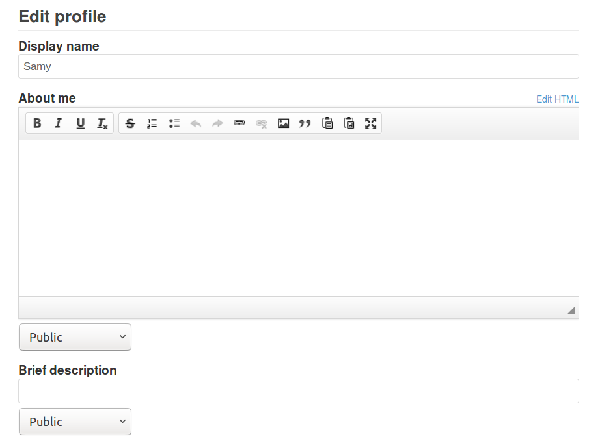
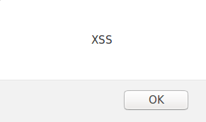
Attack Surfaces for XSS attack – injecting javascript

Slide 15
XSS Attacks to Befriend with Others
Goal: Add Samy to other people’s friend list without their consent.
Investigation taken by attacker Samy:
Samy clicks “add-friend” button from Charlie’s account (discussed in CSRF) to add himself to Charlie’s friend list.
Using Firefox’s LiveHTTPHeader extension, he captures the add-friend request.

Slide 16
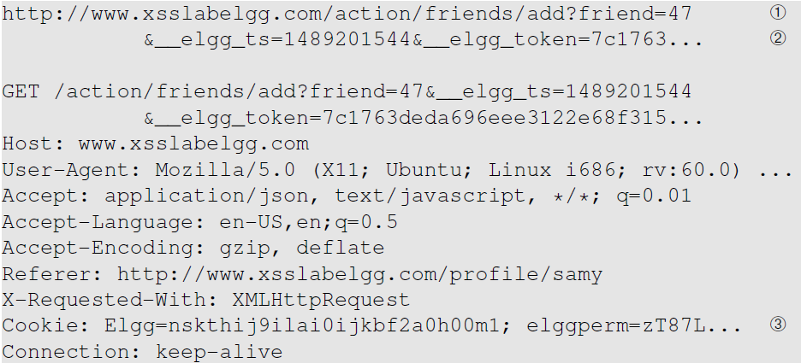
XSS Attacks to Befriend with Others
Line ①: URL of Elgg’s add-friend request. UserID of the user to be added to the friend list is used. Here, Samy’s UserID (GUID) is 47.
Line ②: Elgg’s countermeasure against CSRF attacks (this is now enabled).
Line ③: Session cookie which is unique for each user. It is automatically sent by browsers. Here, if the attacker wants to access the cookies, it will be allowed as the JavaScript code is from Elgg website and not a third-party page like in CSRF.

Slide 17
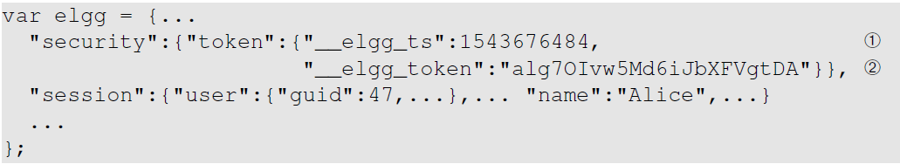
XSS Attack 1: Befriend with Others
The main challenge is to find the values of CSRF countermeasures parameters: _elgg_ts and _elgg_token. On any Elgg page, right click and choose View Page Source, then sear for the following javascript
Line ① and ②: The secret values are assigned to two JavaScript variables elgg.security.token.elgg_ts and elgg.security.token._elgg_token, which make our attack easier as we can load the values from these variables.
Our JavaScript code is injected inside the page, so it can access the JavaScript variables inside the page.

Slide 18
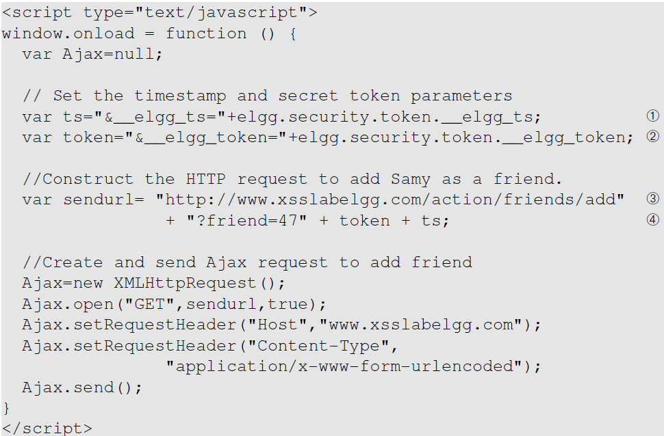
Construct an Add-friend Request
Line ① and ②: Get timestamp and secret token from the JavaScript variables.
Line ③ and ④: Construct the URL with the data attached.
The rest of the code is to create a GET request using Ajax.
* Ajax allows us to sends HTTP requests in the background so it does not cause the browser to navigate away

Slide 19
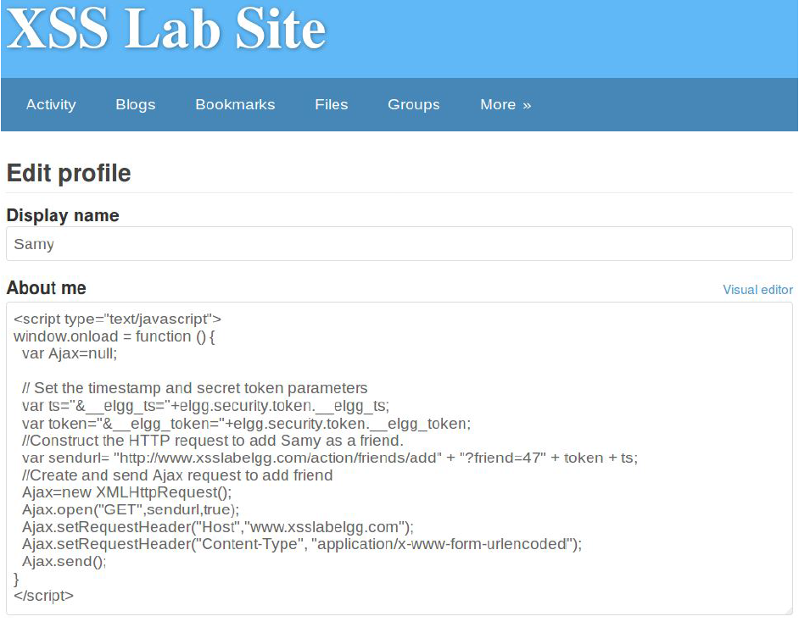
Inject the Code Into a Profile
Samy puts the script in the “About Me” section of his profile.
After that, let’s login as “Alice” and visit Samy’s profile.
JavaScript code will be run and not displayed to Alice.
The code sends an add-friend request to the server.
If we check Alice’s friends list, Samy is added.

Slide 20
XSS Attack 2: Change Other People’s Profiles
Goal: Putting a statement “SAMY is MY HERO” in other people’s profile without their consent.
Investigation taken by attacker Samy :
Samy captured an edit-profile request using LiveHTTPHeader.

Slide 21
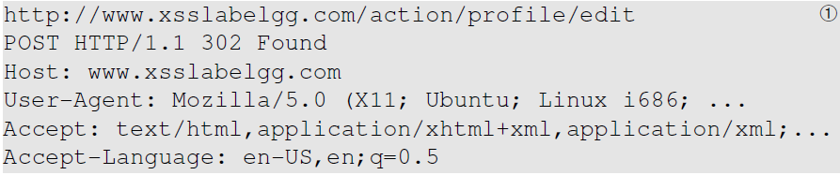
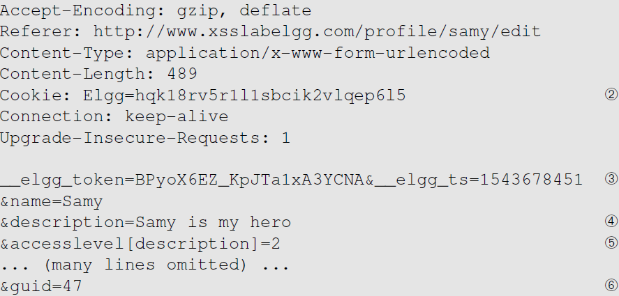
Captured HTTP Request
Line ①: URL of the edit-profile service.
Line ②: Session cookie (unique for each user). It is automatically set by browsers.
Line ③: CSRF countermeasures, which are now enabled.

Slide 22
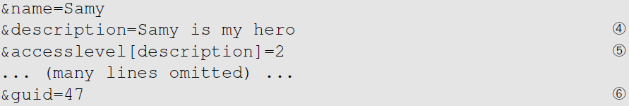
Captured HTTP Request (continued)
Line ④: Description field with our text “Samy is my hero”
Line ⑤: Access level of each field: 2 means the field is viewable to everyone.
Line ⑥: User ID (GUID) of the victim. This can be obtained by visiting victim’s profile page source. In XSS, as this value can be obtained from the page. As we don’t want to limit our attack to one victim, we can just add the GUID from JavaScript variable called elgg.session.user.guid.
Notes:
If the CSRF has already been covered, this is a good time to ask whether we can get the User ID in CSRF? Without knowing the ID, attackers need to know the ID beforehand. In XSS attacks, attackers do not need to do that, they can get the ID directly from inside the page.

Slide 23
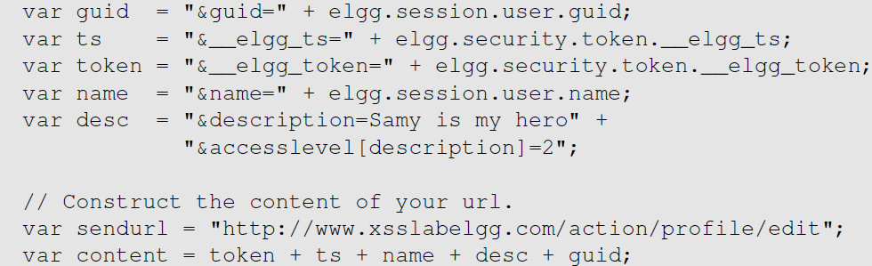
Construct the Malicious Ajax Request

Slide 24
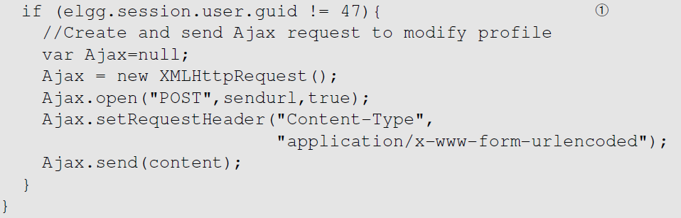
Construct the Malicious Ajax Request
To ensure that it does not modify Samy’s own profile or it will overwrite the malicious content in Samy’s profile.

Slide 25
Inject the into Attacker’s Profile
Samy can place the malicious code into his profile and then wait for others to visit his profile page.
Login to Alice’s account and view Samy’s profile. As soon as Samy’s profile is loaded, malicious code will get executed.
On checking Alice profile, we can see that “SAMY IS MY HERO” is added to the “About me” field of her profile.

Slide 26
Self-Propagation XSS Worm
Using Samy’s worm, not only will the visitors of Samy’s profile be modified, their profiles can also be made to carry a copy of Samy’s JavaScript code. So, when an infected profile was viewed by others, the code can further spread.
Challenges: How can JavaScript code produce a copy of itself?
Two typical approaches:
DOM approach: JavaScript code can get a copy of itself directly from DOM via DOM APIs
Link approach: JavaScript code can be included in a web page via a link using the src attribute of the script tag.

Slide 27
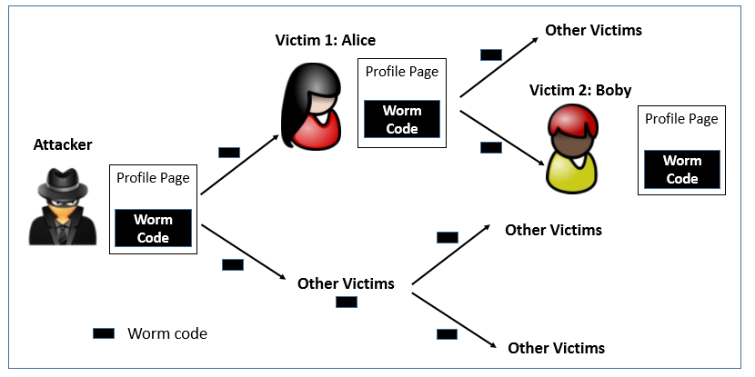
Self -Propagation XSS Worm

Slide 28
Self-Propagation XSS Worm
Document Object Model (DOM) Approach :
DOM organizes the contents of the page into a tree of objects (DOM nodes).
Using DOM APIs, we can access each node on the tree.
If a page contains JavaScript code, it will be stored as an object in the tree.
So, if we know the DOM node that contains the code, we can use DOM APIs to get the code from the node.
Every JavaScript node can be given a name and then use the document.getElementByID() API to find the node.

Slide 29
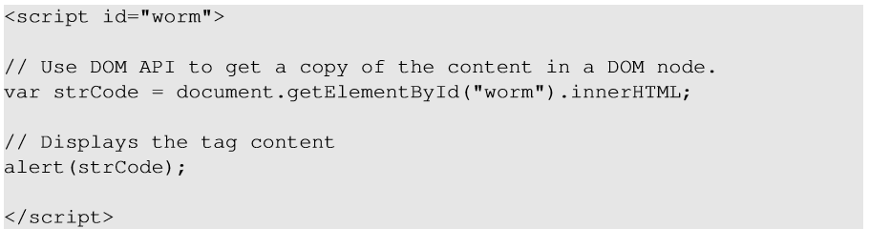
Example: a script which displays itself
Returns the inside part of a node, not including <script> tag
This code displays a copy of itself
Use “document.getElementById(“worm”) to get the reference of the node
innerHTML gives the inside part of the node, not including the script tag.
So, in our attack code, we can put the message in the description field along with a copy of the entire code.

Slide 30
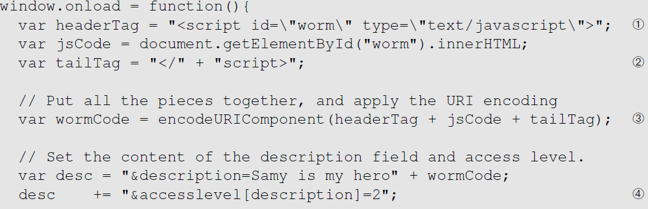
Self-Propagation XSS Worm
<script type="text/javascript" id="worm">
Line ① and ②: Construct a copy of the worm code, including the script tags.
Line ②: We split the string into two parts and use “+” to concatenate them together. If we directly put the entire string, Firefox’s HTML parser will consider the string as a closing tag of the script block and the rest of the code will be ignored.

Slide 31
Self-Propagation XSS Worm
Line ③: In HTTP POST requests, data is sent with Content-Type as “application/x-www-form-urlencoded”. We use encodeURIComponent() function to encode the string.
Line ④: Access level of each field: 2 means public.
After Samy places this self-propagating code in his profile, when Alice visits Samy’s profile, the worm gets executed and modifies Alice’s profile, inside which, a copy of the worm code is also placed. So, any user visiting Alice’s profile will too get infected in the same way.

Slide 32
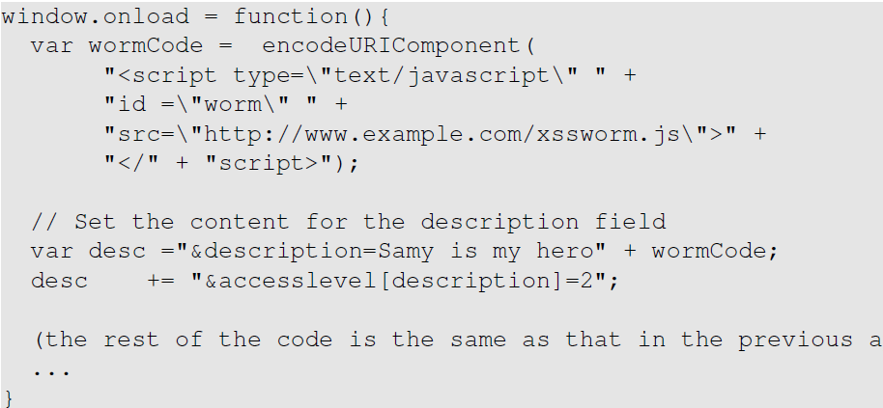
Self-Propagation XSS Worm: The Link Approach
The JavaScript code xssworm.js will be fetched from the URL.
Hence, we do not need to include all the worm code in the profile.
Inside the code, we need to achieve damage and self-propagation.

Slide 33
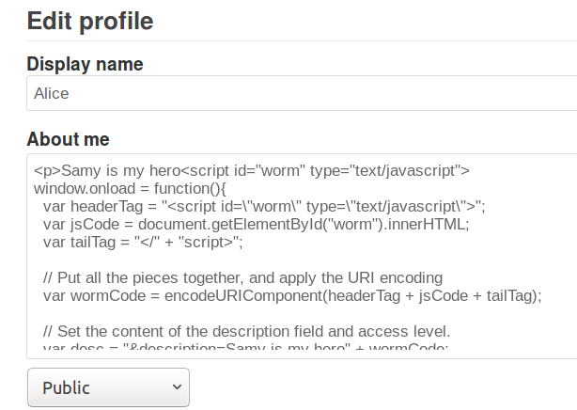
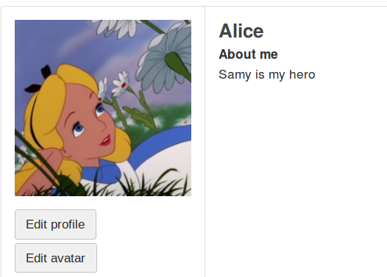
Launching the attack
The inline approach is implemented in self_propogating.js
Log in as Samy, paste the script into Samy’s profile
Log in as Alice and visit Samy’s profile. Alice’s profile gets infected by the worm.

Slide 34
Countermeasures: the Filter Approach
Removes code from user inputs.
It is difficult to implement as there are many ways to embed code other than <script> tag
- Inline, between a pair of <script> and </script> tags
- From an external file specified by the src attribute of a <script> tag
- In an HTML event handler attribute, such as onclick or onmouseover
- In a URL that uses the special javascript: protocol.
Use of open-source libraries that can filter out JavaScript code.
Example : jsoup

Slide 35
Countermeasures: The Encoding Approach
Replaces HTML markups with alternate representations.
If data containing JavaScript code is encoded before being sent to the browsers, the embedded JavaScript code will be displayed by browsers, not executed by them.
Converts <script> alert(‘XSS’) </script> to
&lt;script&gt; alert(&lsquo;XSS&rsquo;) &lt;/script&gt;

Slide 36
Countermeasures: Elgg’s Approach
PHP module HTMLawed:
Highly customizable PHP script to sanitize HTML against XSS attacks.
PHP function htmlspecialchars:
Encode data provided by users, s.t., JavaScript code in user’s inputs will be interpreted by browsers only as strings and not as code.
htmlspecialchars($str) and htmlspecialchars_decode($str)
* Elgg’s countermeasures have been disabled in our lab setup for the experiment purpose

Slide 37
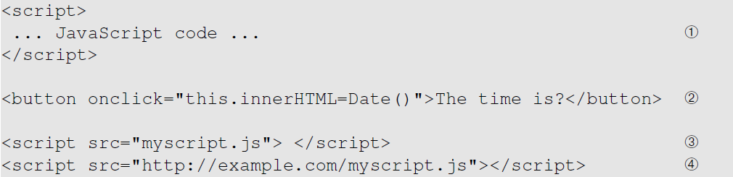
Defeating XSS using Content Security Policy
Fundamental Problem: mixing data and code (code is inlined)
Solution: Force data and code to be separated: (1) Don’t allow the inline approach. (2) Only allow the link approach. With (1) the browser cannot tell where does the code originally come from.
inline
link

Slide 38
CSP Example
Policy based on the origin of the code
Code from self, example.com, and google will be allowed.

Slide 39
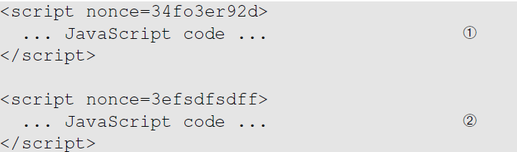
How to Securely Allow Inlined Code
Using nonce: nonce is a one-time randomly generated value by the web server. CSP nonce value is set to all allowed scripts. Any malicious code added to the page does not have the nonce value or a wrong one.
Using hash of the code
Allowed
Not allowed

Slide 40
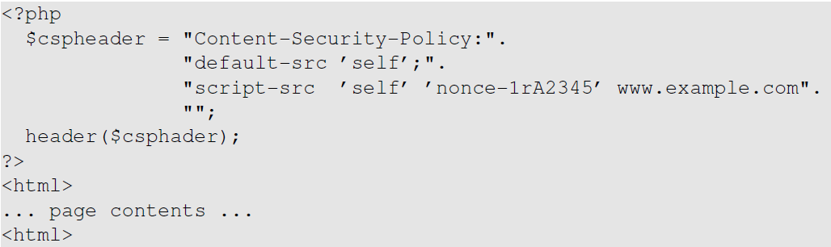
Setting CSP Rules
Generated by a random function and use this value for all safe inline scripts

Slide 41
Experiment with CSP
We run a small web server written in Python, listening on port 8000. Upon receiving a request, it returns a static file csptest.html
The web server set CSP for inline and link scripts which are included in csptest.html

Slide 42
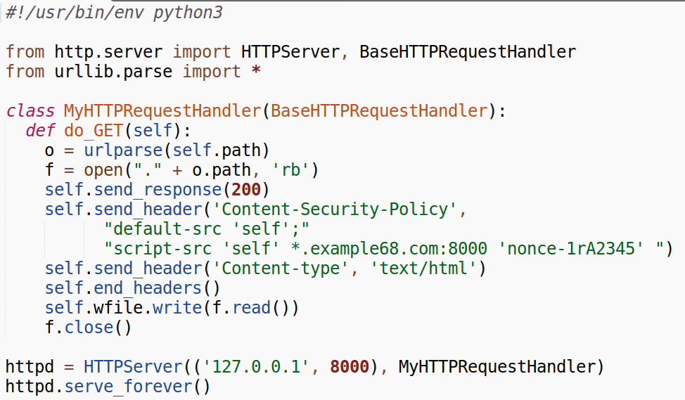
Experiment with CSP
http_server.py

Slide 43
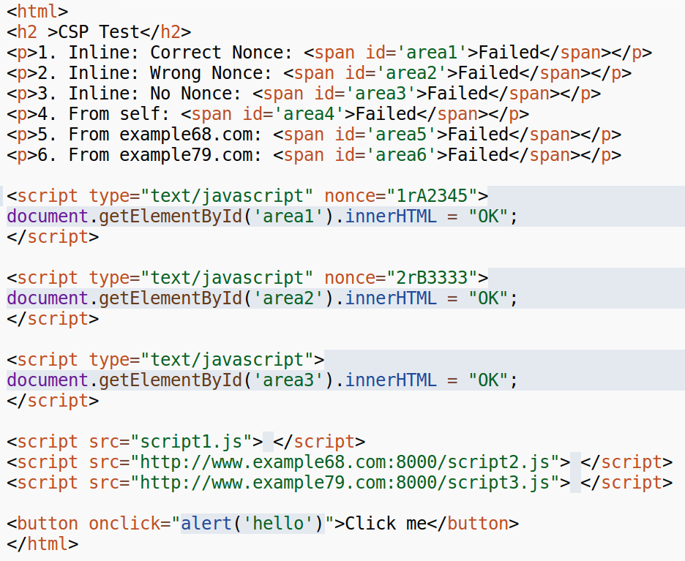
csptest.html
script1, 2, 3.js must
be copied to the
web folder of
corresponding
sites

Slide 44
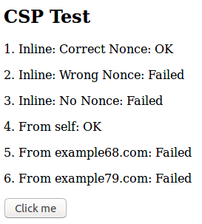
Experiment with CSP
Open in browser 127.0.0.1:8000/csptest.html

Slide 45
Discussion Questions
Question 1: What are the main differences of CSRF and XSS attacks? They both have “cross site” in their names.
Question 2: Can we use the countermeasures against CSRF attacks to defend against XSS attacks, including the secret token and same-site cookie approaches?

Slide 46
Summary
Two types of XSS attacks
How to launch XSS attacks
Create a self-propagating XSS worm
Countermeasures against XSS attacks

