Slide 1

VIETNAM - KOREA UNIVERSITY OF INFORMATION AND COMMUNICATION TECHNOLOGY
COMPUTER SCIENCE DEPARTMENT
BASIC PROJECT 4
AI IMPLEMENT DISCORD BOT
Student : Nguyen Hong Nguyen Hai
Nguyen Viet Anh Quyen
Instructor : Master Trinh Thi Ngoc Linh
Class : 22SE1

Slide 2
1
THEORETICAL BASIS
2
CLIENT AND SERVER
CONTENT
3
GEMINI AI
4
SYSTEM ANALYSIS AND DESIGN

Slide 3


1
THEORETICAL BASIS

Slide 4
1
THEORETICAL BASIS
1 - Machine Learning
Machine Learning is an important field in artificial intelligence (AI) and computer science that focuses on using data and algorithms to simulate human learning abilities.
There are 3 common types of models:
Supervised Machine Learning
Unsupervised Machine Learning
Semi-supervised Machine Learning

Slide 5
1
THEORETICAL BASIS
2 - Neural Network
Neural Network, also known as artificial neural network or artificial neural network, is a complex mathematical model developed based on biological neural networks
More specifically, Neural Network is built based on the operating model of human neurons.

Slide 6
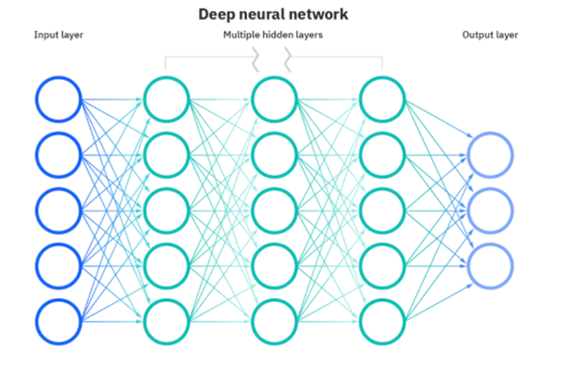
1
THEORETICAL BASIS
2 - Neural Network
Deep Neural Network Model

Slide 7
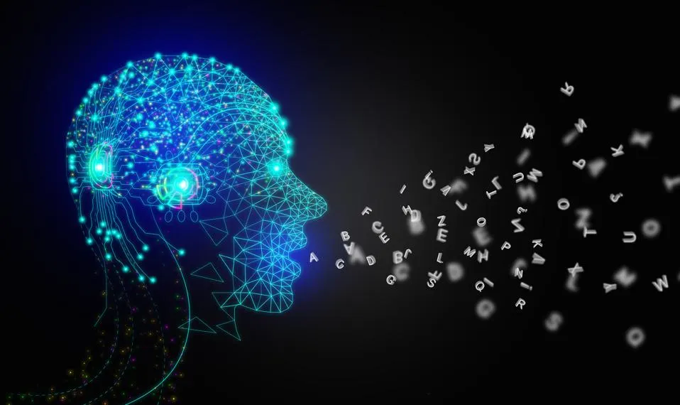
1
THEORETICAL BASIS
3 - Generative AI
Generative AI is a branch of artificial intelligence that focuses on the ability to generate new and diverse content based on initial input data.
Generative AI
Applications of AI include content creation, image and video creation, fake data generation,...

Slide 8
2
CLIENT AND SERVER

Slide 9
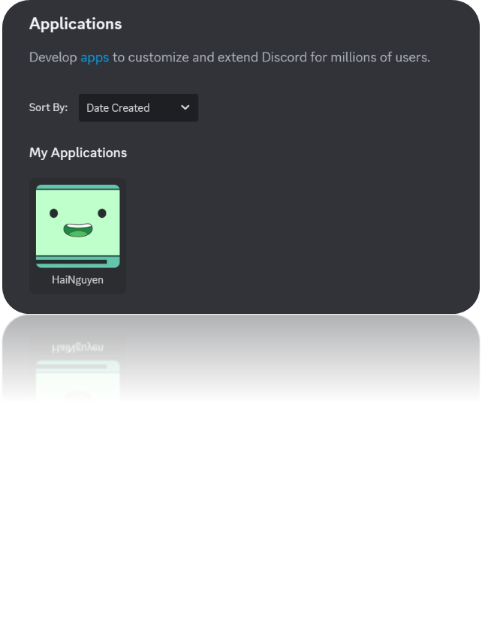
2
CLIENT AND SERVER
1 - Discord Application (Client)
Discord is a creative playground where users can not only chat but also build unique applications. This feature not only meets the need for personalization but also contributes to creating vibrant and diverse communities.
Discord Application Interface

Slide 10
2
CLIENT AND SERVER
2 - Discord API Capabilities
Send and receive messages: Allows bots to send automated messages or respond to user messages.
User management: Handles user information, roles, and permissions.
Channel management: Create, edit, or delete channels on the server.
Event tracking: Get notified when new messages arrive, users join or leave the server, etc.
Advanced interactions: Build slash commands, buttons, and interactive menus.

Slide 11
2
CLIENT AND SERVER
3 - The discord.py
The discord.py is a popular Python library designed to easily interact with the Discord API. With discord.py, developers can quickly build fully-featured Discord bots, from message handling, events, to custom commands.
Outstanding features :
- Supports building bots with powerful interactive features.
- Provides tools for real-time event management.
- Supports slash commands, buttons, and interactive menus.
- Easy to extend and customize.

Slide 12
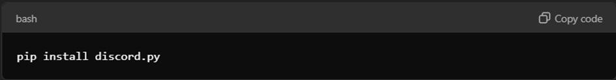
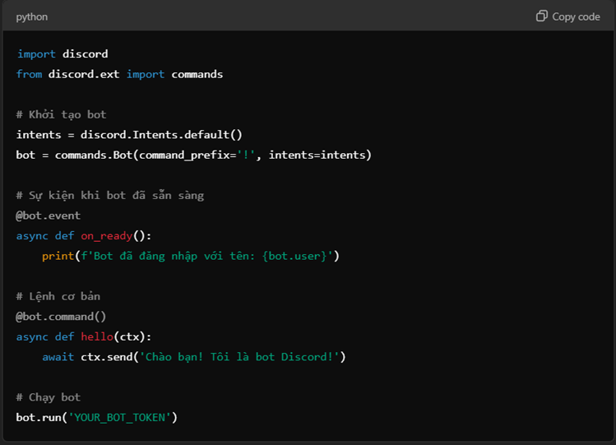
2
CLIENT AND SERVER
4 - Installation and Setup the discord.py
Install the discord.py
Set up the bot.py

Slide 13
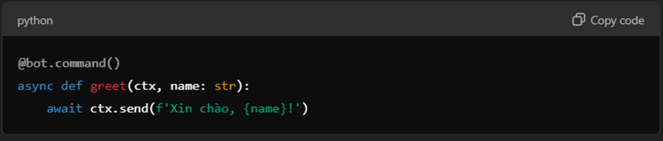
2
CLIENT AND SERVER
4 - Installation and Setup the discord.py
Command Example

Slide 14
3
GEMINI AI

Slide 15
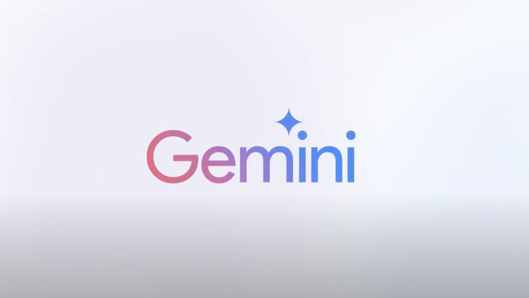
3
GEMINI AI
1 - Introduction the Gemini AI
Gemini is an advanced artificial intelligence platform developed by Google, focusing on creative solutions and intelligent assistance.
Gemini is based on an advanced deep learning model, using billions of parameters to analyze and process data. Gemini also has the ability to learn from user feedback, continuously improving the quality and accuracy of answers.
Gemini AI

Slide 16
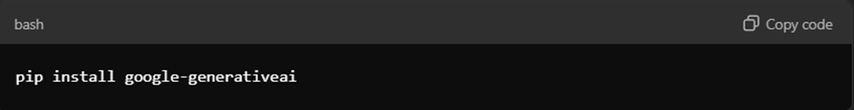
3
GEMINI AI
2 - Gemini’s API by Python
Gemini supports many programming languages, with Python being one of the popular choices. To install the google-generativeai library for Python, use the command:
Install the google_generativeai

Slide 17
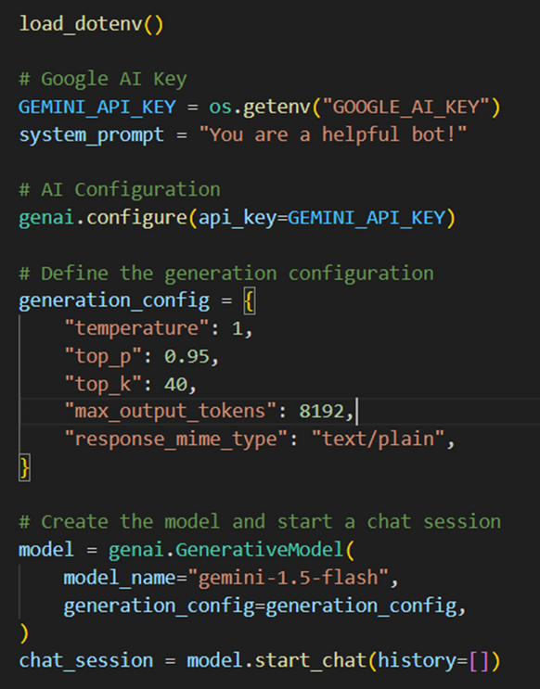
3
GEMINI AI
2 - Gemini’s API by Python
Below is an example illustrating how to integrate Gemini's API into a Python application.
Gemini AI with Python

Slide 18
4
SYSTEM ANALASIS AND DESIGN

Slide 19
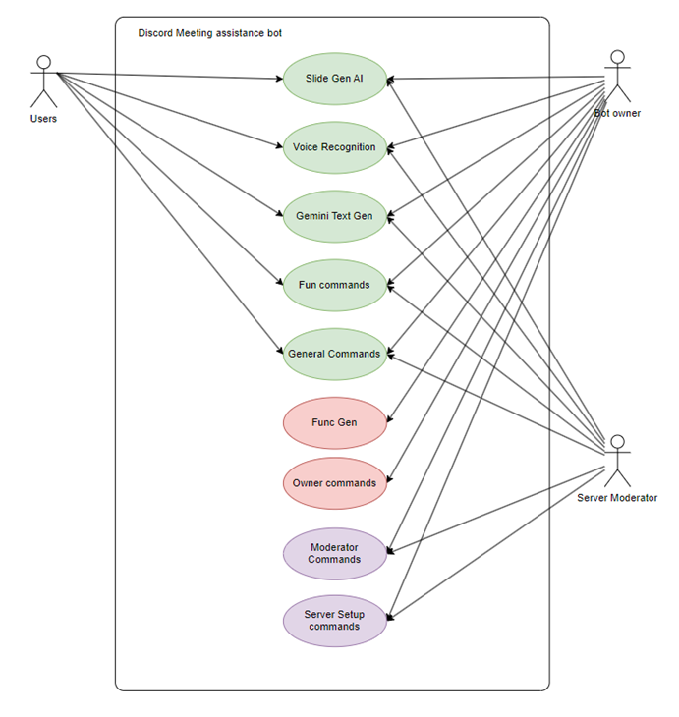
4
SYSTEM ANALASIS AND DESIGN
1 - Usecase Diagram
User: normal user, who regularly directly uses the Bot's features.
Server Moderator: is a bot user but has the right to operate in the Server, Bot has command items specifically for these objects (this group of agents includes Server Owner).
Bot Owner: here refers to the group of agents belonging to the dev team, this group has full control over the bot's functions and special sub-functions reserved for this group of agents.

Slide 20
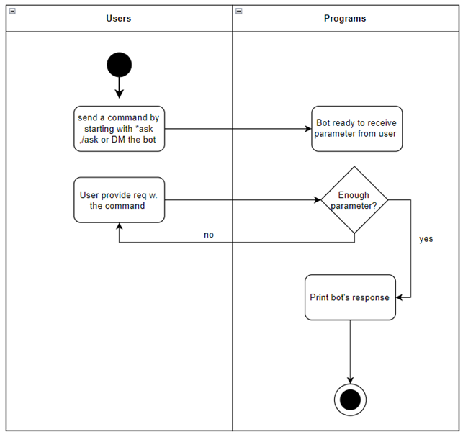
4
SYSTEM ANALASIS AND DESIGN
2 - Activity Diagram
Gemini Cog Activity Diagram

Slide 21
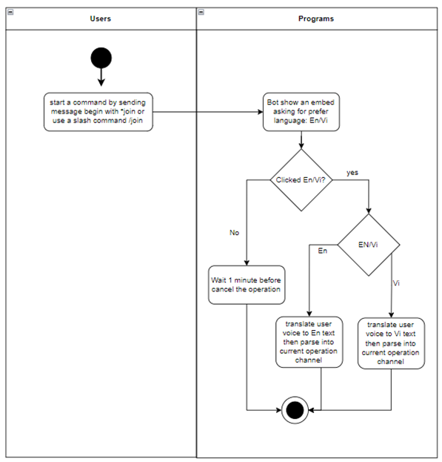
4
SYSTEM ANALASIS AND DESIGN
2 - Activity Diagram
Voice Cog Activity Diagram

Slide 22
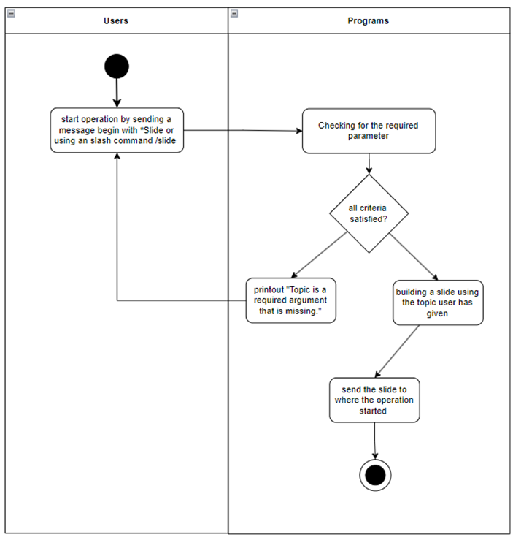
4
SYSTEM ANALASIS AND DESIGN
2 - Activity Diagram
Slide Cog Activity Diagram

Slide 23
Thank
you!

