Slide 1

PRESENTATION
ON
GIT AND GIT HUB
GROUP MEMBER:
TAHSIN TALUKDER (41240202232)
RUBIYA ISLAM AESHA (41240202223)
NAFISA ANZUM (41240202265)
SEFATON NAHAR (41240202312)
COURSE CODE: CSE1290
SUBMITTED TO:
MOHAMMAD NASIF SADIQUE KHAN

Slide 2
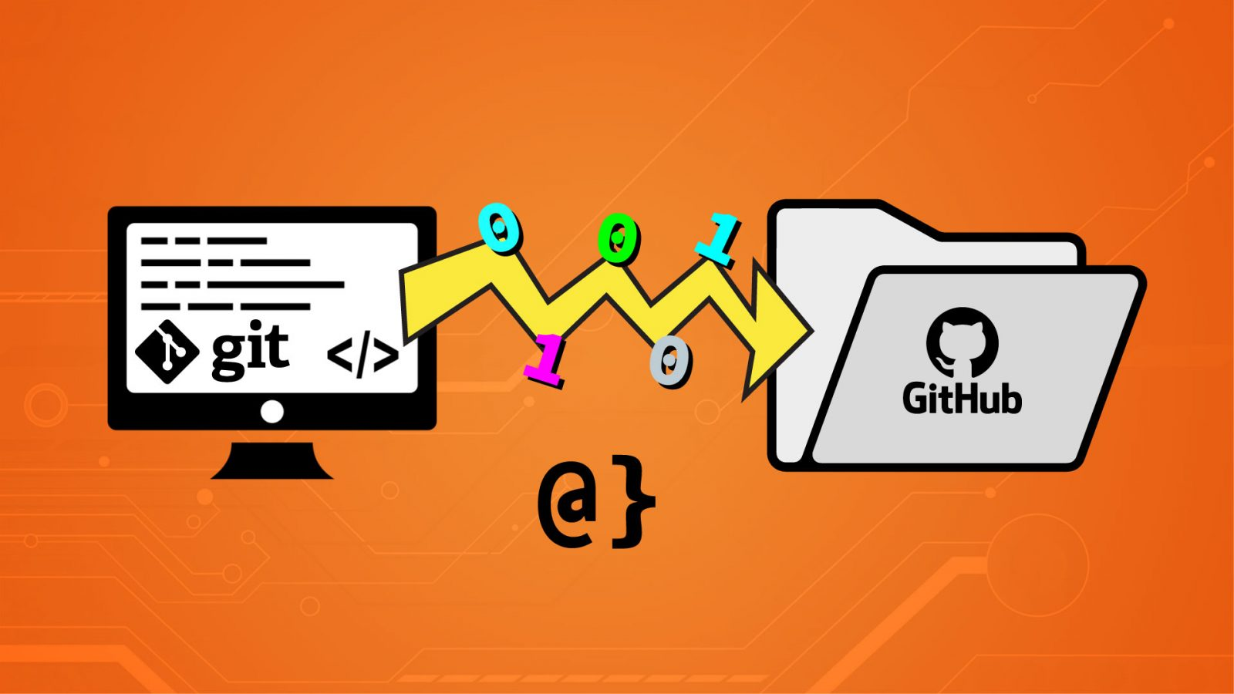

WHAT IS GIT?
Git is a tool (or software) that helps us save and track changes in our files — especially code or projects. It is a Version Control System.
FUNCTION:
Tracks changes in files
Work offline
Collaboration
Branching and merging
Keeps history safe
WHAT IS GITHUB?
GitHub is a website where we can store and share our Git projects online. It helps developers, designers, and teams to collaborate easily .
FUNCTION:
Stores projects online
Tracks changes
Team collaboration
Pull requests
Showcase your work

Slide 3
WHAT IS GIT?
Git is a tool (or software) that helps us save and track changes in our files — especially code or projects. It is a Version Control System.
FUNCTION:
Tracks changes in files
Work offline
Collaboration
Branching and merging
Keeps history safe
WHAT IS GITHUB?
GitHub is a website where we can store and share our Git projects online. It helps developers, designers, and teams to collaborate easily .
FUNCTION:
Stores projects online
Tracks changes
Team collaboration
Pull requests
Showcase your work

Slide 4
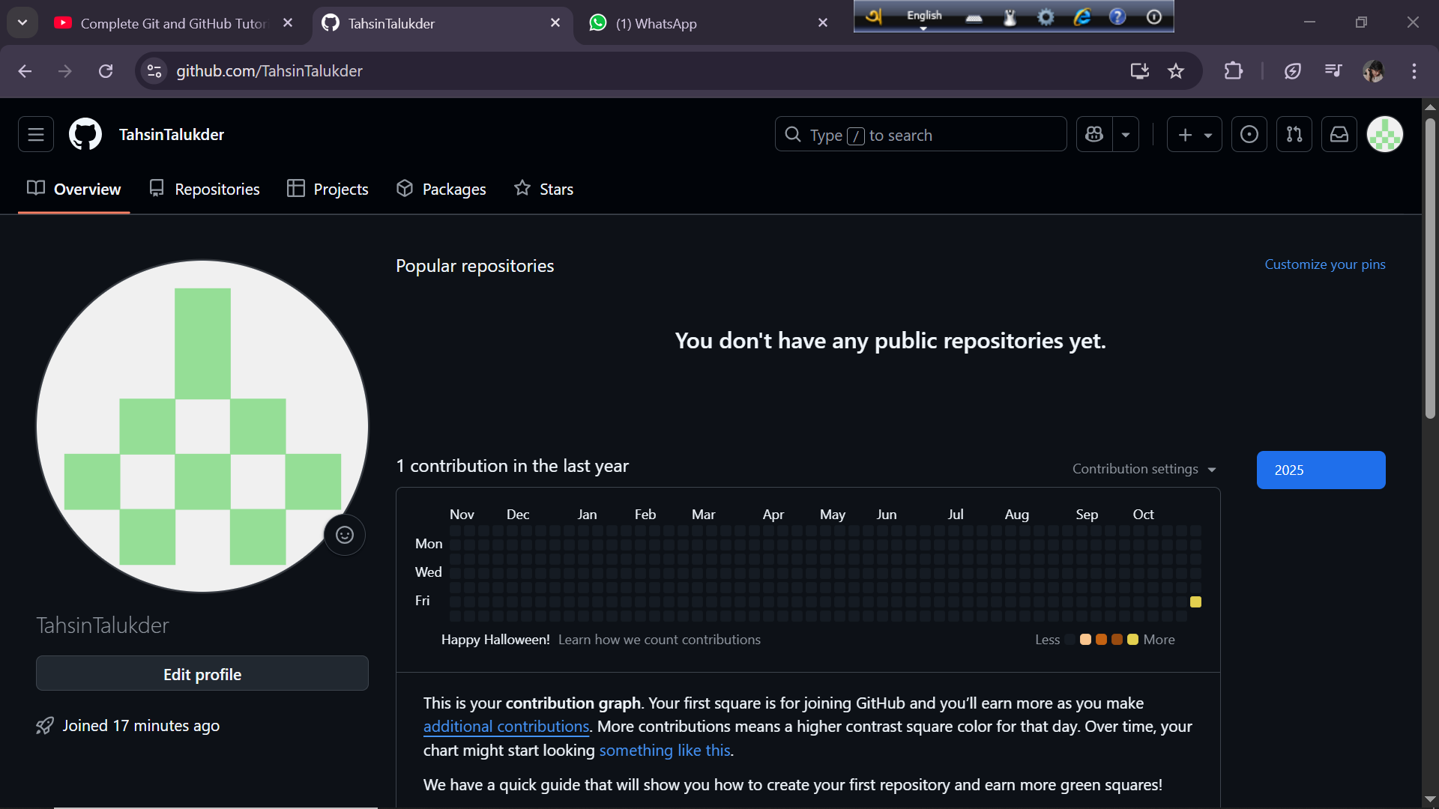
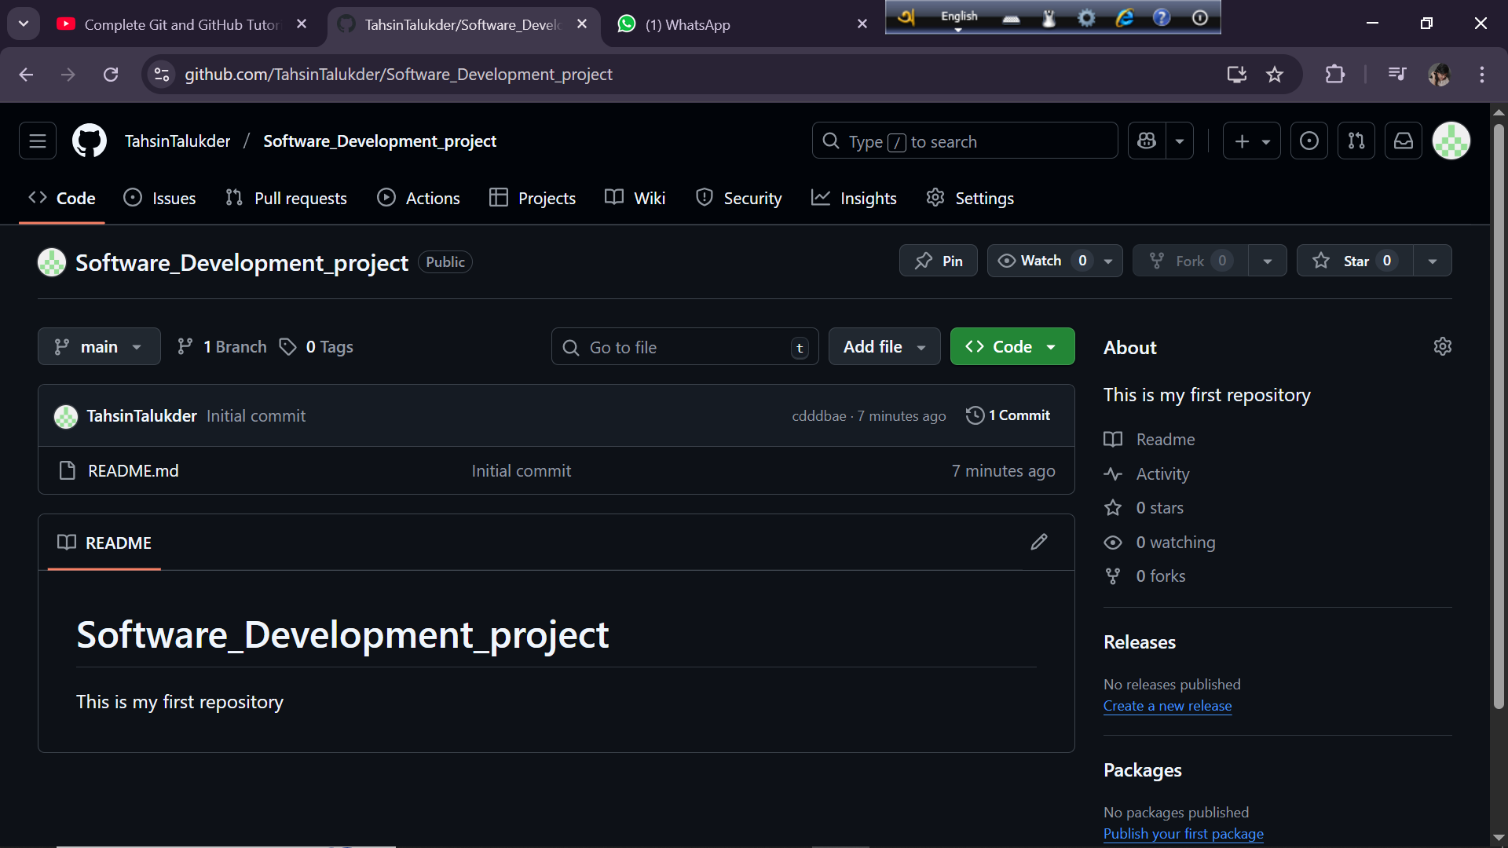
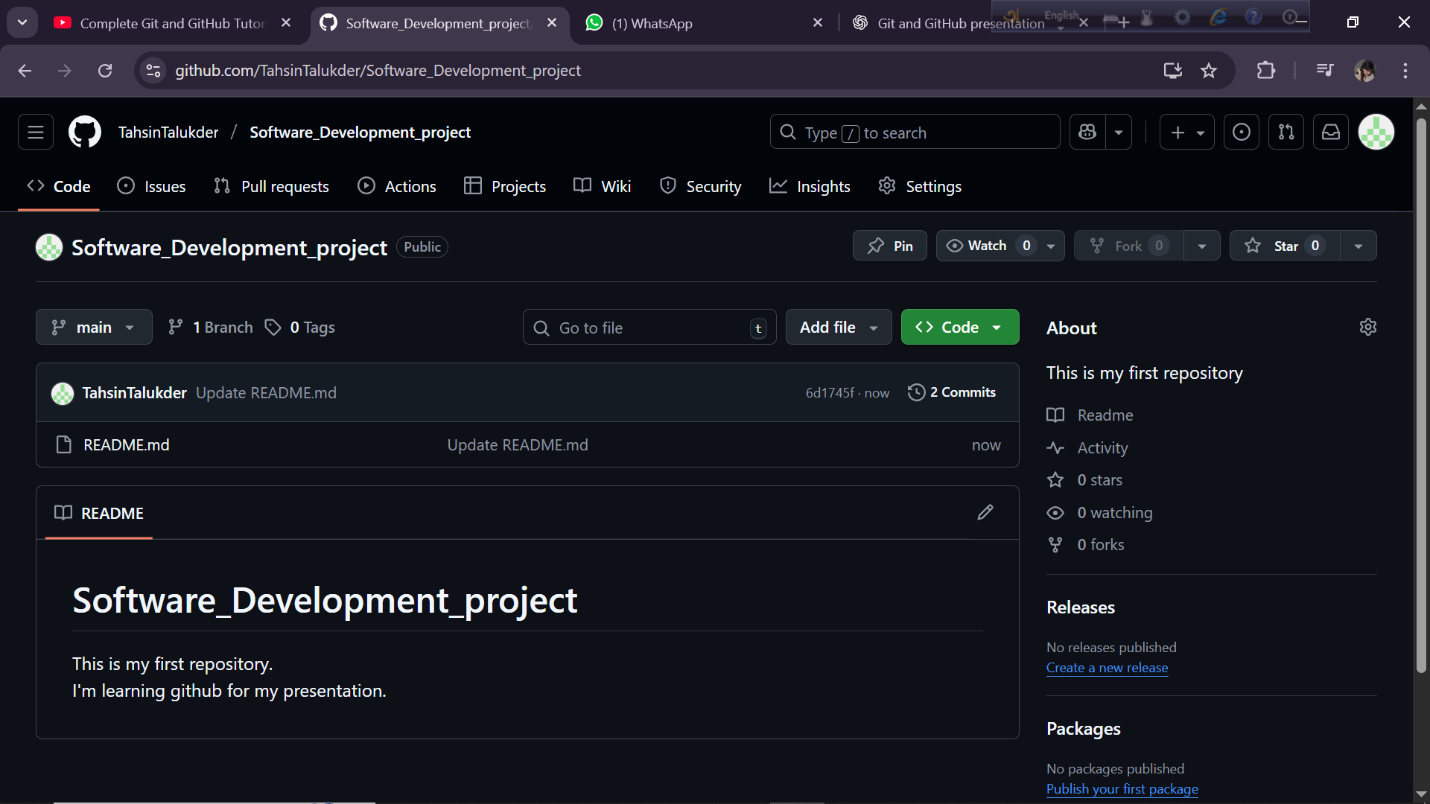
ACCOUNT ON GITHUB:
A GitHub account lets us use GitHub, which is an online platform for saving and sharing your projects.
It’s free to create and only needs an email and username

Slide 5
CREATING REPOSITORY:
A repository (repo) in GitHub is like a folder where you keep all the files and versions of a project. Steps:
1.Click New Repository 2.Name it 3.Choose Public or Private 4.Click Create Repository

Slide 6
COMMITTING CHANGES:
A commit in GitHub means saving your changes in a project with a short message about what you changed.

Slide 7
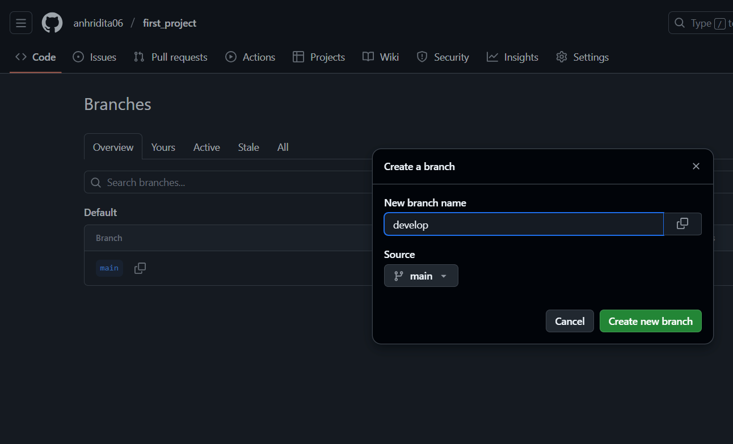
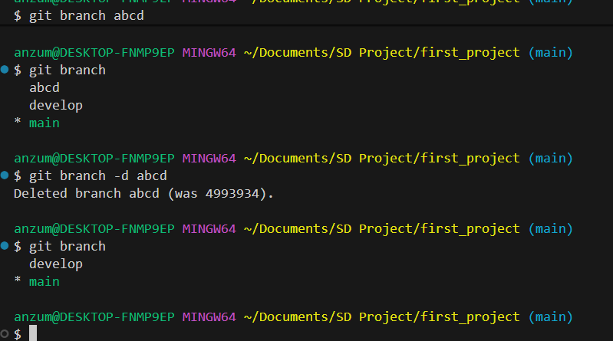
BRANCH MANAGEMENT
A branch is a copy of your project where you can make changes independently
It’s like a sandbox - you can experiment, build features, or fix bugs without touching the main code
The main branch (often called “main” or “master” ) holds the stable, production-ready version of your project
You can create, switch, merge, or delete branches anytime
Branches help teams collaborate without conflicts
After work is done, you merge the branch back into the main codebase
You can create a new branch to work on changes
You can remove a branch when it’s no longer needed

Slide 8
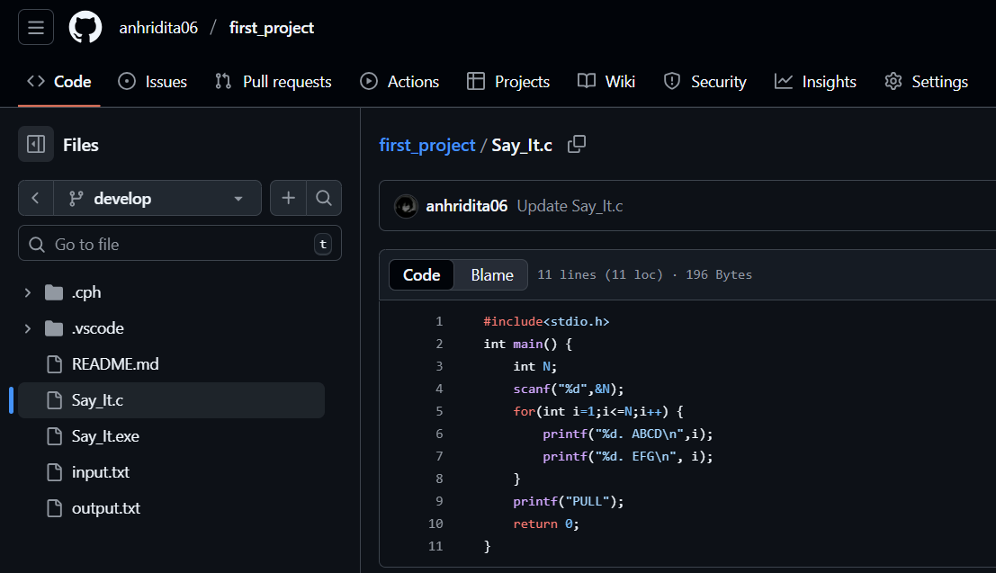
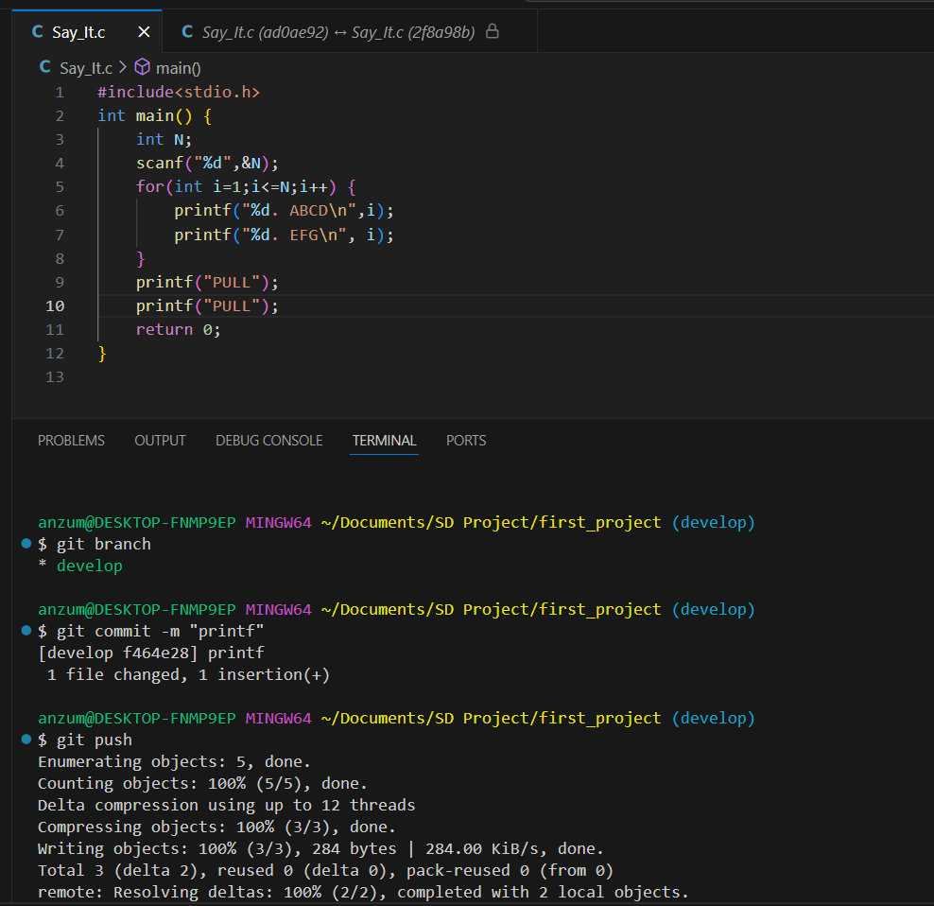
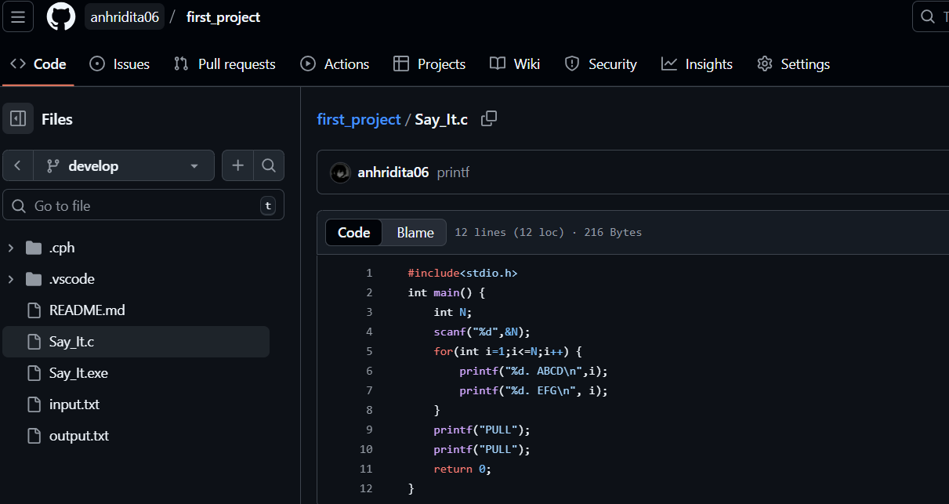
BRANCH OPERATIONS IN GITHUB
Add new code or features without affecting the main branch
Fix bugs and improve existing functionality safely
Edit files and commit changes with clear message
Run and test your code within branch
Check for errors, bugs, or unexpected behavior
Keep your changes focused and related to one task
You can merge a branch into another branch when work is complete

Slide 9
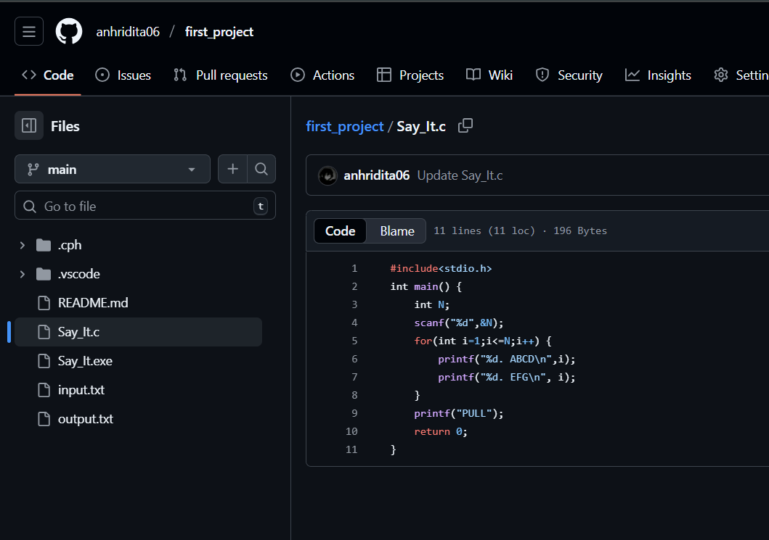
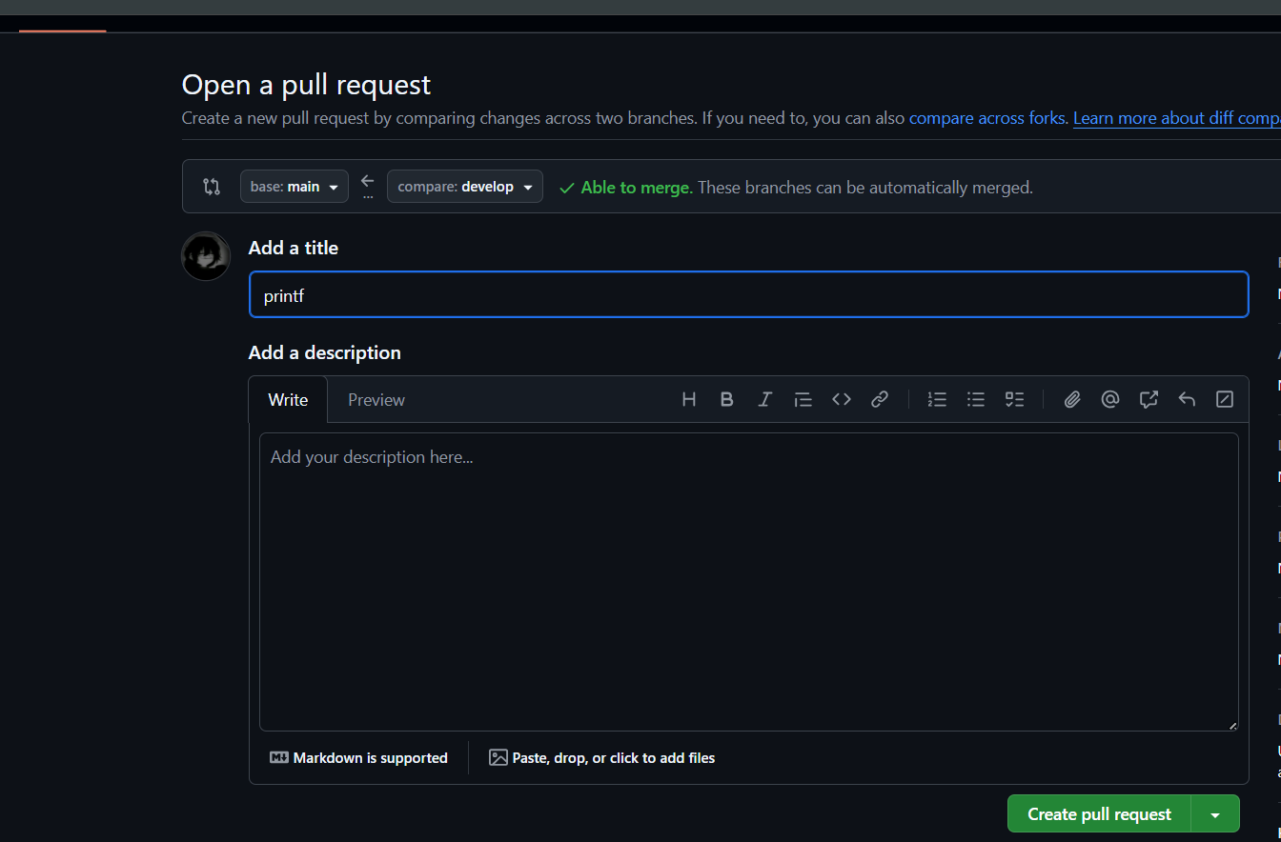
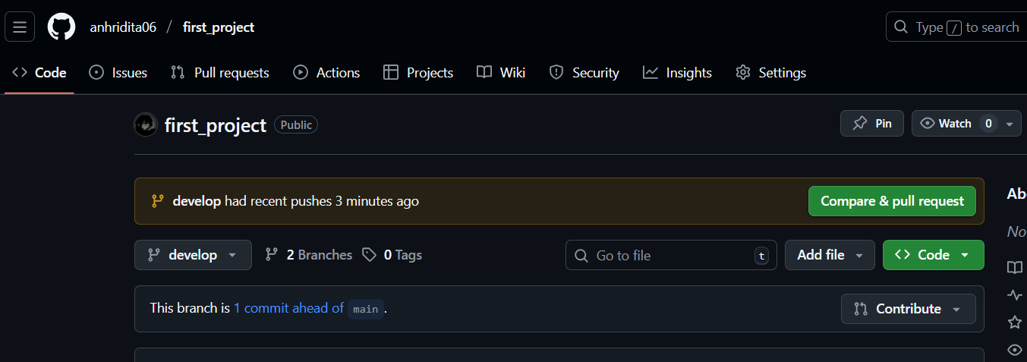
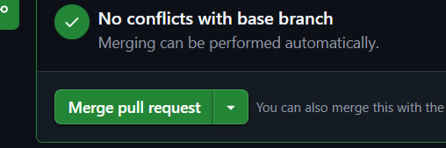
CREATING AND MERGING PULL REQUEST

Slide 10
1.Pull Requests :
Review, discuss, and approve code before merging.
2.Code Reviews & Comments:
Team members give feedback directly on code lines.
6.GitHub Actions :
Automate testing, building, and deployment processes.
Collaboration Features
3.Issues & Project Boards:
Track bugs, assign tasks, and manage workflow visually.
5.Forking & Cloning:
Work independently on copies and contribute via PRs.
4.Branch Protection Rules:
Prevent unauthorized changes; ensure quality control.

Slide 11
command
Basic Setup
git config --global user.name "Your Name"
git config --global user.email "you@example.com"
Check & Track Changes
git status
git add <file>
git add .
git commit -m "message"
Start or Get a Repository
git init
git clone <repo-url>
Undo / Fix
git commit --amend
git reset --hard <commit>
git revert <commit>
git stash
git stash pop
Merge & Update
git merge <branch>
git pull
git push
Remote Repository
git remote -v
git remote add origin <url>

Slide 12

Used by companies like Google, Microsoft, Meta
Helps in:
Open-source contributions
Group projects & team coding
Continuous integration & deployment (CI/CD)
Every developer maintains their own branch → less conflict
Real life uses

Slide 13
Main Advantages:
Version tracking
Easy collaboration
Backup on the cloud
Reusability and transparency
Benifits

Slide 14
Common Issues:
Merge conflicts
Forgetting to commit/push regularly
Mismanaging branches
Not writing clear commit messages
Challenges and Mistakes we face while practising

Slide 15
Git helps manage project versions efficiently.
GitHub enables seamless collaboration.
Practice regularly to master branching, merging, and resolving conflicts.
conclusion

