Slide 1
DSM
Start Map
Result
Pixel value less than 0.6 m but not part of the result, due to isolated pixels
Iteration start point
Inundated area
Safe area

Slide 2
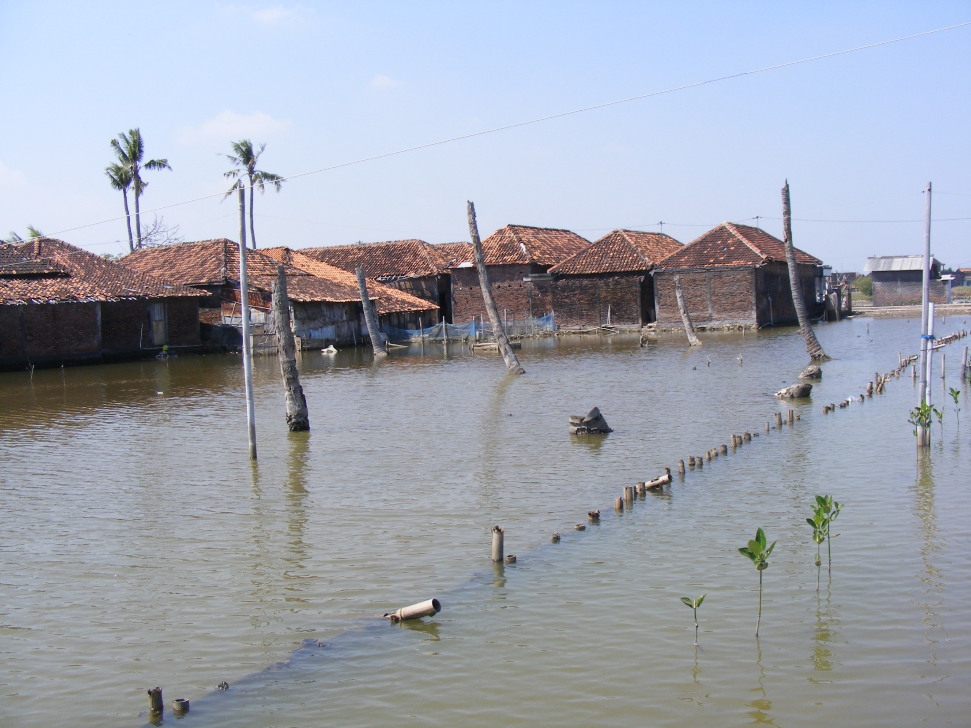
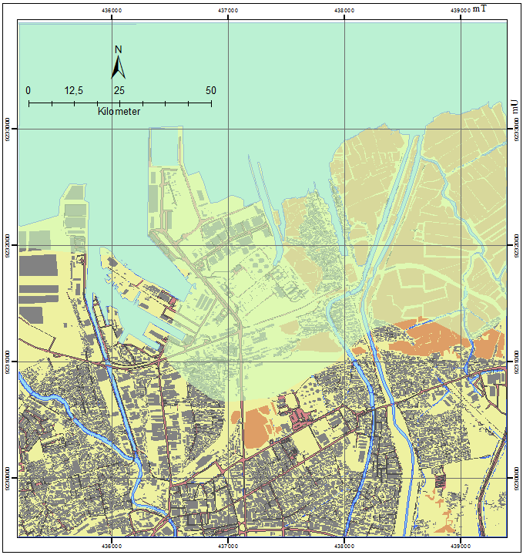
Building
Fishpond
Road
Water body
Bare Land
Tidal Flood 1 m

Slide 3
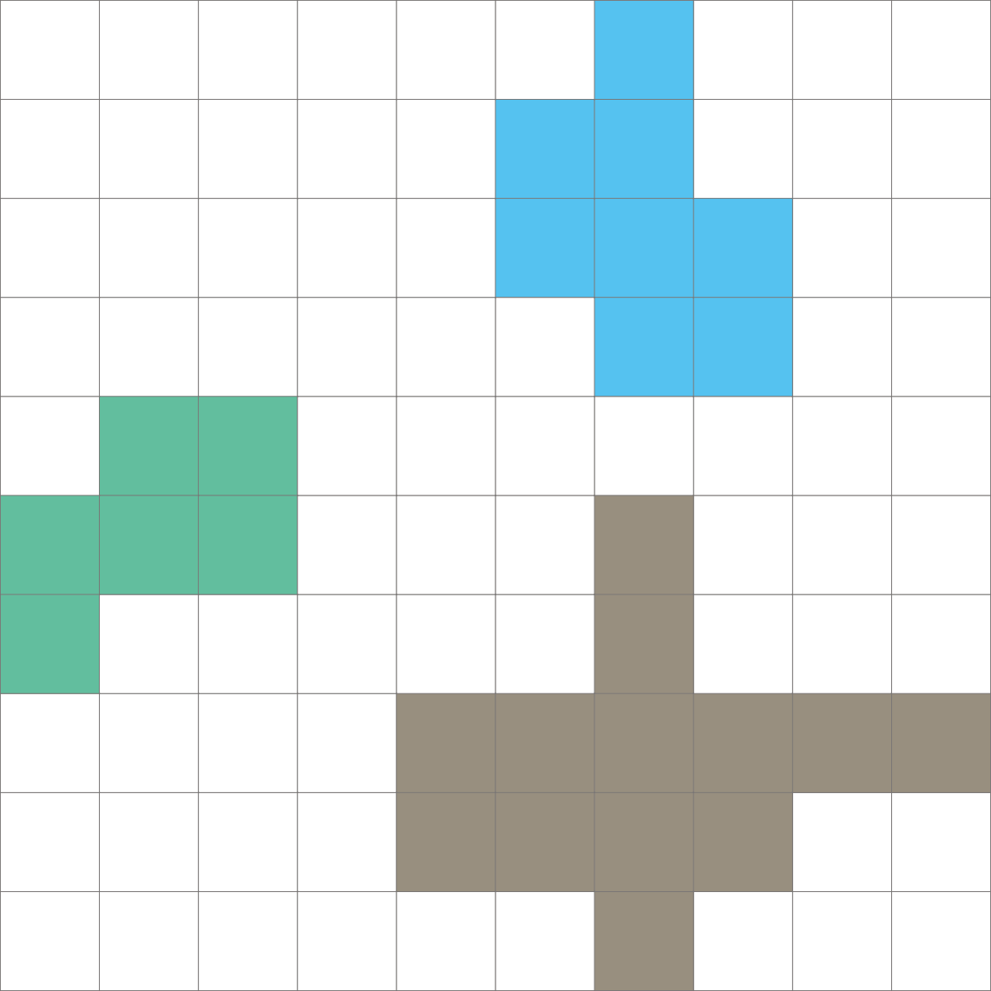

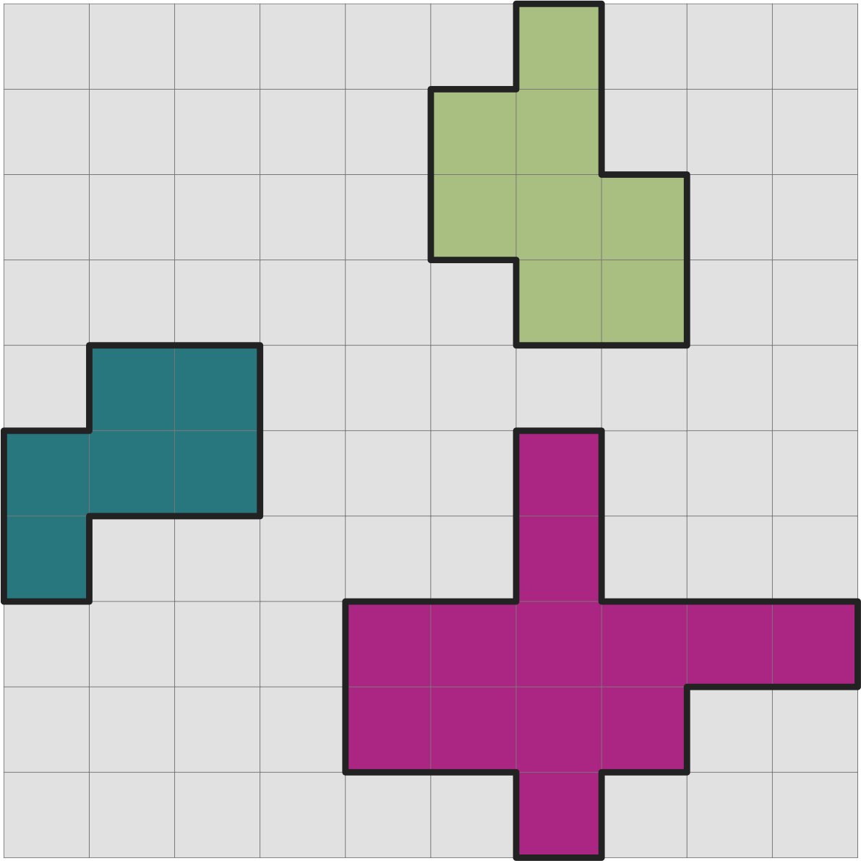
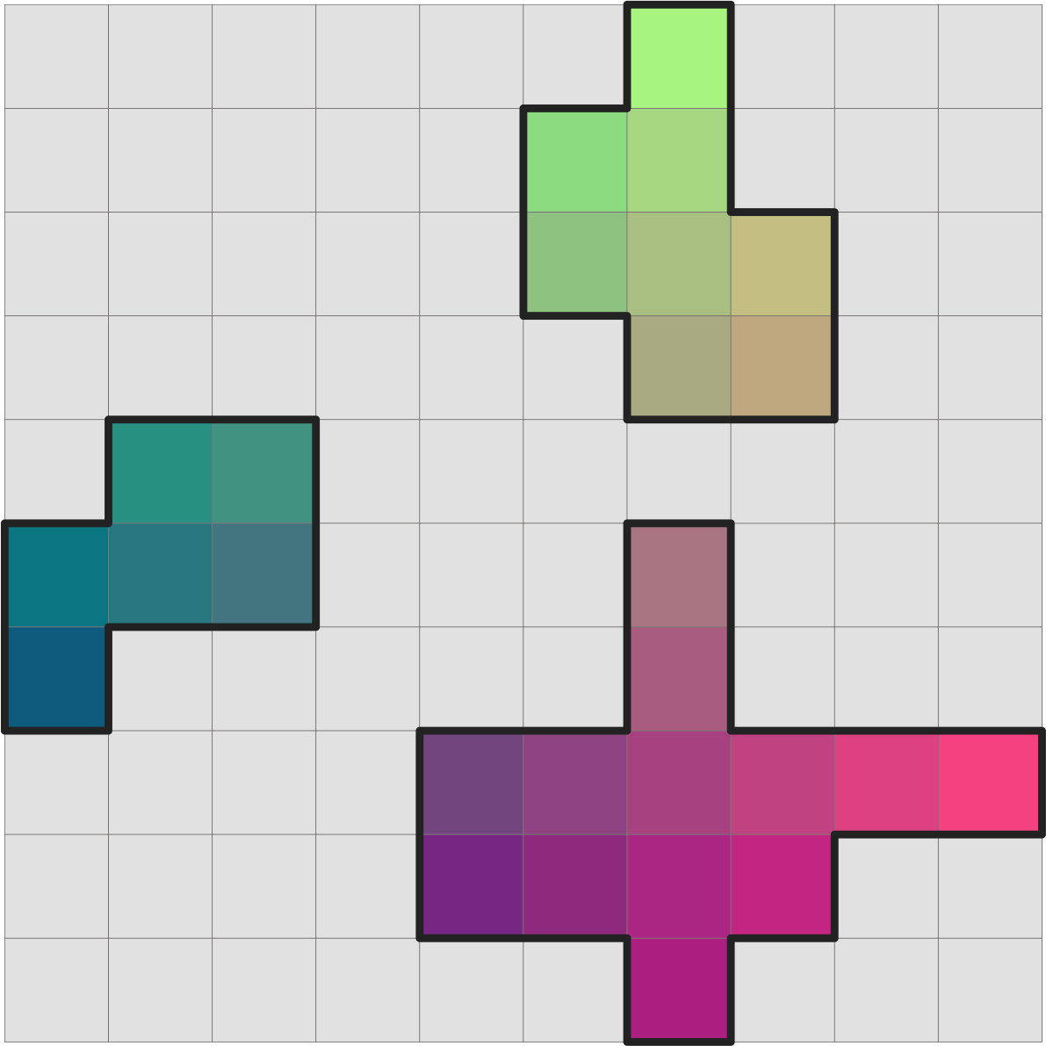
Zone
Value Raster
Output Raster
Value Raster

Slide 4
Remark Value
1- Natural Vegetation
2 - Water
3 - Settlement
4 - Bare land
5 - Plantation
Zone | Count | Variety | Majority | Majority % | Minority | Minority %
A | 6 | 2 | 5 | 83.3 | 1 | 16.7
B | 8 | 2 | 5 | 87.5 | 1 | 25.0
C | 13 | 3 | 1 | 53.8 | 3 | 7.7
Zone Raster
Value Raster
Value Raster with Input Zone
Output Raster

Slide 5
Zone Raster
Value Raster
Value Raster with Input Zone
Remark Value
1- Natural Vegetation
2 - Water
3 - Settlement
4 - Bare land
5 - Plantation
Statistic Result
Zone | A | B | C
Count | 6 | 8 | 13
Variety | 2 | 2 | 3
Majority | 5 | 5 | 1
Majority % | 83.3 | 87.5 | 53.8
Minority | 1 | 1 | 3
Minority % | 16.67 | 25 | 7.7
Output Raster
Output Raster (Majority Value)

Slide 6
GPS
Collect coordinate
Smartphone
Navigation, plotting, collect data, photo
Smartphone
Collect photo
Measuring Tape
Measuring
Survey Form
Collect infrastructure data
Measuring Tape
Measuring

Slide 7
Old workflow
Finding target location
Collect coordinate
measuring
Write down the measurement
Take a photo
Input to spreadsheet
Matching the photo documentation
Analysis, calculate, report
Update the map
New workflow
Navigate to target location
measuring
Plotting, collect the data including the photo
Export data or send to HQ
Analysis, calculate, report & update the map

Slide 8
New workflow
Tabular data containing measurement
Generate design and budget of each plot
Add as an attachment on map feature
reporting
Export to csv and kmz
Extract photos (named by its infrastructure ID)

Slide 9
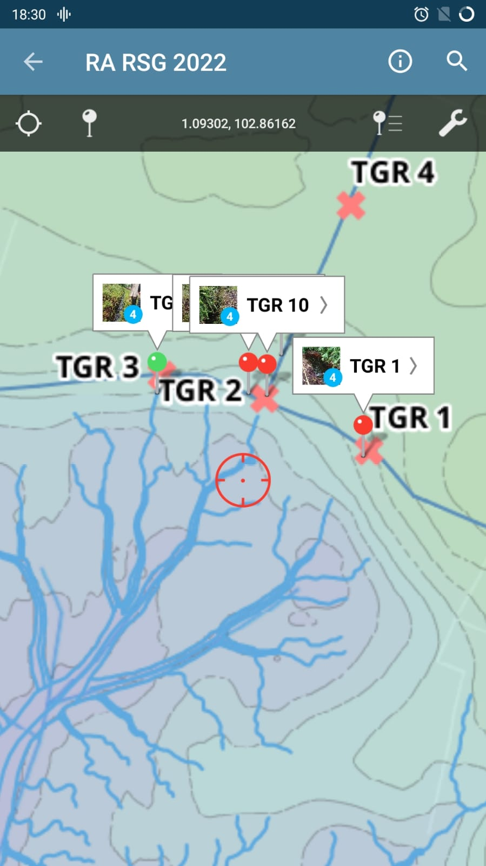
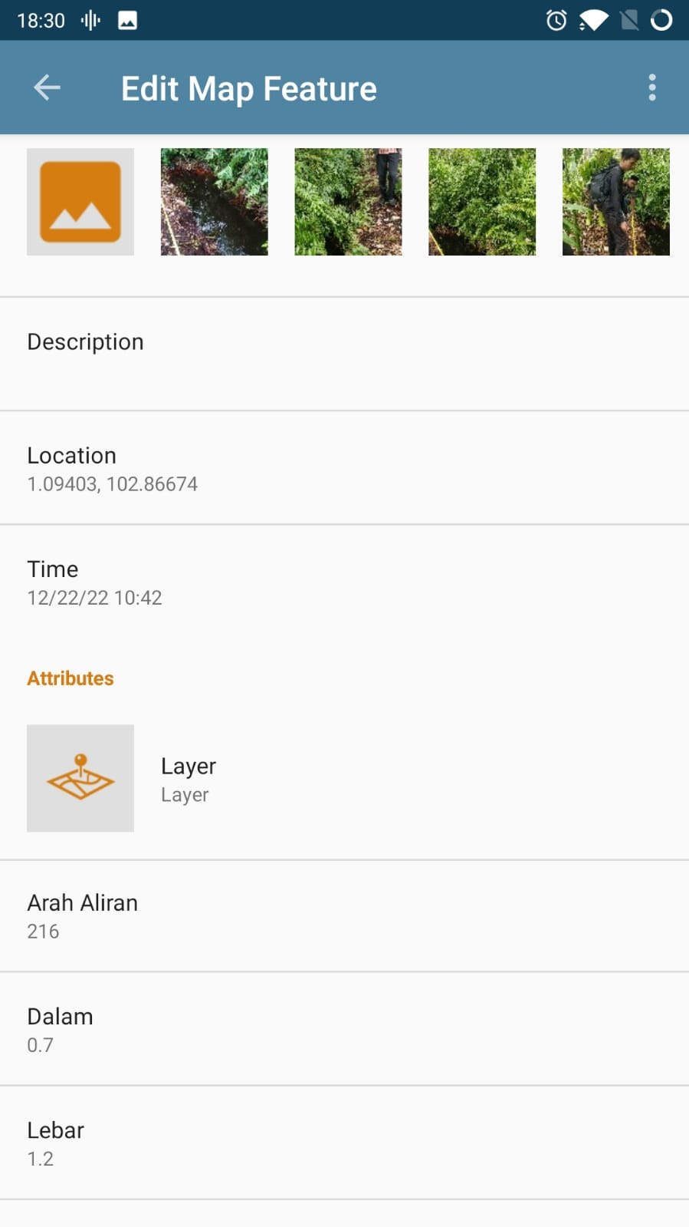
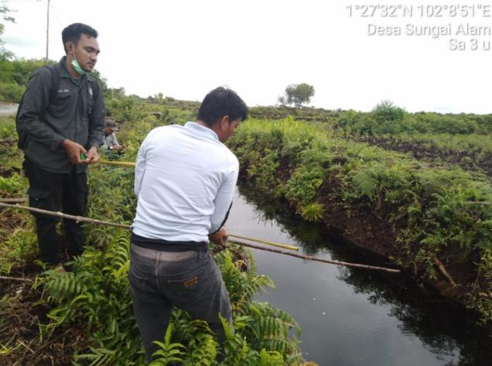
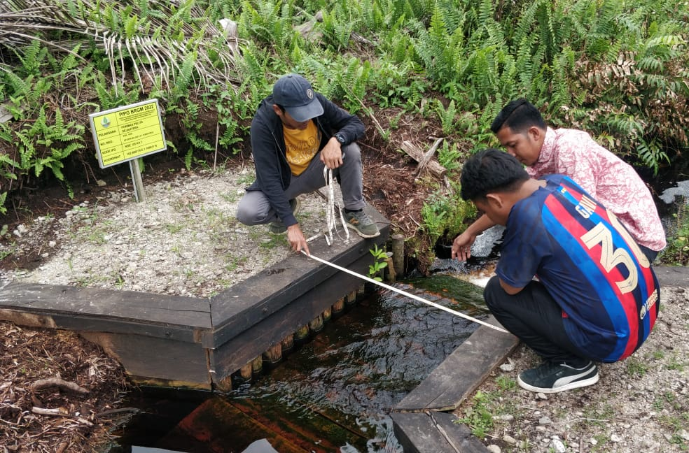
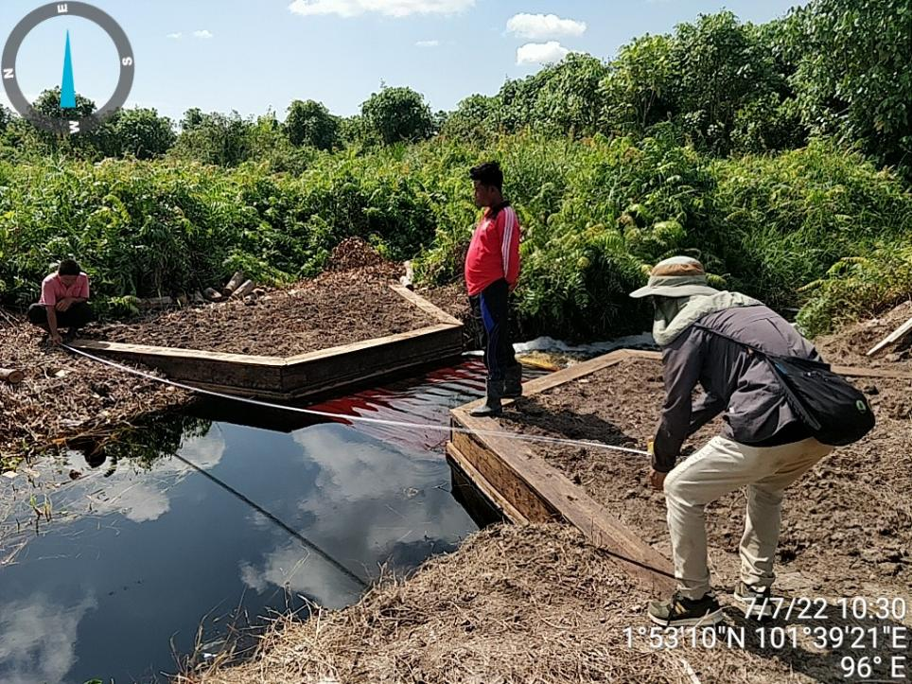

Slide 10
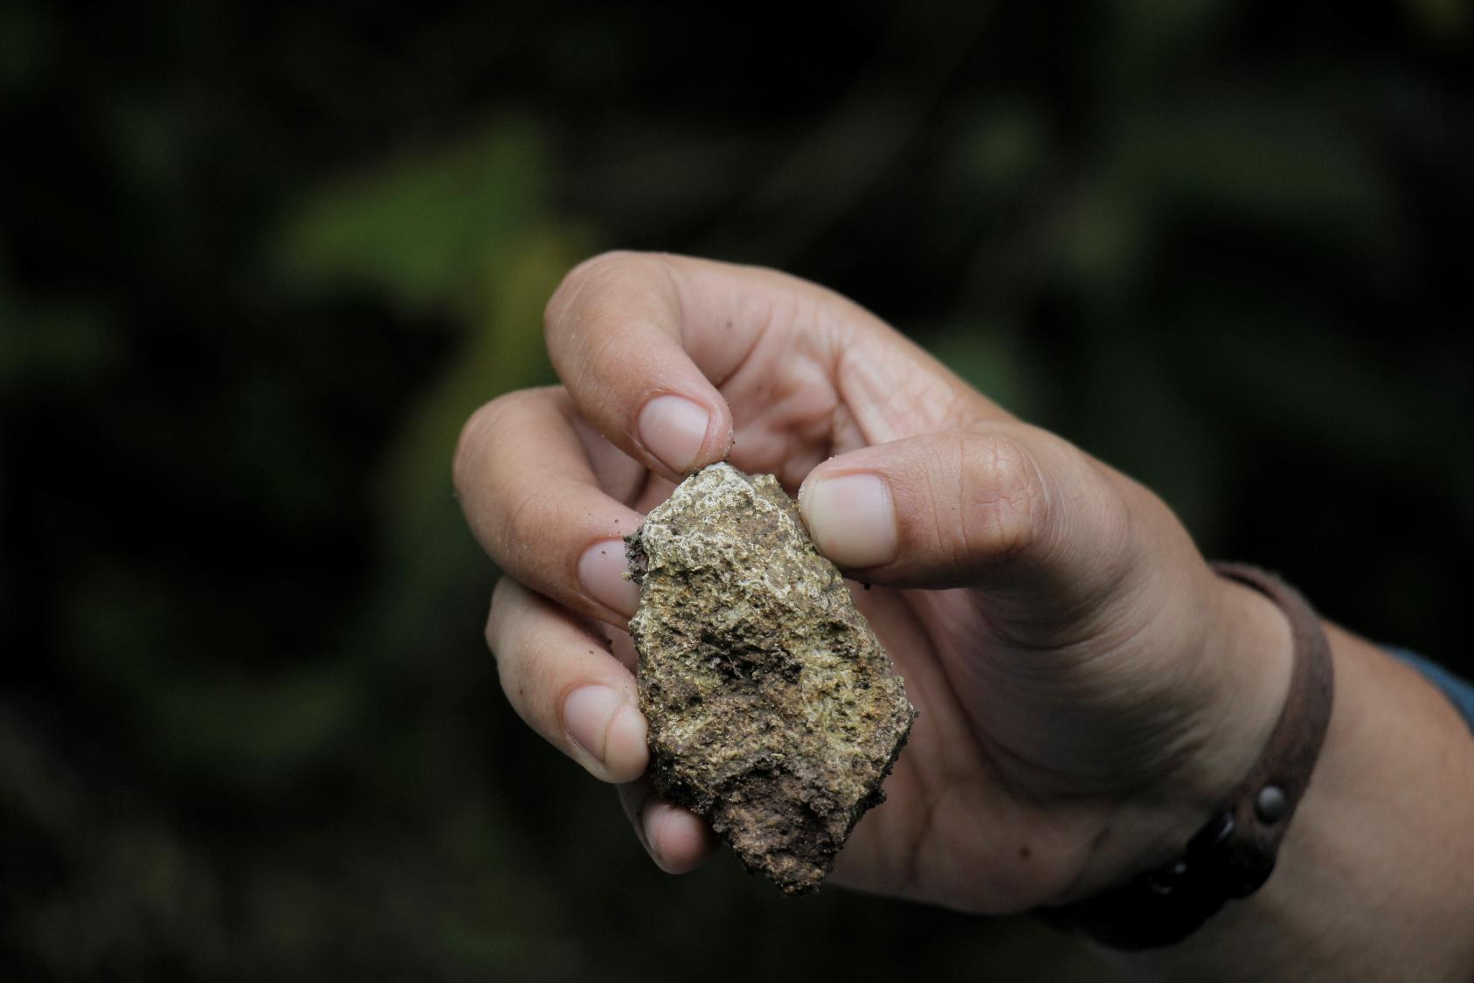
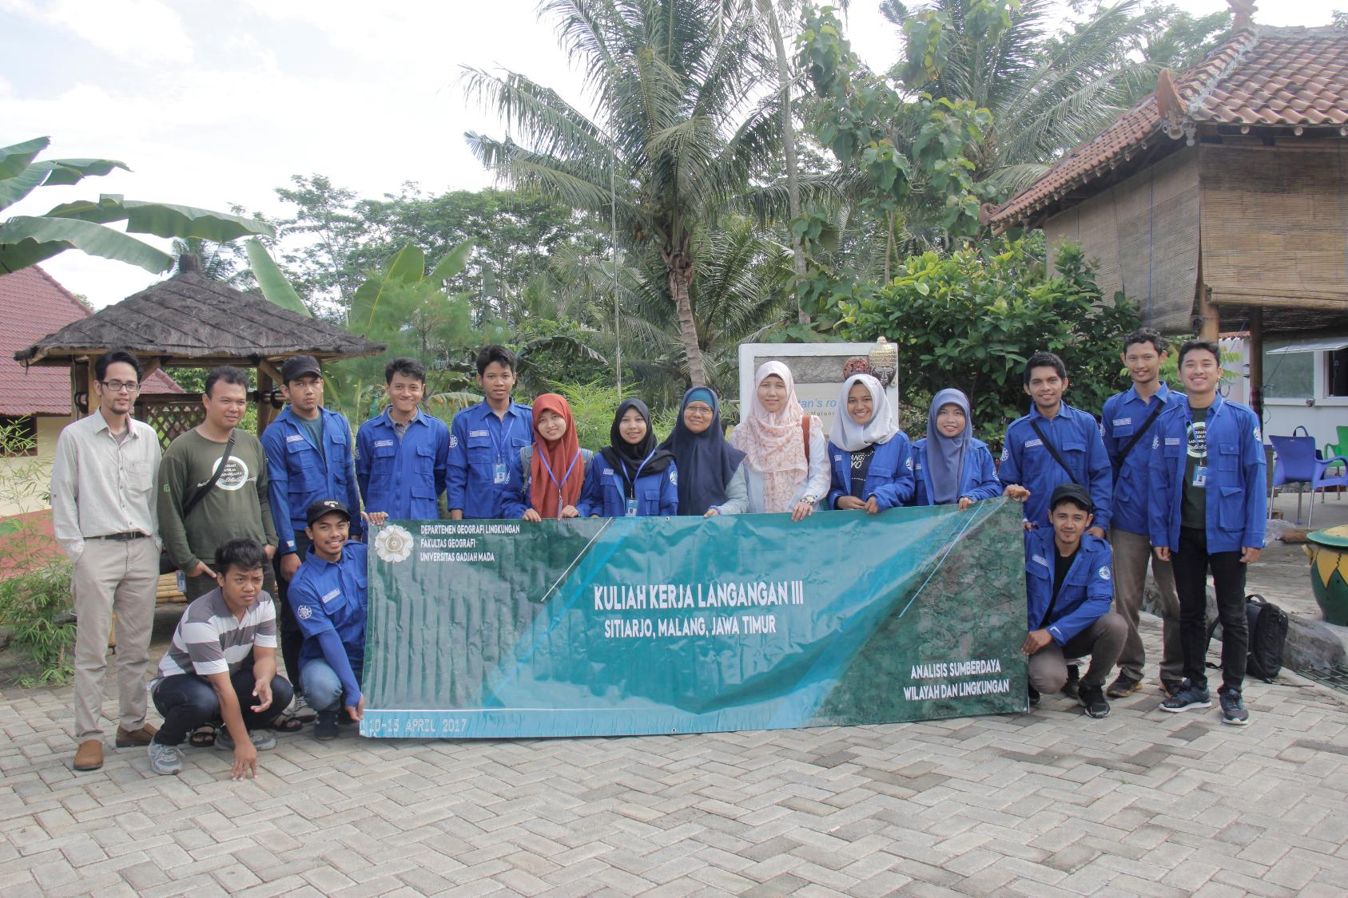
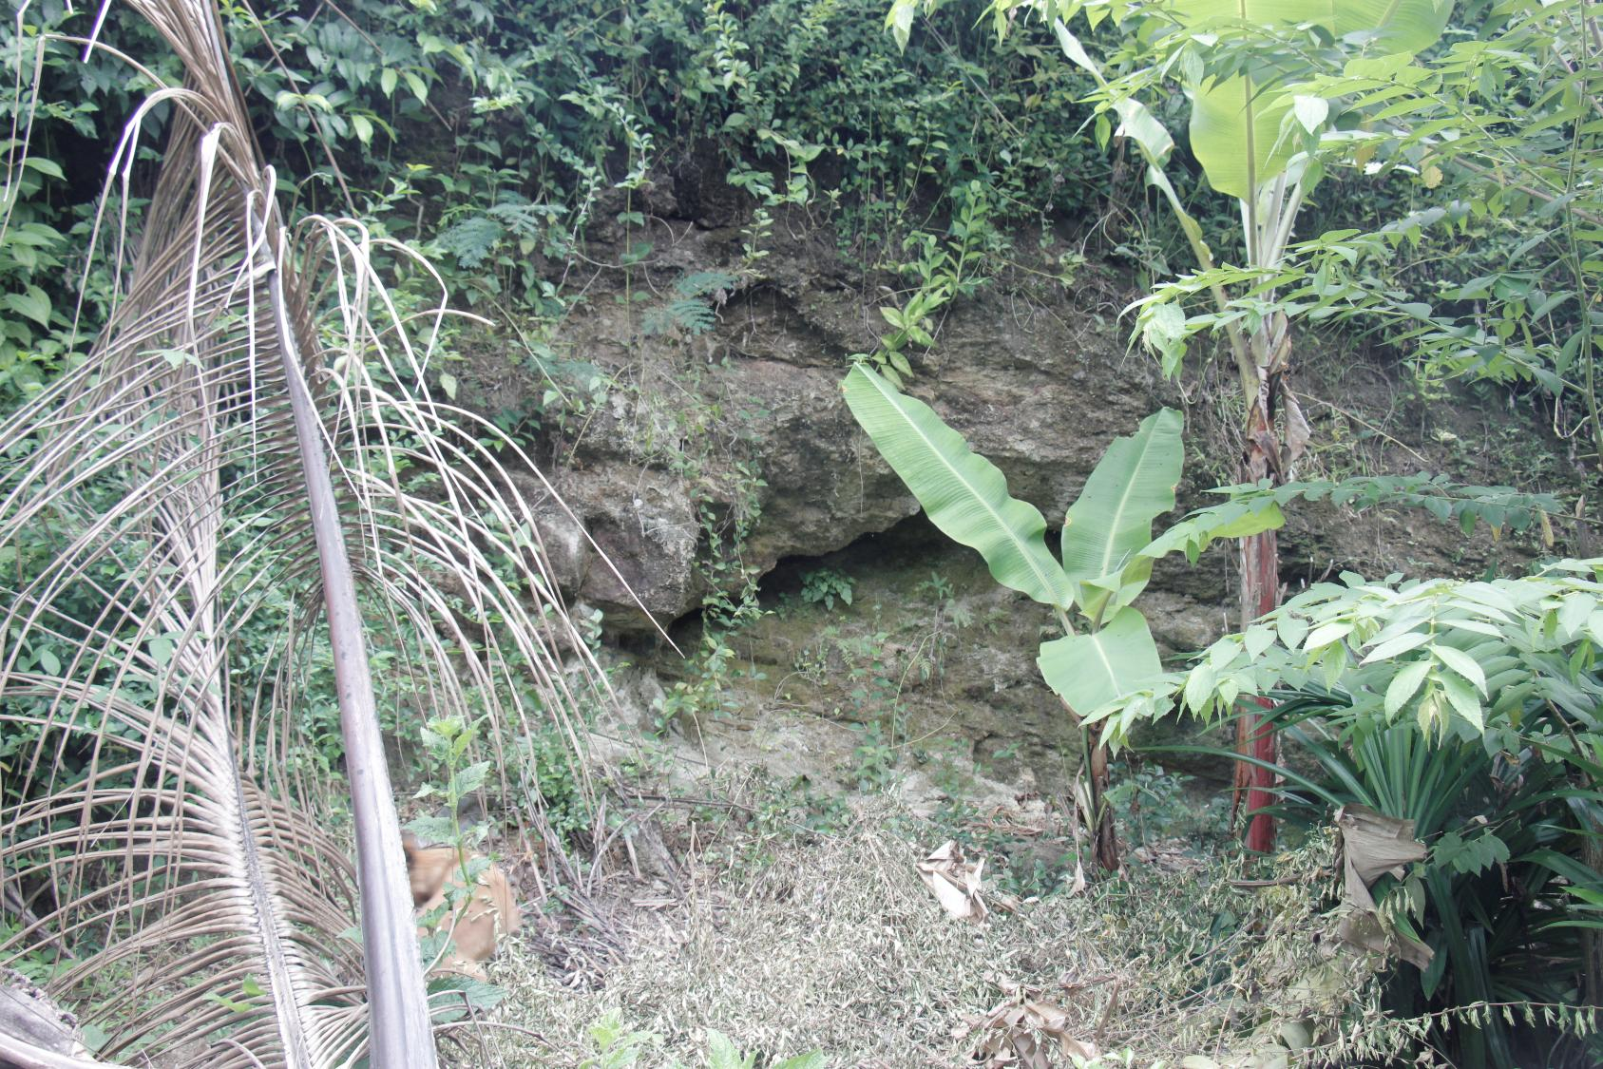
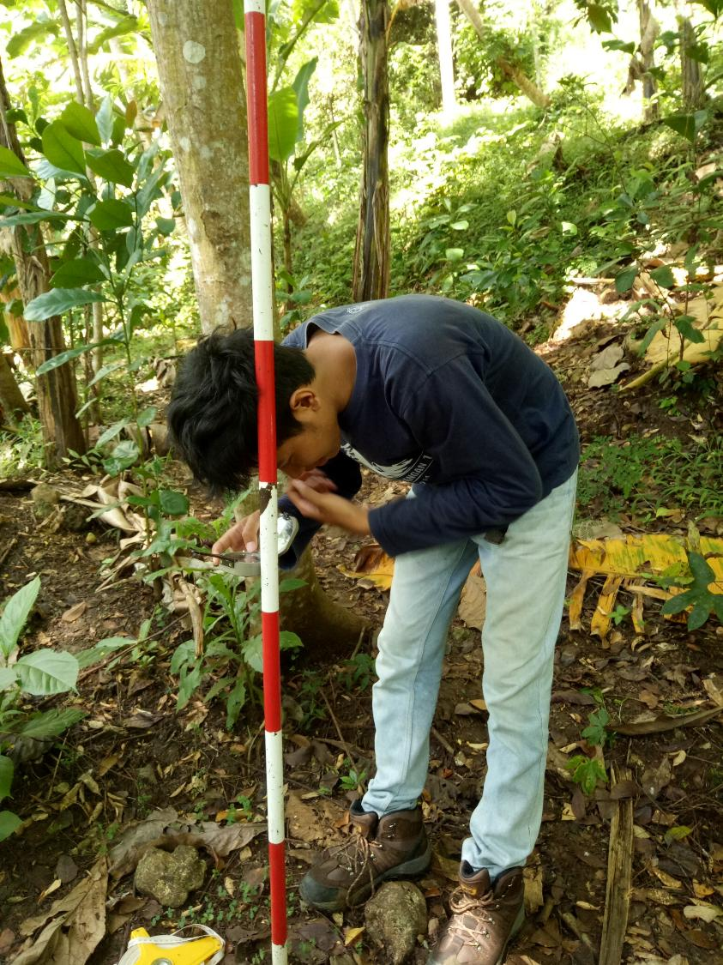
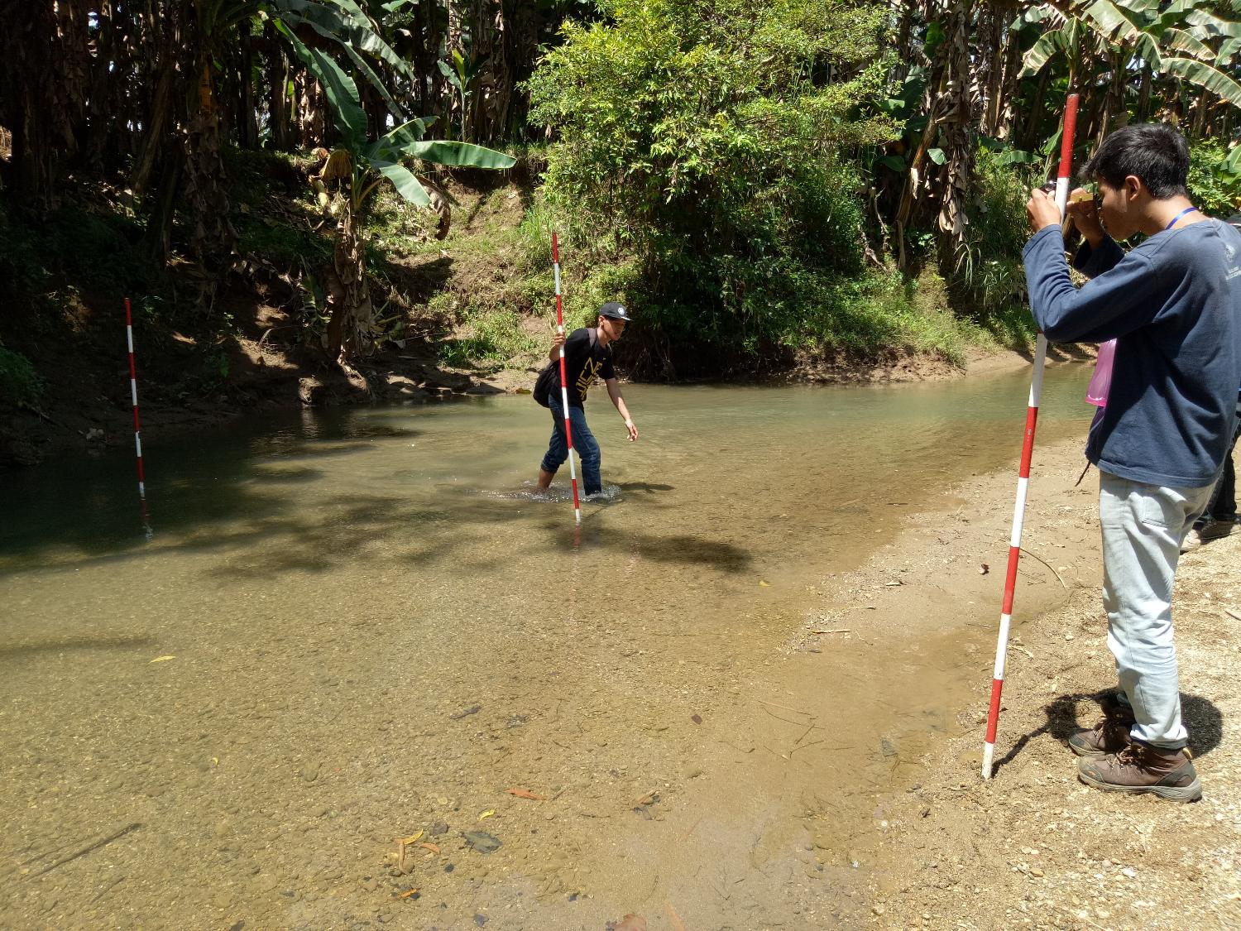
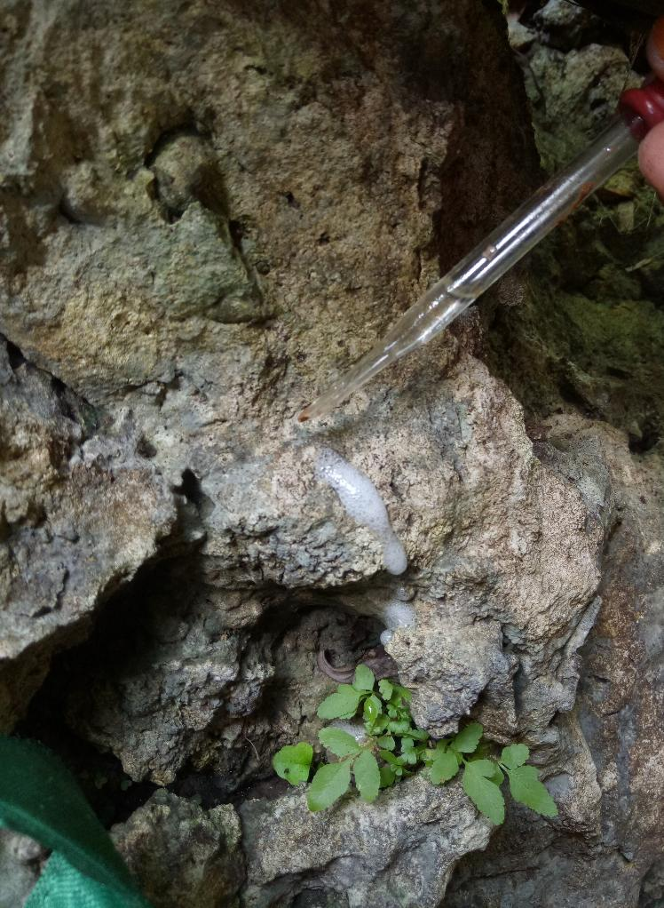
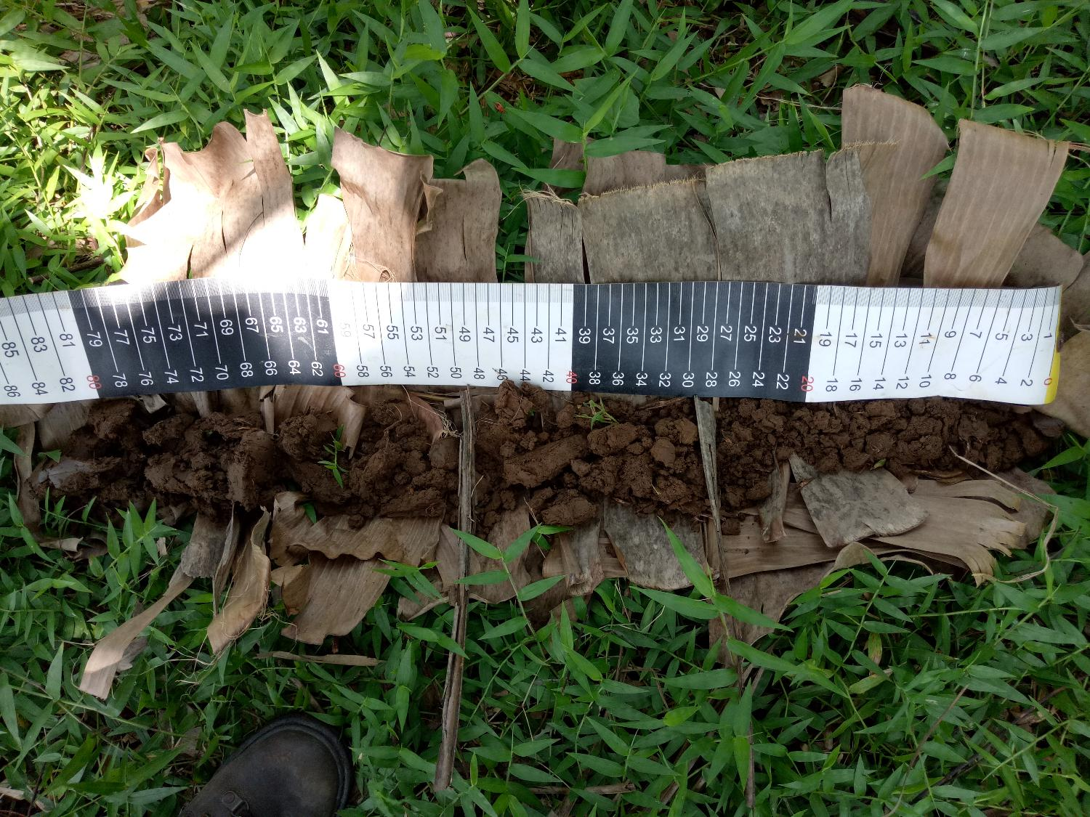

Slide 11
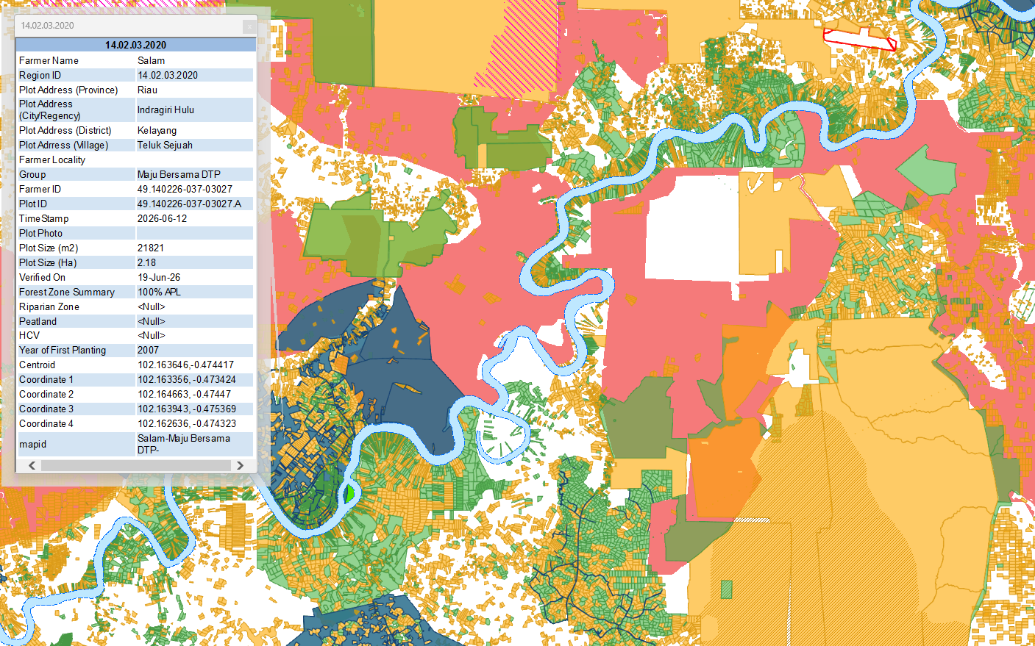
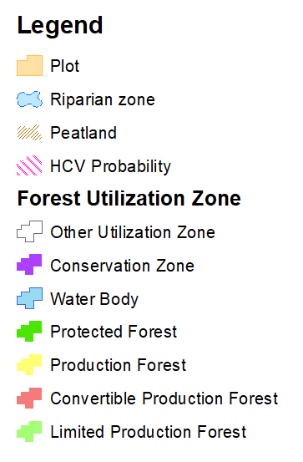
0
0
0

Slide 12
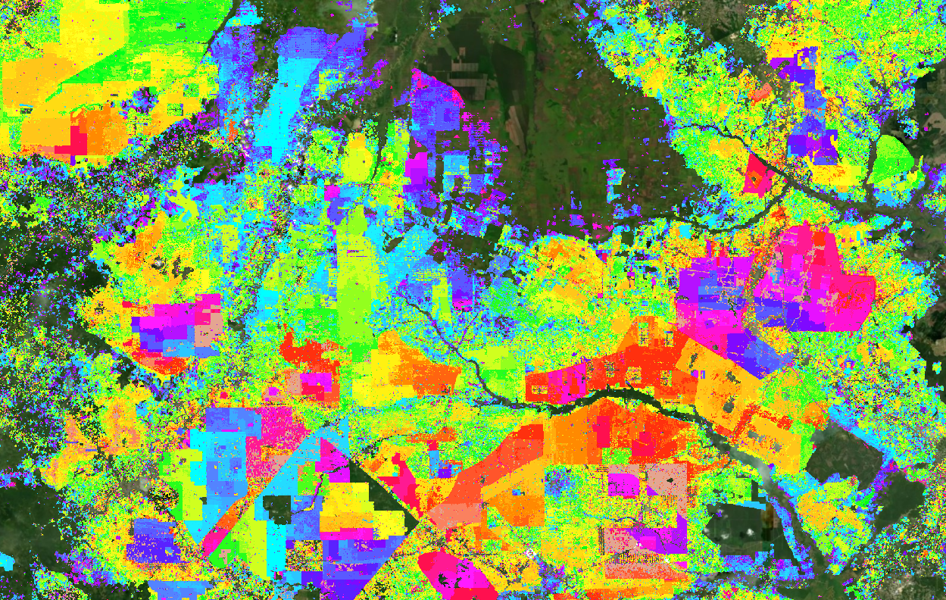
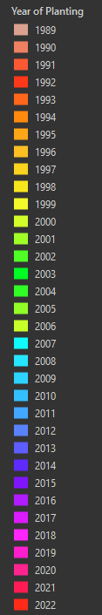

Slide 13
