Slide 1
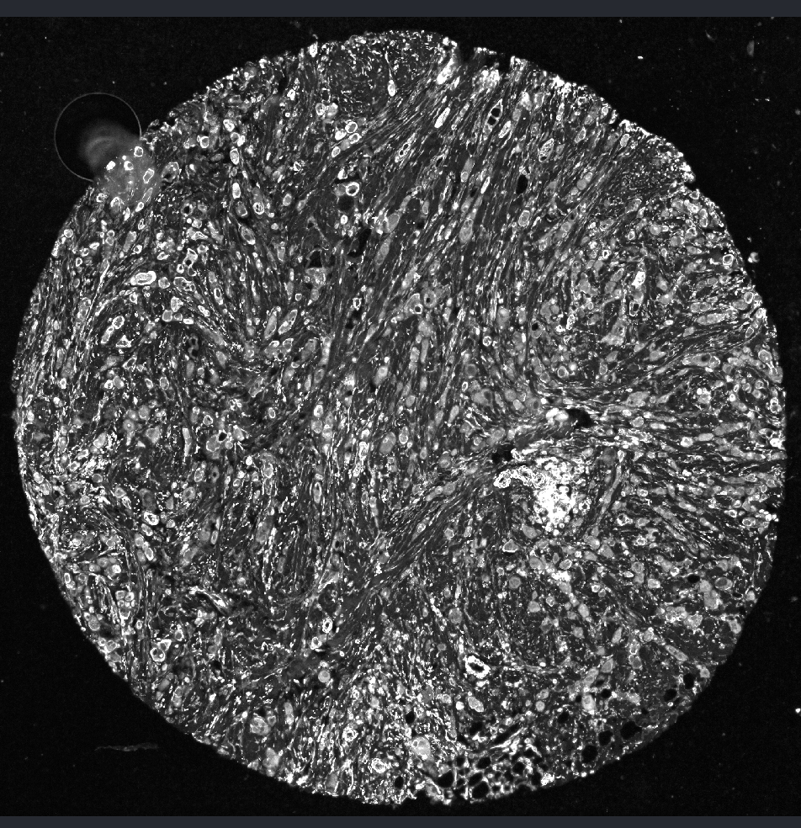
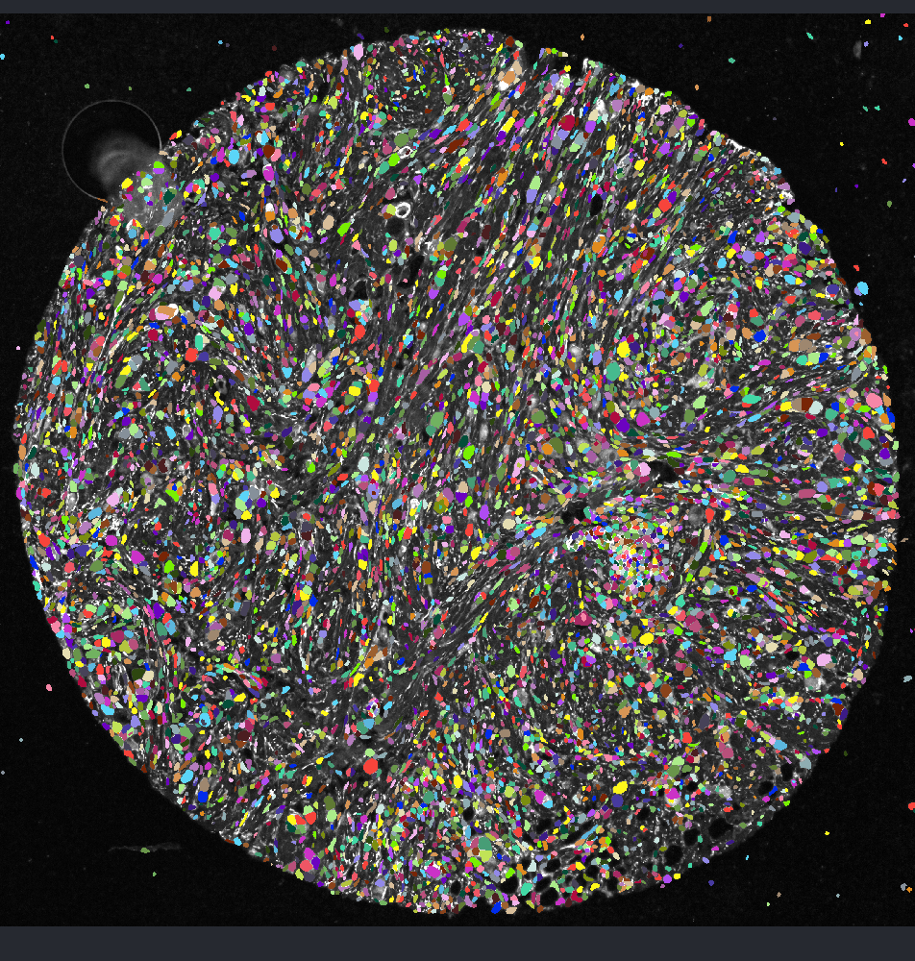
Building a pipeline for analyzing HTAN mIF
1. Automated image quality QC
2. Segmentation (both nucleus and whole cell for all cell types)
3. Automated segmentation QC
4. Quantification and analyze
1. Run a quick diagnostic tool on image metrics:
Low percentile intensity
Signal to noise ratio
Dynamic Range
Coefficient variance of background
2. Testing AI tool on images to detect artifact using QUALIFAI (very slow)
Instaseg
Whole cell segmentation: max projection panCK, aSMA, CD45, Vim (if possible) since biomarkers are varied for each file
Currently manual QC
Haven’t worked on this
Normalize feature expression using UNIFORM
Composition membrane cytoplasm markers (panCK, CD45 and aSMA or Vinmentin )
Whole cell segmentation

Slide 2
Computational
1. Automated image quality QC
Updated: Detecting regions of lost and fold tissue
Step 0: Load reference + candidate round, whole-image gate
Global_disagreement() computes 1 - NCC (normalized cross-correlation) over all foreground pixels at once (foreground defined by an Otsu threshold on the reference image –round1)
If this whole-image disagreement exceeds GLOBAL_DISAGREE_THRESHOLD (0.7), the round is marked registration_failed
Step 1: Per-tile disagreement (tile_disagreement)
The image is split into a grid of tile × tile pixel blocks.
For each tile:
Foreground check: skip tiles where less than min_foreground (5%) of pixels exceed the Otsu threshold — too little tissue to judge.
NCC per tile: same 1 - NCC calculation as the global check, but restricted to this one tile → disagree[r,c].
Signed intensity change: dmean[r,c] = mean(tile_b) - mean(tile_a) — the sign distinguishes gain vs. loss (positive = round B brighter than reference → potential fold/doubled tissue; negative = round B dimmer → potential tissue loss).
Step 2: Flagging (flag_folds)
Tiles are flagged as outliers using robust statistics (median + k·MAD, not mean/std computed from that round's own valid tile disagreement values. A tile is flagged if:
disagree is a spatial outlier (> median + k·MAD), AND
split by the sign of dmean:
dmean > 0 → fold candidate (fold_tile)
dmean < 0 → lost tissue (lose_tile)
Step 3: Export for downstream use
get_flagged_tile_bounds() converts each flagged (row, col) tile into a pixel bounding box (x0,y0,x1,y1), used later to exclude cells whose centroids fall inside.
get_qc_record() summarizes the round: flagged-tile ratio (denominator = only tissue-containing tiles, not background), plus a warning field escalating from PASS → Flag manually check (ratio > 10%) → Majority is lost/fold - Manual review (whole-round registration failure).
plot_flagged_tiles() renders a magenta/green merge (reference vs. candidate round) with red/white rectangles marking lost/fold tiles respectively, for visual QC.
1. Run a quick diagnostic tool on image metrics:
Low percentile intensity
Signal to noise ratio
Dynamic Range
Coefficient variance of background
2. Testing AI tool on images to detect artifact using QUALIFAI (very slow)
- Pros: Already the have weight files and validate DL model that works for specific artifacts (air bubble, tissue fold, autofluoresence)
mIF datasets
- Cons: very slow on bad staining images (200 mins)
Good staining image (50 mins)

Slide 3
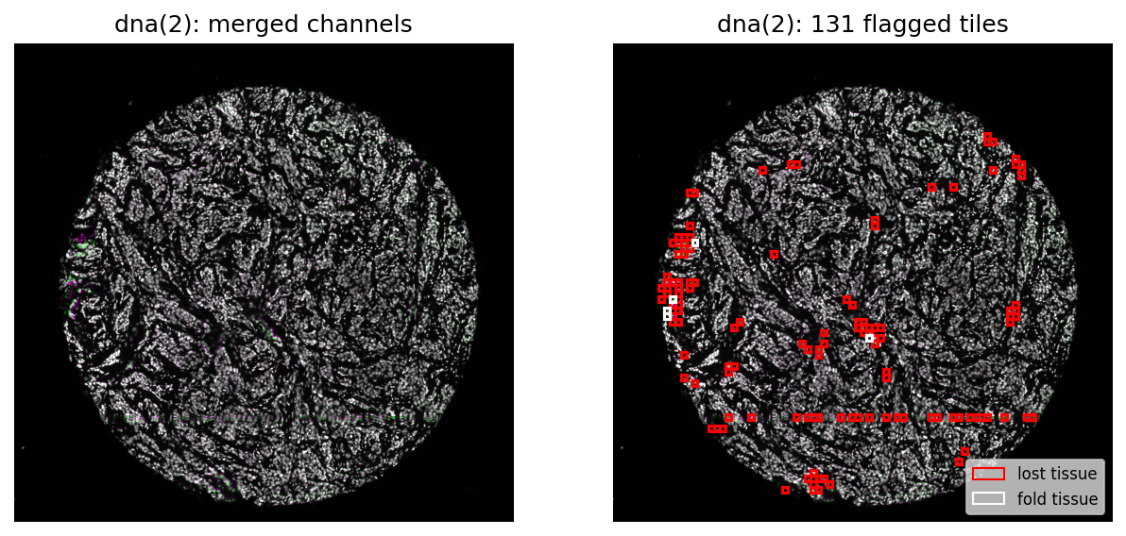
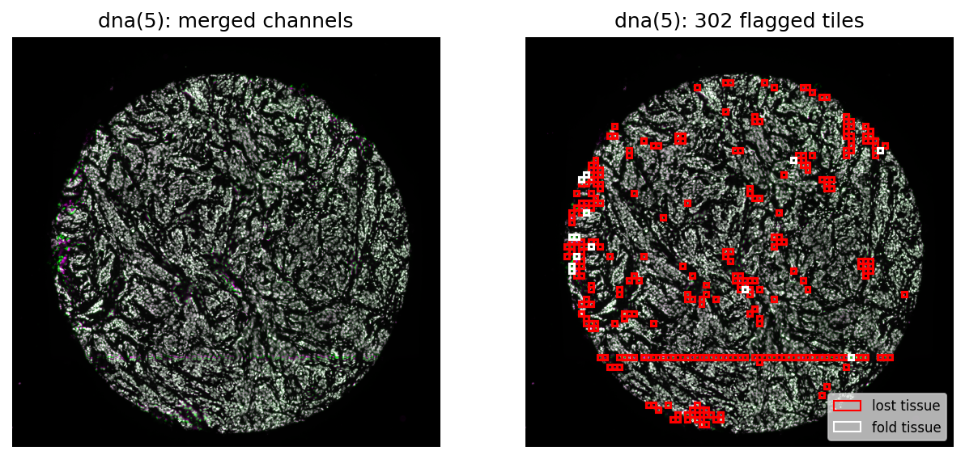
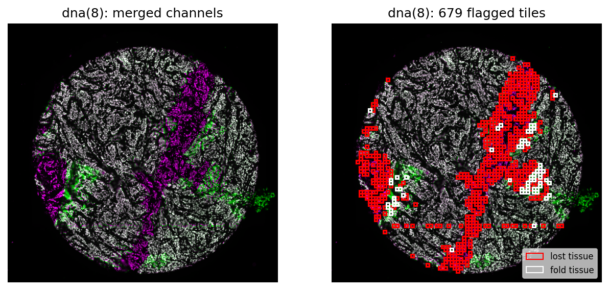
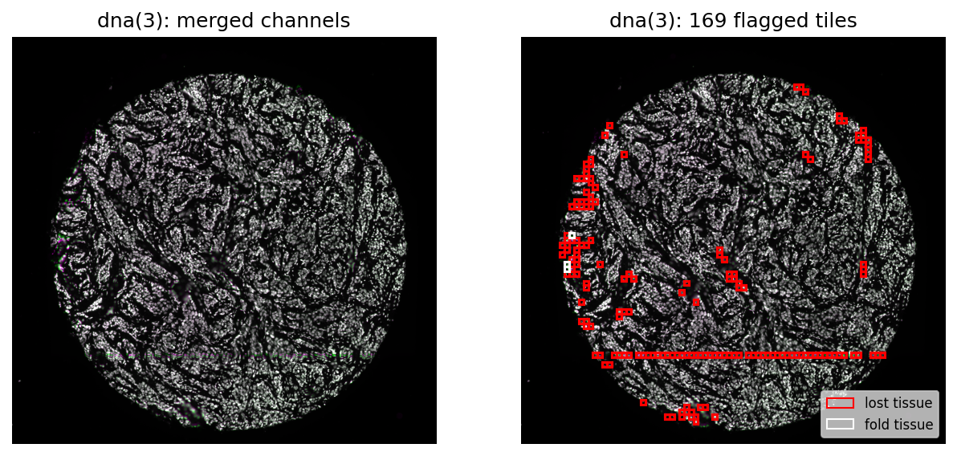

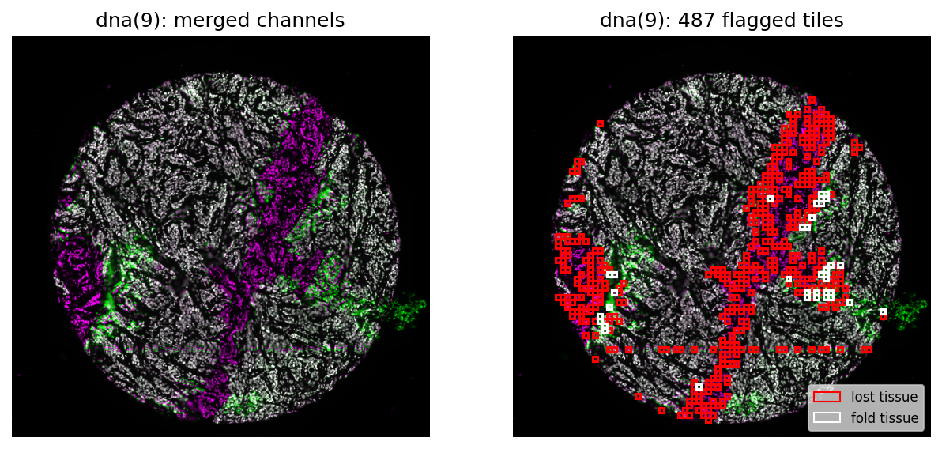
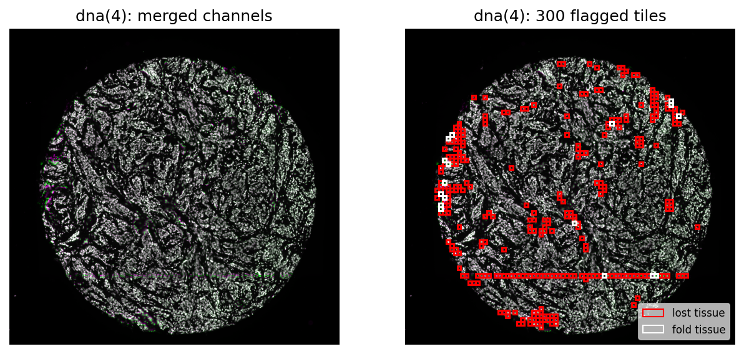
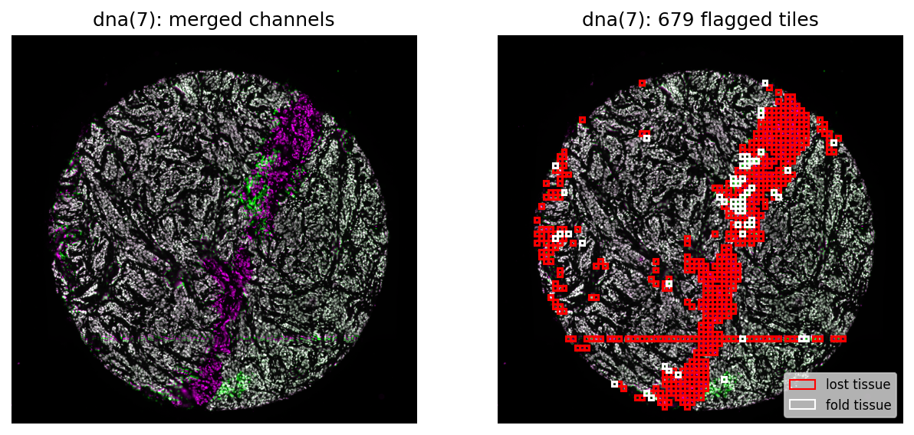
Examples – HTAN (LSP1201-C10)
Merged
Flagged tiles
Merged
Flagged tiles
Merged
Flagged tiles

Slide 4
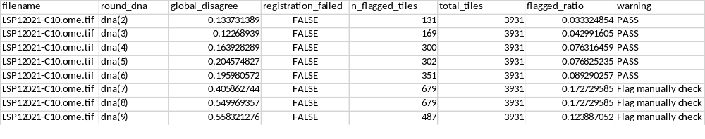
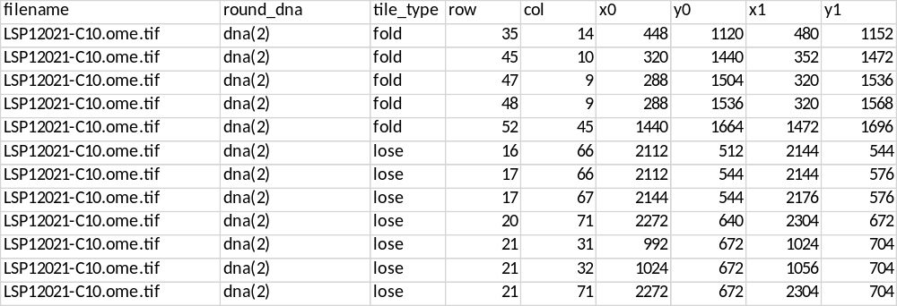
Examples – HTAN (LSP1201-C10)
get_qc_record()
get_flagged_tile_bounds()

Slide 5
1. Automated image quality QC
2. Segmentation (both nucleus and whole cell for all cell types)
3. Automated segmentation QC
4. Quantification and analyze
1. Run a quick diagnostic tool on image metrics:
Low percentile intensity
Signal to noise ratio
Dynamic Range
Coefficient variance of background
Detecting lost/fold regions
Instaseg
Whole cell segmentation: max projection panCK, aSMA, CD45, Vim (if possible) since biomarkers are varied for each file
Mark cells that are the in lost or fold regions as NaN after quantification
Whole cell segmentation
Finished (~ 20 mins -1 hour)
HTAN:
704 NST samples
147 ILC samples

Slide 6
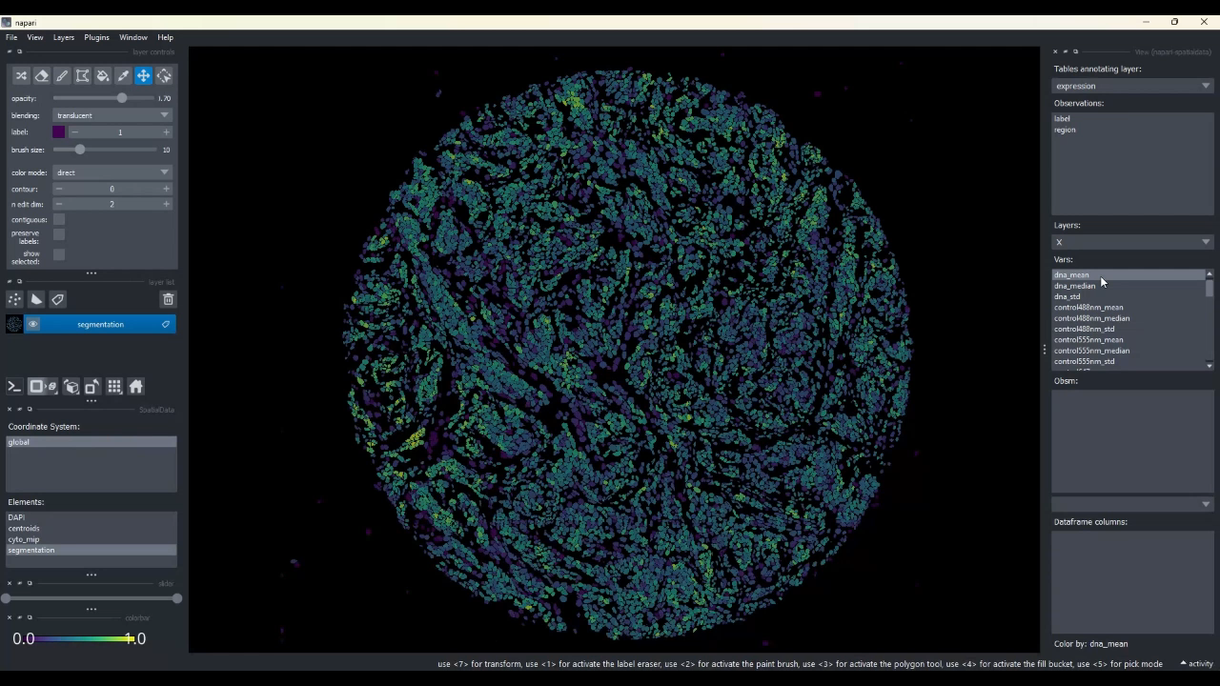
Examples – HTAN (LSP1201-C10)

Slide 8
Computational
1. Automated image quality QC
2. Segmentation (both nucleus and whole cell for all cell types)
3. Automated segmentation QC
4. Quantification and analyze
1. Run a quick diagnostic tool on image metrics:
Low percentile intensity
Signal to noise ratio
Dynamic Range
Coefficient variance of background
Detecting lost/fold regions
Instaseg
Whole cell segmentation: max projection panCK, aSMA, CD45, Vim (if possible) since biomarkers are varied for each file
Mark cells that are the in lost or fold regions as NaN after quantification
Finished (~ 20 mins -1 hour)
704 NST samples
147 ILC samples

Slide 10
Examples – HTAN (LSP1201-C10)
Merged
Flagged tiles
Merged
Flagged tiles
Merged
Flagged tiles

