Slide 1
HPAanalyze at CRUG Hacktoberfest
Anh Tran

Slide 2
The Why of this package
The Human Protein Atlas (HPA) maps human proteins via multiple technologies.
Beautiful web portal, but certain aspects of data retrieval and analysis left something to be desired.

Slide 3
The real Why of this package
I had just learned R (in 2017).
My PhD mentor was overly excited to see some EDA I did with HPA data and suggested that I wrote a software package.
… she meant an iPhone app.
I wrote this package to learn how R worked.

Slide 4
Installation
devtools::install_github("trannhatanh89/HPAanalyze")

Slide 5
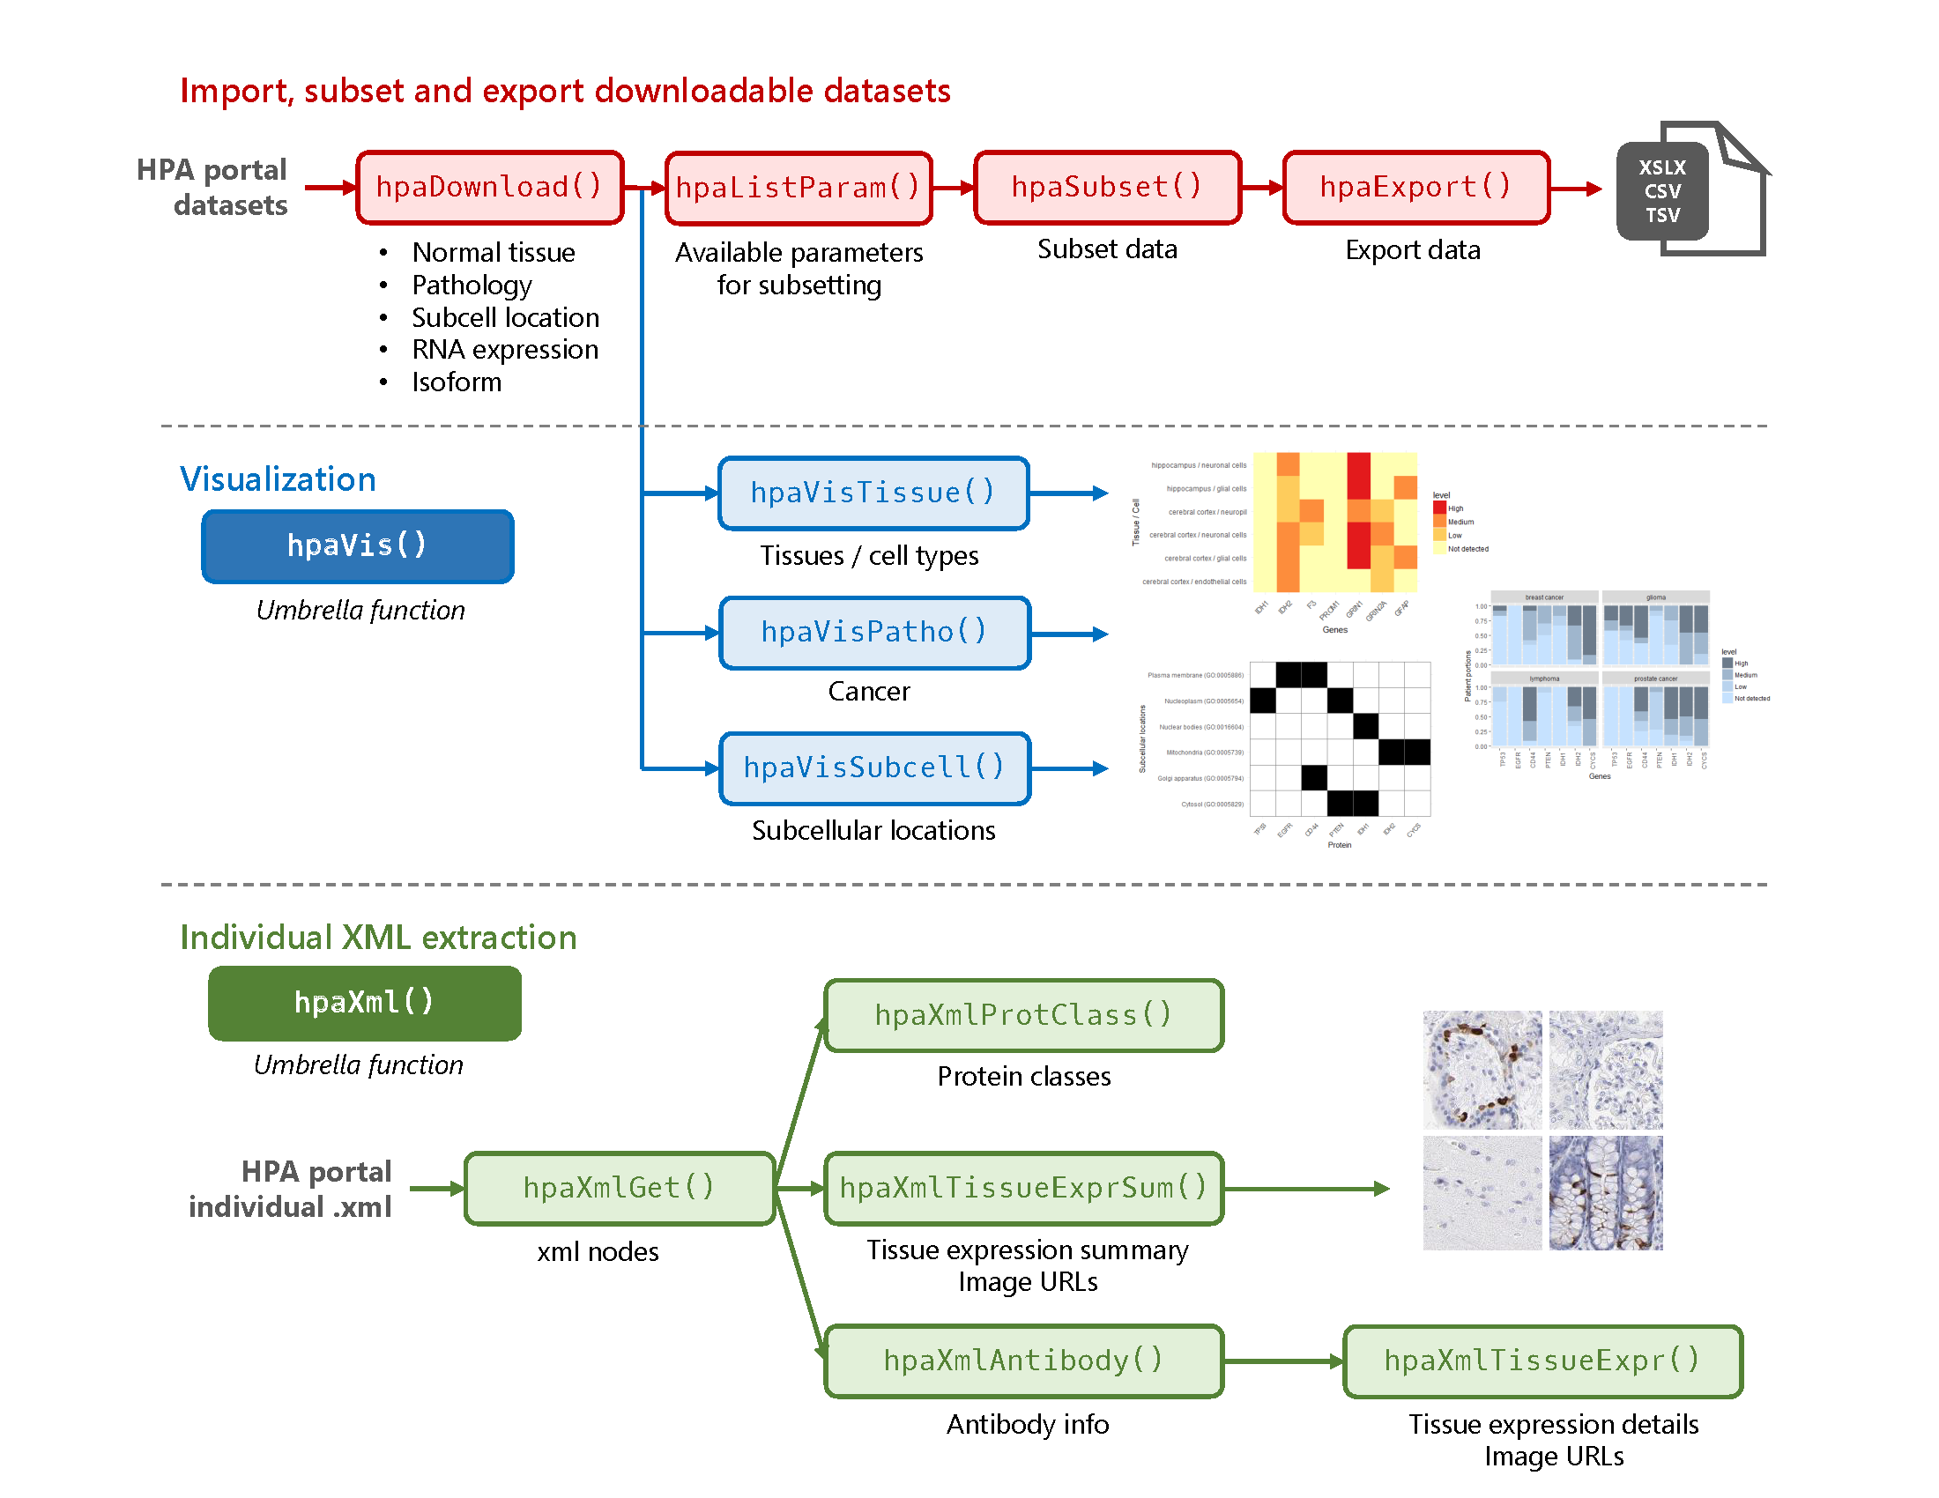
Basic workflow

Slide 6
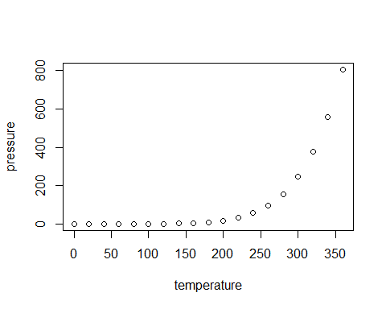
Slide with Plot

