Slide 1
Data analysis for a local non-profit addressing the mental health treatment of incarcerated individuals.
Anh Tran
(trannhatanh89@gmail.com)
CRUG Lightning Talk
June 16, 2021

Slide 2

Why?
Illinois Department of Corrections (IDOC) punishes prisoners with mental illness.
In 2017, the federal court monitor found that the IDOC s psychiatric care as “grossly insufficient” and “extremely poor” in quality, declared that psychiatric care in Illinois prisons is in a “state of emergency.”
Insufficient number of psychiatric staff, enormous backlogs in psychiatric evaluations, and a significant deterioration of mental health for prisoners in solitary confinement.
https://www.uplcchicago.org/what-we-do/prison/

Slide 3
The data
Prison
Jan 2020
Crisis.xlsx
Prison
Feb 2020
Prison
Mar 2020
MHP.xlsx
Prison
Apr 2020
0550.xlsx
…
Prison
Psych.xlsx
Prison
Jan 2021
Prison
Feb 2021
Referral.xlsx
Prison
Mar 2021
…
…
Prison stock.xlsx

Slide 4
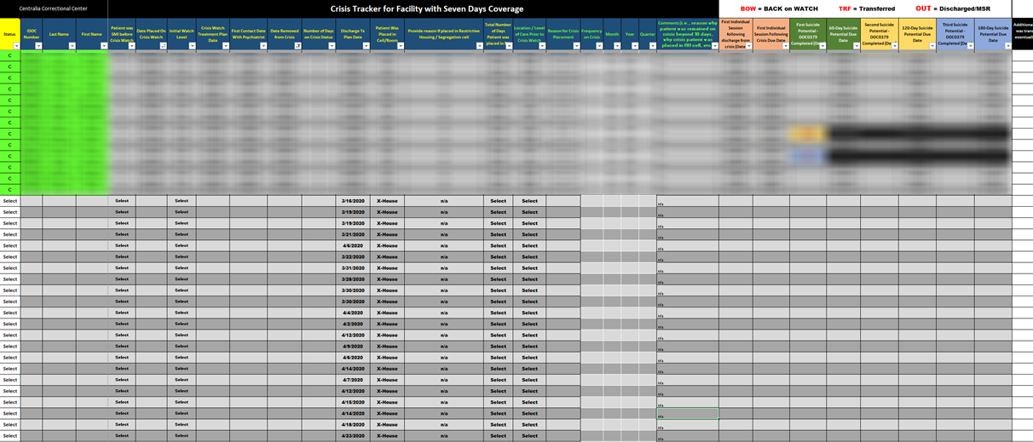
Cleaning data: crisis.xlsx

Slide 5
Cleaning data: crisis.xlsx
crisis_import <- function(file, folder) {
cat(paste0("\n", file, "\n"))
read_csv(
file = paste0("data/", folder, "/crisis/", file),
col_types = cols(.default = "c"),
skip = 1
) %>%
rename(idoc = `IDOC Number`) %>%
janitor::clean_names() %>%
filter(!is.na(idoc)) %>%
mutate(facility = file)
}
Manually convert to csv
read_csv
Clean names with janitor
Filter out rows without actual data
d2021_03$crisis <-
lapply(list.files("data/2021-03/crisis")[!grepl(".xlsx$", list.files("data/2021-03/crisis"))],
crisis_import, folder = "2021-03") %>%
bind_rows() %>%
mutate_at(c(
"date_placed_on_crisis_watch",
"crisis_watch_treatment_plan_date“),mdy) %>%
mutate_at(c(
"number_of_days_on_crisis_status",
"frequency_on_crisis",
"year",
"quarter"), as.numeric)
Loop through the folder and import into a list
bind_rows
Correct the column type with mutate_at

Slide 6
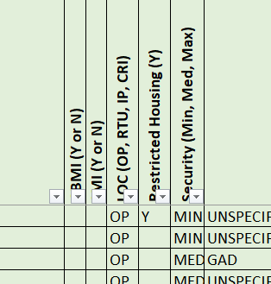
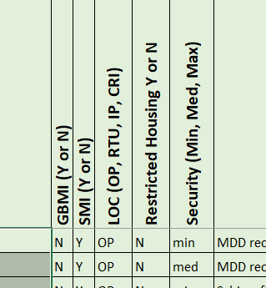
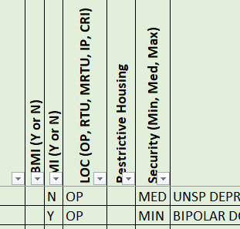
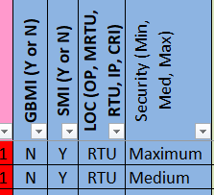
Cleaning data: mhp.xlsx, psych.xlsx

Slide 7
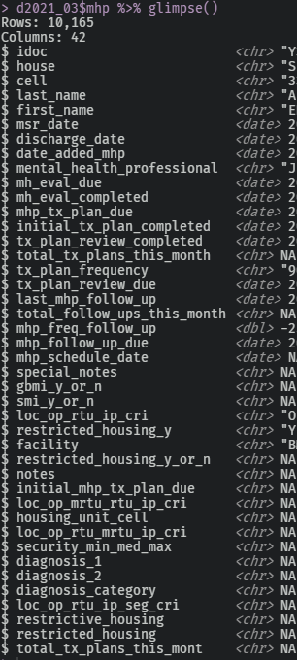
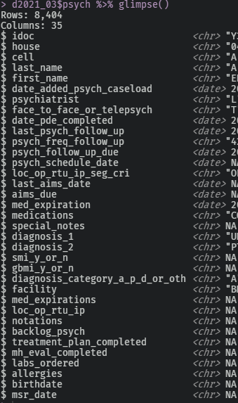
Cleaning data: mhp.xlsx, psych.xlsx

Slide 8
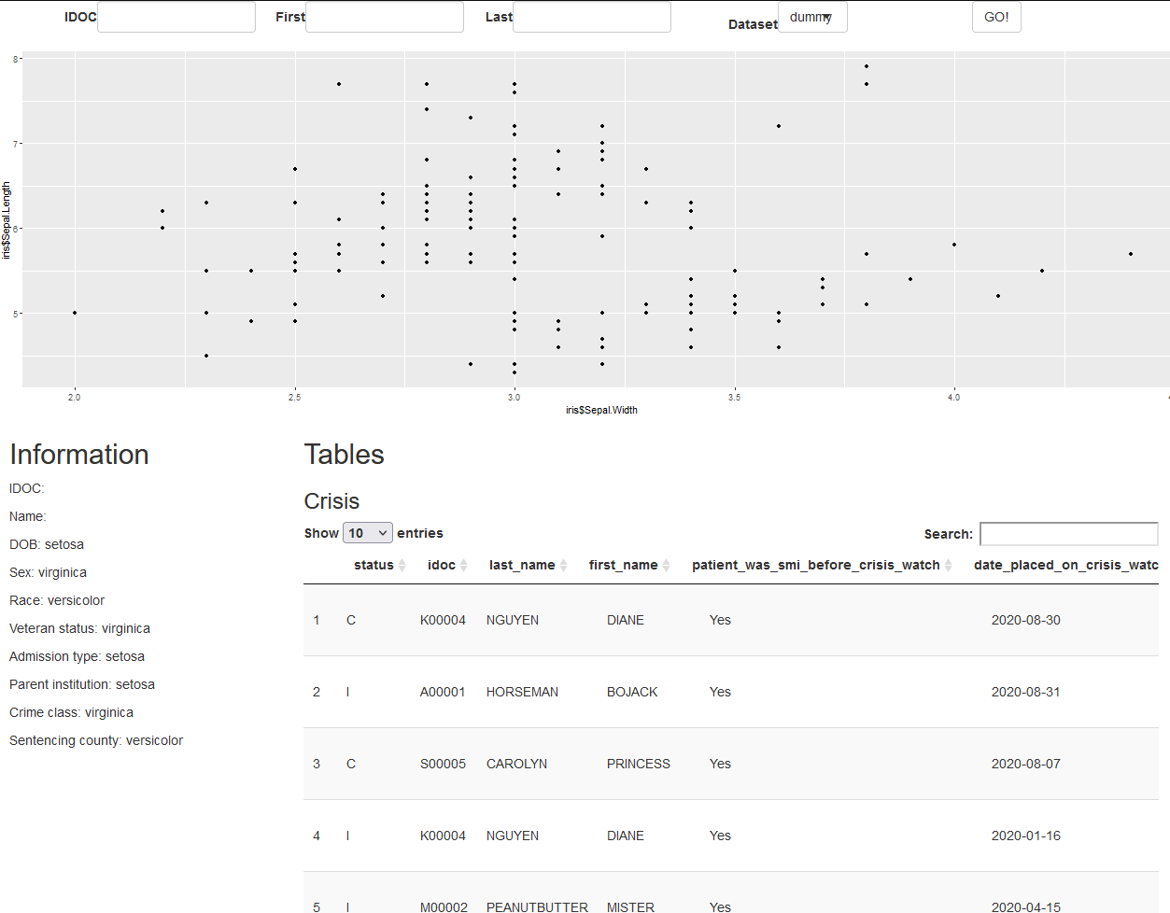
Shiny App

