Slide 1


Writing a (very niche) R package for reproducible data analysis from a public dataset
Anh N. Tran
Postdoc at Northwestern U.
@anh_n_tran
trannhatanh89
SatRday Chicago, April 27, 2019

Slide 2
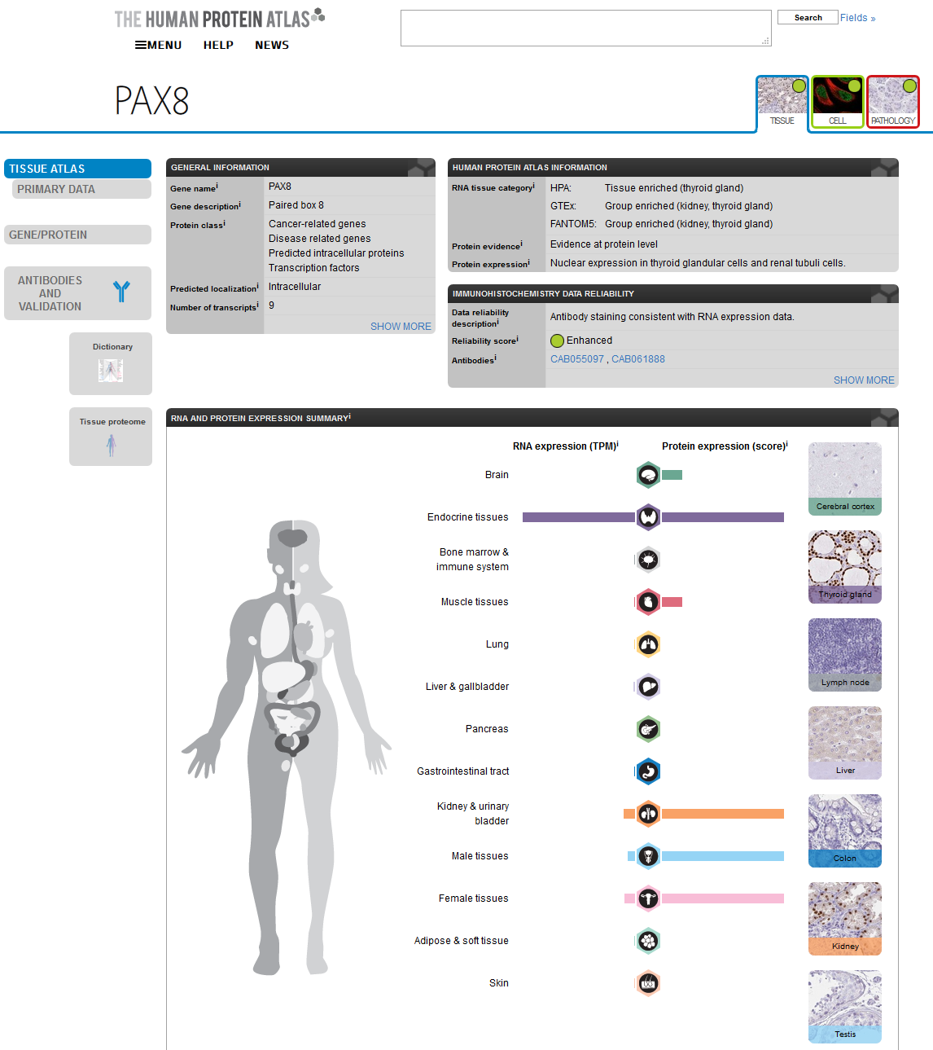

Slide 3
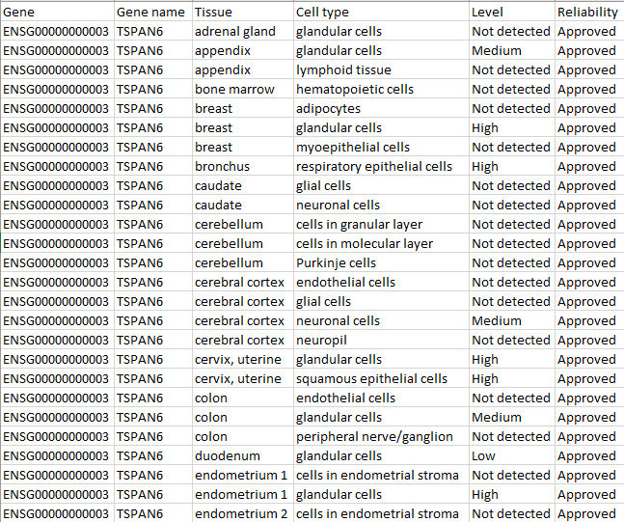
Summarized data provided as .tsv

Slide 4
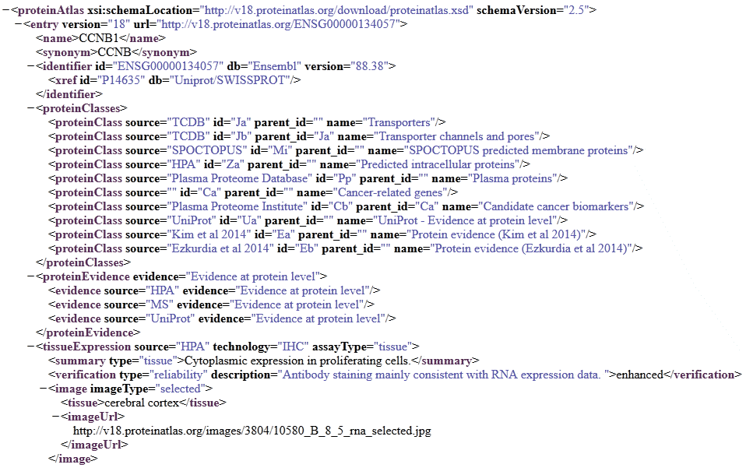


Full datasets provided as .xml(s)
xml2

Slide 5
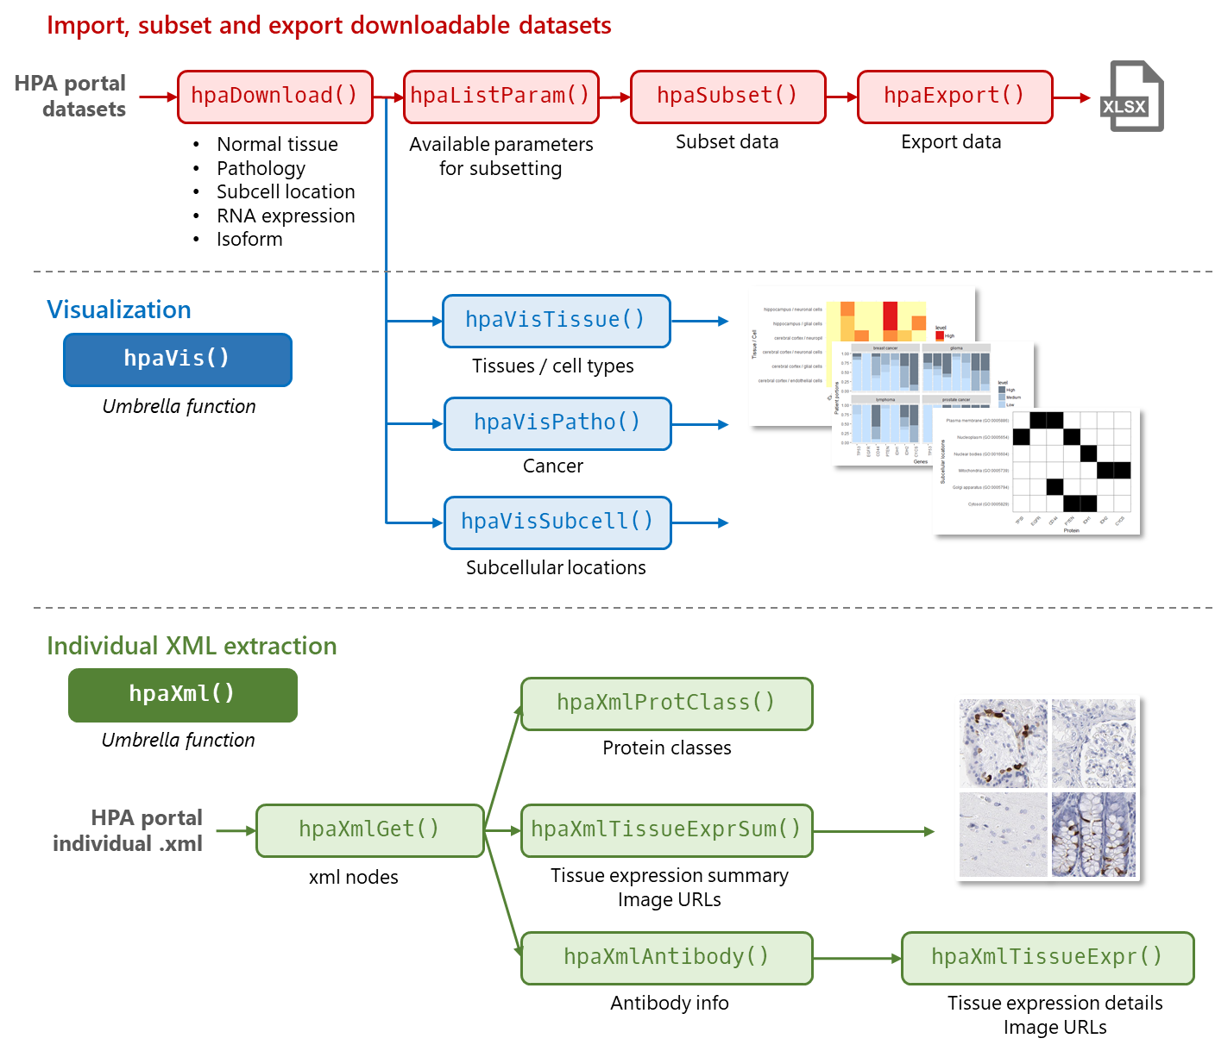

Slide 6
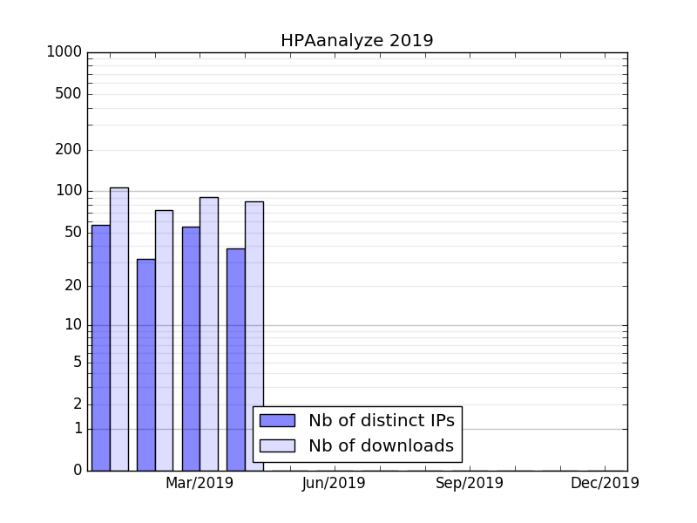
You’re welcome, my 50 users!

