Slide 1

SWP391: Final Project Presentation
<<Project/Product Name + Code>>

Slide 2
Project Overview
Provide brief information about:
Product introduction & Scope
Project team members
How does team manage project?
Project communication: meeting, task assignment,..
Project issue tracking: requirements, tasks, Q&A,…

Slide 3
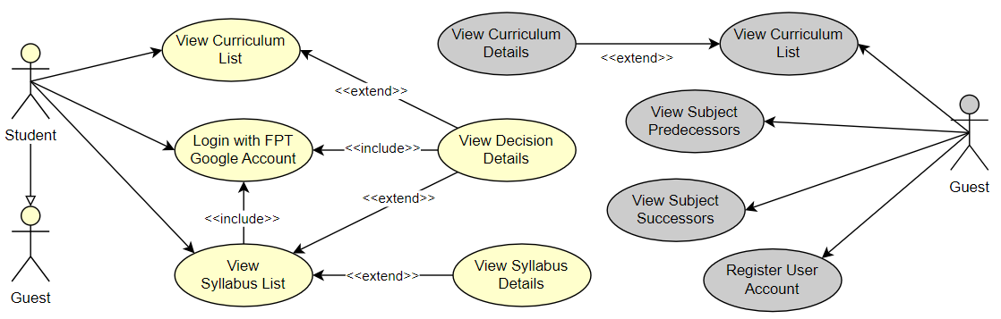
Product Requirements Use Case Diagrams
Provide use case diagrams for the use cases that you have completed in the project.
You can provide in one or multiple diagrams here (preferred to have one diagram for each product actor)

Slide 4
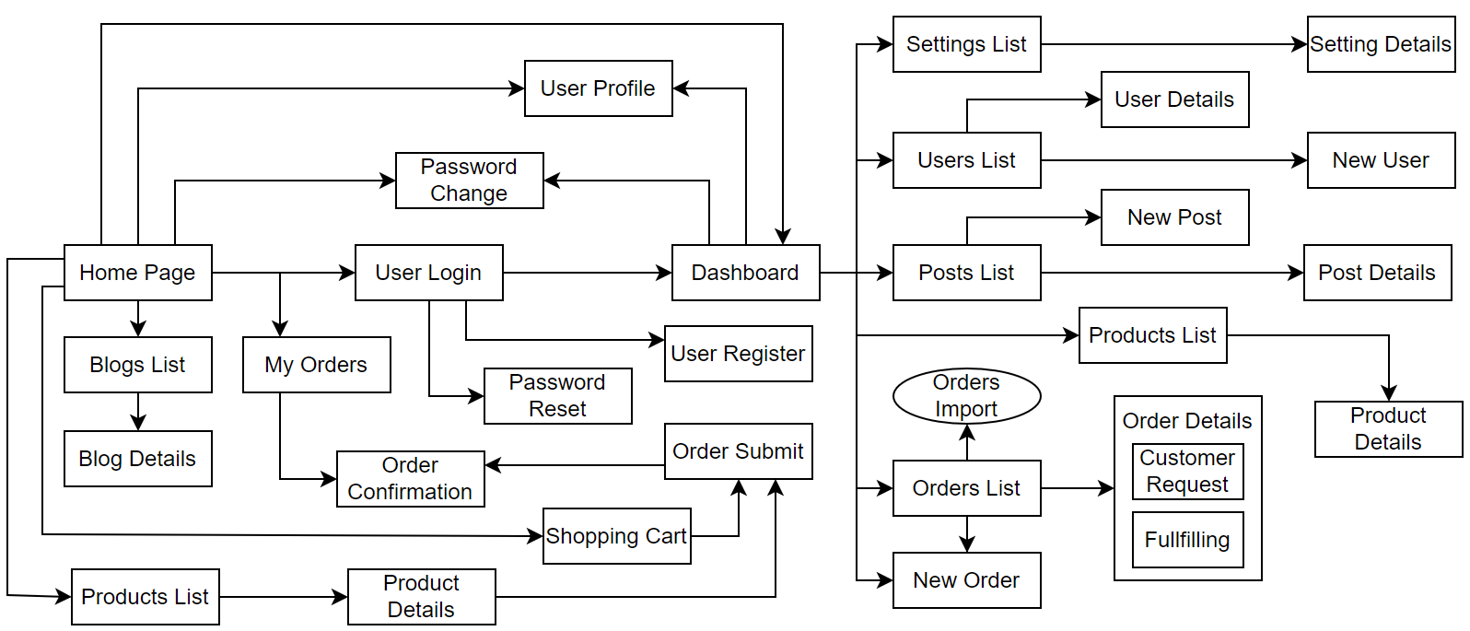
Product Requirements Product Functionalities
Provide product functionalities that you have completed in the project in the forms of
Screen flow for all the screens (see sample below)
List of NonUI functions (if any)

Slide 5
Product Requirements Main Screen UI Design
Provide screenshot(s) for the main screens that you have completed
Main Web screen: Home Page or Landing Page
Main Admin screen: Dashboard (if any)

Slide 6
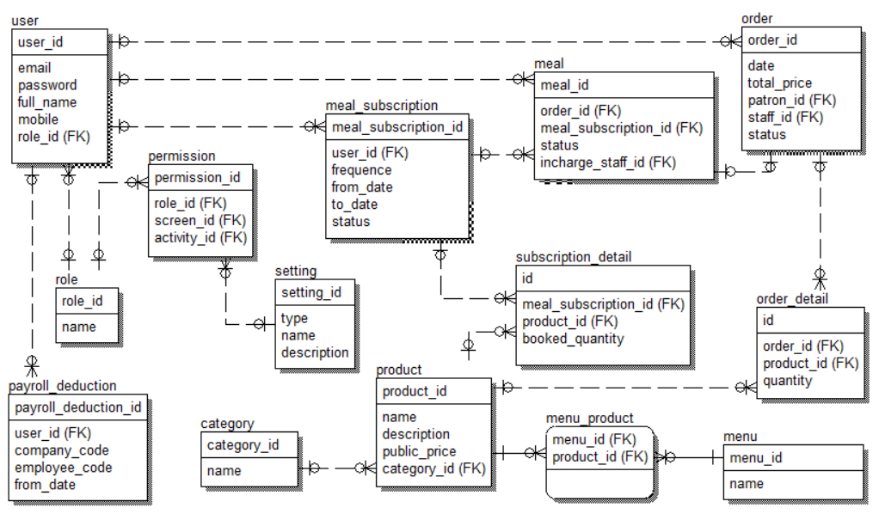
System Design Database Design
Provide database schema here..

Slide 7
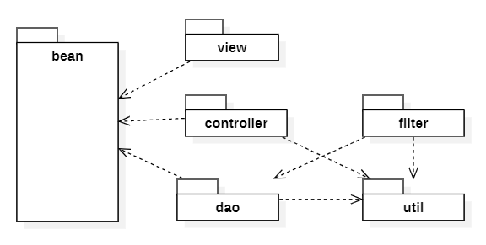
System Design Package Diagram
Provide system package diagram here..

Slide 8
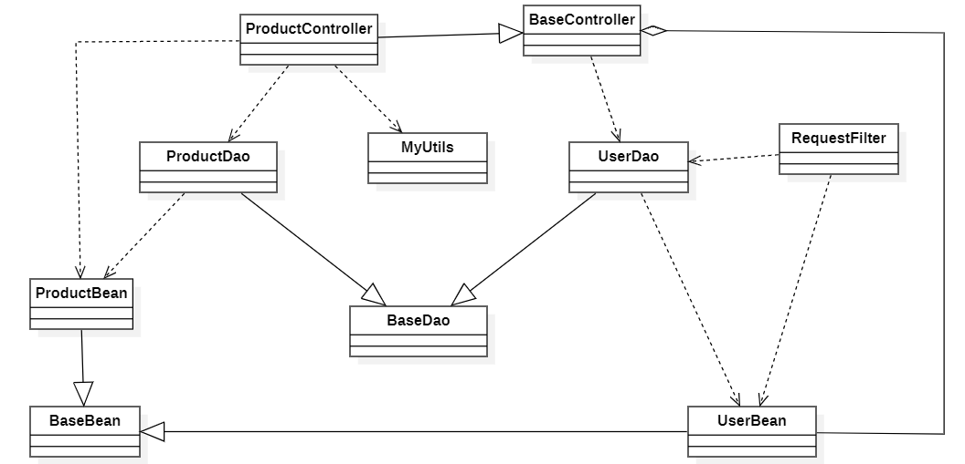
System Design Class Diagram
Provide the best class diagram that your team has designed in the project

Slide 9
System Design Class Diagram
Sequence Diagram

Slide 10
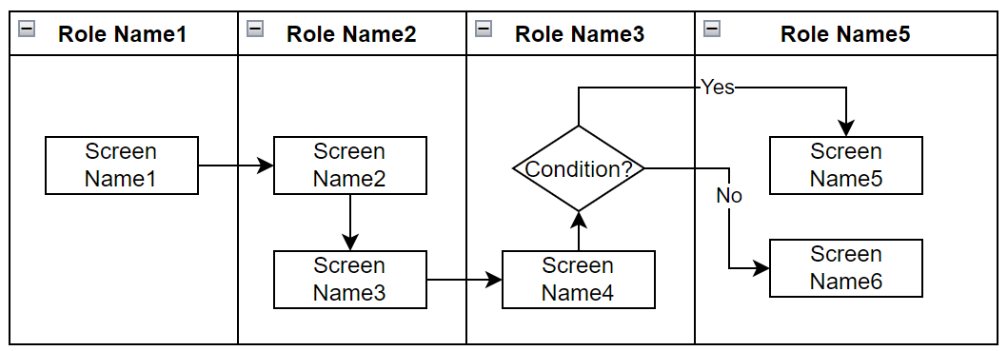
Demonstration
Provide the main workflow(s) that you have completed here..
The workflows can be defined by
Main managing information/data entities
Product/system roles or actors
Each workflow is designed in the form of a swimlane diagram in which screens & actors/roles are included

Slide 11


