Slide 1
HƯỚNG DẪN THỰC HÀNH
Biên soạn và trình bày
Gv Lê Thanh Nhân
Programming in C#
Final Assignment

Slide 2
Đề bài
Create an application in C#:
    Adding new Pupil.
    Displaying all Information.
    Exit.

Slide 3
Đề bài
Person.cs
Creating abstract class named Person.
Creating abstract method named personalReport.

Slide 4
Đề bài
Pupils.cs
Creating class named Pupils.
That is subclass of Person class.
This class has some information:
  Use Properties with read and write on:
      private string name.
      private int age. (Accept value > 0 and <=18 only)
      private string nationality.
  Override methods personalReport.

Slide 5
Đề bài
PupilsManagement.cs
This class has some information:
    Declaring a delegate Display without any parameters.
    Declaring a generic List<Pupils>.
    Methods:
        addPupils(): Add new into list.
        showPupils(): Display information of all of Pupils in list.
        An error message is raised if no any pupils in list.

Slide 6
Đề bài
Application.cs
    Main in class has a user interface
    and execute program.
        Add new pupils.
        Display all information.
        Quit.
    Menu show user’s choice.
    Interact and display result.

Slide 7
Coding Person.cs
namespace finalReview
{
abstract class
{
public abstract void personalReport();
}
}
Person

Slide 8
Coding Pupils.cs
public string Nationality
{
get { return nationality; }
set { nationality = value; }
}
public string Name
{
get { return name; }
set { name = value; }
}
public int Age
{
get { return age; }
set
{
if((value > 0) && (value <= 18))
{
age = value;
}
}
}
private string name;
private int age;
private string nationality;
public override void personalReport()
{
Console.WriteLine(?, ?, ?);
}
namespace finalReview
{
class Pupils: Person
{
          Class data
          Properties
          Override method
}
}

Slide 9
Coding PupilsManagement.cs
namespace finalReview
{
public delegate void Display();
class PupilsManagement
{
List
Method addPupil
Method showPupils
}
}
Pupils pupil = new Pupils();
pupil.Name = Console.ReadLine();
pupil.Age = int.Parse(Console.ReadLine()); pupil.Nationality = Console.ReadLine();
list.Add(pupil);
if (list.Count > 0)
{
foreach (Pupils p in list)
{
p.personalReport();
}
}
else
{
Console.WriteLine("No pupil to display");
}
List<Pupils> list = new List<Pupils>();

Slide 10
Coding application.cs
Dispay insert, select;
insert = app.addPupils;
select = app.showPupils;
do
{
[ _ menu _ ]
case 1:
insert(); break;
case 2:
select(); break;
case 3:
Environment.Exit(0); break;
default:
…;
}while(true);
PupilsManagement app;
app = new PupilsManagement();
namespace finalReview
{
class Application
{
static void Main(string[] args)
{
PupilsManagement instance
Delegate instance
Calling method
menu
}
}
}

Slide 11
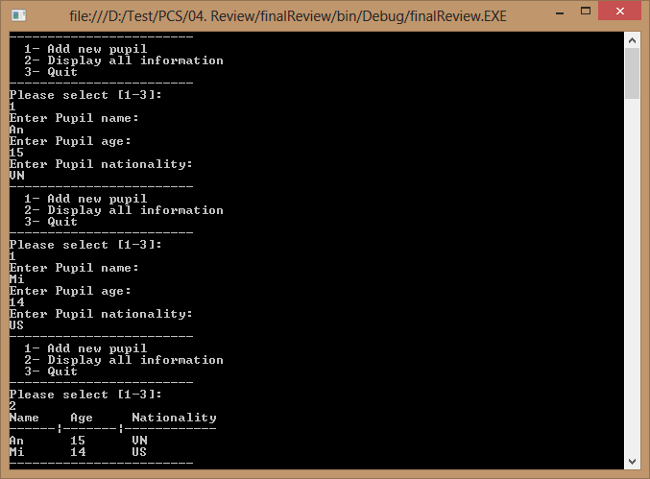

Slide 12

Chúc thành công

