Slide 1
Housing Price Prediction
Student Name: Doan Phuong Anh Tuan
Student ID: 105000184
Project Overview
-The goal is to predict house prices.
-Implemented an Artificial Neural Network (ANN) with Keras.
-Built a Flask web application for user-friendly predictions.
-Dataset contains information on house sales in King County, Washington, USA, including Seattle, covering homes sold between May 2014 and May 2015.

Slide 2
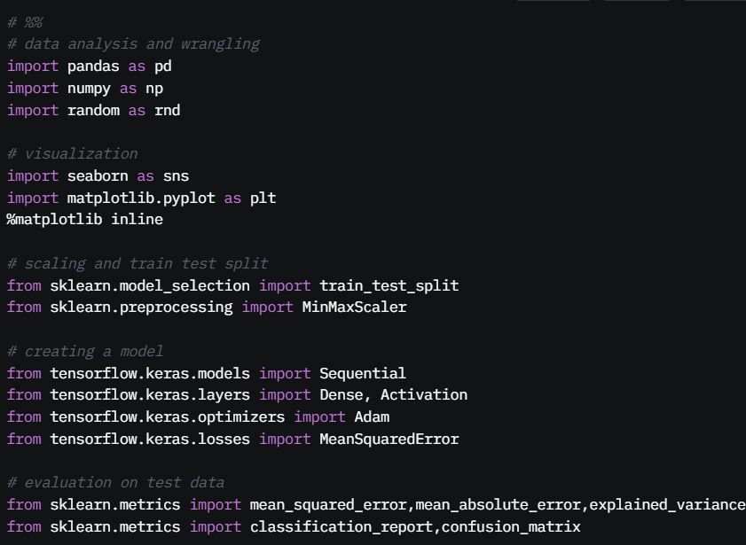
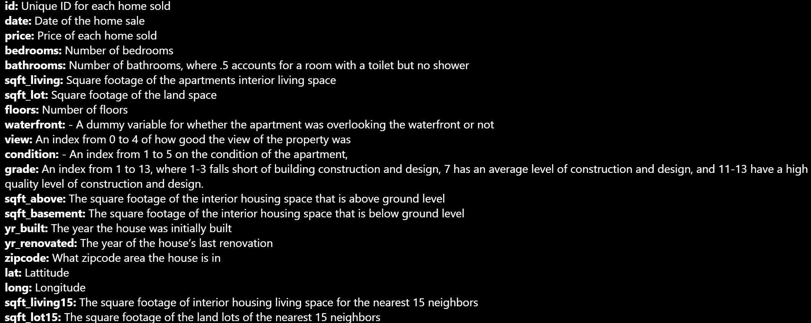
Dataset and Data Preprocessing
-Data prices from King County, includes features such as square footage, number of bedrooms, location, etc.

Slide 3
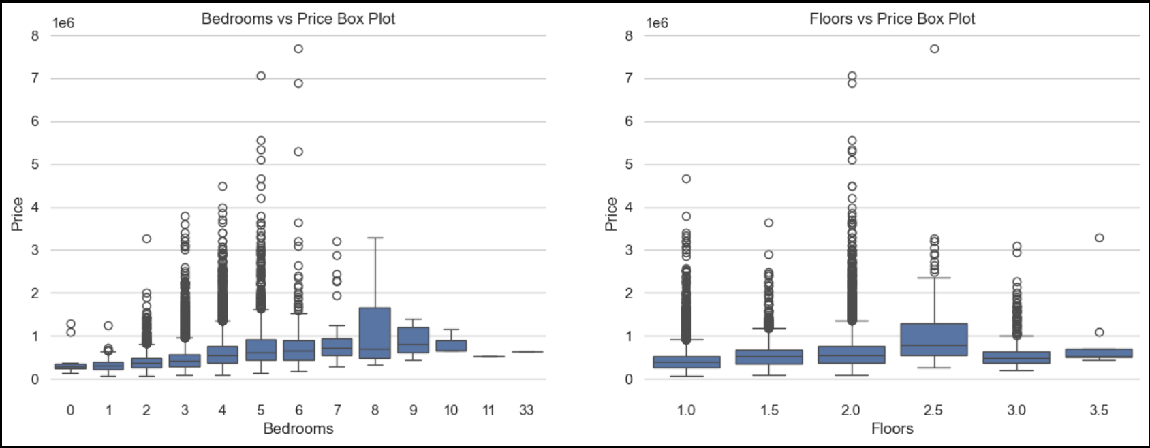
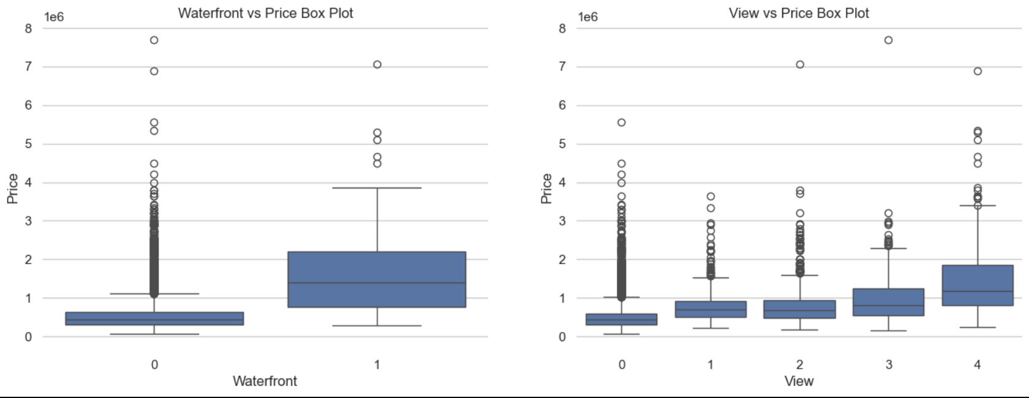
Exploratory Data Analysis
Box plot is a method for graphically depicting groups of numerical data through their quartiles. Box plots may also have lines extending from the boxes (whiskers) indicating variability outside the upper and lower quartiles, hence the terms box-and-whisker plot. Outliers may be plotted as individual points. The spacings between the different parts of the box indicate the degree of dispersion (spread). -We can see that the price tends to go up when the house has more bedrooms -Waterfront houses tends to have a better price value.
-Grade and waterfront effect price. View seem to effect less but it also has an effect on price.

Slide 4
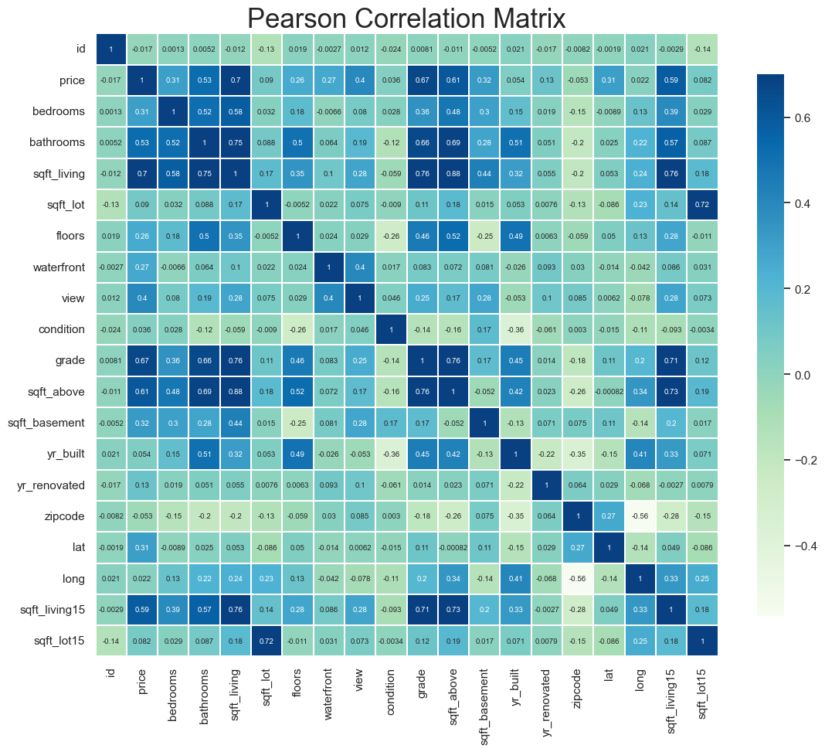
Exploratory Data Analysis
-Analyzed feature correlations with price.
-This allow us to explore labels that are highly correlated
to the price. -sqft_living looks like a highly correlated label
to the price, as well as grade, sqft_above, sqft_living15
and bathrooms.
-Removed irrelevant or highly correlated features to improve
model efficiency.

Slide 5
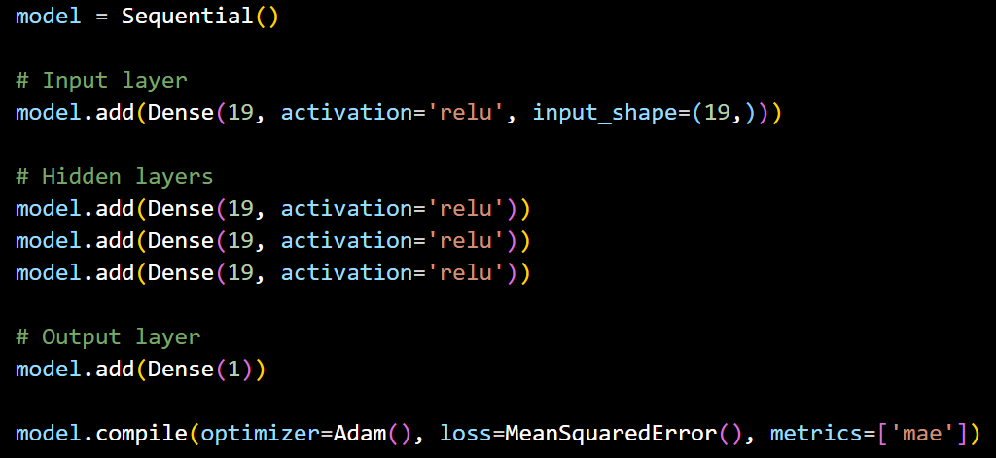
Model Architecture
-Built an Artificial Neural Network (ANN) using Keras.
-Layers: Input layer -> Hidden layers with ReLU activation -> Output layer with linear activation.
-Optimized with Adam optimizer and Mean Squared Error (MSE) loss function.

Slide 6
Model Training & Evaluation
-Split data into training and testing sets (80-20 ratio).
-Trained the model using 400 epochs with batch size 128.
-Performance Metrics:
-Mean Absolute Error (MAE): 105,289.63, indicating that, on average, the model’s predictions deviate by approximately 105,289 USD from the actual prices.
-Mean Squared Error (MSE): 29,066,826,904.82, a measure of the squared error that is sensitive to large deviations.
-Root Mean Squared Error (RMSE): 170,489.96, providing a more interpretable measure of the average error (around 170,489 USD).
-Variance Regression Score (R² Score): 0.7929,
meaning the model explains 79.29% of the variance in house prices based on the input features

Slide 7
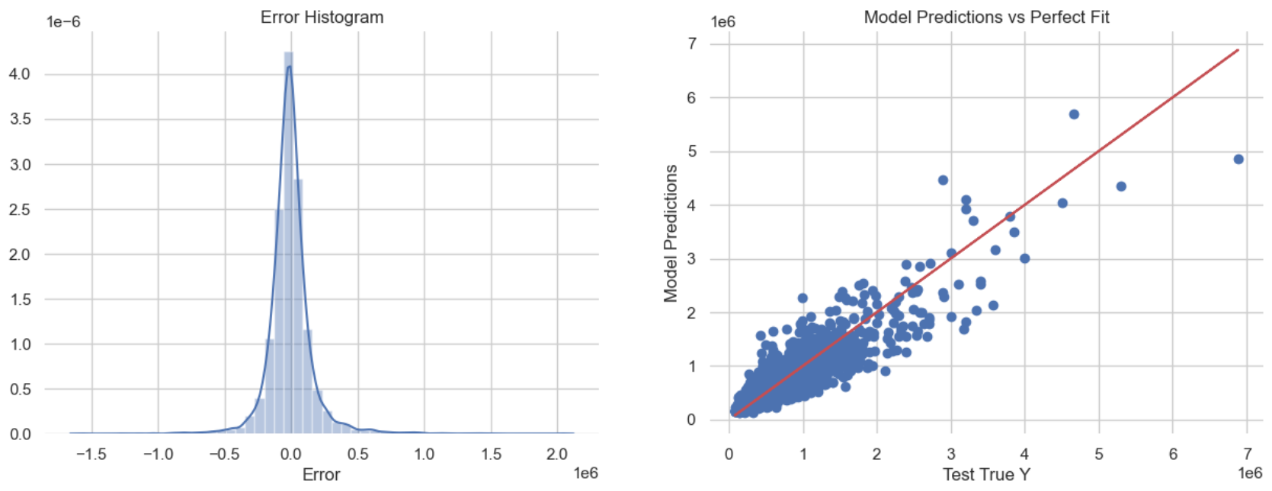
Comparing the model predictions with a perfect fit.
-We can compare the model predictions with a perfect fit to see how accurate the model is.
-The red line represents the perfect prediction.
-This model is good predicting the price of houses between 0 and 2,000,000. There is clearly a good fit.

Slide 8
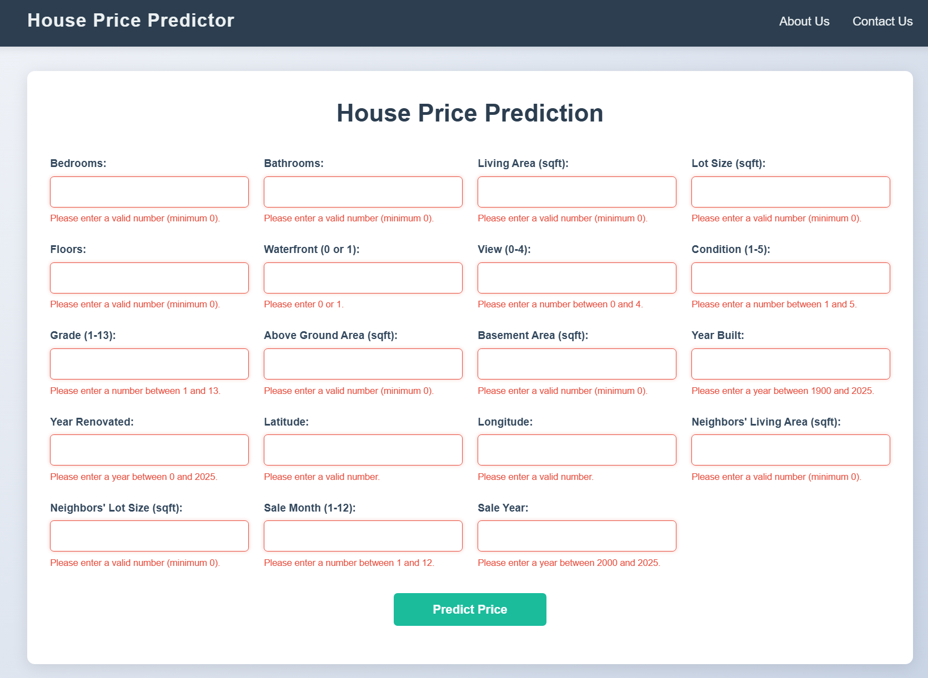
Flask Web Application
-Built a user-friendly web interface using Flask.
-Users input house details, and the model predicts the price.
-Implemented API endpoints to communicate with the trained model.

Slide 9
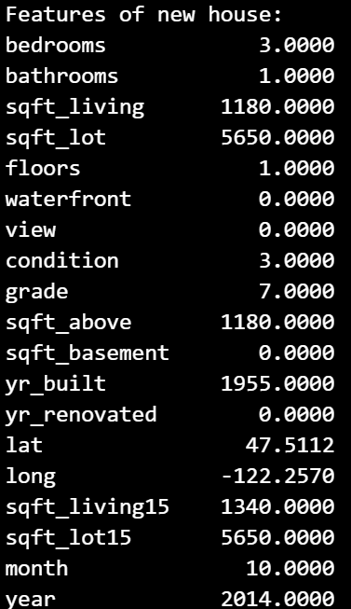
Predict on a brand new house
-I used the model to predict the price of a new house, using the first row of the dataset as an example
-The original price is $221,900 and the model prediction is $296512.
-The model overestimated the price by approximately 74,612$. This discrepancy may be attributed
to factors such as outliers in the dataset or the model’s limited ability to accurately predict prices for
lower-value homes.

Slide 10
Conclusion
This project predicts house prices using a Keras-based ANN. While achieving a 0.799 variance score, the MAE of 105,289.63 shows room for improvement. Enhancing feature engineering, tuning hyperparameters, and refining data preprocessing could boost accuracy. The Flask web app adds usability, and future improvements may involve advanced models and better training techniques.

