Slide 1
Fifteen puzzle
Tuan Anh Le(solo)
Web Programming Fall 2019

Slide 2
Introduction
Fifteen puzzle or also called Game of Fifteen, is a sliding puzzle game that consists of numbers of tiles that equals to a squared number with one missing tile. And the purpose of the game is to place every tile in order by moving the empty tile.
On this project, I programed the Fifteen puzzle game with Javascript, HTML, and some CSS styles.

Slide 3
Requirements met
Able to shuffle the puzzle tiles dynamically by pressing the button “start to play”;
When mouse press a square that next to an empty tile, move that square to the empty space, otherwise, do nothing;
There is a check if a problem is solvable by count the number of tiles and number of inversions in those tiles.
Able to check if the puzzle is solved.

Slide 4
Extra-Features
End of game notification: Hides all other elements and show the victory gif to imply that you won instead of alert(“you won”);
Animations and/or transitions: used the setInterval to play around with the frames to create some animations when playing
Multiple backgrounds: Able to choose the background image for the game from 4 available selections
Different puzzle sizes: 4 different sizes are also available to play

Slide 5
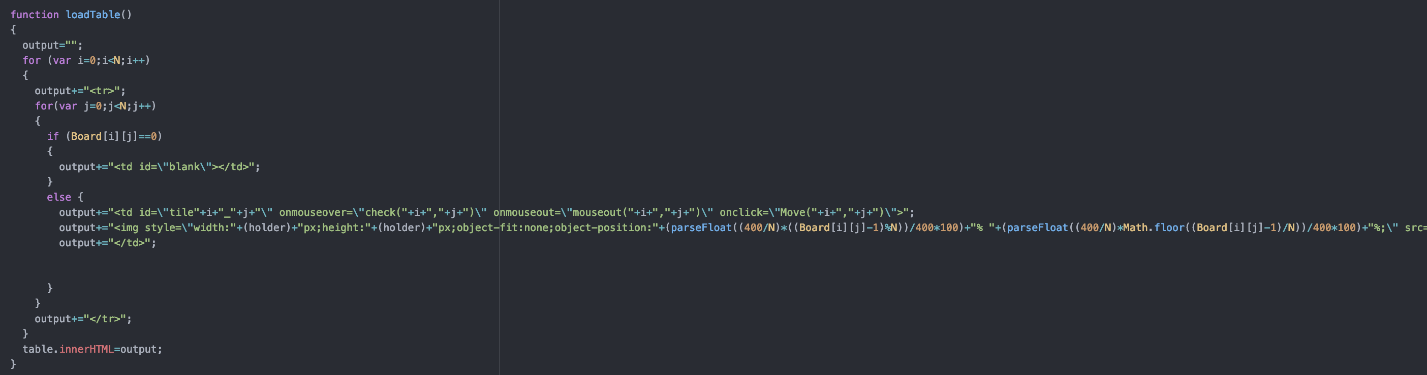
Code snippets

Slide 6
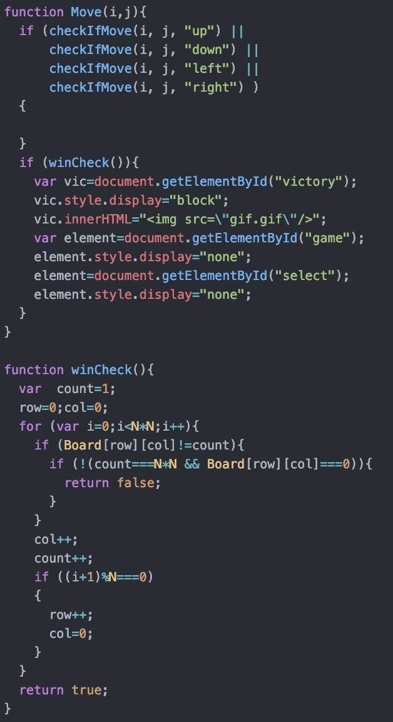
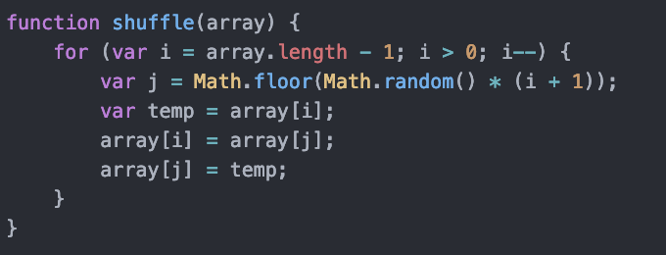
Code snippets

Slide 7
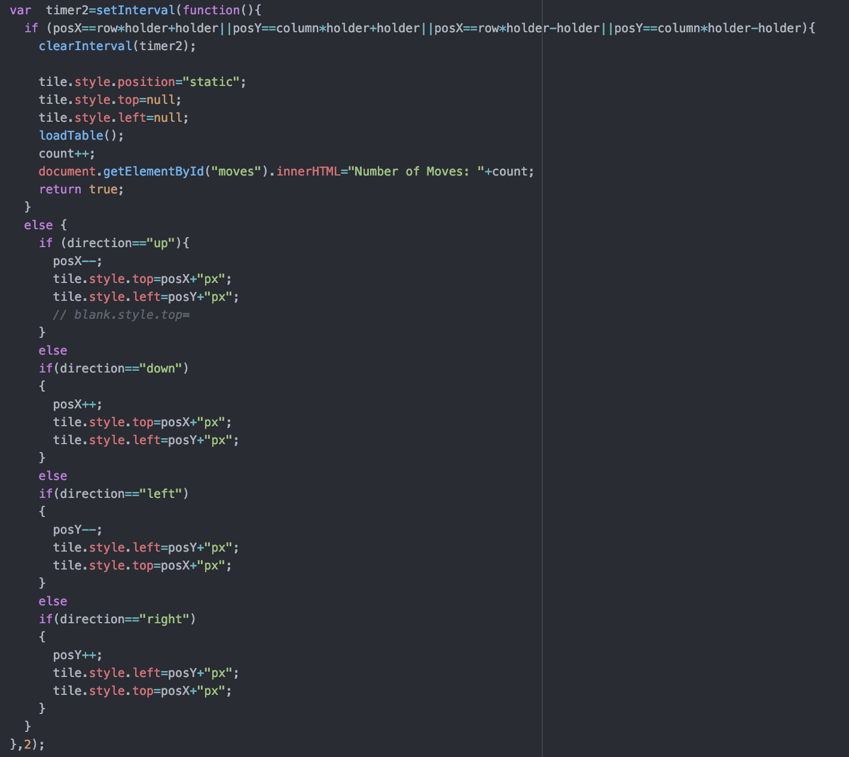
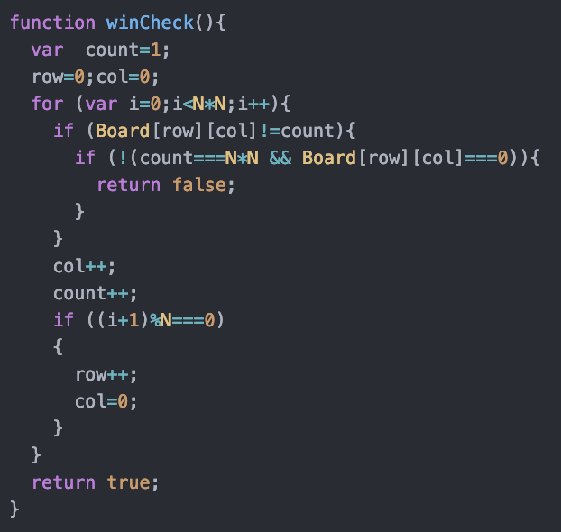
Code snippets

