Slide 1
Final Project
Tuan Anh Le(solo)
Web Programming Fall 2019

Slide 2
Introduction
Purpose to implement an online virtual agent that provide services such as rental car system, and a parking reservation service.
On this project, tools used on the program: PHP, HTML, CSS styles, and MySQL database, some of Javascript.

Slide 3
Requirements met
Able to log in, log out an existing account on the database.
Able to register a new account and write into database.
Able to view summary on the account from the Profile
Able to view the inventory to see available cars to rent
Able to add/view cart with informations
Able to check out and save the order’s information on the database
Able to add a reservation on a parking

Slide 4
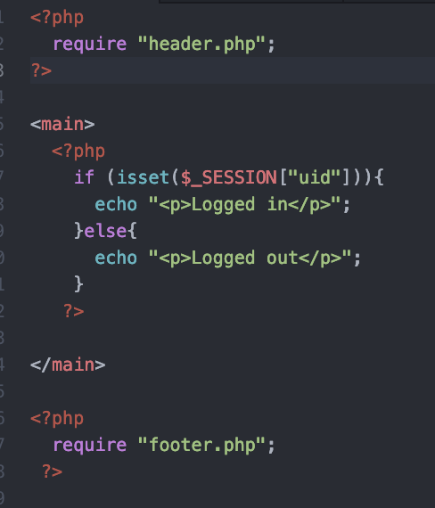
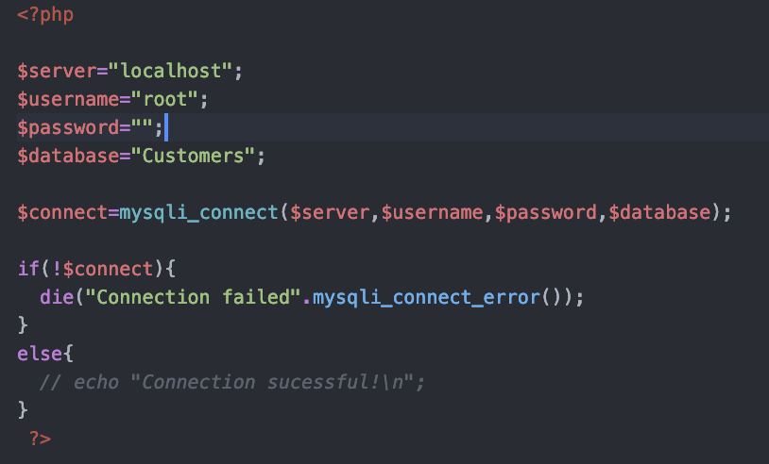
Code snippets

Slide 5
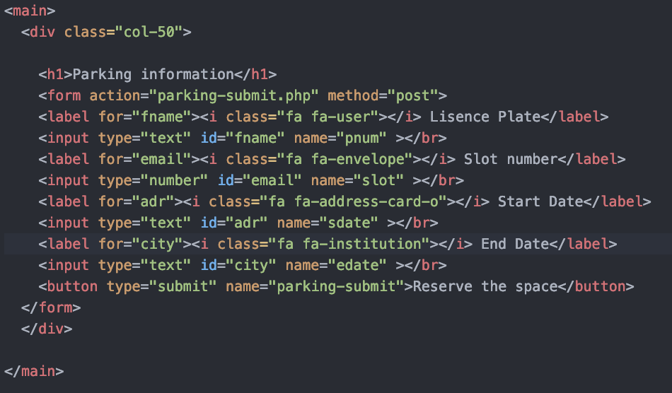
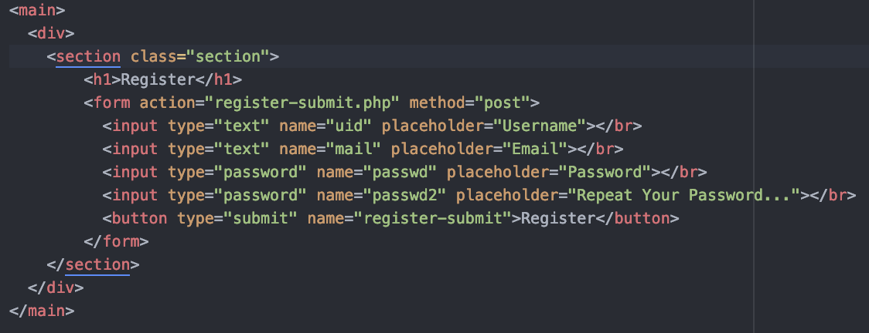
Code snippets

Slide 6

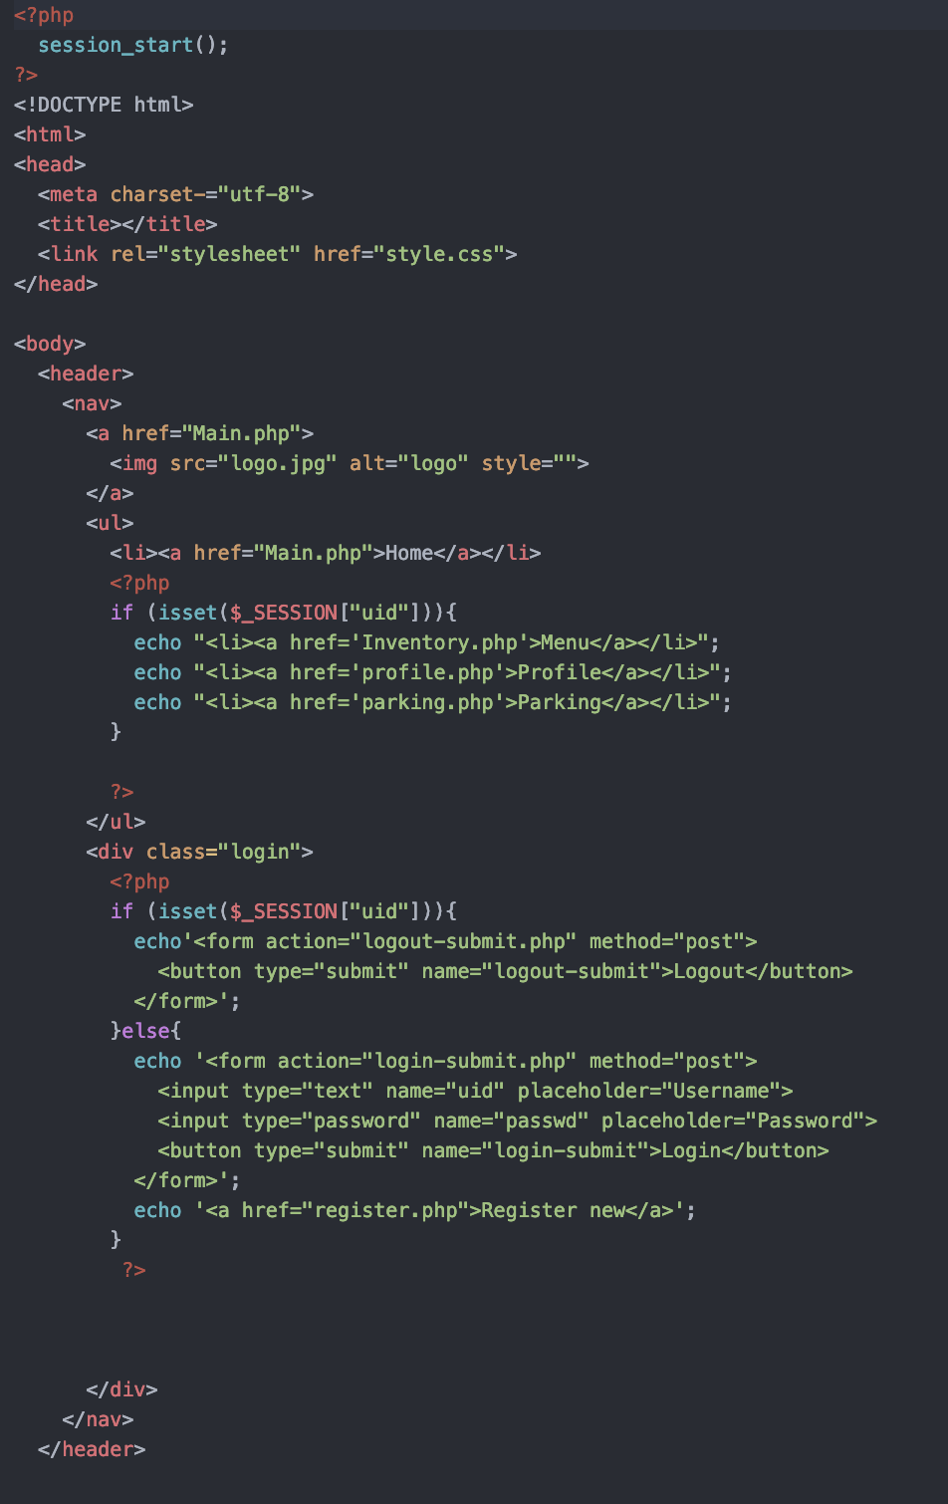
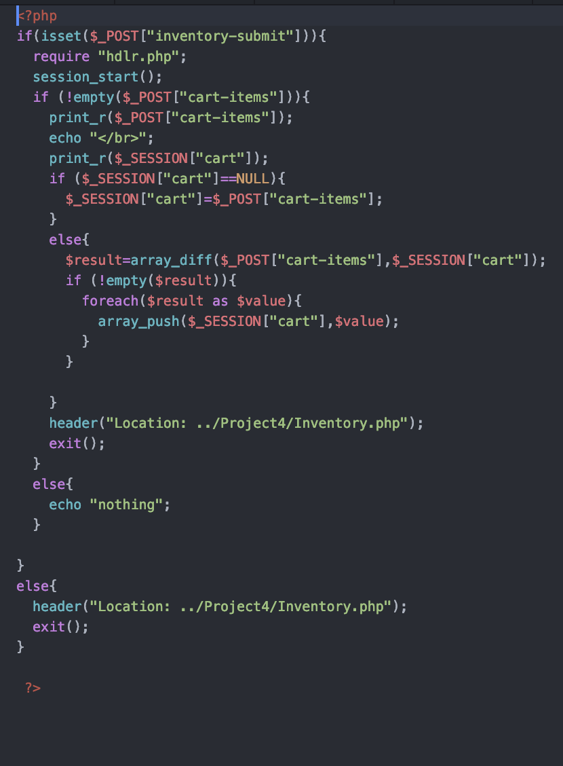
Code snippets

Slide 7
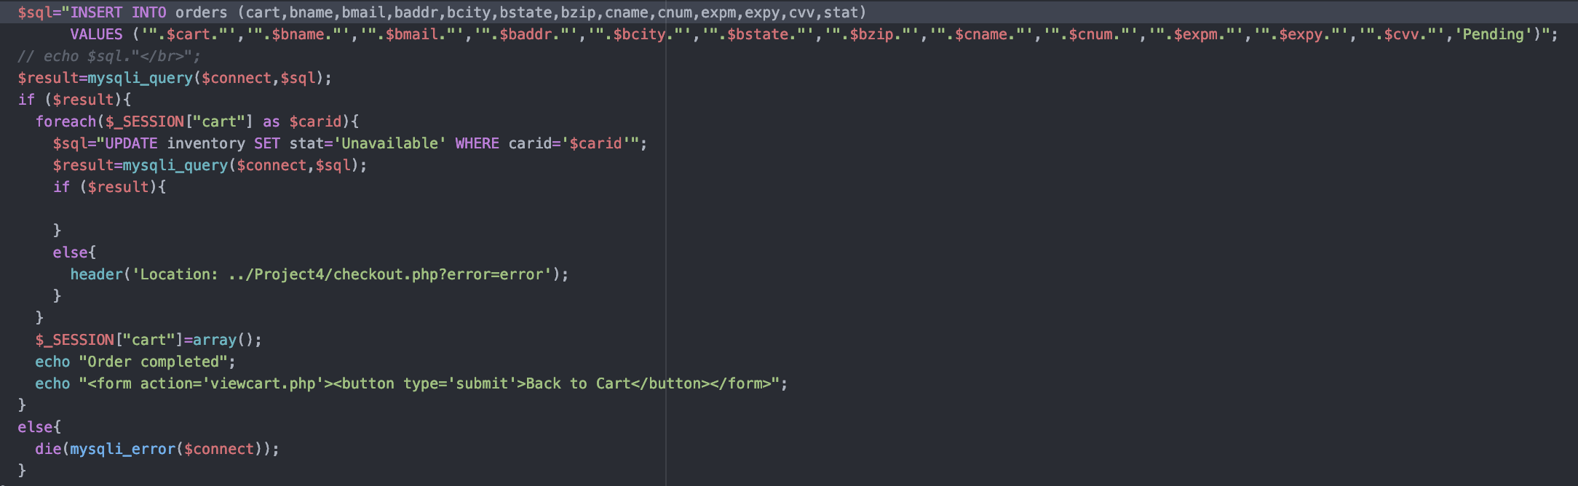
Code snippet

