Slide 1
APPLET

Slide 2
An applet is a Java program that runs in a Web browser.
Applet is a special type of program that is embedded in the webpage to generate the dynamic content. It runs inside the browser and works at client side.
Any applet in Java is a class that extends the java.applet.Applet class.
Advantage of Applet
There are many advantages of applet. They are as follows:
It works at client side so less response time.
Secured
It can be executed by browsers running under many platforms, including Linux, Windows, Mac Os etc.

Slide 3
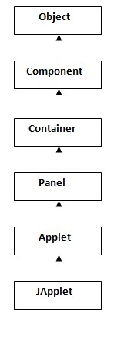
Hierarchy of Applet :
As displayed in the diagram, Applet class extends Panel. Panel class extends Container, which is the subclass of Component.
Where Object class is base class for all the classes in java.
JApplet class is extension of Applet class.

Slide 4
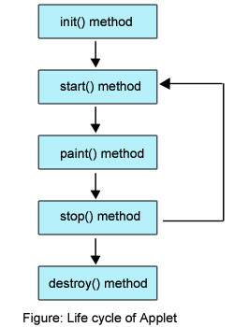
Lifecycle of Applet
There are 5 lifecycle methods of Applet, Those are
public void init(): is used to initialized the Applet. It is invoked only once.
public void start(): is invoked after the init() method or browser is maximized. It is used to start the Applet.
public void paint(Graphics g): is invoked immediately after the start() method, and this method helps to create Applet’s GUI such as a colored background, drawing and writing.
public void stop(): is used to stop the Applet. It is invoked when Applet is stop or browser is minimized.
public void destroy(): is used to destroy the Applet. It is invoked only once.
Remember:
java.applet.Applet class provides
4 methods (init,start,stop & destroy)
and java.awt.Graphics class provides 1 method ( paint) to create Applet.

Slide 5
Simple example of Applet
To execute an Applet, First Create an applet and compile it just like a simple java program.
First.java
import java.applet.Applet;
import java.awt.Graphics;
public class First extends Applet
{
public void paint(Graphics g){
g.drawString(“Welcome to Applet",50,150);
}
}
Compile:
D:\> javac First.java
D:\>
After successful compilation, we get First.class file.

Slide 6
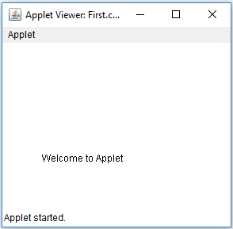
After that create an html file and place the applet code in html file.
First.html
<html>
<body>
<applet code="First.class" width="300" height="300">
</applet>
</body>
</html>
Execute:
D:\> appletviewer First.html

Slide 7
Displaying Graphics in Applet
java.awt.Graphics class provides many methods for graphics programming.
The Commonly used methods of Graphics class:
drawString(String str, int x, int y): is used to draw the specified string.
drawRect(int x, int y, int width, int height): draws a rectangle with the specified width and height.
fillRect(int x, int y, int width, int height): is used to fill rectangle with the default color and specified width and height.
drawOval(int x, int y, int width, int height): is used to draw oval with the specified width and height.
fillOval(int x, int y, int width, int height): is used to fill oval with the default color and specified width and height.
drawLine(int x1, int y1, int x2, int y2): is used to draw line between the points(x1, y1) and (x2, y2).
setColor(Color c): is used to set the graphics current color to the specified color.
setFont(Font font): is used to set the graphics current font to the specified font.

Slide 8
Example: GraphicsDemo.java
import java.applet.Applet;
import java.awt.*;
public class GraphicsDemo extends Applet
{
public void paint(Graphics g)
{
g.setColor(Color.red);
g.drawString("Welcome",50, 50);
g.drawLine(20,30,20,300);
g.drawRect(70,100,30,30);
g.fillRect(170,100,30,30);
g.drawOval(70,200,30,30);
g.setColor(Color.pink);
g.fillOval(170,200,30,30);
}
}

Slide 9
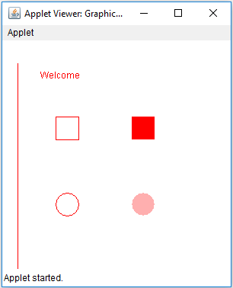
GraphicsDemo.html
<html>
<body>
<applet code="GraphicsDemo.class" width="300" height="300">
</applet>
</body>
</html>
Execution:
D:\> javac GraphicsDemo.java
D:\> appletviewer GraphicsDemo.html

Slide 10
Components of Applets
The components of AWT are the components of Applet,i.e we can use AWT components (Button,TextField,Checkbox, TextArea,Choice & etc.…) in applet.
As we perform event handling in AWT or Swing, we can perform it in applet also.
Let's see the simple example of components and event handling in applet that prints a message by click on the button.

Slide 11
JApplet Class
As we prefer Swing to AWT.
Now we can use JApplet that can have all the controls of swing.
The JApplet class extends the Applet class.
The components of swing are the components of JApplet,i.e we can use swing components (JButton,JTextField,JCheckBox, JTextArea,JList & etc.…) in JApplet.

Slide 12
Thank You

