Slide 1
map marking Zingster Strom
Figure 1

Slide 2
3.1. Nitrate input, i.e. only river discharge

Slide 3
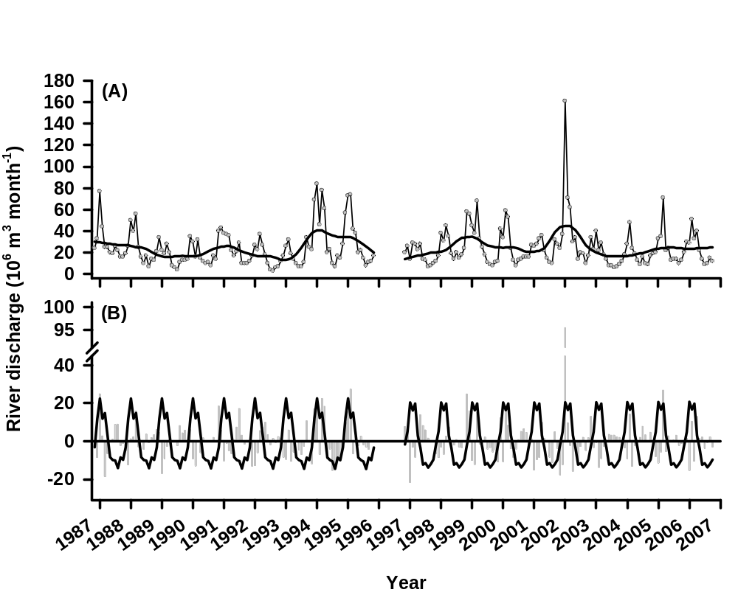
Figure 2. Seasonal decomposition using STL applied to monthly river discharge data at which station? (November 1986 – October 2006, data gap: December 1995 – October 1996). The two periods were analysed separately. (A) The circles show the original time series. The black line is the trend component. (B) The black line is the seasonal component and the residuals are shown by the grey bars.

Slide 4
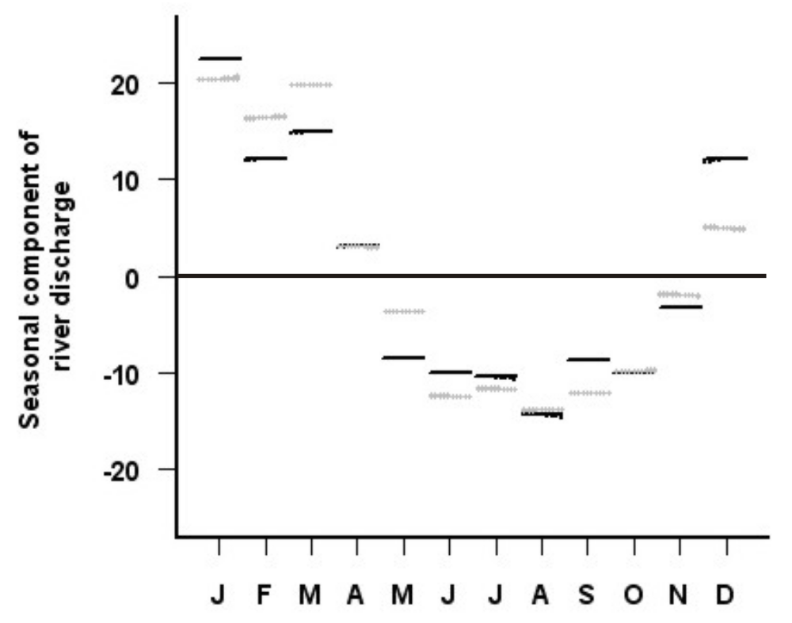
Figure 3. Seasonal cycle sub-series plot for monthly river discharge data of the Zingster Strom. Due to a long data gap, the two periods were analysed separately. Black symbols: November 1986 – November 1995, grey symbols: November 1996-October 2006.

Slide 5
3.2. Output: -Nitrate utilization
Temperature and pH as proxies for biological activity

Slide 6
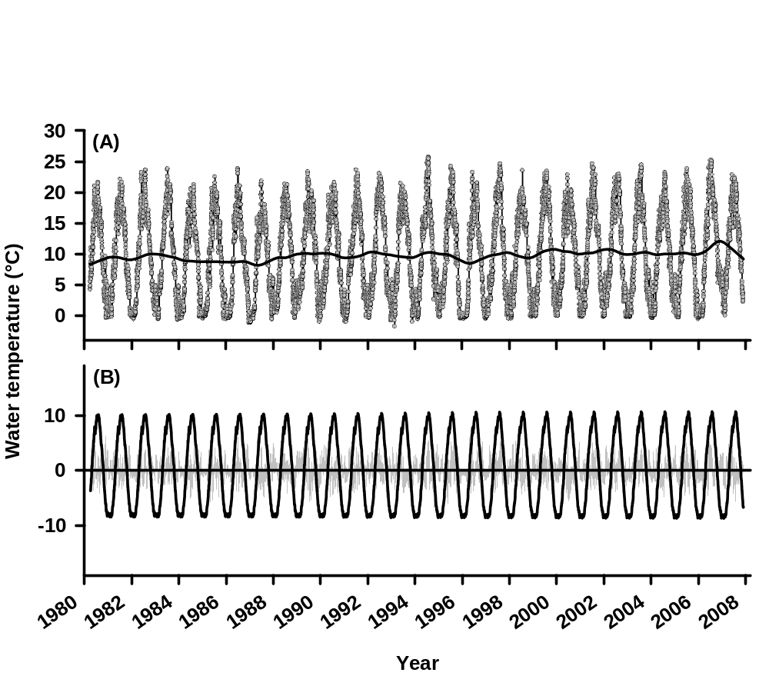
Figure 4. Seasonal decomposition using STL (A) applied to daily water temperature data of the Zingster Strom (January 1, 1980 – December 31, 2007). (A) The circles show the original time series. The black line is the trend component. (B) The black line is the seasonal component and the residuals are shown by the grey bars.

Slide 7
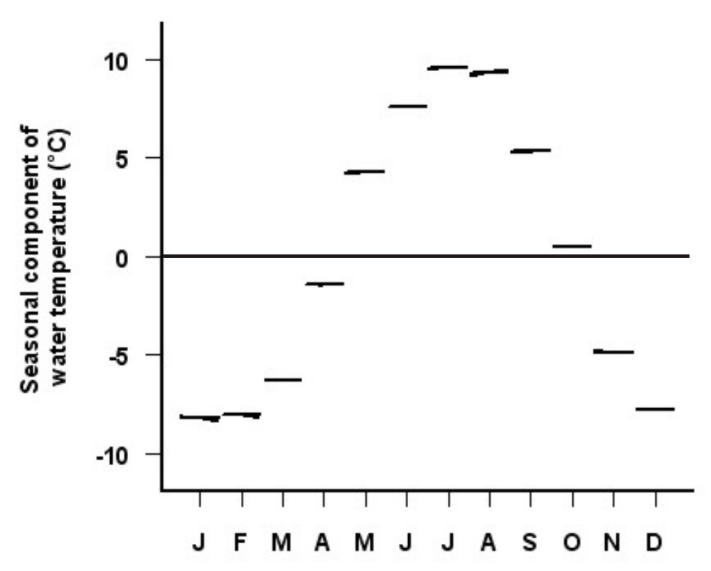
Figure 5. Seasonal cycle sub-series plot for monthly water temperature data of the Zingster Strom (April 1980-November 2007).

Slide 8
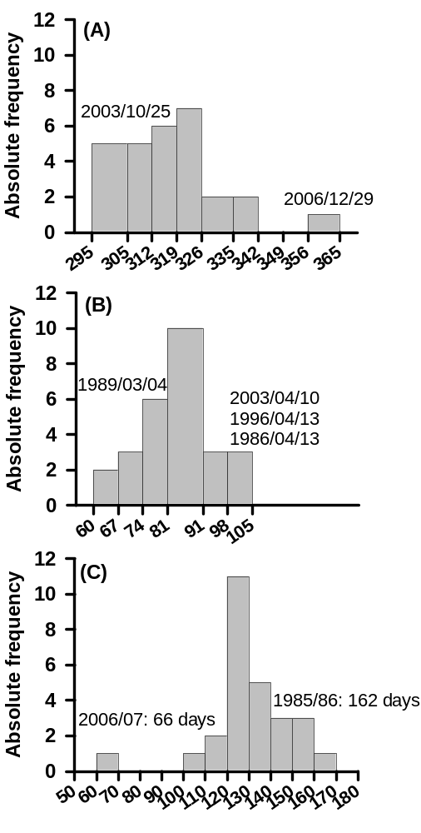
Figure 6. (A) First day with water temperatures < 5°C on at least three consecutive days in autumn. (B) Last day with water temperatures < 5°C on at least three consecutive days in spring in the Zingster Strom (January 1, 1980 – December 31, 2007). (C) Duration of the winter season according to the 5°C-rule.

Slide 9
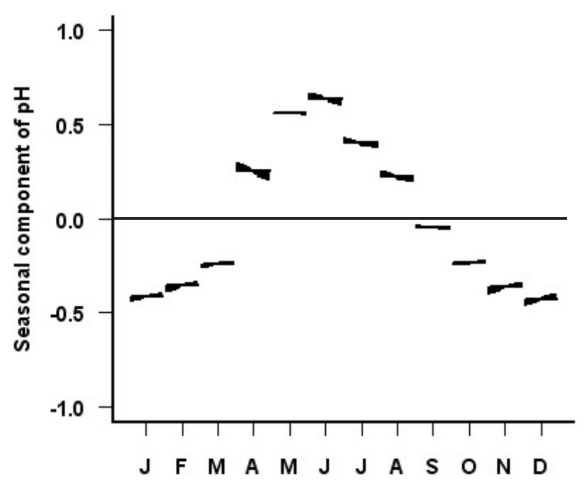
Figure 7. Seasonal cycle sub-series plot for monthly pH data of the Zingster Strom (April 1980-November 2007).

Slide 10
3.3 Nitrate concentration in the water, i.e. input-output

Slide 11
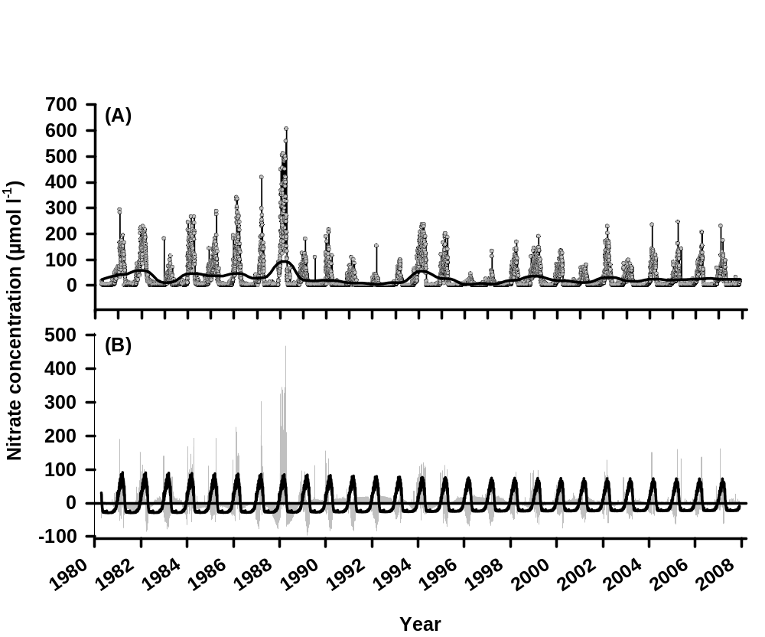
Figure 8. Seasonal decomposition using STL (A) applied to daily nitrate data of the Zingster Strom (April 14, 1980 – November 30, 2007). (A) The circles show the original time series. The black line is the trend component. (B) The black line is the seasonal component and the residuals are shown by the grey bars.

Slide 12
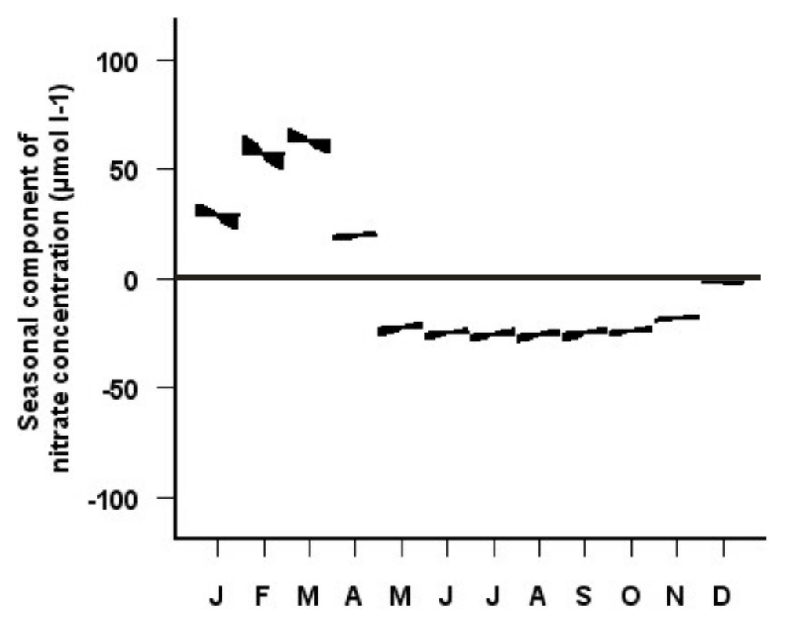
Figure 9. Seasonal cycle sub-series plot for monthly nitrate data of the Zingster Strom (April 1980-November 2007).

Slide 13
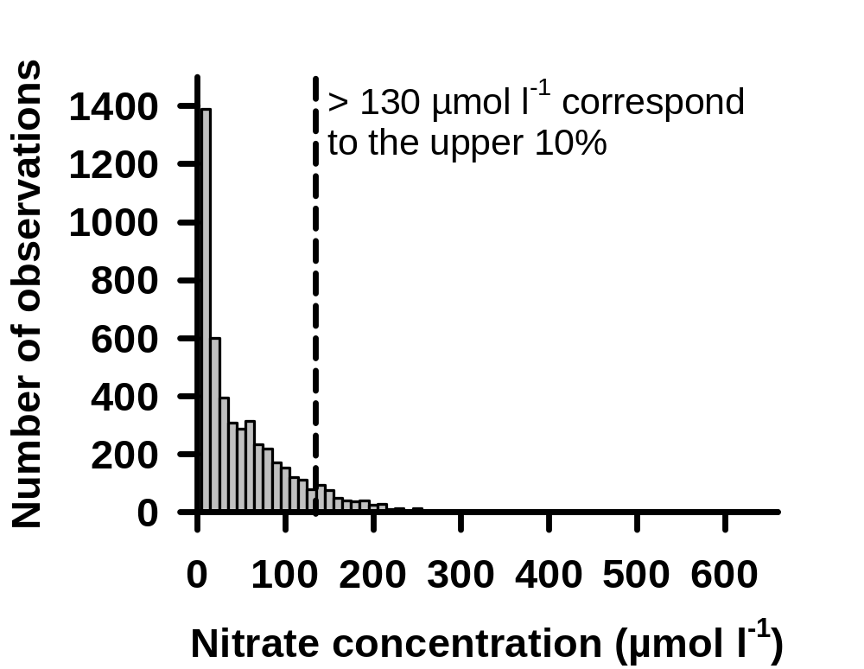
Figure 11. Frequency distribution of daily nitrate concentrations in the Zingster Strom during the winter periods (November-April) from 1980-2007.

Slide 14
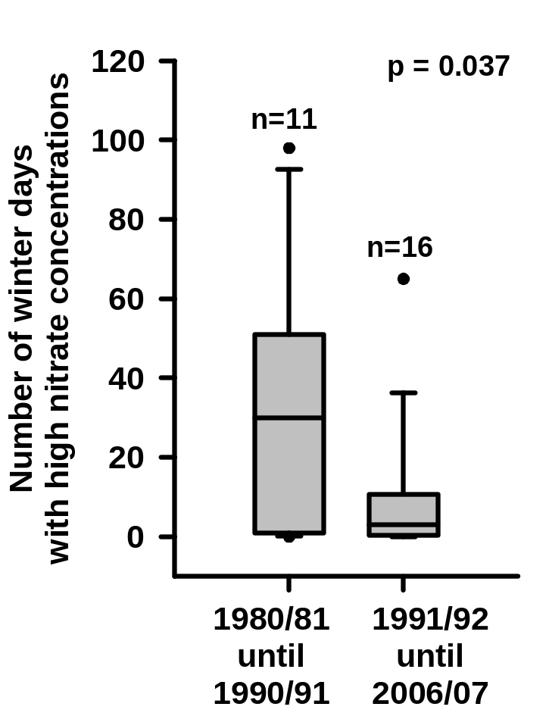
Figure 12. Number of winter days with high nitrate concentrations (i.e. > 130 µmol l⁻¹ from Fig. 9) for the two periods 1980/81-1990/91 and 1991/92-2006/2007 which are characterised by dramatic land use changes. (according to the definition of the winter season November-April for daily nitrate data)

Slide 15
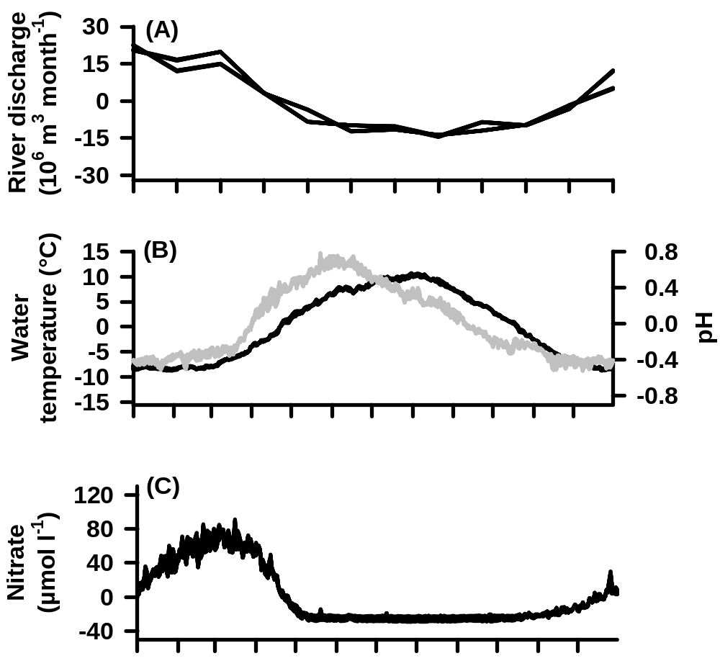
Figure 10. Seasonal components of (A) river discharge based on monthly data, (B) Water temperature and pH based on daily data, and (C) Nitrate concentration based on daily data. For further details see Fig. 2, 4, 8.

Slide 16
übrig

Slide 17
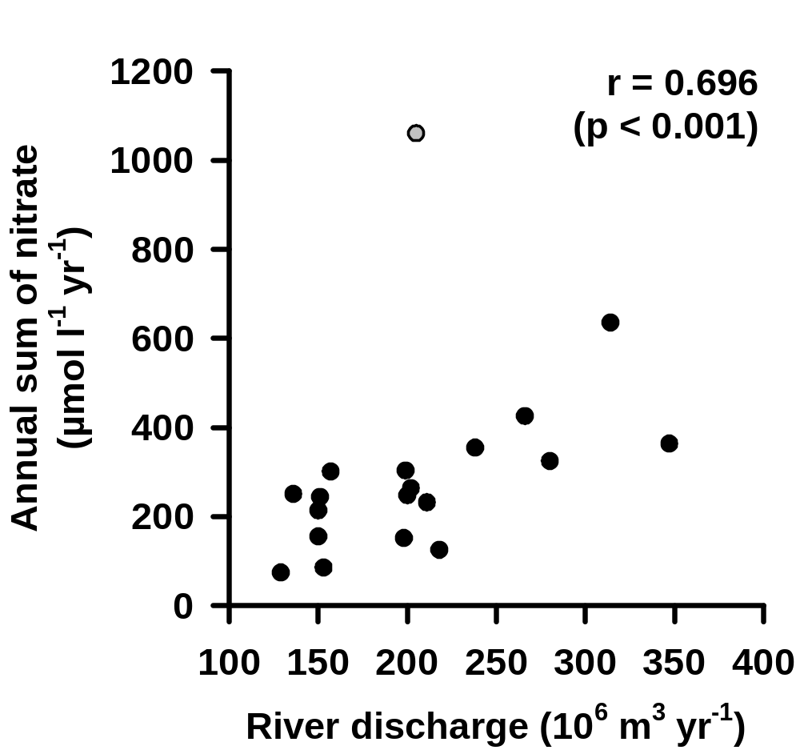
Nicht rein
Annual sum of nitrate as a function of the annual river discharge into the Zingster Strom. Data based on annual data of the hydrological years 1986/87 until 2005/06. The outlier marked in grey represents the year 1987/88. Given is the Spearman rank correlation coefficient.

Slide 18
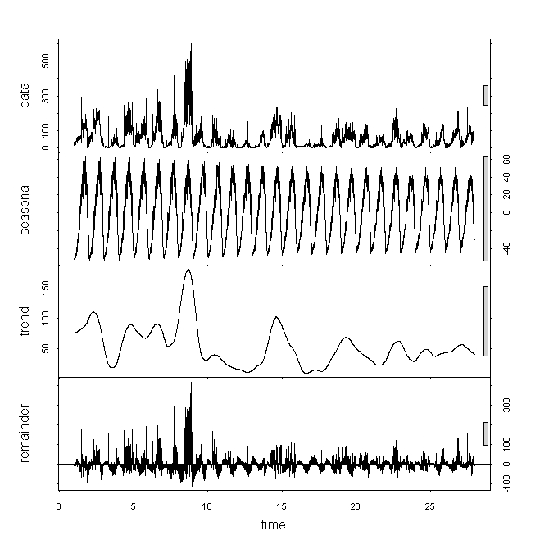
Nicht rein
STL der Wintertage Nitrat

Slide 19
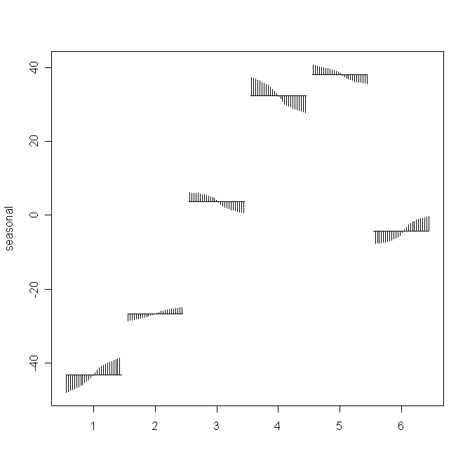
Nicht rein
STL der Wintermonate Nitrat

Slide 20
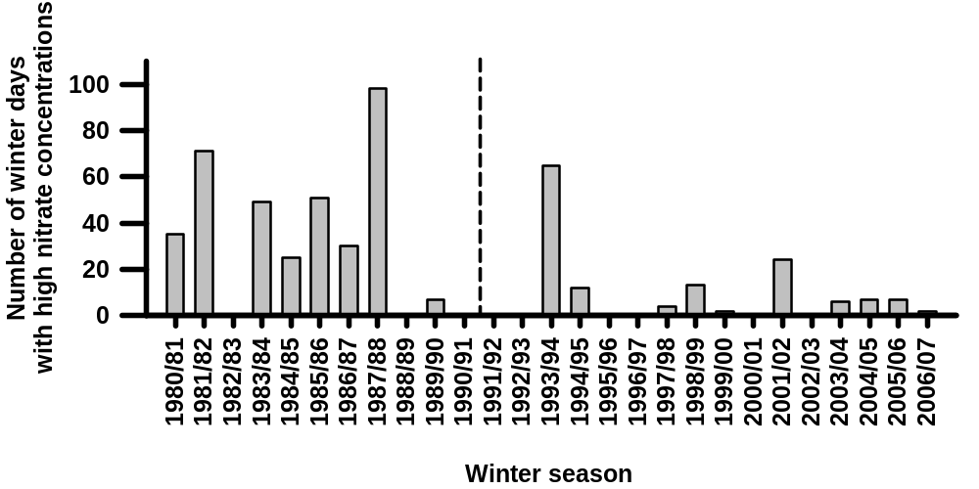
Nicht rein

