Slide 2
Case Study II
Context
Request

Slide 3
Data
10679 records in total
Target variable: risk
26 raw features
Randomly split into 70% train and 30% test

Slide 4
Data
id | risk | gender | ba_age | program | degree | cum_gpa
1 | 0 | M | 30 | MBA | MBA | 2.0
3 | 0 | F | 35 | MBA | MBA | 1.7
5 | 1 | M | 43 | MS_ISM | MS | 0.6
6 | 1 | M | 43 | MS_ISM | MS | 0.6
7 | 0 | M | 52 | MBA | MBA | 2.2
8 | 1 | M | 32 | MS_PRJ | MS | 2.4
9 | 1 | M | 32 | MS_PRJ | MS | 2.4
10 | 1 | M | 32 | MS_PRJ | MS | 2.4
11 | 1 | M | 32 | MS_PRJ | MS | 2.4
13 | 1 | F | 39 | MBA | MBA | 0.6

Slide 5
Data
id | current_balance | in_dissertation | in_future
1 | 0.11 | 0 | 1
3 | 1111.11 | 1 | 0
5 | 0.00 | 0 | 0
6 | 0.00 | 0 | 0
7 | 0.00 | 0 | 1
8 | 1111.11 | 1 | 0
9 | 1111.11 | 1 | 0
10 | 1111.11 | 1 | 0
11 | 1111.11 | 0 | 0
13 | 1111.00 | 0 | 0

Slide 6
EDA (GPA): Double Density Plot
1.0
risk
density
0
1
0.5
0.0
0
1
2
3
cum_gpa

Slide 7
EDA Example
summary(train$bb_gip_etc_ratio_std)
Min. 1st Qu. Median Mean 3rd Qu. Max. NA's 0.00 25.57 92.21 79.33 116.50 1959.00 2356

Slide 8
Feature Selection
Domain knowledge
AUC of single variable model
AIC based on index on single variable model
Other approaches
No guarantee, trial and error

Slide 9
AUC (Program)
1.0
0.8
0.6
True positive rate
0.4
0.2
0.0
0.0
0.2
0.4
0.6
0.8
1.0
False positive rate

Slide 10
AUC (Credits)
1.0
0.8
0.6
True positive rate
0.4
0.2
0.0
0.0
0.2
0.4
0.6
0.8
1.0
False positive rate

Slide 11
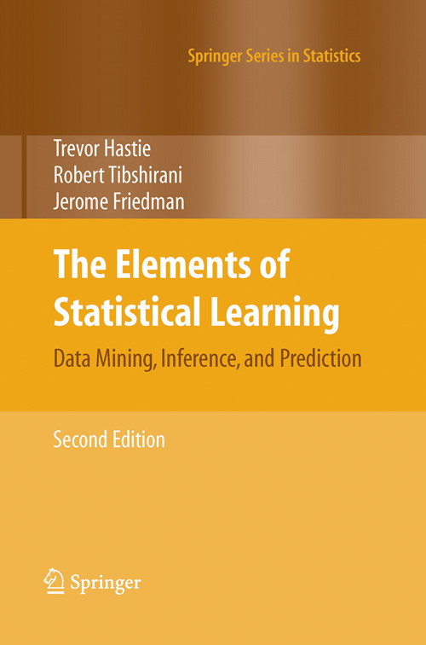
Statistical Learning Models
Logistic Regression
Random Forest
Extra Trees
Gradient Boosting
Neural Network
Ensembling and Stacking
...

Slide 12
Model Selection and Parameter Tuning
Cross Validation
Grid Search

Slide 13
Model Performance

Slide 14
Model Performance

