Slide 1
Exploring Nuances in the Norwegian Equity Market using Pairs Trading
Anders Huse
23.06.2022

Slide 2
Presentation Overview
01
Pairs trading and thesis objectives
05
Factor influence & Sector Nuances
02
Data foundation and clustering Dashboard
06
Case Studies
03
Frameworks
07
Effect of Oil Price Volatility
04
Results
08
Conclusion

Slide 3

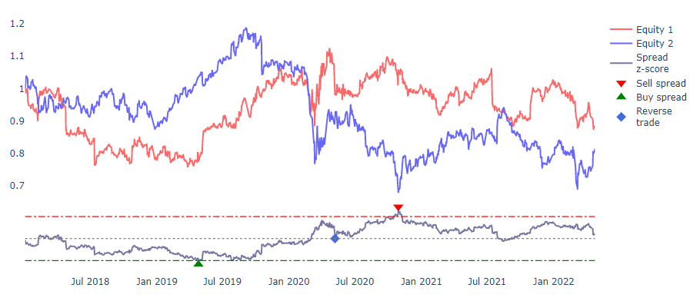



Pairs Trading
Simple pairs trading framework
Statistical arbitrage
Modelling similar financial instruments
What is driving pair relationships?
New trading rules

Slide 4
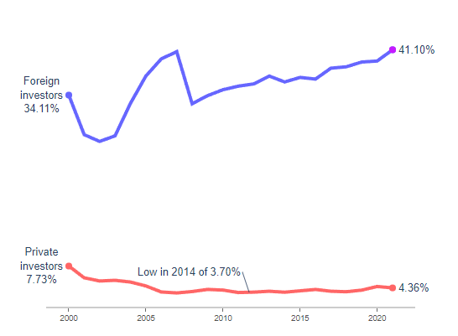
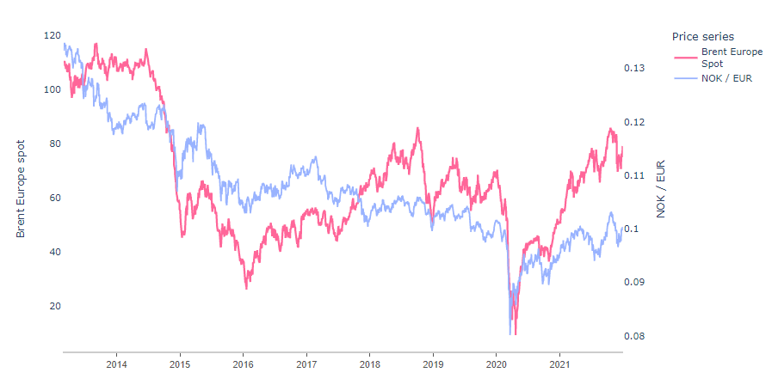
Thesis Objectives - Background
Foreign investor market share
NOK as a petrocurrency

Slide 5
Thesis Objectives - Background
Questions manifestig the goals of the thesis
01
“Do foreign investors have an oversimplified or naive view of the Norwegian equity market?”
02
“Do some financial factors have a disproportional effect on the Norwegian equity market, compared to foreign equity markets?”

Slide 6
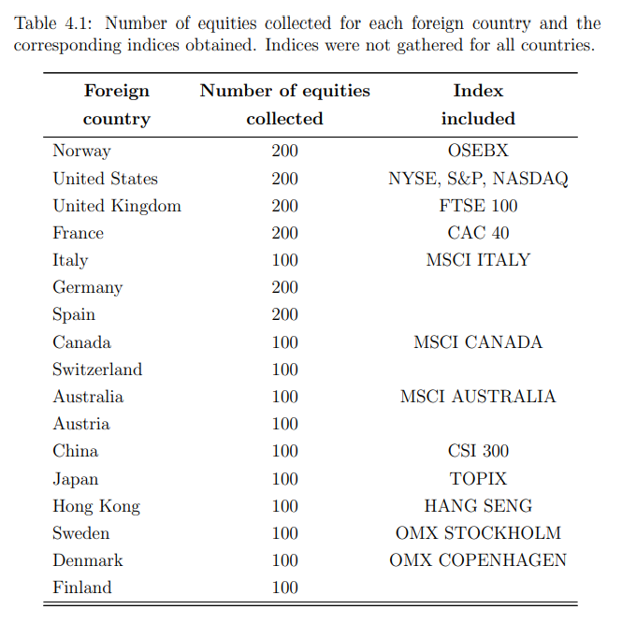
Data Foundation
01
Equity time series for each foreign country including the Norwegian market.
02
Time series for chosen equity indices
03
Time series for the chosen “factors”
04
Native currency rates for all foreign equities

Slide 7
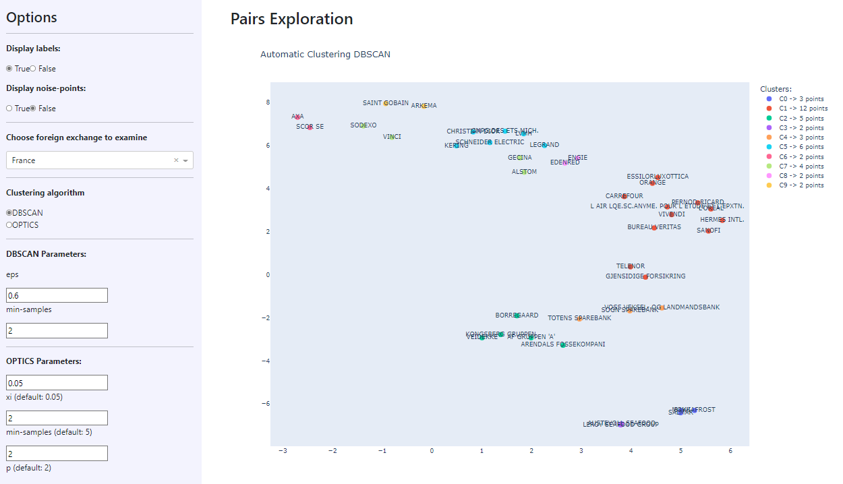

Slide 8
Two Frameworks

Slide 9
Nuanced Framework Trading Rules
Trading Rule 1
Trading Rule 2
Handful factors, disproportional effect on the Norwegian market
In periods when the Norwegian market falls sharply, it will “drag” all equities down with it
Affecting equities not fundamentally correlated to the factors
Constituted of three smaller «checks»
Norwegian market driven down by “low-correlated factor”
Norwegian equity relatively large decline
OSEBX relatively large decline compared to foreign exchanges
Not grounded in company specifics → revert to mean
Norwegian equity overreact → Relative mispricing
Confluence of all three checks

Slide 10
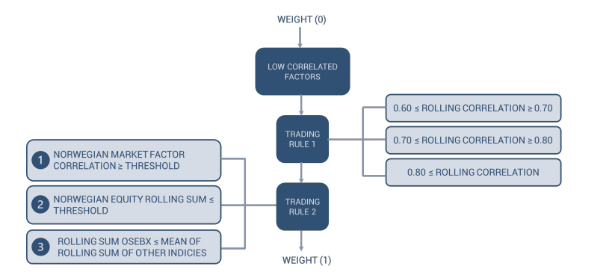
Weight updates
Visual interpretation of the weight updates of the nuanced framework

Slide 11
Results – Two Terms
Strategy Return
Weighted mean return of all trades initialized (both normal and weighted), for one complete run of either the purely statistical or nuanced framework.
Trade Return
Weighted mean return of all trades of one type, either normal or weighted, for one complete run of the nuanced framework

Slide 12
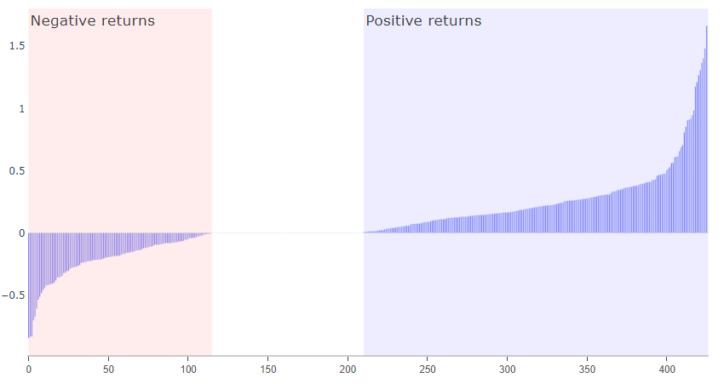
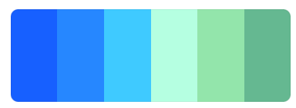
Strategy Return Comparison
Comparing the returns of the two proposed strategies
Strategy Returns
Strategy Return Distribution Nuanced Framework
+ 0.73%
27.2%
50.9%
9.96%
9,63%
Nuanced framework
Basic framework
Notes:
Comparison
Weighted trades outperformed normal trades
One weighted trade per 10 normal trades
Varying across different pairs (show per country?)

Slide 13


Trade Return Comparison
Comparing the performance of the two types of trades
Trade Returns
Average number of normal and weighted trades
11,98%
+ 2.58%
9,40%
18.3
Number of normal trades
1.9
Number of weighted trades
Weighted trades
Normal trades
Notes:
Comparison
Weighted trades outperformed normal trades
One weighted trade per 10 normal trades
Varying across different pairs (show per country?)

Slide 14
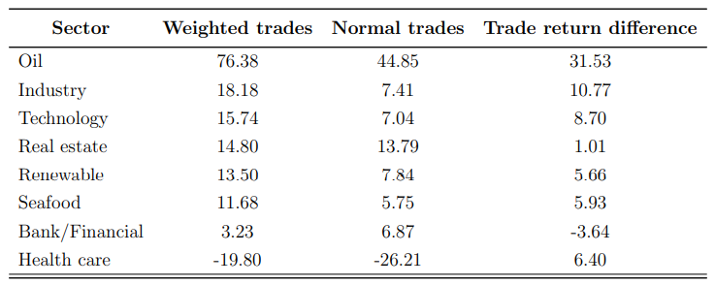
Trade Return - Sectors
Comparing the performance of the two types of trades, grouped by sector of the Norwegian equity of the pair

Slide 15
Factor Influence
For all detected pairs
Other
Copper
20.72%
19.82%
Brent Europe
Commodities
Total number of triggered weighted trades by factors
Silver
15.30%
9.85%
10Y US bond return
Bond returns
9.59%
10Y NO bond return
Notes:
Compare the influence of the different factors in triggering of trades
→ What is factor influence?

Slide 16
Factor Influence - Seafood
Numbers specific to the pairs with the Norwegian equity of the pair being in the seafood industry
Other
746
Brent Europe
Total number of triggered trades by factors for seafood pairs
684
10Y NO
418
10Y US
Notes:
Compare the influence of the different factors in triggering of trades

Slide 17
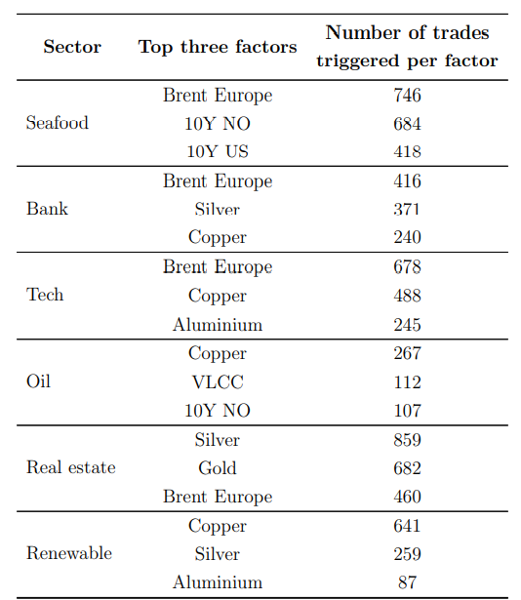
Factor Influence - Summary
For all detected pairs

Slide 18
Case Studies

Slide 19
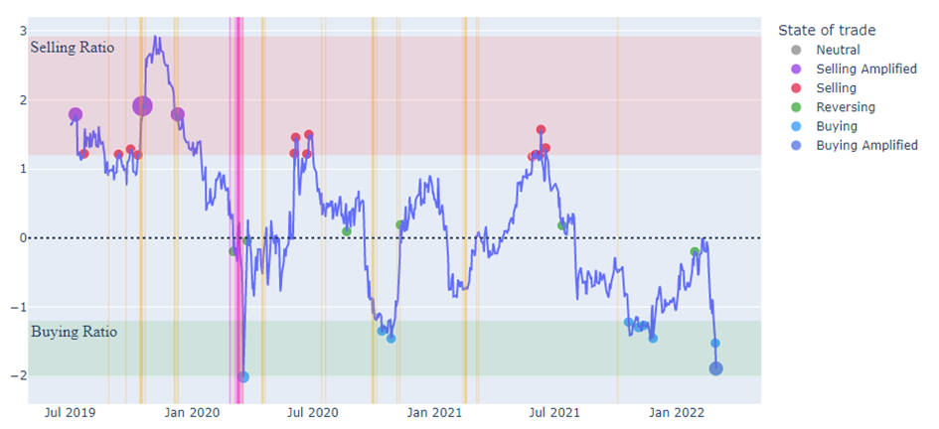
Case Study
Gjensidige Forsikring & Allianz

Slide 20
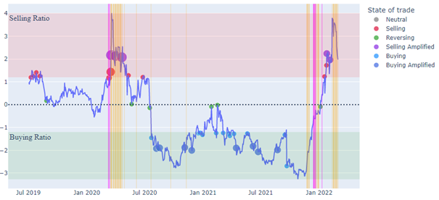
Case Study
Schibsted & Viviendi

Slide 21
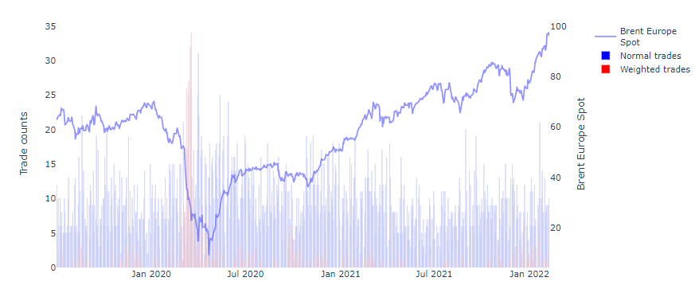
Trade Distribution + Brent Europe
There is a visible relationship between the price of oil and the detection of trades in times of high volatility

Slide 22
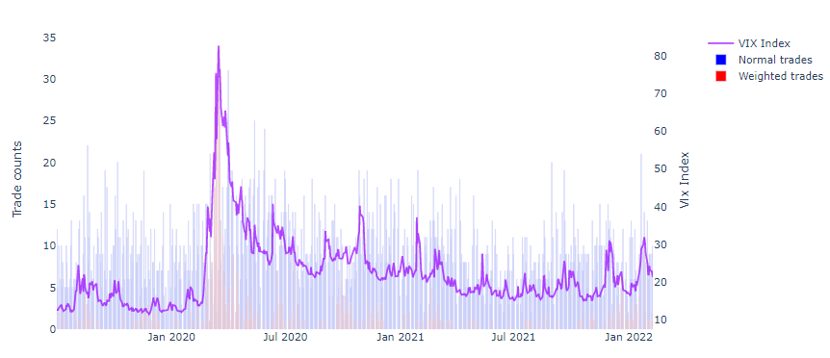
Trade Distribution + VIX

Slide 23
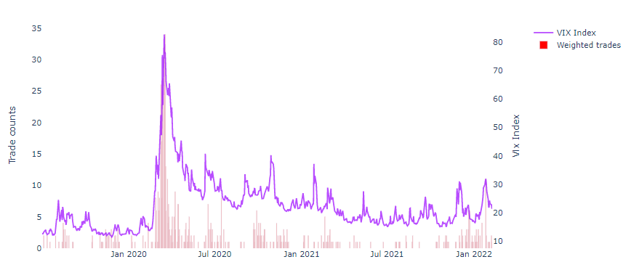
Trade Distribution + VIX

Slide 24



Conclusions
Important take-aways
The nuanced framework outperformed the purely statistical framework
The weighted trades yielded higher returns than the normal trades
Effect of oil price volatility was significant

Slide 25
Questions?

