Slide 1

1 2 LAB | Preparation: - open ws8.pptx from github.com/anhvir/c207 and/or - open wokshop8.pdf (from LMS), and - download lab files from LMS Master Theorem, Merge Sort, problems 1, 3 Simple Sorting algorithms, problem 2 Quicksort and Mergesort, problem 3 Understand the lab’s graph module and implement some graph algorithms
COMP20007.Workshop

Slide 2

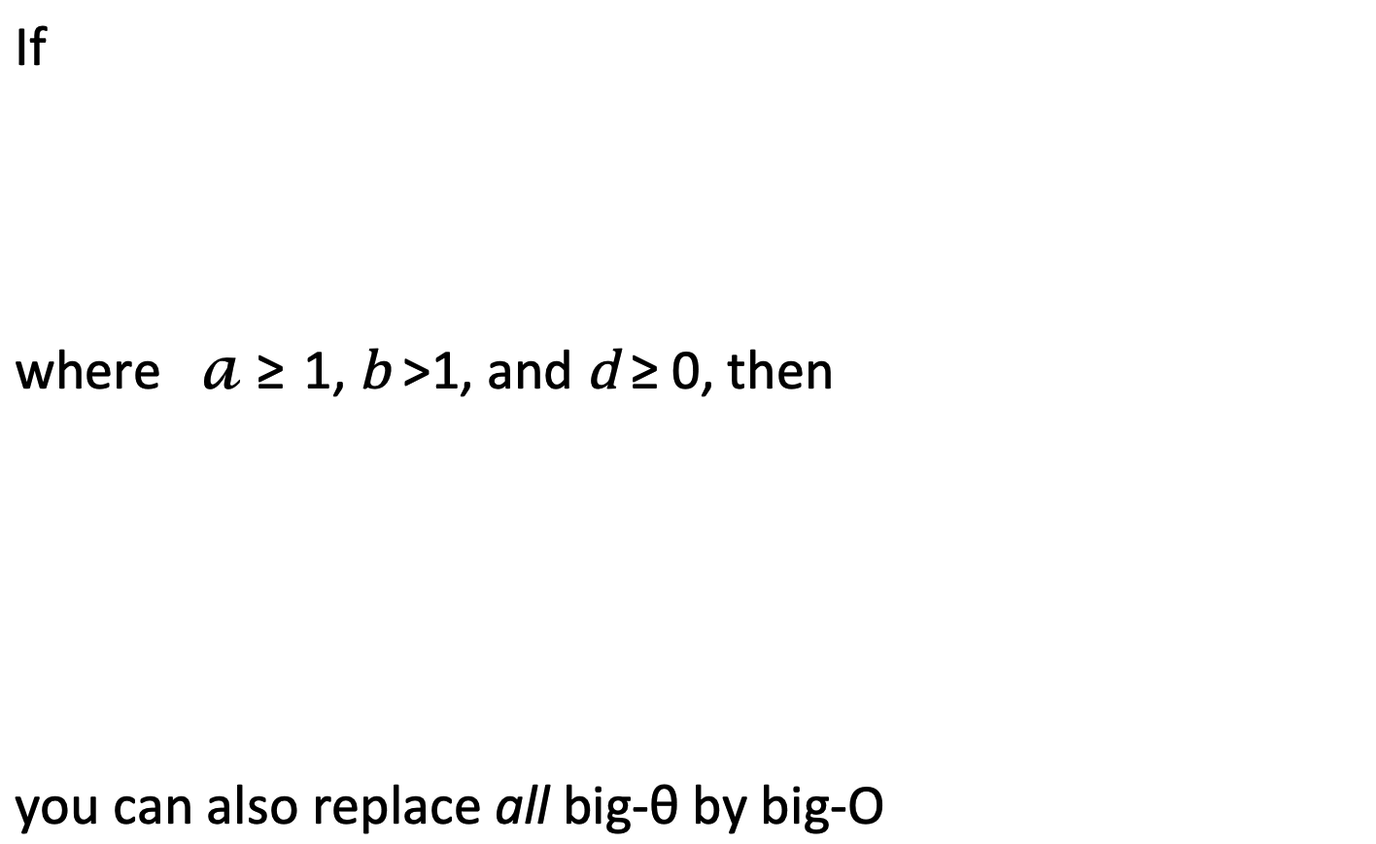
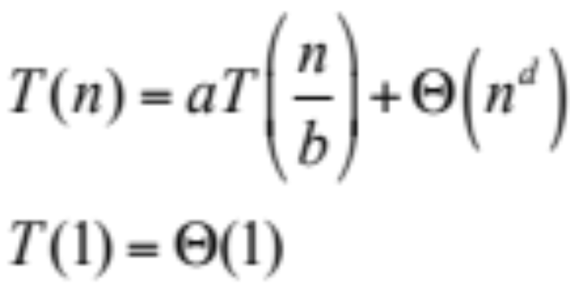
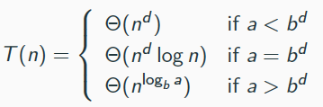

Slide 3
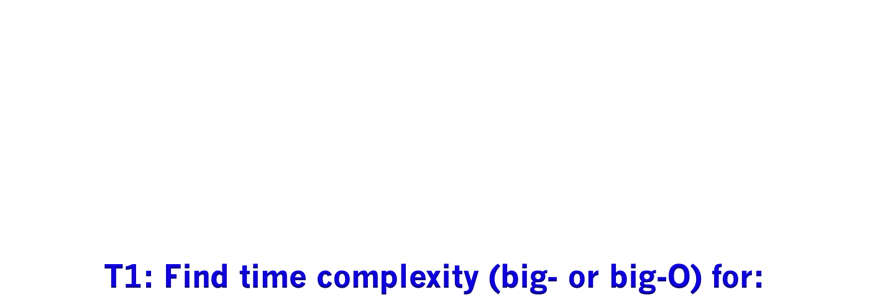

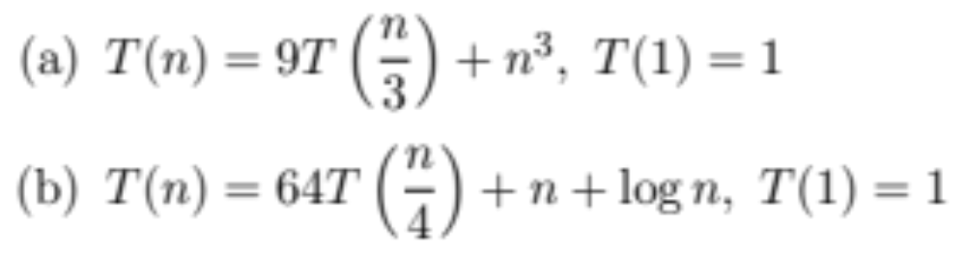
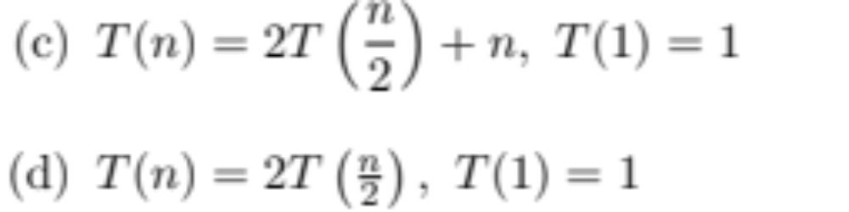
(e) T(n) = 2T(n-1) + 1
COMP20007.Worshop

Slide 4

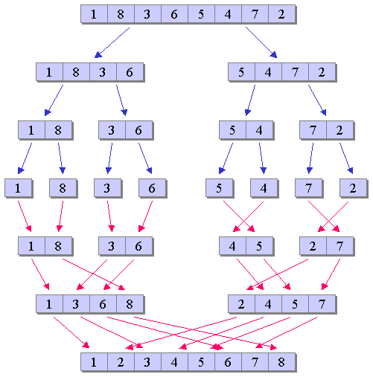
Mergesort is a divide-and-conquer sorting algorithm made up of three steps (in the recursive case): Sort the left half of the input (using mergesort) Sort the right half of the input (using mergesort) Merge the two halves together (using a merge operation) Construct a recurrence relation to describe the runtime of mergesort . Explain where each term in the recurrence relation comes from. Use the Master Theorem to find the time complexity of Mergesort in Big-Theta terms.
COMP20007.Worshop

Slide 5


Construct a recurrence relation to describe the runtime of mergesort . Explain where each term in the recurrence relation comes from. T(n)= T(1)= Use the Master Theorem to find the time complexity of Mergesort in Big-Theta terms.

Slide 6

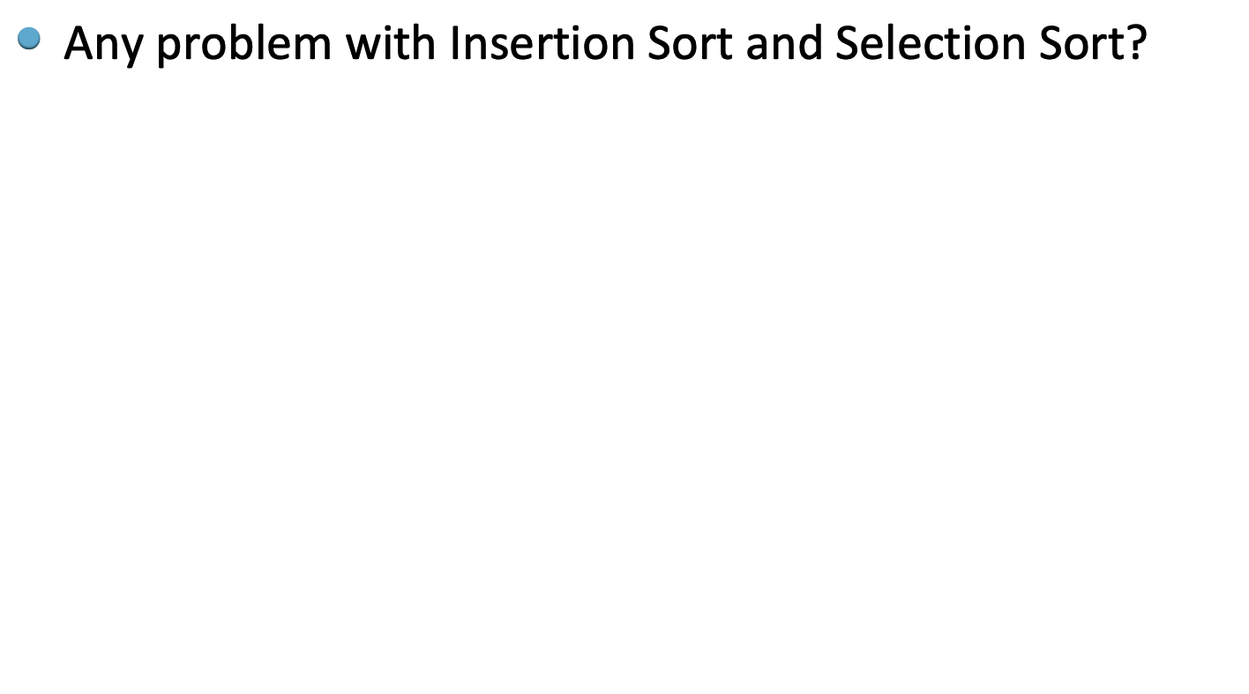
COMP20007.Worshop

Slide 7

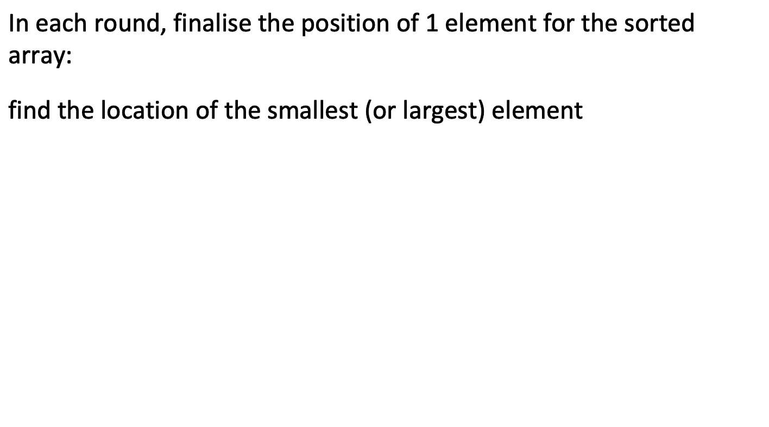
COMP20007.Worshop

Slide 8
























Round 1: consider A[0..4] determine position of the largest swap with the last, ie. A[4]
Round 2: consider A[0..3] determine position of the largest swap with the last, ie. A[3]
Round 4: consider A[0..1] determine position of the largest swap with the last, ie. A[1]
COMP20007.Worshop
COMP20005.Workshop
COMP20007.Worshop

Slide 9

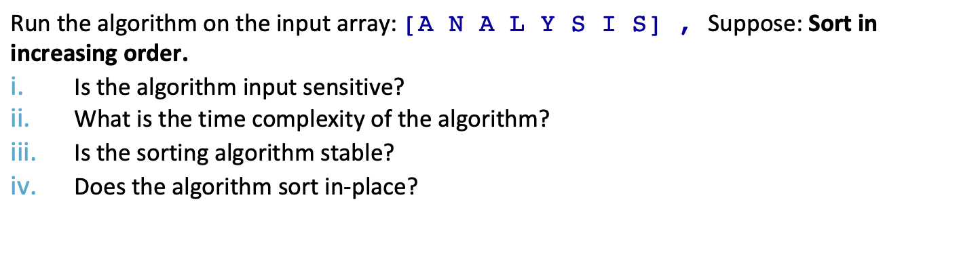
function SelectionSort(A[0..n-1]
Step | Array (note that | is used to separate the “done” part from the “not-yet-done” part
start | | A N A L Y S I S
1
COMP20007.Worshop

Slide 10

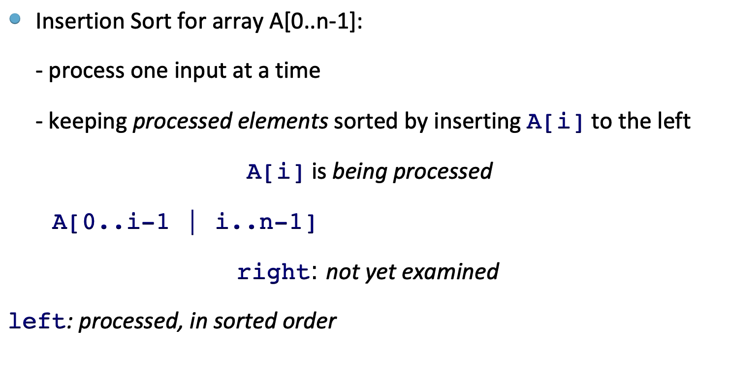
COMP20007.Worshop

Slide 11
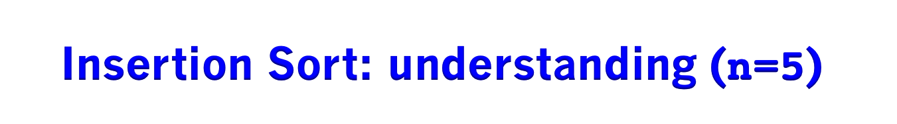
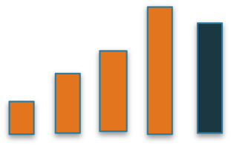
Round 1: consider A[1] A[0..0] is sorted insert A[1] to the left so that A[0..1] is sorted
Round 2: consider A[2] A[0..1] is sorted insert A[2] to the left so that A[0..2] is sorted
Round i: consider A[4] A[0..4] is sorted insert A[i] to the left so that A[0..4] is sorted
COMP20005.Workshop

Slide 12
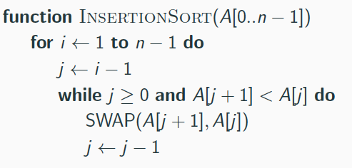
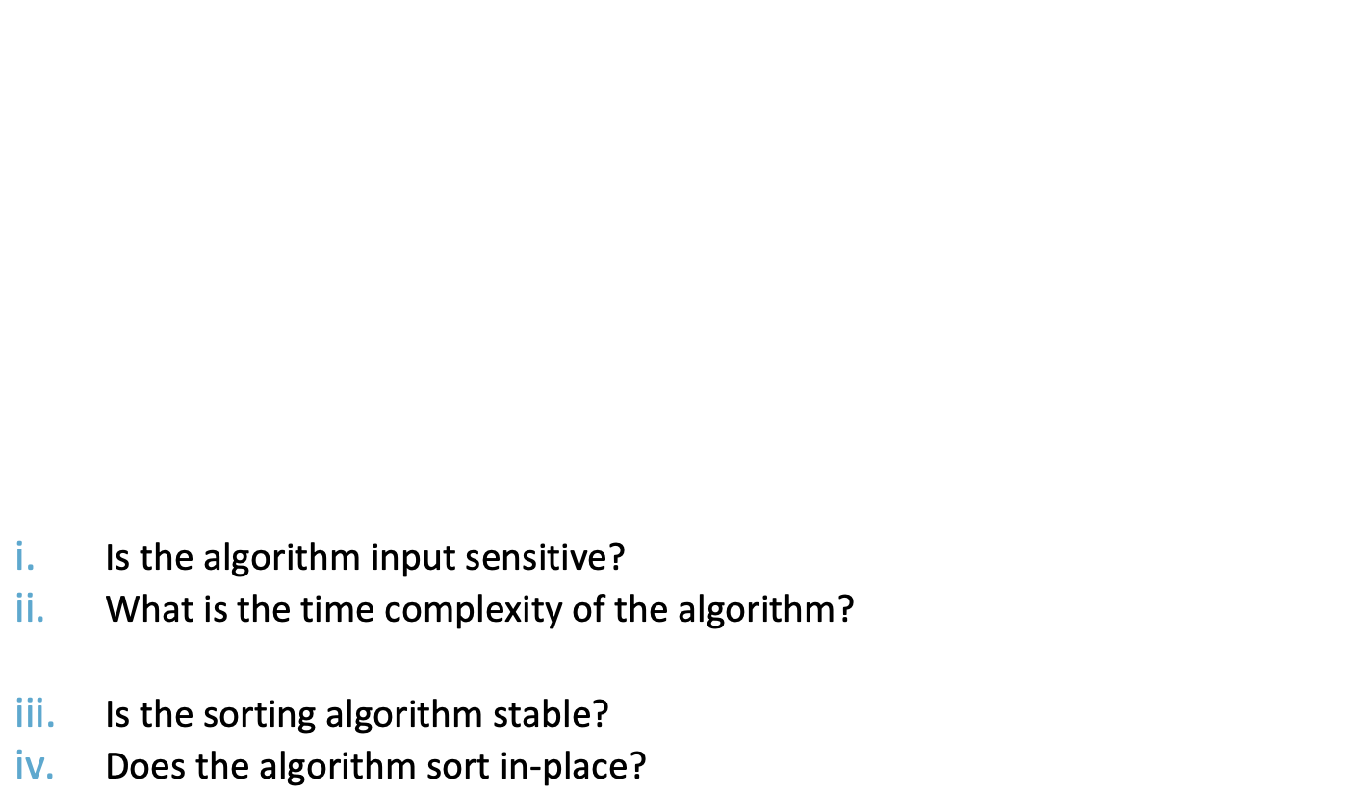
Step | Array (note that | is used to separate the “examined” part from the “not-yet-seen” part
start | A | N A L Y S I S
1
COMP2

Slide 13
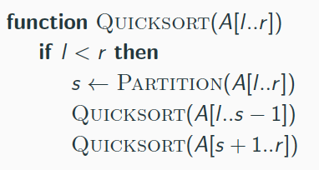
Partition(A[l..r])
<=A[s] >=A[s]
A: [l..s-1] s [s+1..r]
return s
COMP20007.Worshop

Slide 14
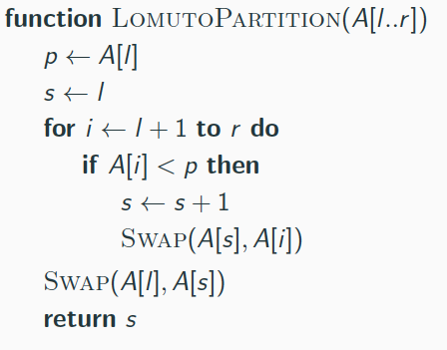
Using p= A[l] as the pivot
Loop: processing A[i] with i=l+1,...,r
During the loop, maintaining loop invariants:
l [l+1 .. s] s+1 .. i | i+1 .. r
<p >=p not yet processed
After the loop: swap A[l] with A[s]
Example: partitioning
16472 : l=0, r=4 p=1 | 86472: l=0, r=4 p=8 | 56472: l=0, r=4 p=5
1[]|6472 i=0, s=0 | 8[]|6472 i=0, s=0 | 5[]|6472 i=0, s=0
COMP20007.Worshop

Slide 15
input-sensitive?
complexity=?
stable?
in-place?
Partition(A[l..r])
<=A[s] >=A[s]
A[l..s-1 s s+1..r ]
return s
COMP20007.Worshop

Slide 16
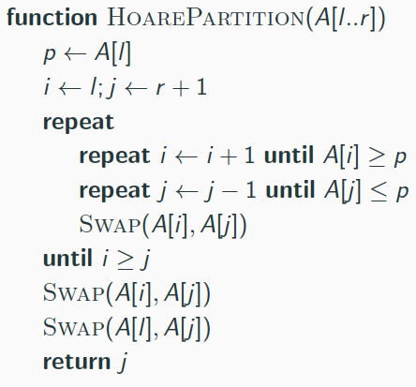
moving i forward, j backward so that:
A[l+1..i-1]<=p, A[i]>=p
A[j+1..r]>=p, A[j]<=p
A[l..j .. i ..r]
undo last swap (why?)
-before each loop iteration-
A: l [l+1..i-1] i .. j [j+1..r]
<=p >=p
Example A[0..4], p=A[0]=5:
5 []6 4 7 2 [] i=0, j=5
COMP20007.Worshop

Slide 17
Exercise: run Quicksort
A N A L Y S I S p=A
A [] N A L Y S I S []
COMP20007.Worshop

Slide 18
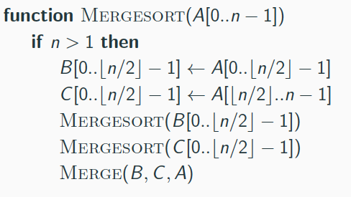
function BottomUpMS(A[0..n-1])
create_empty_queue
enqueue singleton array A[0],
A[1],..., A[n-1] into Q
while queue.size>1 do
dequeue arrays A and B
merge A and B to C
enqueue C
dequeue A
COMP20007.Worshop

Slide 19
Exercise: run bottum-up:
ANALYSIS
[A] [N] [A] [L] [Y] [S] [I] [S]
function BottomUpMS(A[0..n-1])
create_empty_queue
enqueue singleton array A[0],
A[1],..., A[n-1] into Q
while queue.size>1 do
dequeue arrays A and B
merge A and B to C
enqueue C
dequeue A
COMP20007.Worshop

Slide 20
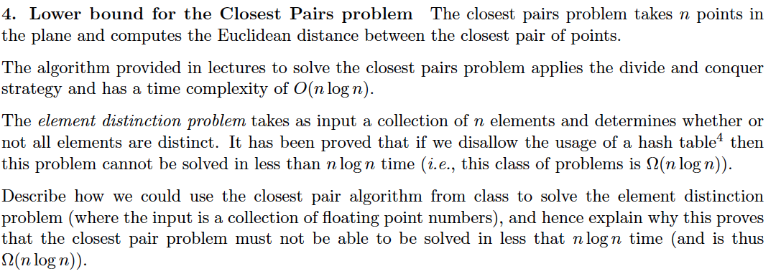
COMP20007.Worshop

