Slide 1
COMP20007 Workshop Week 6
1 2 | Topic 1: DFS & Topological Sorting Exercise: Q6.1 (toposort) Topic 2: Binary Trees & BST Group/Individual Exercises: Q 6.2, 6.4, 6.3 Lab: ASSIGNMENT 1 Finish ass1 if not yet done, or review workshops week 5-6 and ask questions on request: understanding BFS and Prim’s, Dijkstra’s

Slide 2
DFS review: Q&A on algorithm & complexity
function DFS(G=(V,E))
for each v in V do
mark v with 0
for each v in V do
if v is marked with 0 then
DfsExplore(v)
function DfsExplore(v)
// start visiting v
mark v with 1
for each edge (v,w) in E do
if w is marked with 0 then
DfsExplore(w)
// end visiting v
A
B
C
D
G
E
F

Slide 3
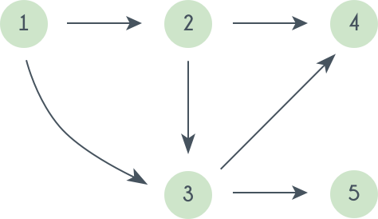
DFS exercise: push- and pop-order (pre- and post-order)
Problem:
For the graph below, write the push and pop order for DFS, starting from node 1
Method 1: Fill in the yellow boxes with push-orders, pink boxes with pop-orders. Note that you can start pop orders with 1, you can also use a timestamps for both push- and pop-orders.
1
?
?
?
?
?
?
?
?
?

Slide 4
DFS exercise: push- and pop-order (pre- and post-order)
Problem:
For the graph below, write the push and pop order for DFS, starting from node 1
Method 2: Explicitly show the order of the push and pop operations, and also show the content of the stack. Fill in the yellow box. orders.
The PUSH and POP, using $ for the bottom of stacks. ops stack content init $ push 1 $1 ?

Slide 5
DFS exercise: push- and pop-order, DFS complexity
// building push[V] and pop[V] function DFS(G=(V,E)) for each v in V do mark v with 0 for each v in V do if v is marked with 0 then DfsExplore(v) function DfsExplore(v) mark v with 1 for each edge (v,w) in E do if w is marked with 0 then DfsExplore(w)
Problem: Modify the DFS algorithm so that it also builds the arrays push[V] and pop[V]to store the push- and the pop-order of the vertices.
Example graph:
Homework: Complexity of the algorithm: using adjacency matrix ? using adjacency list ?
Homework: What’s the complexity of BFS : Prim’s : Dijkstra’s :

Slide 6
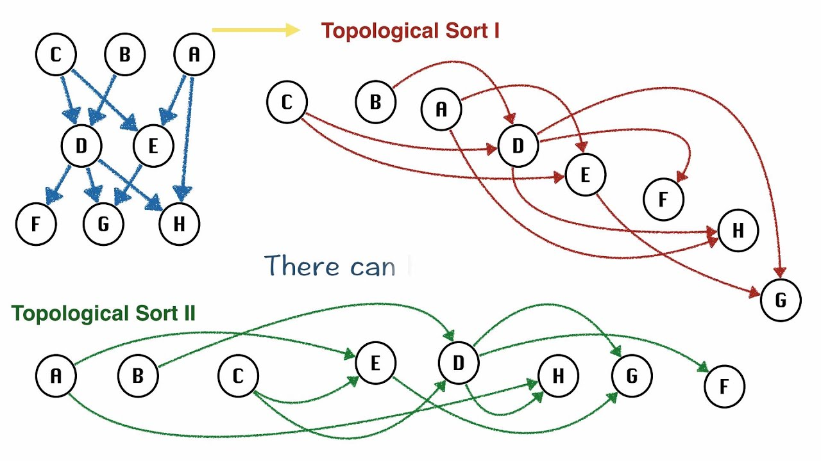
Topological Sorting (for DAG only!)
A topological ordering: sorting the nodes of the graph such that all edges point in one direction, to nodes later in the ordering.

Slide 7
Group Work: Q 6.1
T1: Finding a topological order for the graph by running a DFS.
YOUR ANSWER:
First, run the DFS
(you can also just draw graph and write down push and pop order on the left and right of each node like we did earlier)
The topological order resulted from the above DFS run:
???
operation content | operation content
init stack $ push A $A

Slide 8
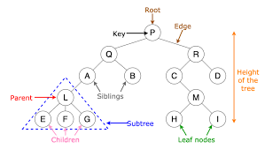
Topic 2 Binary Trees as Special Graphs
X
X
X
left right
child child
Notes:
denotes a NULL node, aka. external node, only a few of them drawn here. If the tree has n internal nodes, it has n+1 external nodes
Make differences between:
leaf nodes and external nodes
none-leaf nodes and internal nodes
X

Slide 9
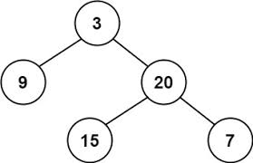
Binary Tree: Recursive Definition
A binary tree is:
NULL, or
a node, called the tree’s root node, that contains:
some data, normally including a key,
a link to another binary tree called the root’s left child, and
a link to another binary tree called the root’s right child
Side note: a non-empty tree is fully defined by its root. For simplicity we use: tree T = its root node = pointer to its root node.
T
X
X
X
X
X
X

Slide 10
Binary tree traversal
What is tree traversal?
For a tree T, what job we need to do with Traversal(T)?
What is inorder, preorder, postorder traversal? Are they BFS or DFS?
What is level-order traversal? Is it BFS or DFS?
T
Write the nodes in order visited by:
Inorder :
Preorder :
Postorder :
Levelorder:
X
X
X
X
X
X
Anh Vo 5 April 2022

Slide 11
Binary tree traversal
What is tree traversal? visiting all nodes of a tree
For a tree T, what job we need to do with Traversal(T)? 3 jobs: visit the root, traverse the left child, traverse the right child
What is inorder, preorder, postorder traversal? just depends on when we visit the root: in-between, before, or after traversing the children. All of them are DFS.
What is level-order traversal? Think of the tree as a graph, and start traversal from the root. In level-order, we visit level by level, left to right, starting from the root. This is BFS.
T
Write the nodes in order visited by:
Inorder : 9 3 15 20 7
Preorder : 3 9 20 15 7
Postorder : 9 15 7 20 3
Levelorder: 3 9 20 15 7
X
X
X
X
X
X
Anh Vo 5 April 2022

Slide 12
Q 6.4: Binary Tree Sum
Write an algorithm to calculate the sum of a binary tree where each node contains a number.
YOUR ANSWER: The pseudocode:
function Sum( T )
???

Slide 13
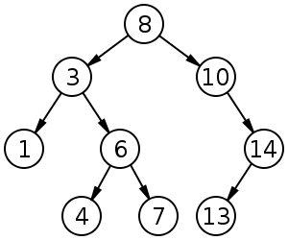
Binary (Search) Tree
How to:
print the keys in increasing order?
print in decreasing order?
copy the tree?
free the tree?
Your answers:

Slide 14
Group/Individual work
Questions 6.2, 6.3.

Slide 15
Q 6.2: conventional traversal
Write the inorder, preorder and postorder traversals of
the following binary tree:
YOUR ANSWER:
In-order:
?
Pre-order:
?
Post-order:
?

Slide 16
Q 6.3: level-order traversal
YOUR ANSWER:
a) Level-order: ???
Level-order: visit level-by-level, left-to-right, starting from the root (which is in 0-th level).
For the tree below, what’s the visited order?
Write the level-order pseudo-code.
b) // level order traversal for binary tree T // supposing a non-empty tree has 3 components // T.root, T.left, T.right function LevelOrder(T) ??? // for reference function BFS(G=(V,E)) mark each node in V with 0 for each v in V do if v is marked with 0 then Q := empty queue mark v with 1 inject(Q, v) //=enQueue while Q ≠ ∅ do u := eject(Q) //=deQueue // visit u for each (u,w) in E do if w is marked 0 then mark w with 1 inject(Q, w)//=enQueue

Slide 17
LAB
Questions on Dijkstra’s and BFS?
Assignment 1:
do assignment 1 if not yet done
make sure that you can finish on time
note that you can discuss general problems with your friends but please do not reveal or show your solution and code
OR:
do not-yet-done problems (if any) of previous workshops/lab/lectures

