Slide 1
COMP20007 Workshop Week 8
1 2 LAB | Preparation: - use the powerpoint or PDF slides for note taking if you like, but - have papers and pens (or drawing tools) ready, and/or - ready to work on whiteboards Binary Heap: Operations, Heapsort, Questions 8.2, 8.3 Sorting Algorithms - quicksort: Question 8.1 Quickselect (Question 8.4) Lab: Sorting algs, follow the given instructions

Slide 2

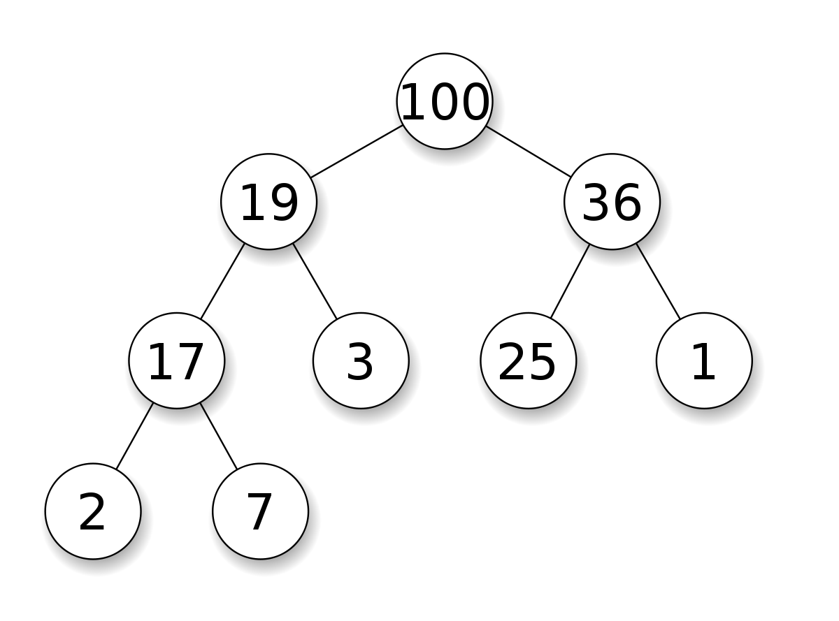
A Priority Queue: Binary Heap = ?
Binary Heap as a concrete data type (implementation) for PQ.
min heap, max heap = ?
What is a, say, max heap?
How is it implemented?

Slide 3
Binary Heap: conceptually, is a binary tree
Example | Conditions
 | The tree is complete: all levels, except for the last, are full the last level is filled from left to right The heap property: each node has a higher priority (here, is larger) than any of its descendants (or equivalently, just its children).

Slide 4
Binary Heap: is implemented as an array!
Visualisation: as a complete binary tree | Implementation: using arrays
 | note: H[1] is for the root H[0] not used (or used for a sentinel)
Heap is H[1..n] level i occupies 2^{i} cells in array H[1..n] (except for the last level) - if root is level 1, then level i starts from H[i] | Heap h is a pair {H[], n}, elements in H[1..n] level i occupies 2i cells in array H[1..n] parent of H[i] is H[i/2] iif i>1 left child of H[i] is H[2*i] iif 2*i<=n right child of H[i] is H[2*i+1] iif 2*i+1<=n
idx | 0 | 1 | 2 | 3 | 4 | 5 | 6 | 7 | 8 | 9
val | ✕ | 100 | 19 | 36 | 17 | 3 | 25 | 1 | 2 | 7

Slide 5

Binary Heap: parent and children of a node
left child of H[i] is H[2*i]
right child of H[i] is H[2*i+1]
parent of H[i] is H[i/2]
4/2 i=4 4*2 4*2+1
idx | 0 | 1 | 2 | 3 | 4 | 5 | 6 | 7 | 8 | 9
val | ✕ | 100 | 19 | 36 | 17 | 3 | 25 | 1 | 2 | 7

Slide 6
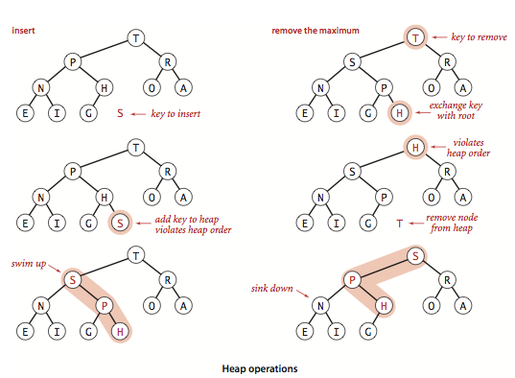
inject = enPQ = Insert a new elem into a heap
Notes:
8
6
5
Sift Up
while (has parent and parent has lower priority): swap up with the parent
sift Up
3
9

Slide 7
eject = delete (and returns) the heaviest
Notes:
Sift Down:
while (has children and the heavier child has higher priority): swap down with the heavier child
sift Down

Slide 8
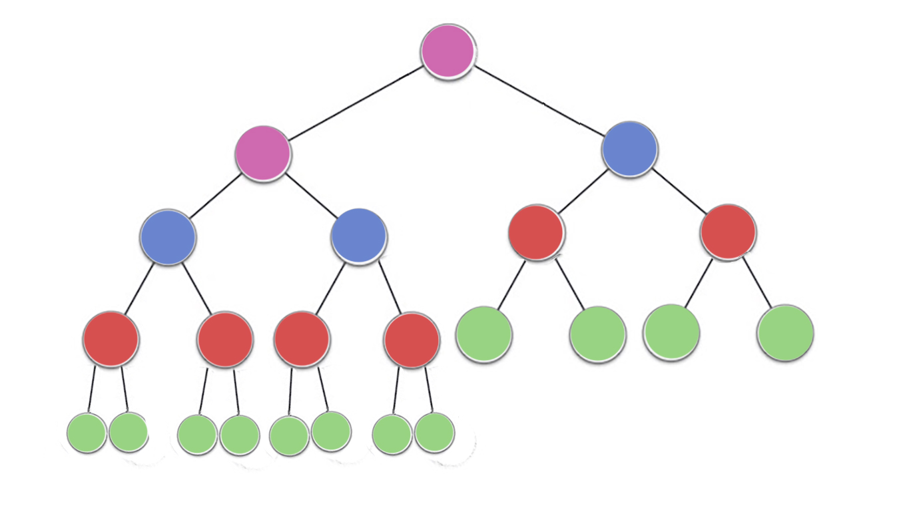
Heapify: Turning an array H[1..n] into a heap
Notes:
function Heapify(H[1..n])
for i ← n/2 downto 1 do
downheap(H, i)
= Θ(n) (see lectures and/or ask Google for a proof)
The operation is aka. Heapify/Makeheap/ Bottom-Up Heap Construction
Example: build maxheap for keys E X A M P

Slide 9
Q 8.2
Your answers:
array is: [ ??? ]
Run the RemoveRootFromHeap:
Run the InsertIntoHeap(2)
Show how this heap would be stored in an array as discussed in lectures (root is at index 1; node at index i has children at indices 2i and 2i+1)
Run the RemoveRootFromHeap (eject) algorithm from lectures on this heap by hand (i.e., swap the root and the “last”element and remove it. To maintain the heap property we then SiftDown from the root).
Run the InsertIntoHeap (inject) algorithm and insert the value 2 into the heap

Slide 10
Q 8.3 [opt]: k-smallest using min-heap
The k-th smallest problem:
Given an array A[] of n elements, and an integer k
Find the k-th smallest value (suppose that k is zero-origin, that is, k can be any of 0, 1, 2, ..., n-1)
How can we use a min-heap data structure to solve the kth-smallest element problem? What is the time-complexity of this algorithm?
Your answer:
Algorithm | Complexity
function HeapkthSmallest(A[0..n-1],k)

Slide 11
Basic Sorting Algorithms
Question 8.1
We saw the following sorting algorithms, (a) Selection Sort (b) Insertion Sort (c) Quicksort (with Lomuto partitioning) For each algorithm: (i) Run the algorithm on the array: [A N A L Y S I S] (ii) time complexity of the algorithm=? (iii) Is the sorting algorithm stable? (iv) Does the algorithm sort in-place? (v) Is the algorithm input sensitive? (vi) What is the strongest point of the algorithm (when should it be used)? If you get time, try to answer these questions for (d) Quicksort (with Hoare partitioning), and (e) Merge Sort (f) Heap Sort
Know how to run by hand the following algorithms:
Selection Sort
Insertion Sort
Quick Sort with Lomuto’s Partitioning
Quick Sort with Hoare’s Partitioning
Merge Sort
Heap Sort
Run example with keys:
E X A M P
LAB: follow instructions in workshop sheet

Slide 12
Quicksort for A[l..r]
function quicksort(A[l..r])
if l >= r then return s ← do partitioning, ie: # Lomuto or Hoare or … pivot= A[l] rearrange A[] into A[l..s-1] A[s] A[s+1..r] so that A[s]= pivot all elements in A[l..s-1] are <= pivot all elements in A[s+1..r] are >= pivot quicksort(A[l..s-1)) quicksort(A[s+1..r)
Notes: We can choose any element in A[l..r] as pivot: just swap it with A[l] at the start of partitioning A[l..s-1] or A[s+1..r] could be empty Complexity depends on the relative lengths of A[l..s-1] and A[s+1..r]

Slide 13
function LomutoPartition(A[l..r])
# loop init:
P ← A[l]
s ← l, i ← l+1
# loop invariant:
# A[l+1..s]<P A[s+1..i-1]≥P
# A[i..r] not yet examined
while i ≤ r do
# move i++ until A[i]<P
if A[i] < P then
#extend the yellow area
s ← s + 1
Swap(A[s], A[i])
i ← i+1
# at loop exit (i=r+1) -----------------→
# A[s] is the last yellow (OR s=l)
Swap(A[l], A[s])
return s
s i
P
l r
s i
<P >=P un-examined
P
s i→i
<P >=P un-examined
P
x
s i
<P >=P un-examined
P
s i
<P >=P
P
s
<P >=P
l r
P

Slide 14
Example: Run quicksort with Lomuto’s for [ E X A M P]
# loop init:
P ← A[l]
s ← l, i ← l+1
# loop invariant:
# A[l+1..s]<P A[s+1..i-1]≥P
# A[i..r] not yet examined
while i ≤ r do
# move i++ until A[i]<P
if A[i] < P then
#extend the yellow area
s ← s + 1
Swap(A[s], A[i])
i ← i+1
# at loop exit (i=r+1) -----------------→
# A[s] is the last yellow (OR s=l)
Swap(A[l], A[s])
return s
Partitioning [ E X A M P]
E_{s} X_{i} A M P
E_{s} X A_{i} M P
E A_{s} X_{i} M P
E A_{s} X M P _{i}
[A] E_{s} [X M P]
To simplify, we will write out the sequence only: at the beginning and end of the loop, and after a swap.
The algorithm is quite slow on small arrays!
Partitioning [ X M P]
X_{s} M_{i} P
X M_{si} P
X M_{s} P_{i}
X M P_{si}
X M P_{s i}
[P M] X_{s}
Partitioning [ P M]
P_{s} M_{i}
P M_{si}
P M_{s i}
[M] P_{s}
Final sorted: [ A E M P X]

Slide 15
qsort with Lomuto’s Partitioning
Q8.1c): Run quicksort with Lomuto’s for [ A N A L Y S I S]. Here we rewrite the sequence after each swap and at the start/end of the loop.
1. Partitioning of
A N A L Y S I S
A_{s} N_{i} A L Y S I S
???
3. Partitioning of
???
???
5. Partitioning of
???
???
2. Partitioning of
???
???
4. Partitioning of
???
???
Final sorted sequence
???

Slide 16
function HoarePartition(A[l..r])
i→ ←j
# loop init: P ← A[l] i ← l; j ← r + 1 # loop invariant: # A[l+1..i]≤P A[j..r]≥P # A[i+1..j-1] not yet examined repeat # move i forward until A[i]>=P repeat i←i+1 until A[i] ≥ P # same as do i←i+1 while A[i]<P # move j backward until A[j]<=P repeat j←j−1 until A[j] ≤ P # extend yellow and green area # at the same time by swapping ----→ if (i<j) then Swap(A[i], A[j]) until i ≥ j # at loop’s exit: Swap(A[l], A[j]) return j
P
l r
i j
<=P un-examined >=P
P
i→ i j ←j
<=P un-examined >=P
P
i j
<=P un-examined >=P
P
j i
<=P >=P
P
Run example with
E X A M P
j
<=P >=P
P

Slide 17
qsort with Hoare’s Partitioning
Q8.1d): Run quicksort with Hoare’s for [ A N A L Y S I S]. Here we rewrite the sequence after each swap and at the start/end of the loop.
1. Partitioning of
A N A L Y S I S
A_{i} N A L Y S I S _{j}
???
3. Partitioning of
???
???
2. Partitioning of
???
???
4. Partitioning of
???
???
Final sorted sequence
???

Slide 18
Also
Make sure you can run (by hand) Merge Sort and HeapSort for
[E X A M P]
[A N A L Y S I S]
And, review the lectures for the remaining questions of problem 1. For each sorting algorithm, think:
which is the best situations when we want to employ that algorithm?
in which situations when we definitely don’t want that algorithm?

Slide 19
Q 7.4 [opt]
Design an algorithm Quickselect based on Quicksort which uses the Partition algorithm to find the k-th smallest element in an array A.
Show how you can run your algorithm to find the k-th smallest element where k = 4 and A = [9,3,2,15,10,29,7].
What is the best-case time-complexity of your algorithm? What type of input will give this time-complexity?
What is the worst-case time-complexity of your algorithm? What type of input will give this time-complexity?
What is the expected-case (i.e., average) time-complexity of your algorithm?
When would we use this algorithm instead of the heap based algorithm from Question 3

Slide 20
partitionning & qselect
 | partition( A[lo..hi]): ... return m
11 12 13 14 15 16 17 | function qselect( A[lo..hi], k) m= partition(A[lo..hi])
21 22 23 | function ksmallest(A[0..n-1], k) if (k>=0 && k<n) return qselect(A[0..n-1], k)
Notes:
Note on average complexity:
After each iteration of Partitioning, our pivot is more likely to have the original array splitted into two sub-arrays, with each of them containing "some proportion" of elements from the original array. Even if we consider a very imbalanced split, with 99% of the elements placed into one sub-array, and 1% of elements go into another sub-array, we will still end up with a linear complexity. In case that we are really unlucky, our k-th smallest element always lays in the larger sub-array (the array contains 99% of elements), we would have the following recursive relation:
T(n) = T(0.99n)+Theta(n), T(1)=1
By master theorem we can find that T(n) is still in Theta(n). Considering that we had two assumptions (highlighted yellow above), this T(n) is worse than our average case. And since the best case for QuickSelect is Theta(n), we can surely conclude that the average / expected time complexity is Theta(n), for a random ordered input.

Slide 21
Check: partitionning & qselect
 | partition( A[lo..hi]): ... return m
11 12 13 14 15 16 17 | function qselect( A[lo..hi], k) m= partition(A[lo..hi]) if (k==m) then return A[m] if (k<m) then qselect(A[lo..m-1], k) else qselect(A[m+1..hi], k)
21 22 23 | function ksmallest(A[0..n-1], k) if (k>=0 && k<n) return qselect(A[0..n-1], k)
Notes:
Note on average complexity:
After each iteration of Partitioning, our pivot is more likely to have the original array splitted into two sub-arrays, with each of them containing "some proportion" of elements from the original array. Even if we consider a very imbalanced split, with 99% of the elements placed into one sub-array, and 1% of elements go into another sub-array, we will still end up with a linear complexity. In case that we are really unlucky, our k-th smallest element always lays in the larger sub-array (the array contains 99% of elements), we would have the following recursive relation:
T(n) = T(0.99n)+Theta(n), T(1)=1
By master theorem we can find that T(n) is still in Theta(n). Considering that we had two assumptions (highlighted yellow above), this T(n) is worse than our average case. And since the best case for QuickSelect is Theta(n), we can surely conclude that the average / expected time complexity is Theta(n), for a random ordered input.

Slide 22
Problem 4
Design an algorithm based on Quicksort which uses the Partition algorithm to find the k-th smallest element in an array A.
Show how you can run your algorithm to find the k-th smallest element where k = 4 and A = {9,3,2,15,10,29,7}.
What is the best-case time-complexity of your algorithm? What type of input will give this time-complexity?
What is the worst-case time-complexity of your algorithm? What type of input will give this time-complexity?
What is the expected-case (i.e., average) time-complexity of your algorithm?

Slide 23
LAB

