Slide 1
COMP20007 Workshop Week 6
1 2 3 LAB | Preparation: - open ws6.pptx from github.com/anhvir/c207 - (optional) open wokshop6.pdf (from LMS) Topic 1: DFS and BFS: Group Work: Problems T1, T2, T4, T3 (in listed order) Topic 2: Dijkstra’s and Prim’s Algorithms Group Work: Problems T5, T6 Assignment 1 Q&A, and make sure that you can scp, ssh, use dimefox to test/submit do Assignment 1 or do not-yet-done exercises Before leaving: Please give comments on the format of today’s workshop

Slide 2
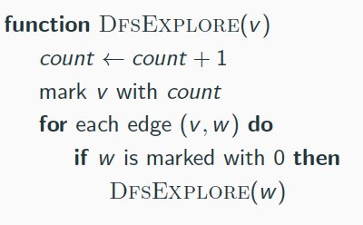
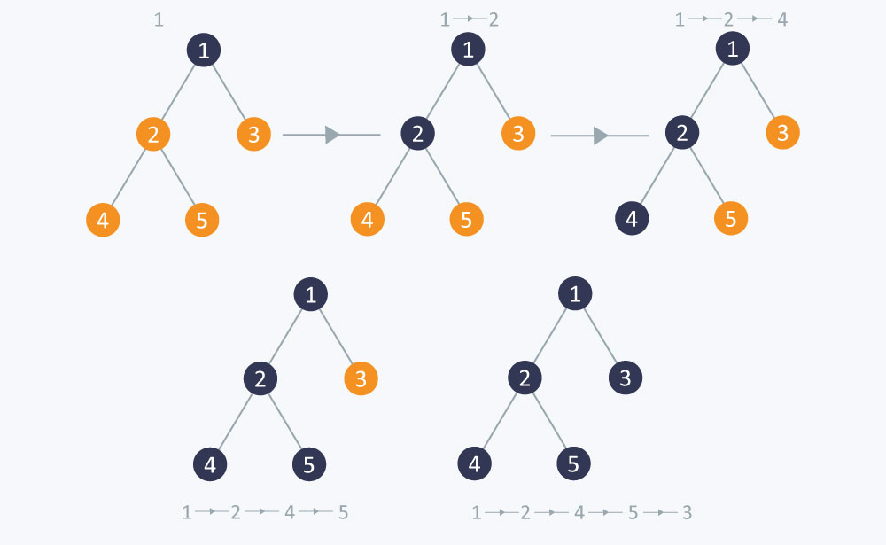
DfsExplore(1): explore a connected component from node 1

Slide 3
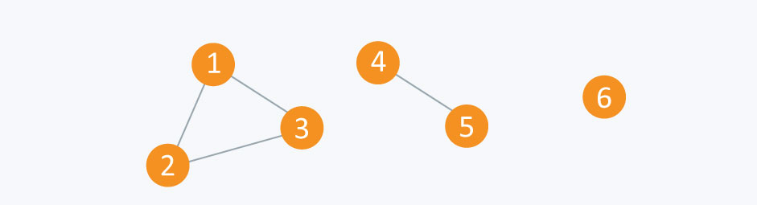
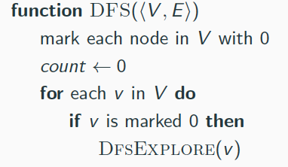
DFS: explore a whole (multi-component) graph
Using DFS how can we discover that:
this graph has 3 components?
this graph is cyclic?
Using DfsExplore, how can we list the
length of all possible paths from 1 → 3 ?

Slide 4
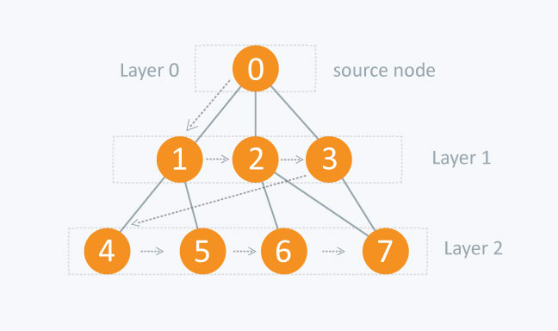
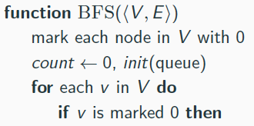
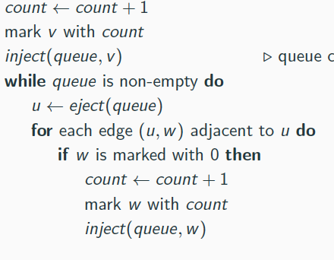
BfsExplore(0): explore a component from node 0, in BFS manner
BfsExplore(v)
function BfsExplore(v)

Slide 5
T1: Depth First Search
List the order of the nodes visited by the a) DFS and b) BFS algorithms
A
C
F
B
D
YOUR ANSWER: a) The order of the nodes visited by DFS is: A b) The order of the nodes visited by BFS is: A
E
G

Slide 6
T3: Finding Cycles
a) Explain how one can also use BFS to see whether an undirected
graph is cyclic. b) Which of the two traversals, DFS and BFS, will be able to find cycles faster? (If there is no clear winner, give an example where one is better, and another example where
the other is better. – but skip this part if it takes more than 1 minute)
YOUR BRIEF ANSWER:
BfsExplore(v)
function BfsExplore(v)

Slide 7
T4: 2-Colourability
Design an algorithm to check whether an undirected graph is 2-colourable, that is, whether its nodes can be coloured with just 2 colours in such a way that no edge connects two nodes of the same colour. To get a feel for the problem, try to 2-colour the following graph (start from S). Do you expect we could extend such an algorithm to check if a graph is 3-Colourable, or in general: k-Colourable?
S
A
E
F
B
D
C
YOUR BRIEF ANSWER:
a) try to 2-colour the above graph, starting from S, using 2 colours + and –
hint: what is colour for S? how do we continue?
b) So, how to solve the 2-colourability?
c) Do you expect we could extend such an algorithm to check if a graph is 3-Colourable, or in general: k-Colourable?

Slide 8

T2
A DFS of a di-graph can be represented as a collection of trees. Each edge of the graph can then be classified as a tree edge, a back edge, a forward edge, or a cross edge. A tree edge is an edge to a previously un-visited node, a back edge is an edge from a node to an ancestor, a forward edge is an edge to a non-child descendent and a cross edge is an edge to a node in a different sub-tree (i.e., neither a descendent nor an ancestor)
Draw a DFS tree based on the following graph, and classify its edges into these categories.
In an undirected graph, you wont find any forward edges or cross edges. Why is this true? You might like to consider the graph above, with each of its edges replaced by undirected edges.
A gift from Anh: If you are a bit bored or tired, skip this exercise, and
instead use pages 24-36 (of this file) to entertain yourselves ;-)

Slide 9
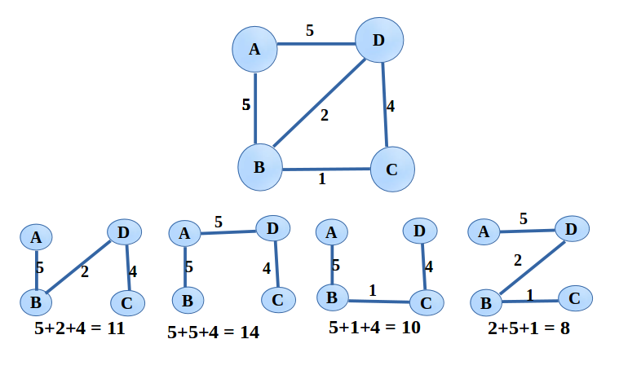
Dijkstra’s Algorithm: purpose= ?
What’s the purpose of the DA?

Slide 10
Dijkstra’s Algorithm
purpose | SSSP (that involves all nodes of a connected graph)
init | for all v ∈V : dist[v]= ∞ prev[v]= nil dist[S]= 0
basic loop | for all u∈V, at each step choose u that dist[u] is min amongst the unselected
action after selecting u | for all unselected v such that (u,v)∈E: if dist[v]>dist[u]+w(u,v): update dist[v] update prev[v]
Q: what is update dist[v] ? update prev[v] ?
why Dijkstra’s algorithm is greedy?

Slide 11
T5: SSSP with Dijkstra’s Algorithm (DA)
Dijkstra’s algorithm computes the shortest path to each node in a graph from a single starting node (the ‘source’). Trace Dijkstra’s algorithm on the following graph, with node E as the source
Repeat the algorithm with node A as the source. How long is the shortest path from E to A? How about A to F

Slide 12
Dijkstra’s Algorithm from E
dist[E] prev[E]
(nil, not shown)
step | node explored | A | B | C | D | E | F | G
0 |  | ∞ | ∞ | ∞ | ∞ | 0 | ∞ | ∞
DA is a BFS. DA is used to find shortest path from a source to all other nodes. A practical implementation is to maintain 3 arrays:
dist[v] = shortest-distance-found-so-far from source to v
prev[v] = id of the node preceding v in the path-found-so-far
visited[v] = Y if v has been explored/visited, N if not yet

Slide 13
DA from E
step | node explored | A | B | C | D | E | F | G
0 |  | ∞ | ∞ | ∞ | ∞ | 0 | ∞ | ∞
1 | E | ∞ | 9E | ∞ | 7E |  | ∞ | 6E
At step 1: choose the node with minimal dist amongst the unvisited nodes. This is E. Then, consider to update dist[v] for v= {B, D, G}. And, mark E as visited ???.

Slide 14
DA from E How long, and what is, the shortest path from E to A? cost= path =
step | node explored | A | B | C | D | E | F | G
0 |  | ∞ | ∞ | ∞ | ∞ | 0 | ∞ | ∞
1 | E | ∞ | 9E | ∞ | 7E |  | ∞ | 6E
2 | G

Slide 15
DA from A How long, and what is, the shortest path from E to A? How about from A to F?
step | node visited | A | B | C | D | E | F | G
0 |  | 0/nil | ∞/nil | ∞/nil | ∞/nil | ∞/nil | ∞/nil | ∞/nil
1
2
3
4
5
6
7

Slide 16
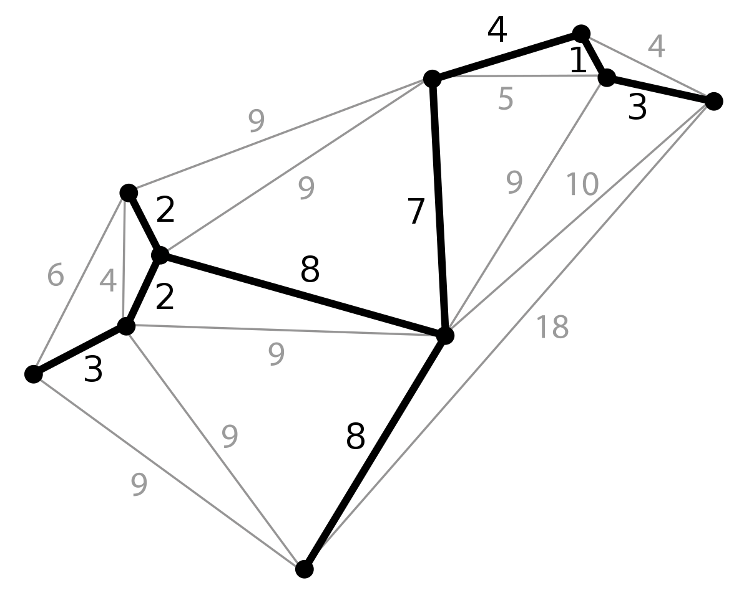
Prim’s Algorithm: Finding a MST of a connected graph
Concepts of spanning trees and MST

Slide 17
Dijkstra’s and Prim’s are similar?
 | Dijkstra’s | Prim’s
purpose | SSSP (that involves all nodes of a connected graph) | MST (that involves all nodes of a connected graph)
init | for all v ∈V : dist[v]= ∞ prev[v]= nil dist[S]= 0 | same
basic loop | for all u∈V, at each step choose u that dist[u] is min amongst the unselected | same
action after selecting u | for all unselected v such that (u,v)∈E: if dist[v]>dist[u]+w(u,v): update dist[v] update prev[v] | same loop to decide whether to include edge (u,v): if dist[v]>w(u,v): same
So, the 2 alg are similar. The only difference is the optimizing functions. There are many other situations when the same algorithm applied, but perhaps with a different optimizing function.

Slide 18
T6: Minimum Spanning Tree with Prim’s Algorithm
Prim’s algorithm finds a minimum spanning tree for a weighted graph. Discuss what is meant by the terms ‘tree’, ‘spanning tree’, and ‘minimum spanning tree’.
Run Prim’s algorithm on the graph below, using A as the starting node. What is the resulting minimum spanning tree for this graph? What is the cost of this minimum spanning tree?

Slide 19
Prim’s Alg from A What’s the resulting MST? What’s the cost of that MST?
step | node visited | A | B | C | D | E | F | G
0 |  | 0 | ∞ | ∞ | ∞ | ∞ | ∞ | ∞
1 | A |  | 2A | 4A | 1A
2 | D
3
4
5
6
7

Slide 20
Food for our brain
You’re organizing your birthday party and inviting n friends. From these friends you know that there are some pairs of people who hate each other. You want to know if it’s possible to divide guests into 2 different tables so that in each table there is no such hating pair. Design an algorithm for that.
You have un unweighted undirected graph. Design an algorithm to find the shortest part (the part with least number of edges) between 2 vertices. What if the graph is weighted?

Slide 21
assignment 1
Do it early! Submit early, resubmit if needed!
Read & participate in discussion forum!
Make sure that you follow well the specification.
Check your writing part carefully..
Test your program carefully: remember to test on dimefox
Make sure you don’t have memory leak:
check that every execution of malloc matches with an execution of free, and
[optional] use tools like valgrind to test for memory leak.

Slide 22
How to test/submit the programming part
Suppose that all all of your files are in directory A1. To submit:
When on the parent directory of A1, copy the whole A1 to dimefox using scp (or pscp, but perhaps you should install scp):
scp –r A1 username@dimefox.eng.unimelb.edu.au:
pscp –r A1 username@dimefox.eng.unimelb.edu.au:
Then, login into dimefox using ssh, after that, in dimefox, test your program with make, and do the test with sample data and sample outputs
To test, when on dimefox run:
cd ~/A1
make clean
make
./a1 p2a < tests/p2a-in-1.txt >my-p2a-out-1.txt
<compare to see that my-p2a-out-1.txt is the same as tests/p2a-out-1.txt>
To submit, when on dimefox run:
cd ~/A1
submit comp20007 a1 Makefile *.c *.h

Slide 23
Lab: do assmt1 or your choice

Slide 24
Extra: understanding DFS on di-graphs and the concepts of tree-, back-, forward-, cross-edges
A
B
E
C
D

Slide 25
DFS
A
B
E
C
D

Slide 26
DFS
1
A
note: black number 1 is the
push order
B
E
C
D

Slide 27
DFS
1
A
2
B
E
C
D

Slide 28
DFS
1
`
A
2
B
E
C
D
3

Slide 29
DFS
1
`
A
2
B
E
C
D
3
4

Slide 30
DFS
1
note: orange number 1 represents
the pop order
`
A
2
B
E
C
D
3
4
1

Slide 31
DFS
1
`
A
2
B
E
C
D
3
2
4
1

Slide 32
DFS
1
`
A
2
5
B
E
C
D
3
2
4
1

Slide 33
DFS
1
`
A
2
5
3
B
E
C
D
3
2
4
1

Slide 34
DFS
1
`
A
2
4
5
3
B
E
C
D
3
2
4
1

Slide 35
DFS
1
`
A
5
Oranges edges are tree edges. Not used used edges: all would be back-edges if the graph was un-directed
2
4
5
3
B
E
C
D
3
2
4
1

Slide 36
DFS
`
A
Oranges edges are tree edges. Not used edges: red are forward edges blue are back-edges other dashed are cross edges Why don’t we have forward and cross edges in undirected graph?
B
E
C
D

