Slide 1
COMP20007 Workshop Week 9
1 2 3 LAB | Preparation: - have draft papers and pen ready, or ready to work on whiteboard - be ready with Ed.Week 10 Workshop Hashing: Q 10.1, 10.2 Huffman Coding: Questions 10.3, 10.4 Revision on demands: Complexity (Question 10.5) Solving Recurrences Lab: playing with hashing code

Slide 2
hashing/hashtable = ?

Slide 3
Hash Table: dictionary with average 𝛉(1) search/insert/delete
Hashing= hash table T + hash function h(x): store key x at T[h(x)]
0
1
…
k
m-1
Example:
storing a list of <= 100 student records, each student has a unique student number in the range of:
1..100
5,001..6,000
1..10,000
h(x)= ?, m=?
suppose h(x)= k for some x
h(x)
x
x
hash table T: array T that contain data (or pointers to data)
hash table size m: size of the array.
hash slot, aka. hash bucket: an entry T[i] of hash table T
hash function h: a function that converts a key x to an index h(x) that 0≤h(x)<m, h(x) is required to:
distribute keys evenly (uniformly) along the table,
be efficient (𝛉(1))

Slide 4
Collisions
Collision when h(x1) = h(x2) for some x1≠ x2.
Collisions are normally unavoidable.

Slide 5

Collisions
Example:
m=5, h(x)= x% m
Here: h(8)= h(5)
Methods to reduce collisions:
using a prime number for hash table size m.
making the table size m big
Even though, collisions might still happen
0
1
2
3
4
5
13
14
5
13
14
8

Slide 6
Collision Solution 1: Separate Chaining
h(x) = x % 7, keys entered in decreasing order:
100, 81, 64, 49, 36, 25, 16, 4,2,1,0
In separate chaining, buckets contain the link to a data structure (such as linked lists), not the data themselves.

Slide 7

Solution 2: Linear Probing (here, data are in the buckets)
linear probing= when colliding, find the successive empty cell.
Example: m=5, h(x)= x mod m,
keys inserted: 5, 13, 4, 8
?0
😀1
2
?3
?4
5
13
14
Hashing with linear probing:
When inserting we do some probes until getting a vacant slot:
h(x) replaced by
H(x, probe)= (h(x) + probe) mod m
where probe is 0, 1, 2 …
until reaching a vacant slot
The same procedure for search
Deletion is problematic! (why?)
5
13
14
8

Slide 8
Double Hashing
When colliding, look forward for empty cells at distance h2(x)
Example: m=5, h(x)= x mod m,
h2(x)= x mod 3,
keys inserted: 5, 13, 4, 8
?0
1
😀 2
?3
4
5
13
14
Hashing with double hashing:
similar to linear probing, but employ a second hash function h2(x):
H(x,probe)= (h(x)+ probe*h2(x)) mod m
where probe is 0, 1, 2, … (until reaching a vacant slot).
Note that:
h2(x) ≠ 0 for all x, (why?)
to be good, h2(x) should be co-prime with m, (how?)
Note: linear probing is just a special case of double hashing when h2(x)=1.
Both linear probing and double hashing are referred to as Open Addressing methods.
5
13
14
8

Slide 9
Q 10.1, 10.2 [Group/Individual]: Separate chaining
Q 10.1: Consider a hash table in which the elements inserted into each slot are stored in a linked list. The table has a fixed number of slots L=2. The hash function to be used is h(k)=k mod L.
Show the hash table after insertion of records with the keys 17 6 11 21 12 33 5 23 1 8 9
Can you think of a better data structure to use for storing the records that overflow each slot?
Q 10.2: Consider a hash table in which each slot can hold one record and additional records are stored elsewhere in the table using linear probing with steps of size i=1. The table has a fixed number of slots L=8. The hash function to be used is h(k)=k mod L.
Show the hash table after insertion of records with the keys 17 7 11 33 12 18 9
Repeat using linear probing with steps of size i = 2. What problem arises, and what constraints can we place on i and L to prevent it?
Can you think of a better way to find somewhere else in the table to store overflows?

Slide 10
Q 10.1: Separate chaining
Consider a hash table in which the elements inserted into each slot are stored in a linked list. The table has a fixed number of slots L=2. The hash function to be used is h(k)=k mod L.
Show the hash table after insertion of records with the keys 17 6 11 21 12 33 5 23 1 8 9
Can you think of a better data structure to use for storing the records that overflow each slot?
Your solution & notes:

Slide 11
Q 10.2: Open addressing
Consider a hash table in which each slot can hold one record and additional records are stored elsewhere in the table using linear probing with steps of size i=1. The table has a fixed number of slots L=8. The hash function to be used is h(k)=k mod L.
Show the hash table after insertion of records with the keys 17 7 11 33 12 18 9
Repeat using linear probing with steps of size i = 2. What problem arises, and what constraints can we place on i and L to prevent it?
Can you think of a better way to find somewhere else in the table to store overflows?
Your solution & notes:

Slide 12
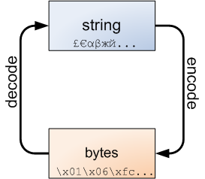
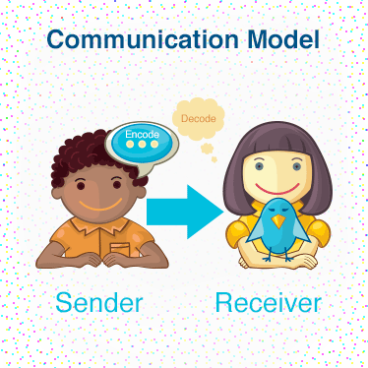
Coding: used for storage, communication and …

Slide 13
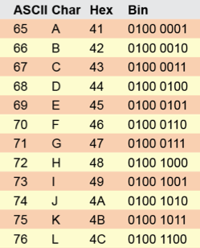
Coding & Data Compression
a variable-length code
a fixed-length code
= ?

Slide 14
Encoding (Compressing)
The task:
Input: a message T such as that cat, that bat, that hat over some alphabet
Output: an encoded message T’ – an efficient storage of T with the guarantee that T can be reproduced from T’. For example
T’= 11100011110100010111…
ASCII code: each letter is replaced by a 8-bit codeword → 28 bytes
Principle of Data Compression: Use less number of bits (shorter codeword) for symbol that appears more frequently.

Slide 15
Input message: that cat, that bat, that hat
alphabet= [a b c h t , ] (or perhaps all ASCII characters)
How to compress: 3 steps
1.Modeling: making assumptions about the structure of messages
that cat, that bat, that hat (character model)
that cat, that bat, that hat (word model)
that cat, that bat, that hat (bi-character model)
2. Statistics: find symbol distribution
3. Coding: build the code table and do encoding

Slide 16
Input message: that cat, that bat, that hat
alphabet= [a b c h t , ] (or perhaps all ASCII characters)
1. Modeling: making assumptions about the structure of messages
that cat, that bat, that hat (character model)
2. Statistics: build table of frequencies, aka weight table. For this character model:
or just
3. Coding: build the code table and do encoding
→ 11100011110100010111...
a | b | c | h | t | , | _
6/28 | 1/28 | 1/28 | 4/28 | 9/28 | 2/28 | 5/28
a | b | c | h | t | , | _
6 | 1 | 1 | 4 | 9 | 2 | 5
a | b | c | h | t | , | _
01 | 0000 | 0001 | 100 | 11 | 001 | 101

Slide 17
Input message: that cat, that bat, that hat
alphabet= [a b c h t , ] (or perhaps all ASCII characters)
1. Modeling: making assumptions about the structure of messages
that cat, that bat, that hat (character model)
2. Statistics: build table of frequencies, aka weight table. For this character model:
or just
3. Coding: build the code table and do encoding
→ 11100011110100010111...
this code is prefix-free:
no codeword is a prefix of another codeword
[so, decoding is possible]
a | b | c | h | t | , | _
6/28 | 1/28 | 1/28 | 4/28 | 9/28 | 2/28 | 5/28
a | b | c | h | t | , | _
6 | 1 | 1 | 4 | 9 | 2 | 5
a | b | c | h | t | , | _
01 | 0000 | 0001 | 100 | 11 | 001 | 101

Slide 18
Huffman Coding = a method for building minimum-redundancy code (given a table of frequencies)
Build Huffman code:
make a node for each weight
join 2 smallest weights and make a parent node (of binary tree), continue until having a single root
for each node, assign 0- and 1-bit for 2 associated edges
Example: build a Huffman code for
do it!
a | b | c | h | t | , | _
6 | 1 | 1 | 4 | 9 | 2 | 5

Slide 19
Huffman Coding
Note: there are different versions of Huffman code for a same weight table (depending on dealing with ties, assigning 0- and 1-bits), all we need to do is to choose a way and keep consistency. For instance (canonical Huffman’s coding):
when joining 2 weights into one, always make the smaller weight be the left child (hence, need to always keeps current roots in weight ordering)
choose a consistent way for breaking ties
when assigning code, always set 0 to the left edge, 1 to the right edge
Additional notes
When sending encoded messages, the sender also need to send the weight table (or something equivalent). It’s important that the receiver/decoder builds the code in the same way as the sender/encoder does.

Slide 20
Q 10.3&4: Huffman Code Generation
Q 10.3: Huffman’s Algorithm generates prefix-free code trees for a given set of symbol frequencies. Using these algorithms generate two code trees based on the frequencies in the following message:
losslesscodes
What is the total length of the compressed message using the Huffman code?
Problem 4: the code tree
Q 10.4: Decode:
00100110000011100011011011110011110110100010011011110001101111

Slide 21
Q 10.3: Huffman Code Generation
Huffman’s Algorithm generates prefix-free code trees for a given set of symbol frequencies. Using these algorithms generate two code trees based on the frequencies in the following message:
losslesscodes
What is the total length of the compressed message using the Huffman code?
Your solution:

Slide 22
Q 10.4: Canonical Huffman decoding
The code tree was generated using Huffman’s algorithm, and converted into a Canonical Huffman code tree. Note: _ denotes space. Assign codewords to the symbols in the tree, such that left branches are denoted 0 and right branches are denoted 1. Use the resulting code to decompress the following message:
00100110000011100011011011110011110110100010011011110001101111
Your soln:

Slide 23


Revision 1: Complexity Analysis – Lec W2, Workshop W3; W4- recurrences,
1 ≺ log n ≺ n^{𝜺} ≺ n^{c} ≺ n^{log n} ≺ c^{n} ≺ n^{n} where 0 < 𝜺 < 1 <c
O( f(n) + g(n) ) = O( max{f(n), g(n)} ) note: these 3 also applied O(c f(n)) = O( f(n) ) to big-𝝦 O( f(n) x g(n) ) = O(f(n)) x O(g(n))
1+2+ ... + n = n(n+1)/2 = 𝝦(n²) 1² + 2² + ... + n² = n(n+1)(2n+1)/6 = 𝝦(n³) 1 + x + x² + ... + x^{n} = (x^{n+1}-1)/(x-1) (x≠1)
f(n) = O(g(n))
f(n) = 𝝦( g(n) )
f(n) = 𝝮(g(n))

Slide 24
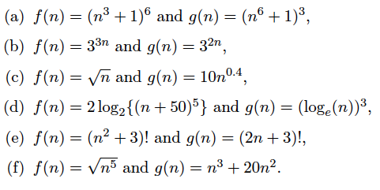
Revision exercises: Q 10.5+
Q 10.5: For each of the following cases, indicate whether f(n) is O(g(n)), or
𝝮(g(n)) , or both (that is, 𝝦(g(n))
Q 10.5+: Solve the following recurrence relations. Give both a closed form expression in terms of n and a Big-Theta bound.
T(n)= T(n/2)+1, T(1)= 1
T(n)= T(n-1) + n/5, T(0)= 0
Other exercises: review complexity exercises for Workshops Week 3, 4, 7

Slide 25
R1 exercises: Q10.5
For each of the following cases, indicate whether f(n) is O(g(n)), or
𝝮(g(n)) , or both (that is, 𝝦(g(n))
Your solution/notes: a) b) c) d) e)

Slide 26
R1 exercises: Q10.5+
Your solution/notes: a) b)
Q 10.5+: Solve the following recurrence relations. Give both a closed form expression in terms of n and a Big-Theta bound.
T(n)= T(n/2)+1, T(1)= 1
T(n)= T(n-1) + n/5, T(0)= 0
Notes:
Apply the Master Theorem (Workshop W7) if possible (ie. if having a, b, and 𝝦(n^{d}) or O(n^{d}), and if the question just asks about big-O/big- 𝝦 )
Otherwise, using substitution to expand until T(1) or T(0)

Slide 27
Lab
“play” with the hashing code by following the instructions in Ed.
and/or continue with reviewing.

