Slide 1
COMP20007 Workshop Week 6
1 2 | Preparation: download ppt (or pdf) from github.com/anhvir/c207 Topic 1: Topological Sorting Group Work: Problems T1 (toposort) Topic 2: Binary Trees & BST Group Work: Problems 2, 3, 4 Lab: Finish ass1 if not yet done, or Finish lab works of previous weeks

Slide 2
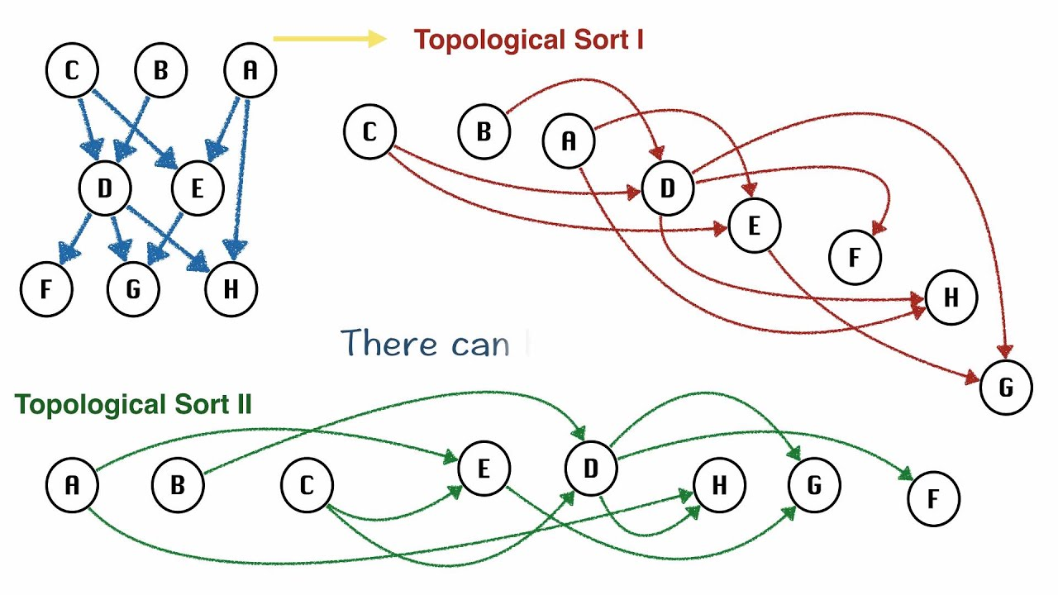
Topological Sorting (for DAG only!)
A topological ordering: sorting the nodes of the graph such that all edges point in one direction, to nodes later in the ordering.

Slide 3
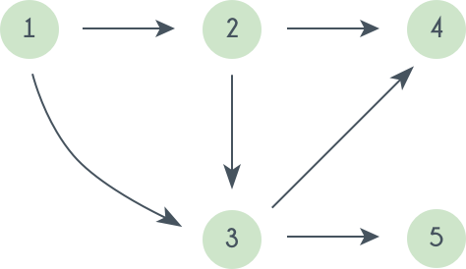
Topological Sorting
Method 1: Select a source (node with no incoming edges), then remove this source and all of its incidents (ie. its outgoing edges). Repeat this process until all nodes have been selected.
What’s the complexity of this algorithm if using adjacency matrix? list?
Complexity for
Adjacency matrix:
O( ) ? ϴ( ) ?
Adjacency list:
O( ) ? ϴ( ) ?

Slide 4
Topological Sorting
Another Algorithm (discussed in lectures) involves running a DFS on the DAG and keeping track of the order in which the vertices are popped from the stack. The topological ordering will be the reverse of this order.
What’s the complexity if using adjacency lists for graphs? adj matrix?
How to have the pop-order?
Complexity for
Adjacency matrix:
O( ) ? ϴ( ) ?
why?
Adjacency list:
O( ) ? ϴ( ) ?
why?

Slide 5
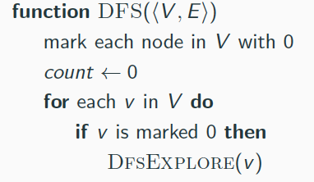
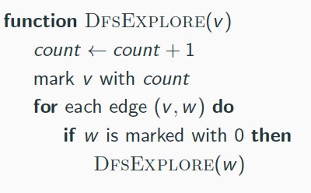
DFS: push- and pop-order (pre- and post-order)
function Dfs(<V,E>) mark each u in V as unvisited for each u in V do if u is unvisited then BfsExplore(u)
function DfsExplore(u) mark u as visited for each edge (u,v) do if v is unvisited then DfsExplore(v)
Problem:
For the graph below, write the push and pop order for DFS, starting from node 1
Modify the DFS algorithm so that it also builds the arrays pre[V] and post[V]to store the push- and the pop-order of the vertices.

Slide 6
Group Work: problem 1
T1: Finding a topological order for the graph by running a DFS.
YOUR ANSWER:
note: it would be better first to write down the operations with and the content of stack like:
(you can also just draw graph and write down push and pop order on the left and right of each node)
operation content | operation content
init stack $ push A $A

Slide 7
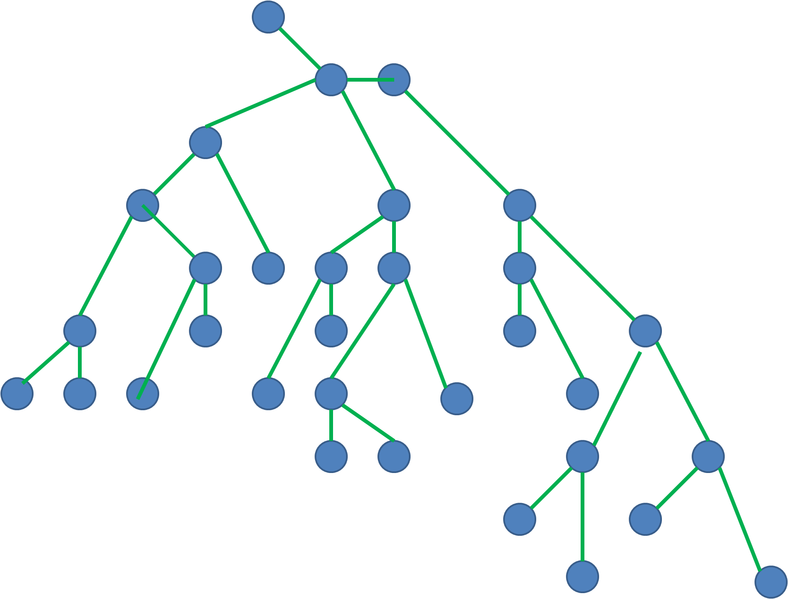
Trees as Special Graphs
If a graph (V,E) is a tree, then:
digraph?
cyclic?
connected?
sparse/dense?
relationship between n=|V| and m=|E| :
best representation?

Slide 8
Binary Tree: Recursive Definition

Slide 9
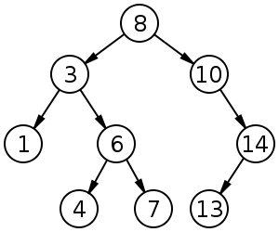
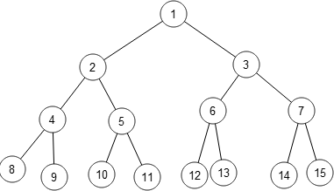
Binary tree traversal
What is inorder, preorder, postorder, and level-order traversal? Are they BFS or DFS?
Inorder:
Preorder:
Postorder:
Group Work: Problems T3, T4, T5.

Slide 10
Problem 4: Binary Tree Sum
Write a recursive algorithm to calculate the sum of a binary tree where each node contains a number.
YOUR ANSWER: The pseudocode:
function Sum( T )

Slide 11
Binary (Search) Tree
How to:
print the number in increasing order?
print in decreasing order?
copy the tree?
free the tree?
Your notes:

Slide 12
Problem 2: conventional traversal
Write the inorder, preorder and postorder traversals of
the following binary tree:
YOUR ANSWER:
In-order:
Pre-order:
Post-order:

Slide 13
Problem 3: level-order traversal
Level-order: visit level-by-level, left-to-right, starting from the root (which is in 0-th level).
For the tree below, what’s the visited order?
Write the level-order pseudo-code.
YOUR ANSWER:
Level-order:

Slide 14
Problem 3: level-order traversal
Level-order: visit level-by-level, left-to-right, starting from the root (which is in 0-th level).
For the tree below, what’s the visited order?
Write the level-order pseudo-code.
YOUR ANSWER: The pseudocode:
function LevelOrder( T )

Slide 15
LAB
Assignment 1:
check & make sure that you can submit right now
ask questions
note that you can discuss general problems with your friends but please do not reveal or show your solution and code
OR:
do not-yet-done problems (if any) of previous workshops/lab/lectures

Slide 16
Group Work: moved to Week 7
T2: Dijkstra’s algorithm, unmodified, can’t handle some graphs with negative edge weights. Your friend has come up with a modified algorithm for finding shortest paths in a graph with negative edge weights:
Find the largest negative edge weight, call this weight −w.
Add w to the weight of all edges in the graph. Now, all edges have non-negative weights.
Run Dijkstra’s algorithm on the resulting non-negative-edge-weighted graph.
For each path found by Dijkstra’s algorithm, compute its true cost by subtracting w from the weight of each of its edges.
a) Give an example showing that DA can’t handle negative weights. b) Will your friend’s algorithm work? Give an example.

