Slide 1
COMP20007 Workshop Week 8
1 2 LAB | Preparation: - open ws8.pptx from github.com/anhvir/c207 and/or - open wokshop8.pdf (from LMS), and - download lab files from LMS Master Theorem, Merge Sort, problems 1, 3 Simple Sorting algorithms, problem 2 Quicksort and Mergesort, problem 3 Understand the lab’s graph module and implement some graph algorithms

Slide 2
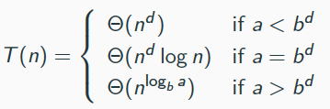
The Master Theorem
If
where a ≥ 1, b >1, and d ≥ 0, then
you can also replace all big-θ by big-O

Slide 3
T1: Find time complexity (big- or big-O) for:
(e) T(n) = 2T(n-1) + 1

Slide 4
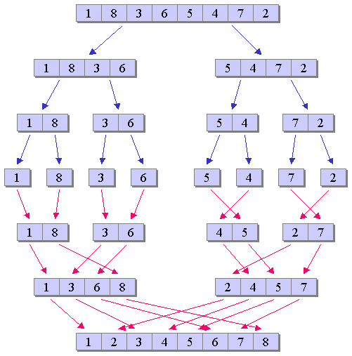
T3: Mergesort Time Complexity
Mergesort is a divide-and-conquer sorting algorithm made up of three steps (in the recursive case): Sort the left half of the input (using mergesort) Sort the right half of the input (using mergesort) Merge the two halves together (using a merge operation) Construct a recurrence relation to describe the runtime of mergesort . Explain where each term in the recurrence relation comes from. Use the Master Theorem to find the time complexity of Mergesort in Big-Theta terms.

Slide 5
T3: Mergesort Time Complexity
Construct a recurrence relation to describe the runtime of mergesort . Explain where each term in the recurrence relation comes from. T(n)= T(1)= Use the Master Theorem to find the time complexity of Mergesort in Big-Theta terms.

Slide 6
Simple Sorting Algorithms
Any problem with Insertion Sort and Selection Sort?

Slide 7
Selection Sort = ?
In each round, finalise the position of 1 element for the sorted array:
find the location of the smallest (or largest) element

Slide 8
Selection Sort: n=5, increasing order, select the smallest
Round 1: consider A[0..4] determine position of the largest swap with the last, ie. A[4]
Round 2: consider A[0..3] determine position of the largest swap with the last, ie. A[3]
Round 4: consider A[0..1] determine position of the largest swap with the last, ie. A[1]
COMP20007.Worshop
COMP20007.Worshop

Slide 9
Selection Sort
function SelectionSort(A[0..n-1]
1 2 | A N A L Y S I S
Run the algorithm on the input array: [􏰑A N A L Y S I S􏰒] , Suppose: Sort in increasing order.
What is the time complexity of the algorithm?
Is the sorting algorithm stable?
Does the algorithm sort in-place?
Is the algorithm input sensitive?

Slide 10
Insertion Sort
Insertion Sort for array A[0..n-1]:
- process one input at a time
- keeping processed elements sorted by inserting A[i] to the left
A[i] is being processed
A[0..i-1 i..n-1]
right: not yet examined
left: processed, in sorted order

Slide 11
Insertion Sort: understanding (n=5)
Round 1: consider A[1] A[0..0] is sorted insert A[1] to the left so that A[0..1] is sorted
Round 2: consider A[2] A[0..1] is sorted insert A[2] to the left so that A[0..2] is sorted
Round i: consider A[4] A[0..4] is sorted insert A[i] to the left so that A[0..4] is sorted

Slide 12
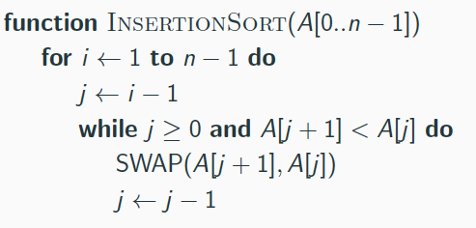
Insertion Sort
1 2 | A N A L Y S I S
Run the algorithm on the input array: [􏰑A N A L Y S I S􏰒] , Suppose: Sort in increasing order.
What is the time complexity of the algorithm?
Is the sorting algorithm stable?
Does the algorithm sort in-place?
Is the algorithm input sensitive?

Slide 13
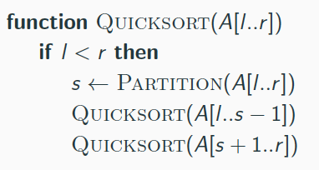
Quicksort (usage: Quicksort(A[0..n-1])
Partition(A[l..r])
<=A[s] >=A[s]
A[l..s-1 s s+1..r ]
return s

Slide 14
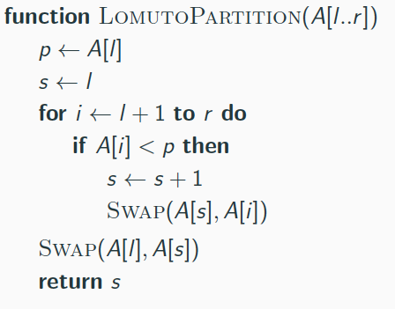
Quicksort: Lomuto Partitioning
Using p= A[l] as the pivot
Loop: processing A[i] with i=l+1,...,r
During the loop, maintaining loop invariants:
A[l l+1 .. s s+1 .. i i+1 .. r]
<p >=p not yet processed
After the loop: swap A[l] with A[s]
Example: partitioning for 4 2 5 1 6
s=0, i=1 4_{s} 2_{i} 5 1 6

Slide 15
Quicksort: Lomuto Partitioning
Using p= A[l] as the pivot
Loop: processing A[i]
During the loop, maintaining loop invariants:
A[l l+1 .. s s+1 .. i i+1 .. r]
<p >=p not yet processed
After the loop: swap A[l] with A[s]
Exercise: quicksort for ANALYSIS
A N A L Y S I S

Slide 16
Quicksort (usage: Quicksort(A[0..n-1])
input-sensitive?
complexity=?
stable?
in-place?
Partition(A[l..r])
<=A[s] >=A[s]
A[l..s-1 s s+1..r ]
return s

Slide 17
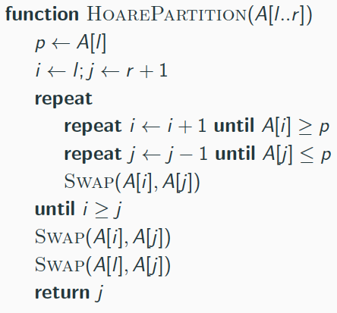
Quicksort: Hoare Partitioning
moving i forward, j backward so that:
A[l+1..i-1]<=p, A[i]>=p
A[j+1..r]>=p, A[j]<=p
A[l..j .. i ..r]
undo last swap (why?)
------during the loop------
A[l l+1..i-1 i .. j j+1..r]
<=p >=p
Example:
4 2 5 1 6

Slide 18
Quicksort: Hoare Partitioning
Exercise: run Quicksort
A N A L Y S I S p=A

Slide 19
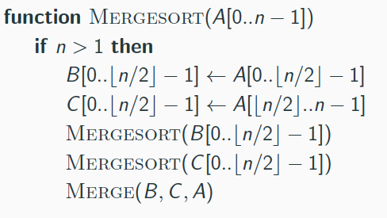
T3: Mergesort: Top-Down & Bottom-Up Algorithms
function BottomUpMS(A[0..n-1])
create_empty_queue
enqueue singleton array A[0],
A[1],..., A[n-1] into Q
while queue.size>1 do
dequeue arrays A and B
merge A and B to C
enqueue C
dequeue A

Slide 20
T3: Mergesort: Top-Down & Bottom-Up Algorithms
Exercise: run bottum-up:
ANALYSIS
[A] [N] [A] [L] [Y] [S] [I] [S]
function BottomUpMS(A[0..n-1])
create_empty_queue
enqueue singleton array A[0],
A[1],..., A[n-1] into Q
while queue.size>1 do
dequeue arrays A and B
merge A and B to C
enqueue C
dequeue A

Slide 21
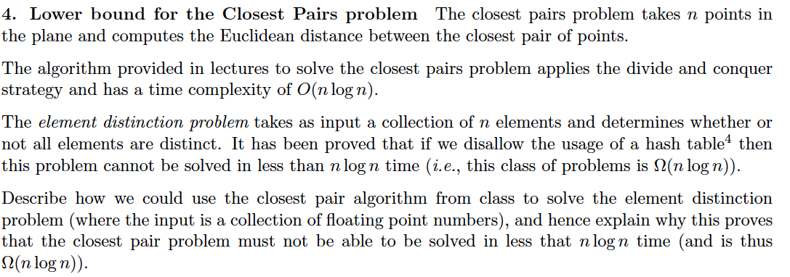
T3: Closest-pair and element-distinction

