Slide 1

1 2 3 LAB | Preparation: - open ws6.pptx from github.com/anhvir/c207 - open wokshop6.pdf (from LMS) Topic 1: DFS and BFS: Group Work: Problems T1, T2, T4, T3 (in order) Topic 2: Dijkstra’s and Prim’s Algorithms Group Work: Problems T5, T6 Assignment 1 Q&A, and make sure that you can scp, ssh, use dimefox to test/submit do Assignment 1 or do not-yet-done exercises Before leaving: Please give comments on the format of today’s workshop
COMP20007.Workshop

Slide 2

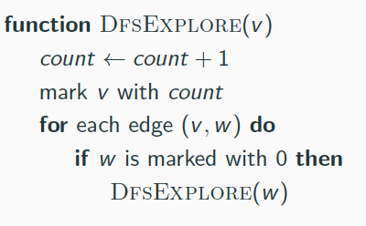
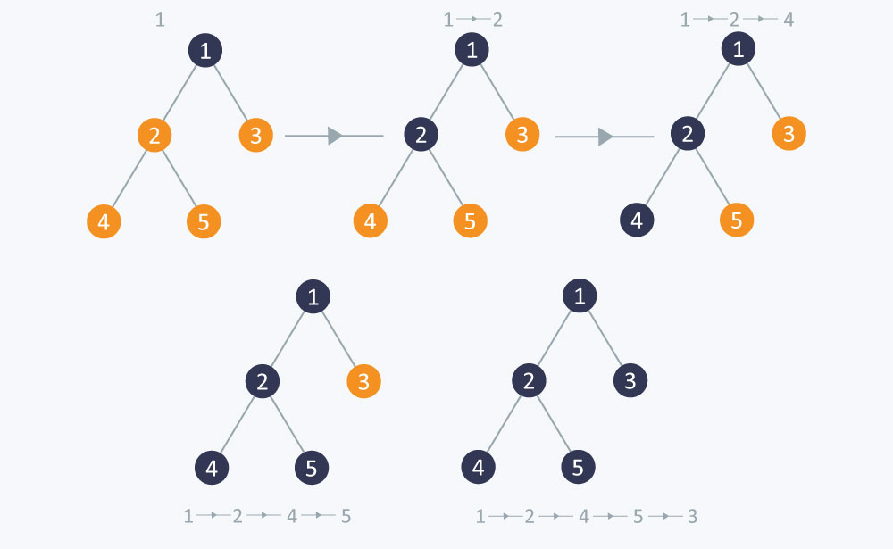
COMP20007.Worshop

Slide 3
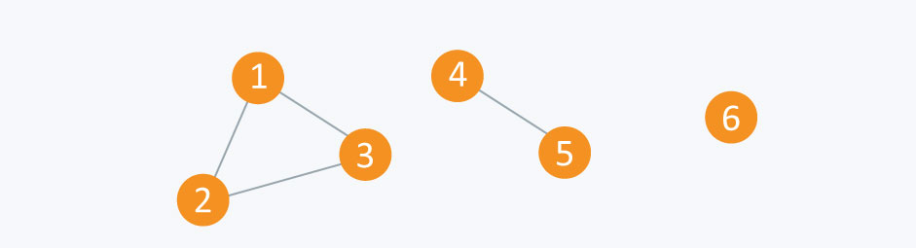
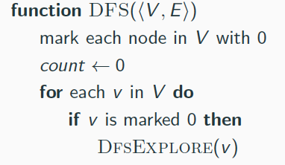
COMP20007.Worshop

Slide 4
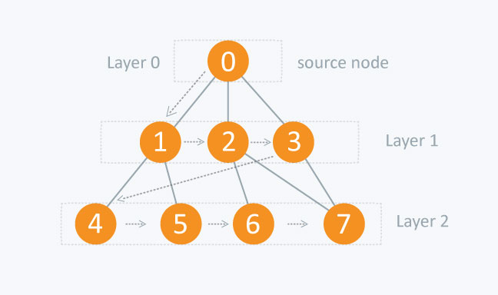
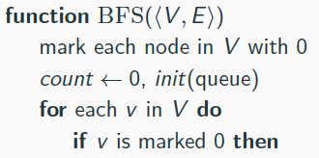
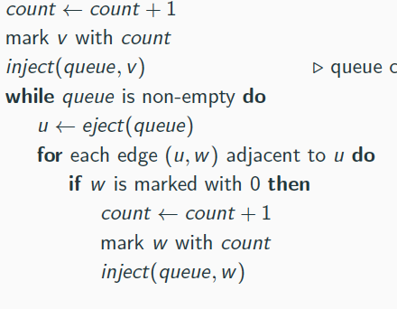
BfsExplore(v)
function BfsExplore(v)
COMP20007.Worshop

Slide 5









List the order of the nodes visited by the a) DFS and b) BFS algorithms
A
C
F
B
D
YOUR ANSWER: a) The order of the nodes visited by DFS is: A b) The order of the nodes visited by DFS is: A
E
G
COMP20007.Worshop

Slide 6
a) Explain how one can also use BFS to see whether an undirected
graph is cyclic. b) Which of the two traversals, DFS and BFS, will be able to find cycles faster? (If there is no clear winner, give an example where one is better, and another example where
the other is better. – but skip this part if it takes more than 1 minute)
YOUR BRIEF ANSWER:
BfsExplore(v)
function BfsExplore(v)
COMP20007.Worshop

Slide 7








Design an algorithm to check whether an undirected graph is 2-colourable, that is, whether its nodes can be coloured with just 2 colours in such a way that no edge connects two nodes of the same colour. To get a feel for the problem, try to 2-colour the following graph (start from S). Do you expect we could extend such an algorithm to check if a graph is 3-Colourable, or in general: k-Colourable?
S
A
E
F
B
D
C
YOUR BRIEF ANSWER:
a) try to 2-colour the above graph, starting from S, using 2 colours + and –
hint: what is colour for S? how do we continue?
b) So, how to solve the 2-colourability?
c) Do you expect we could extend such an algorithm to check if a graph is 3-Colourable, or in general: k-Colourable?
COMP20007.Worshop

Slide 8

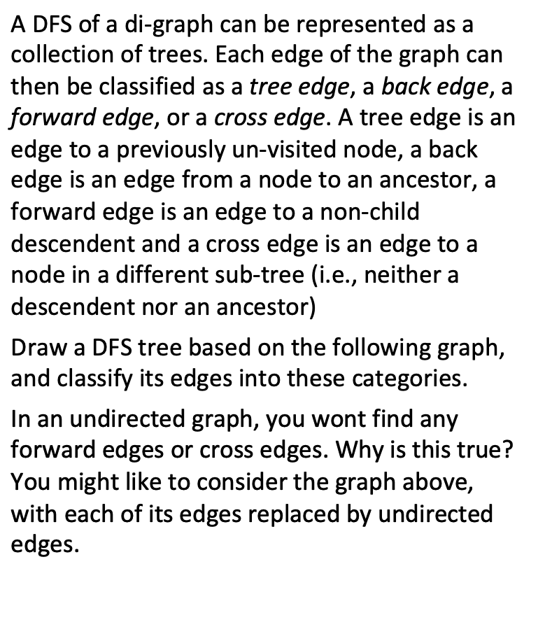

A gift from Anh: If you are a bit bored or tired, skip this exercise, and
instead use pages 23-35 (of this file) to entertain yourselves ;-)
COMP20007.Worshop

Slide 9


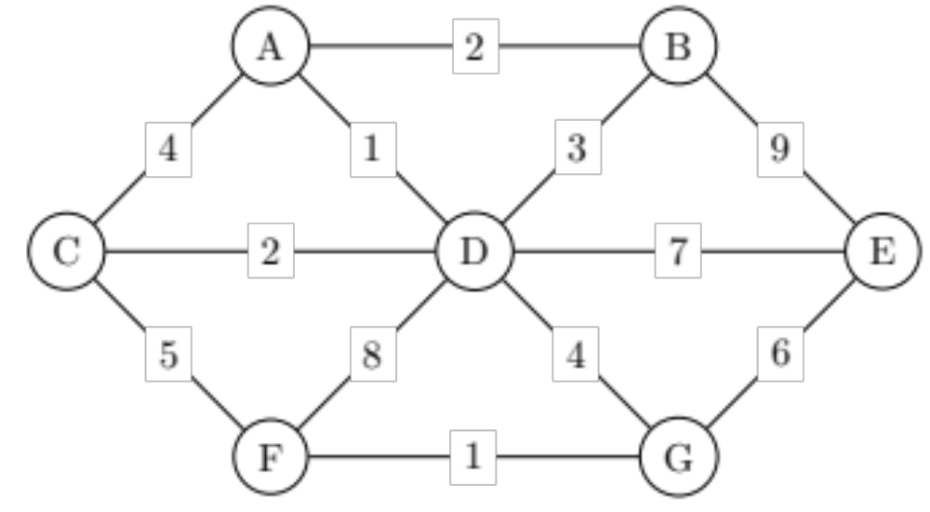
COMP20007.Worshop

Slide 10

purpose | SSSP (that involves all nodes of a connected graph)
init | for all v ∈V : dist[v]= ∞ prev[v]= nil dist[S]= 0
basic loop | for all u∈V, at each step choose u that dist[u] is min amongst the unselected
action after selecting u | for all unselected v such that (u,v)∈E: if dist[v]>dist[u]+w(u,v): update dist[v] update prev[v]
Q: what is update dist[v] ? update prev[v] ?
why Dijkstra’s algorithm is greedy?
COMP20007.Worshop

Slide 11

 | Dijkstra’s | Prim’s
purpose | SSSP (that involves all nodes of a connected graph) | MST (that involves all nodes of a connected graph)
init | for all v ∈V : dist[v]= ∞ prev[v]= nil dist[S]= 0 | same
basic loop | for all u∈V, at each step choose u that dist[u] is min amongst the unselected | same
action after selecting u | for all unselected v such that (u,v)∈E: if dist[v]>dist[u]+w(u,v): update dist[v] update prev[v] | same loop to decide whether to include edge (u,v): if dist[v]>w(u,v): same
So, the 2 alg are similar. The only difference is the optimizing functions. There are many other situations when the same algorithm applied, but perhaps with a different optimizing function.
COMP20007.Worshop

Slide 12

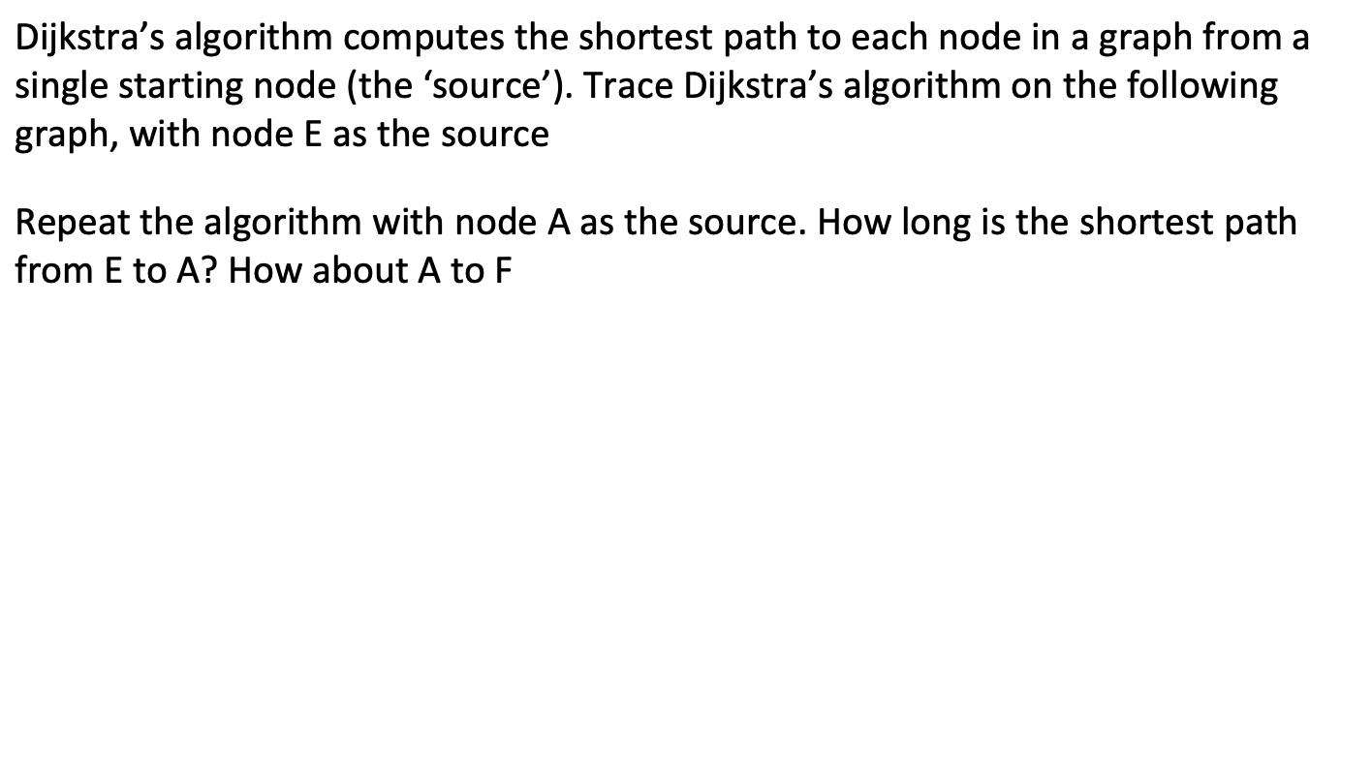
COMP20007.Worshop

Slide 13

dist[E] prev[E]
step | node visited | A | B | C | D | E | F | G
0 |  | ∞/nil | ∞/nil | ∞/nil | ∞/nil | 0/nil | ∞/nil | ∞/nil
DA is a BFS. DA is used to find shortest path from a source to all other nodes. A practical implementation is to maintain 3 arrays:
dist[v] = shortest-distance-found-so-far from source to v
prev[v] = id of the node preceding v in the path-found-so-far
visited[v] = Y if v has been explored/visited, N if not yet
COMP20007.Worshop

Slide 14

step | node visited | A | B | C | D | E | F | G
0 |  | ∞/nil | ∞/nil | ∞/nil | ∞/nil | 0/nil | ∞/nil | ∞/nil
1
At step 1: choose the node with minimal dist amongst the unvisited nodes. This is E. Then, consider to update dist[v] for v= {B, D, G}. And, mark E as visited ???.
COMP20007.Worshop

Slide 15

step | node visited | A | B | C | D | E | F | G
0 |  | ∞/nil | ∞/nil | ∞/nil | ∞/nil | 0/nil | ∞/nil | ∞/nil
1 | E | ~ | 9/E | ~ | 7/E |  | ~ | 6/E
2
3
4
5
6
7
COMP20007.Worshop

Slide 16
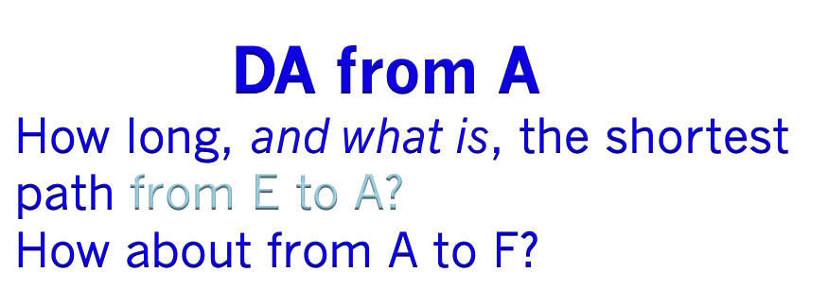
step | node visited | A | B | C | D | E | F | G
0 |  | 0/nil | ∞/nil | ∞/nil | ∞/nil | ∞/nil | ∞/nil | ∞/nil
1
2
3
4
5
6
7
COMP20007.Worshop

Slide 17

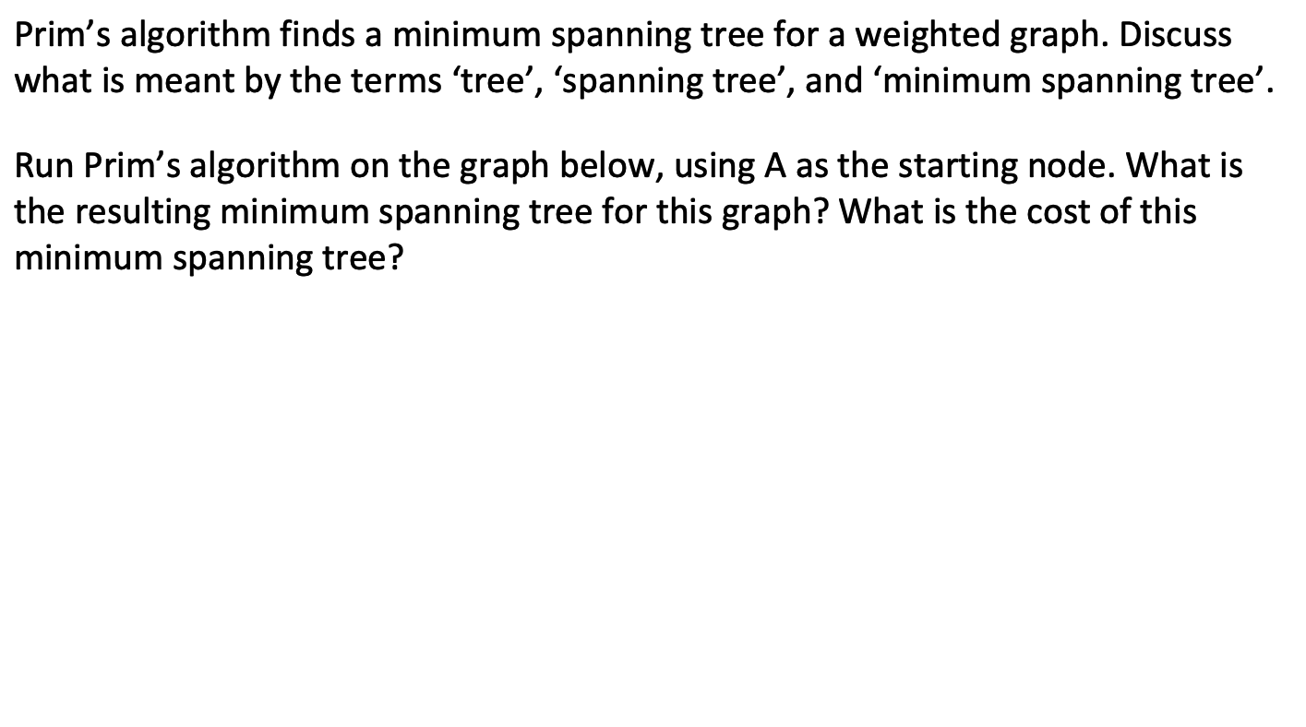
COMP20007.Worshop

Slide 18

step | node visited | A | B | C | D | E | F | G
0 |  | 0/nil | ∞/nil | ∞/nil | ∞/nil | ∞/nil | ∞/nil | ∞/nil
1
2
3
4
5
6
7
COMP20007.Worshop

Slide 19


COMP20007.Worshop

Slide 20


COMP20007.Tute
Anh Vo 18 March 2016

Slide 21

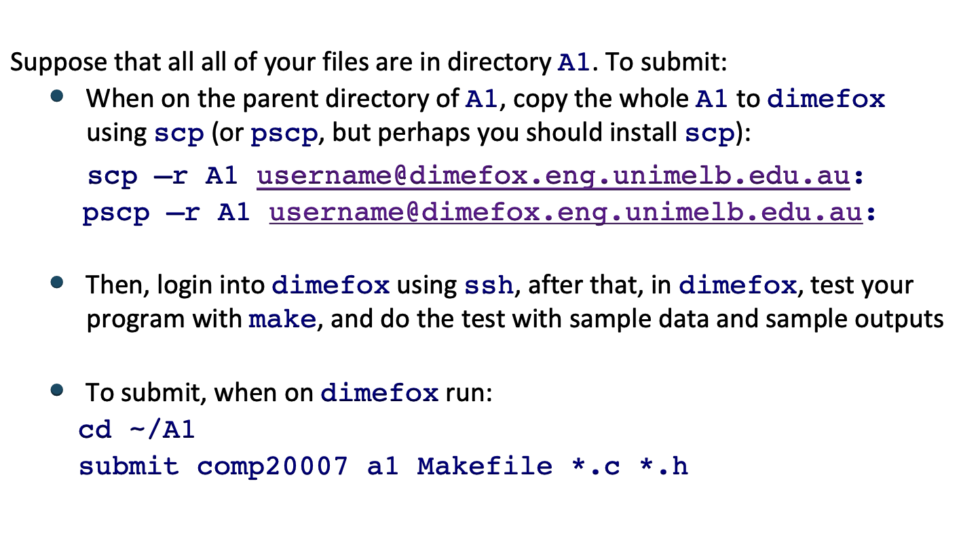
COMP20007.Worshop

Slide 22

COMP20007.Worshop

Slide 23






A
B
E
C
D
COMP20007.Worshop

Slide 24

A
B
E
C
D
COMP20007.Worshop

Slide 25
1
A
note: black number 1 is the
push order
B
E
C
D
COMP20007.Worshop

Slide 26
1
A
2
B
E
C
D
COMP20007.Worshop

Slide 27

1
A
2
B
E
C
D
3
COMP20007.Worshop

Slide 28
1
A
2
B
E
C
D
3
4
COMP20007.Worshop

Slide 29
1
A
note: orange number 1 represents
the pop order
2
B
E
C
D
3
4
1
COMP20007.Worshop

Slide 30
1
A
2
B
E
C
D
3
2
4
1
COMP20007.Worshop

Slide 31
1
A
2
5
B
E
C
D
3
2
4
1
COMP20007.Worshop

Slide 32
1
A
2
5
3
B
E
C
D
3
2
4
1
COMP20007.Worshop

Slide 33
1
A
2
4
5
3
B
E
C
D
3
2
4
1
COMP20007.Worshop

Slide 34
1
A
5
Oranges edges are tree edges. Not used used edges: all would be back-edges if the graph was un-directed
2
4
5
3
B
E
C
D
3
2
4
1
COMP20007.Worshop

Slide 35
A
Oranges edges are tree edges. Not used edges: red are forward edges blue are back-edges other dashed are cross edges Why don’t we have forward and cross edges in undirected graph?
B
E
C
D
COMP20007.Worshop

