Slide 1
COMP20007 Workshop Week 9
1 2 3 4 5 LAB | Preparation: - have draft papers and pen ready - open ws9.pptx from github.com/anhvir/c207 and/or - open wokshop9.pdf (from LMS), and - download lab files from LMS BST: problems, Rotation (T1), Balance factor (T2) AVL Tree: Concepts, Insertion (T3) 2-3 Tree: Concepts, Insertion (T4) Binary Heap: Operations (T5, T6) Quickselect (T7) Lab: Playing with Quicksort code

Slide 2
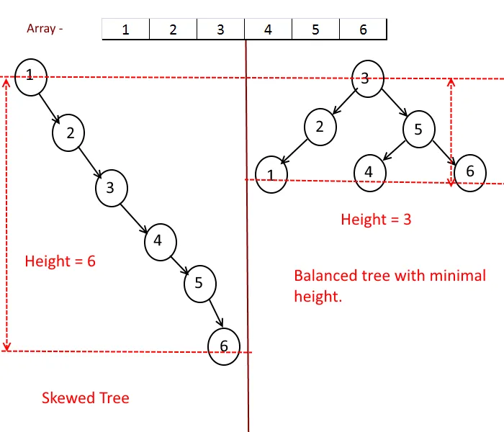
BST: skewed, unbalanced, balanced
The efficiency of searching in a BST depends on how balance the tree is.
If we insert 1,2,3,4,5,6 into an empty BST, we get a skewed tree.
If we insert 3,2,5,1,4,6 into an empty BST, we get a balanced tree.
We want to have balanced search trees, no matter what’s the data input order

Slide 3
T2: Balance factor
A node’s ‘balance factor’ is defined as the height of its right subtree minus the height of its left subtree. Calculate the balance factor of each node in the following binary search tree.
Balanced tree = when the balance factor of each node is 0, -1, or +1.

Slide 4
T1: Rotation
In the following binary trees, rotate the ‘X’ node to the right (that is, rotate it and its left child). Do these rotations improve the overall balance of the tree?
(a)
Note: 2 types of rotations: Right Rotation (a node and its left child), and Left Rotation ( a node and its right child)
X→right

Slide 5
T1: Rotation
In the following binary trees, rotate the ‘X’ node to the right (that is, rotate it and its left child). Do these rotations improve the overall balance of the tree?
(b) (c)
Note: 2 types of rotations: Right Rotation (a node and its left child), and Left Rotation ( a node and its right child)

Slide 6
AVL Tree
What? – just a balanced BST
Why?

Slide 7
Using Rotations to rebalance AVL
At the start: an empty BST is an AVL
Problem: When inserting a new node to an AVL, the latter might become unbalanced
Approach: use Rotations to rebalance. It’s important first to determine:
Which node to be rotated? Rotated left or right?

Slide 8
Two Basic Rotations: 1) Single Rotation
Applied when an AVL (subtree) has a stick form:
A
B
Questions we should ask ourselves:
Which node (or tree) is unbalanced?
Which rotation can be done?
→ Rotate the root and hence balance the stick
C
C
B
A

Slide 9
Two Basic Rotations: 1) Double Rotation
Applied when an AVL (subtree) has a non-stick form:
Rotation1:
Rotate the child of the unbalanced root and turn the tree to a stick
Rotation2:
Just a single rotation for a stick.
A
C
B
C
A
B

Slide 10
Using Rotations to rebalance AVL
Problem: When inserting to AVL, it might become unbalanced
Approach: Rotations (Rotate WHAT?, and HOW?)
Rotate WHAT?
The lowest subtree X which is unbalanced
HOW
Consider the first 3 nodes X→A→B in the path from root X to the just-inserted node
Apply a single rotations if that path is a stick, double rotation otherwise

Slide 11
T3: AVL Tree Insertion
Insert the following letters into an initially-empty AVL Tree (easy example).
A V L T R E X M P

Slide 12
2-3 Trees
What? It’s a search tree, but not a binary! Each node might have 1 or 2 data, and hence 2 or 3 children.
How to insert:
start from root, go down and insert to a leaf
if the new leaf has <=2 data, it’s ok
if the new leaf has 3 data: promote the middle data to the parent

Slide 13
T5: 2-3 Tree Insertion
Insert the following letters into an initially-empty 2-3 Tree.
A L G O R I T H M

Slide 14
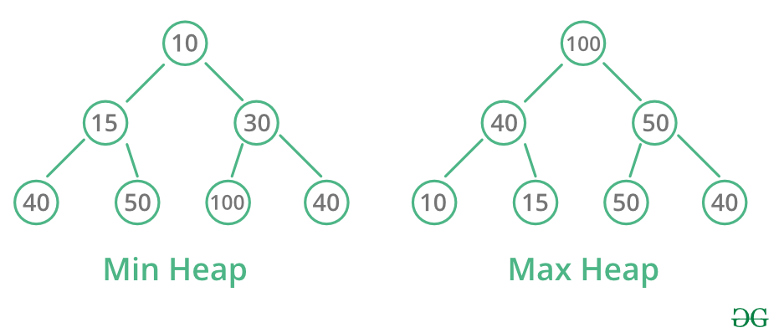
Binary Heap
Binary heap is a priority queue
For simple keys, we can have min-heap or max-heap

Slide 15
Binary Heap is implemented as an array!
Visualisation | Implementation
 | Array indices and content: 0 1 2 3 4 5 6 7 8 9 10 |_|1 |3 |9 |4 |5 |15|14|8 |6 |10 -- ----- ----------- -------- Heap h is a pair {H[], n} - H[] is an array - n: number of elements in H[] - H[1..n] is used, H[0] not employed
Heap h is implemented as an array H[1..n] `H[0] is not used) node of level 0 is in H[1] level k has 2^{k} nodes, and they are in H[2^{k}..2^{k+1}—1] and so: parent of H[i] is H[i/2] iif i>1 left child of H[i] is H[2*i] iif 2*i<=n right child of H[i] is H[2*i+1] iif 2*i+1<=n

Slide 16
Heap Repair: SiftUp and SiftDown
When? When there is one, and only one, element that might violate the heap property.

Slide 17
Heap Repair: SiftUp and SiftDown
When: there one, and only one, element that might violate the heap property.
Complexity=?
12
0

Slide 18
A Priority Queue: Binary Min Heap
Example | Conditions
 | Array is: [ ]
T1 a) Show how this heap would be stored in an array as discussed in lectures (root is at index 1; node at index i has children at indices 2i and 2i+1)
Your answer: _

Slide 19
T5 b)
Run the RemoveRootFromHeap algorithm from lectures on this heap by hand

Slide 20
T5 c)
Run the InsertIntoHeap algorithm and insert the value 2 into the heap

Slide 21
Heap: Big-O Complexity
Heap operations:
SiftUp:
SiftDown:
InsertIntoHeap:
Heapify: turn un-ordered array H[1..n] into a heap
RemoveRootFromHeap:
heapsort:

Slide 22
T6 [opt]: k-smallest using min-heap
The k-th smallest problem:
Given an array A[] of n elements, and an integer k
Find the k-th smallest value (suppose that k is zero-origin, that is, k can be any of 0, 1, 2, ..., n-1)
Using min-heap for the k-th smallest:
How
What the complexity?
Algorithm | Complexity
function HeapkthSmallest(A[0..n-1],k)

Slide 23
T7
Design an algorithm Quickselect based on Quicksort which uses the Partition algorithm to find the k-th smallest element in an array A.
Show how you can run your algorithm to find the k-th smallest element where k = 4 and A = 􏰅[9,3,2,15,10,29,7􏰆].
What is the best-case time-complexity of your algorithm? What type of input will give this time-complexity?
What is the worst-case time-complexity of your algorithm? What type of input will give this time-complexity?
What is the expected-case (i.e., average) time-complexity of your algorithm?
When would we use this algorithm instead of the heap based algorithm from Question T6?

Slide 24
partitionning & qselect
 | partition( A[lo..hi]): ... return m
11 12 13 14 15 16 17 | qselect( A[lo..hi], k): m= partition(A[lo..hi]) if (k==m) return A[m] if (k<m) qselect(A[lo..m-1], k) else qselect(A[m+1..hi], k)
21 22 23 | ksmallest(A[0..n-1], k): if (k>=0 && k<n) return qselect(A[0..n-1], k)
Notes:
Note on average complexity:
After each iteration of Partitioning, our pivot is more likely to have the original array splitted into two sub-arrays, with each of them containing "some proportion" of elements from the original array. Even if we consider a very imbalanced split, with 99% of the elements placed into one sub-array, and 1% of elements go into another sub-array, we will still end up with a linear complexity. In case that we are really unlucky, our k-th smallest element always lays in the larger sub-array (the array contains 99% of elements), we would have the following recursive relation:
T(n) = T(0.99n)+Theta(n), T(1)=1
By master theorem we can find that T(n) is still in Theta(n). Considering that we had two assumptions (highlighted yellow above), this T(n) is worse than our average case. And since the best case for QuickSelect is Theta(n), we can surely conclude that the average / expected time complexity is Theta(n), for a random ordered input.

Slide 25
T2
Design an algorithm based on Quicksort which uses the Partition algorithm to find the k-th smallest element in an array A.
Show how you can run your algorithm to find the k-th smallest element where k = 4 and A = 􏰅9,3,2,15,10,29,7􏰆.
What is the best-case time-complexity of your algorithm? What type of input will give this time-complexity?
What is the worst-case time-complexity of your algorithm? What type of input will give this time-complexity?
What is the expected-case (i.e., average) time-complexity of your algorithm?

