Slide 1

1 2 | Preparation: - open ws7.pptx from github.com/anhvir/c207 - open wokshop7.pdf (from LMS) Topic 1: Topological Sorting Group Work: Problems T1 (toposort), T2 (Dijkstra’s with negative weights) Topic 3: Binary Trees & BST Group Work: Problems T3, T4, T5
COMP20007.Workshop

Slide 2

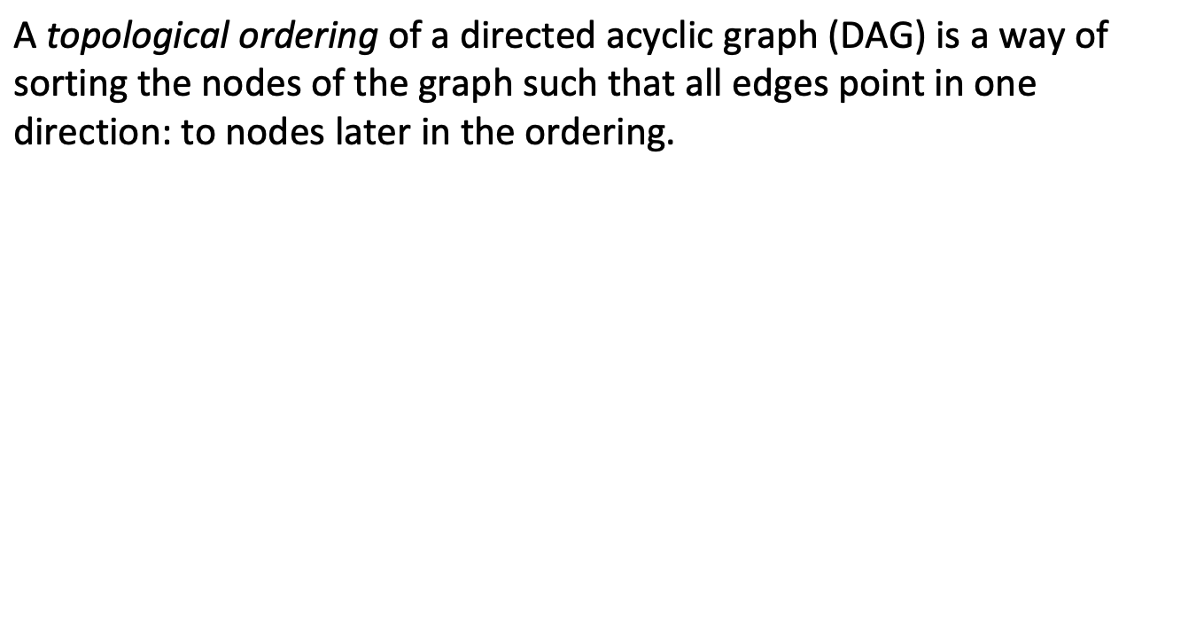
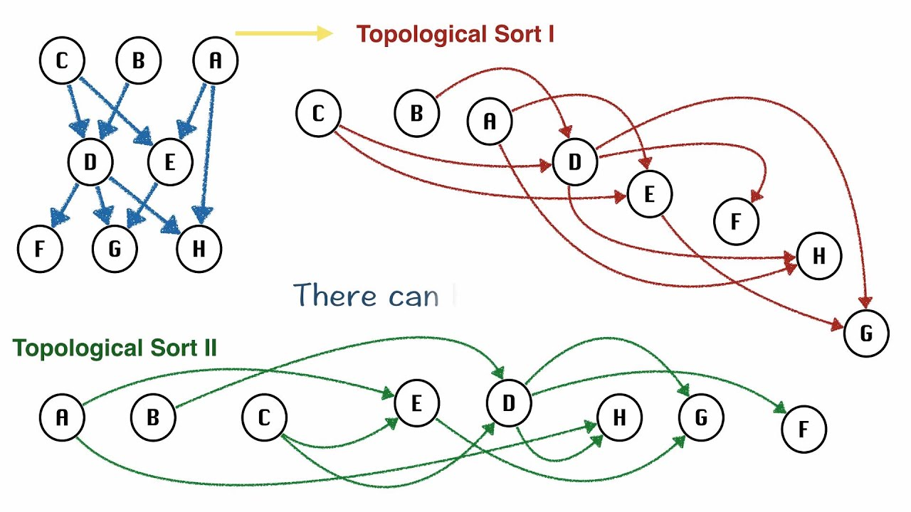
COMP20007.Worshop

Slide 3
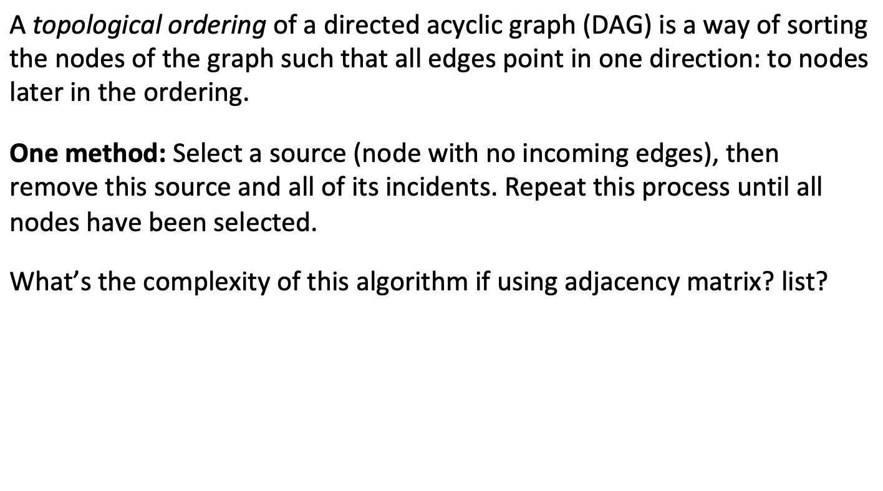
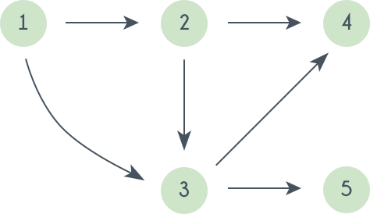
COMP20007.Worshop

Slide 4
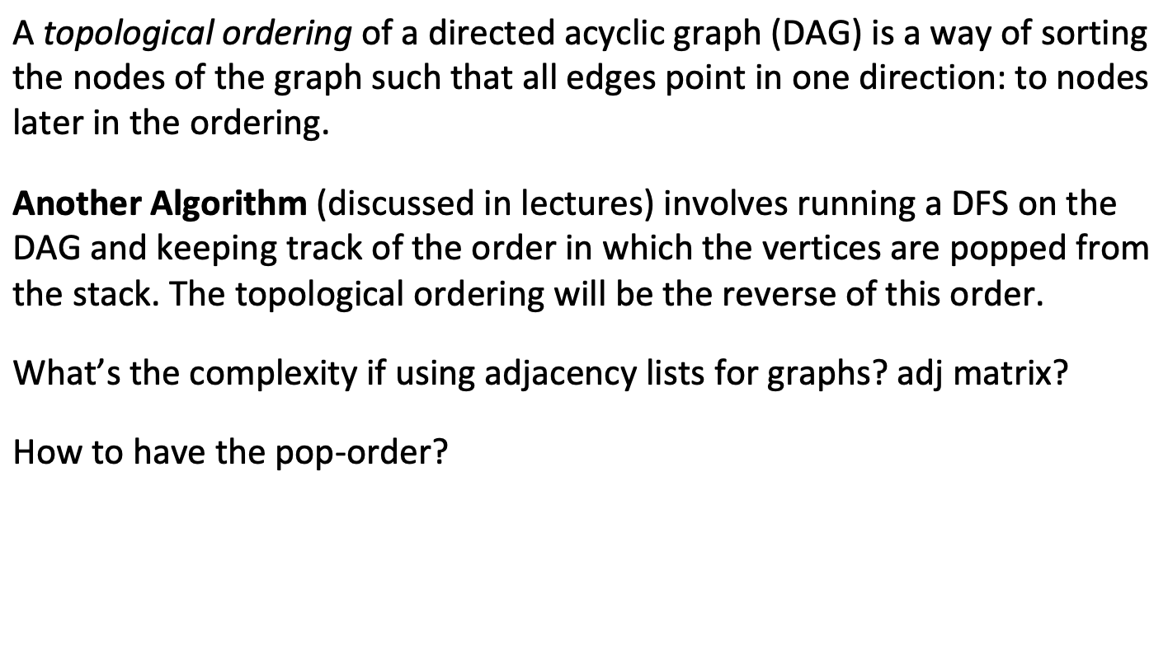
COMP20007.Worshop

Slide 5
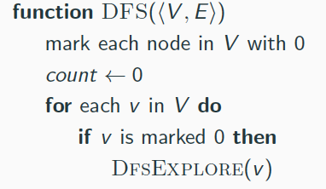
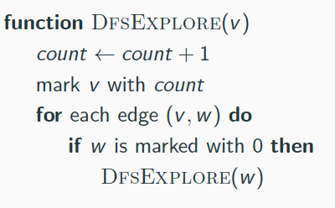
Problem: Modify the algorithm so that it also builds the arrays pre[V] and post[V]to store the push- and the pop-order of the vertices.
COMP20007.Worshop

Slide 6

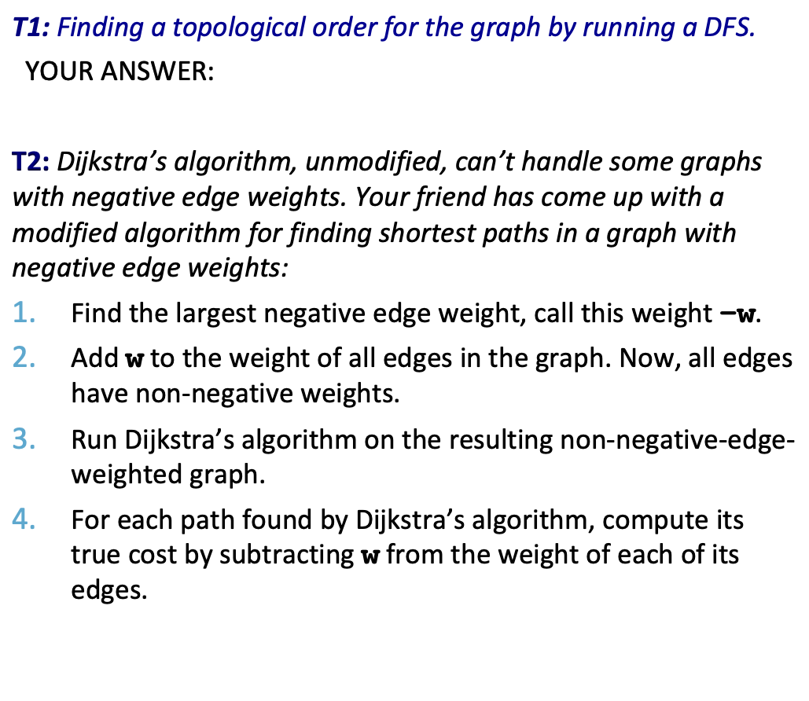
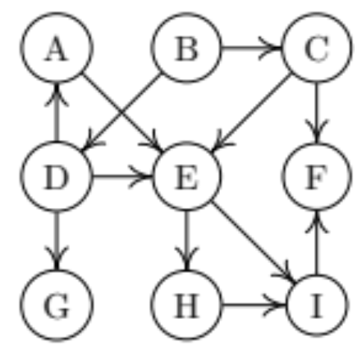
a) Give an example showing that DA can’t handle negative weights. b) Will your friend’s algorithm work? Give an example.
COMP20007.Worshop

Slide 7

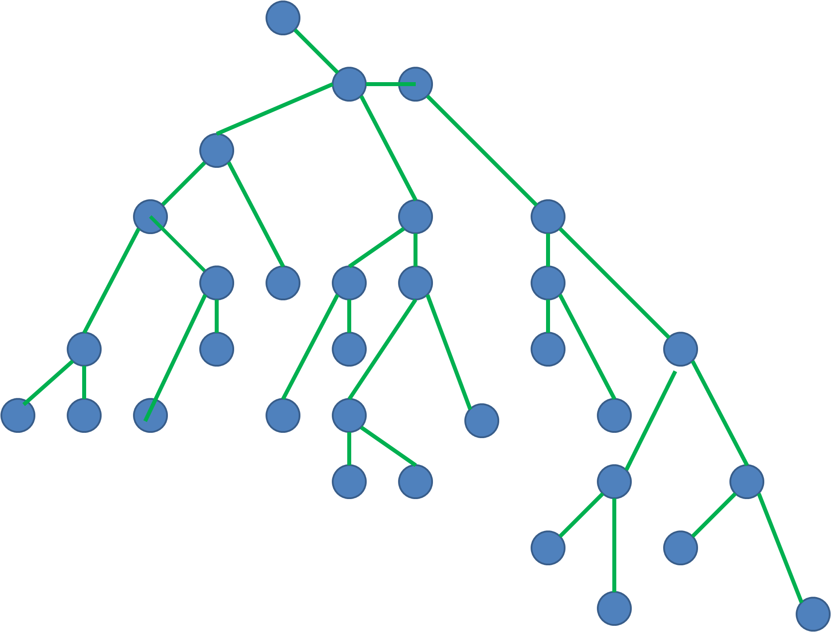
If a graph (V,E) is a tree, then:
COMP20007.Worshop

Slide 8

COMP20007.Worshop

Slide 9

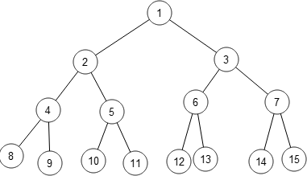
What is inorder, preorder, postorder, and level-order traversal? Are they BFS or DFS?
Group Work: Problems T3, T4, T5.
COMP20007.Worshop

Slide 10

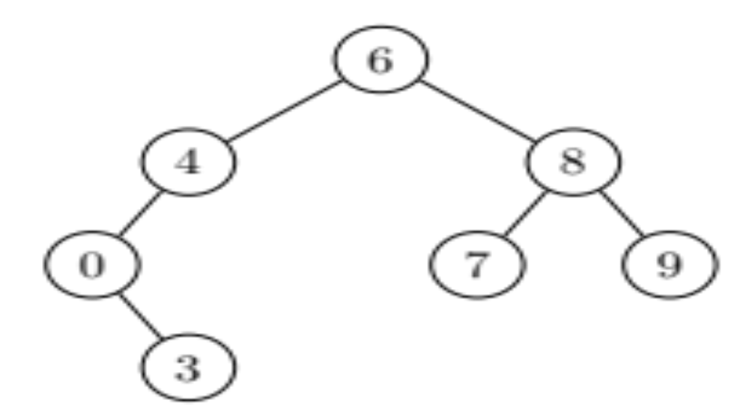
Write the inorder, preorder and postorder traversals of
the following binary tree:
YOUR ANSWER:
In-order:
Pre-order:
Post-order:
COMP20007.Worshop

Slide 11

Level-order: visit level-by-level, left-to-right, starting from the root (which is in 0-th level).
For the tree below, what’s the visited order?
Write the level-order pseudo-code.
YOUR ANSWER:
Level-order:
COMP20007.Worshop

Slide 12

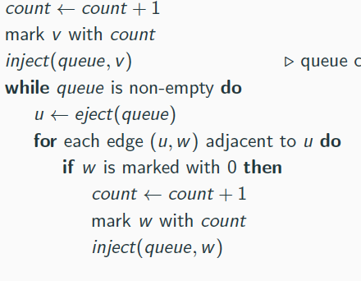
function BfsExplore(v)
b) Write the level-order pseudo-code.
YOUR ANSWER: The pseudocode:
function LevelOrder( T )
COMP20007.Worshop

Slide 13
Write a recursive algorithm to calculate the sum of a binary tree where each node contains a number.
YOUR ANSWER: The pseudocode:
function Sum( T )
COMP20007.Worshop

Slide 14

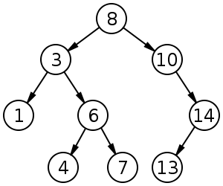
How to:
print the number in increasing order?
print in decreasing order?
copy the tree?
free the tree?
COMP20007.Worshop

