Slide 1
Anh Tran (SNL); Julien Tranchida (CEA Cadarache)
Multi-fidelity Gaussian process and Bayesian optimization for materials design: Application to ternary random alloys
The views expressed in the article do not necessarily represent the views of the U.S. Department of Energy or the United States Government. Sandia National Laboratories is a multimission laboratory managed and operated by National Technology and Engineering Solutions of Sandia, LLC., a wholly owned subsidiary of Honeywell International, Inc., for the U.S. Department of Energy’s National Nuclear Security Administration under contract DE-NA-0003525.
Tran, A., Tranchida, J., Wildey, T., & Thompson, A. P. (2020). Multi-fidelity machine-learning with uncertainty quantification and Bayesian optimization for materials design: Application to ternary random alloys. The Journal of Chemical Physics, 153(7), 074705.

Slide 2
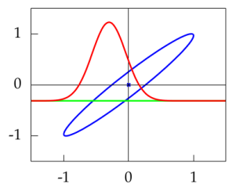

Gaussian process - Introduction
A non-parametric and statistical model based on normal distribution
A conditional of a Gaussian is Gaussian!
A framework that has existed for more than a half century
Why is it so popular?
1. Deringer, V. L., Bartók, A. P., Bernstein, N., Wilkins, D. M., Ceriotti, M., & Csányi, G. (2021). Gaussian process regression for materials and molecules. Chemical Reviews, 121(16), 10073-10141.
2. Rasmussen, C.E., 2003. Gaussian processes in machine learning. In Summer school on machine learning (pp. 63-71). Springer, Berlin, Heidelberg.
3. B. Shahriari, K. Swersky, Z. Wang, R. P. Adams, and N. de Freitas, Proc. IEEE
104, 148 (2016).
If then
Photo courtesy from Neil Lawrence (2016).

Slide 3
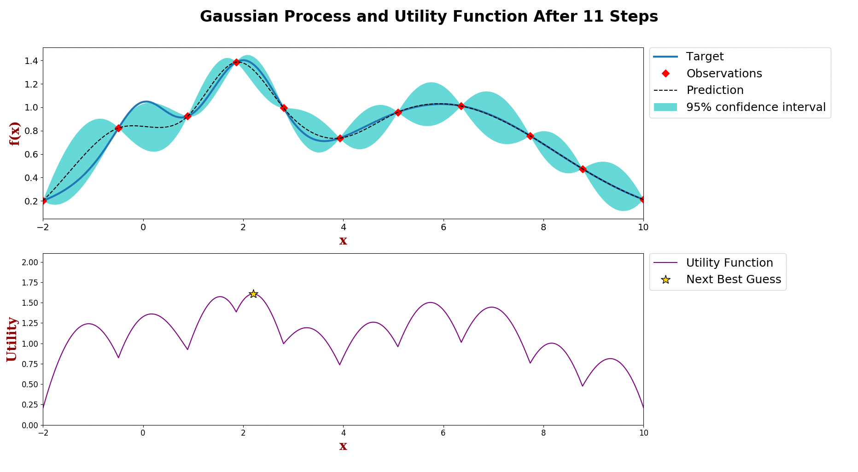
Gaussian process - Introduction
A powerful and flexible framework
And versatile, but in what sense?
  Multi-objective
  Multi-task
  Multi-fidelity
  Mixed-integer
  Scalable for Big Data
  High-dimensional
  Asynchronous parallel
  Etc.
An animation of Bayesian optimization

Slide 4


Gaussian process - Introduction
Let denote the set of observations and denote an arbitrary test points
Prediction is a Gaussian distribution
is a vector of covariance terms.

Slide 5


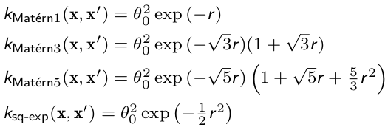
Gaussian process - Introduction
Kernels:
  Stationary (default), i.e. only depends on distance
  Anisotropic vs. isotropic
  Symmetric positive semi-definite matrix
  Many good choices
  Affect smoothness of GP
  (hint: first derivative at origin)
B. Shahriari, K. Swersky, Z. Wang, R. P. Adams, and N. de Freitas, Proc. IEEE 104, 148 (2016).

Slide 6


Gaussian process - Introduction
How to train a GP
  Maximizing the log marginal likelihood function
  Alternatively, can treat hyper-parameters as stochastic parameters and marginalize out using MC
  Complexity
  More computationally expensive with more data
  Approximations are available to reduce complexity at the cost of accuracy, e.g. low-rank approx.
Snoek, J., Larochelle, H., & Adams, R. P. (2012). Practical bayesian optimization of machine learning algorithms. Advances in neural information processing systems, 25.

Slide 7
Gaussian process - Introduction
What is the point of optimization?
  Everything is about efficiency
  Crux: how to select the next input parameters
  Debate of optimization policies
Bayesian optimization is a gradient-free approach
  Input parameters are found by maximizing acquisition function
  Active learning: balancing exploration vs. exploitation
  Minimal dataset

Slide 8


Gaussian process - Introduction
Acquisition function
  Probability of improvement (PI)
  Expected improvement (EI)
  Upper confidence bound (UCB)
Mockus, Jonas (1975). “On Bayesian methods for seeking the extremum”. In: Optimization Techniques IFIP Technical Conference. Springer, pp. 400–404.
Mockus, Jonas (1982). “The Bayesian approach to global optimization”. In: System Modeling and Optimization, pp. 473–481
Srinivas, Niranjan et al. (2009). “Gaussian process optimization in
the bandit setting: No regret and experimental design”. In: arXiv
preprint arXiv:0912.3995.
Srinivas, Niranjan et al. (2012). “Information-theoretic regret
bounds for Gaussian process optimization in the bandit setting”.
In: IEEE Transactions on Information Theory 58.5,
pp. 3250–3265.

Slide 9



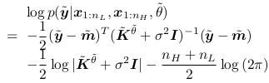

Gaussian process - Multi-fidelity
1. Kennedy, Marc C and Anthony O’Hagan (2000). “Predicting the output from a complex computer code when fast approximations are available”. In: Biometrika 87.1, pp. 1–13
2. Yang, X., Zhu, X., & Li, J. (2020). When bifidelity meets cokriging: An efficient physics-informed multifidelity method. SIAM Journal on Scientific Computing, 42(1), A220-A249.
3. Xiao, M., Zhang, G., Breitkopf, P., Villon, P., & Zhang, W. (2018). Extended Co-Kriging interpolation method based on multi-fidelity data. Applied Mathematics and Computation, 323, 120-131.
4. Tran, A., Wildey, T., & McCann, S. (2020). sMF-BO-2CoGP: A sequential multi-fidelity constrained Bayesian optimization framework for design applications. Journal of Computing and Information Science in Engineering, 20(3).
Auto-regressive formulation
Covariance matrix
Posterior mean
Posterior variance
Log marginal likelihood
Fidelity level to query

Slide 10
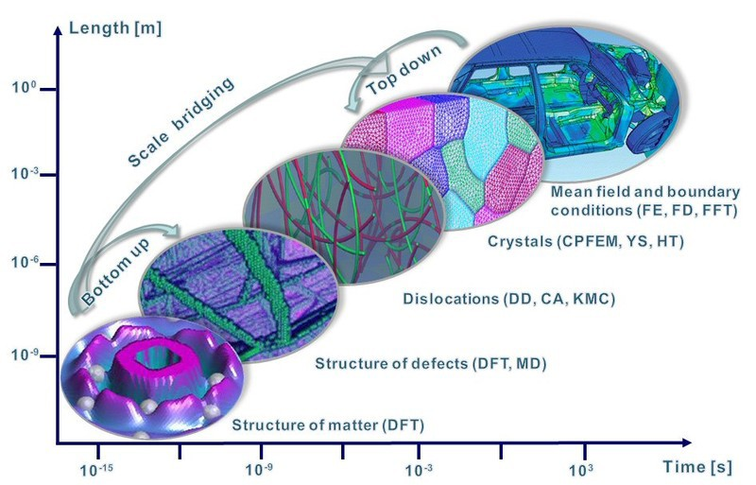
A multi-scale perspective
But try to look at this from a multi-fidelity perspective
Machine learning prediction is not very accurate, but computationally cheap
DFT is accurate, but expensive
Propose a multi-fidelity approach to back ML prediction with DFT when it’s necessary.
Photo courtesy of Dierk Raabe. http://www.dierk-raabe.com/multiscale-modeling/

Slide 11
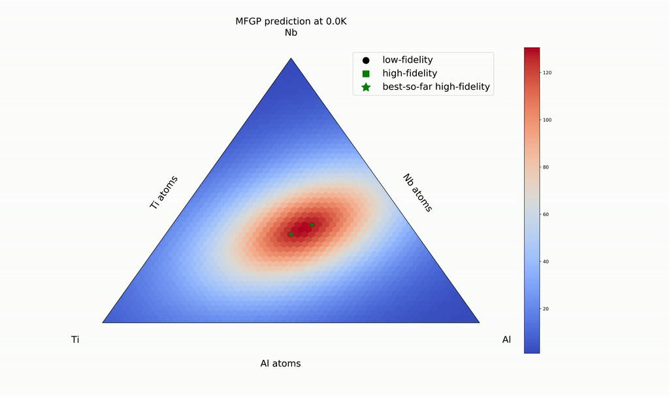
Multi-fidelity for multi-scale
Materials design: inverse problem
From chemical composition to materials properties

Slide 12
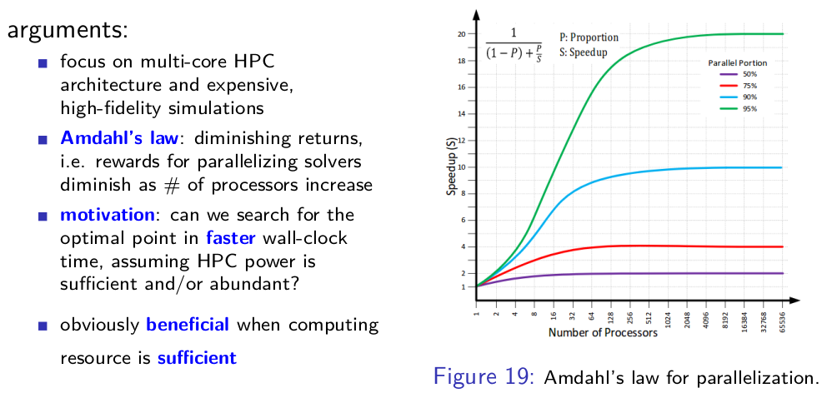
Bayesian Optimization Parallelism
A MPI perspective: Why parallelize optimization?

Slide 13
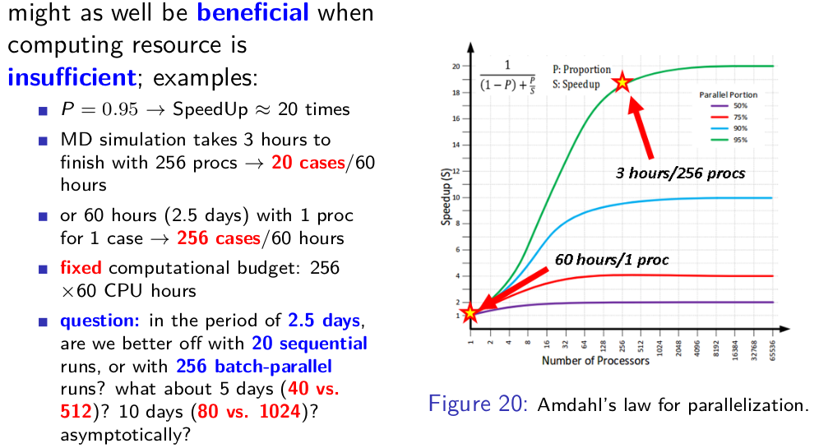
Bayesian Optimization Parallelism
A MPI perspective: Why parallelize optimization?

Slide 14
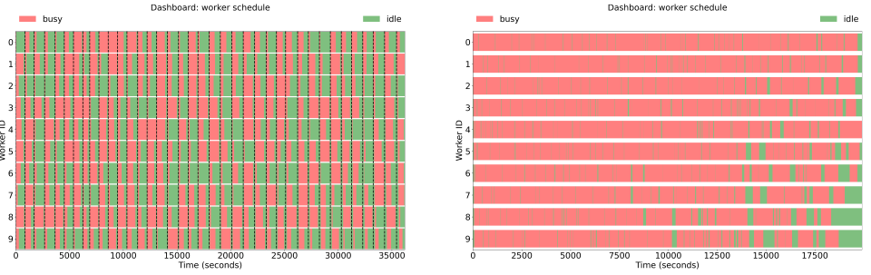
Bayesian Optimization Parallelism
A MPI perspective
  Why asynchronous parallel?

Slide 15

The code, the data, and the tutorials
https://dakota.sandia.gov/
Source code available: https://dakota.sandia.gov/download.html
A Sandia National Laboratories’s flagship software in uncertainty quantification and optimization
How to compile Dakota on Ubuntu 20.04 LTS: https://dakota.sandia.gov/content/linux-ubuntu-2004
apt-get install gcc g++ gfortran cmake libboost-all-dev libblas-dev liblapack-dev libopenmpi-dev openmpi-bin gsl-bin libgsl-dev python perl libhdf5-dev
cmake -D CMAKE_C_FLAGS="-O2" -D CMAKE_CXX_FLAGS="-O2" -D CMAKE_Fortran_FLAGS="-O2"\
-D DAKOTA_HAVE_GSL:BOOL=TRUE -D HAVE_QUESO:BOOL=TRUE -D DAKOTA_HAVE_MPI:BOOL=TRUE \
-D DAKOTA_HDF5:BOOL=TRUE -D Boost_NO_BOOST_CMAKE:BOOL=TRUE ${DAK_SRC}

Slide 16
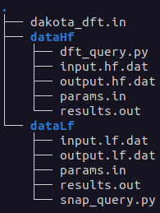
The code, the data, and the tutorials
https://dakota.sandia.gov/content/manuals
Interface examples: src/dakota-examples/official/drivers/
Directory
Two pseudo-simulations
  snap_query.py
  dft_query.py
Input: params.in; Output: results.out; I/O interface
Dakota input file: dakota_dft.in

