Slide 1

OOP Mini Project
Group 13 – Topic: Visualization of Tree Data Structures
Ho Tran Anh Vu – 20194885
Phung Thu Hang – 20194758
Pham Trung Hieu – 20194763
Lecturer: Nguyen Thi Thu Trang

Slide 2
1. Problem Statement
Design a program to display and explain some basic operations of four types of tree: Generic Tree, Binary Tree, Balanced Tree, Balanced Binary Tree.
Some basic operations on tree: create, insert, delete, update, traverse, search.
Design a GUI for the program followed by the instructions:
One main menu to choose type of tree, help menu and exit the program.
One screen for visualizing tree data structures and their operations.

Slide 3
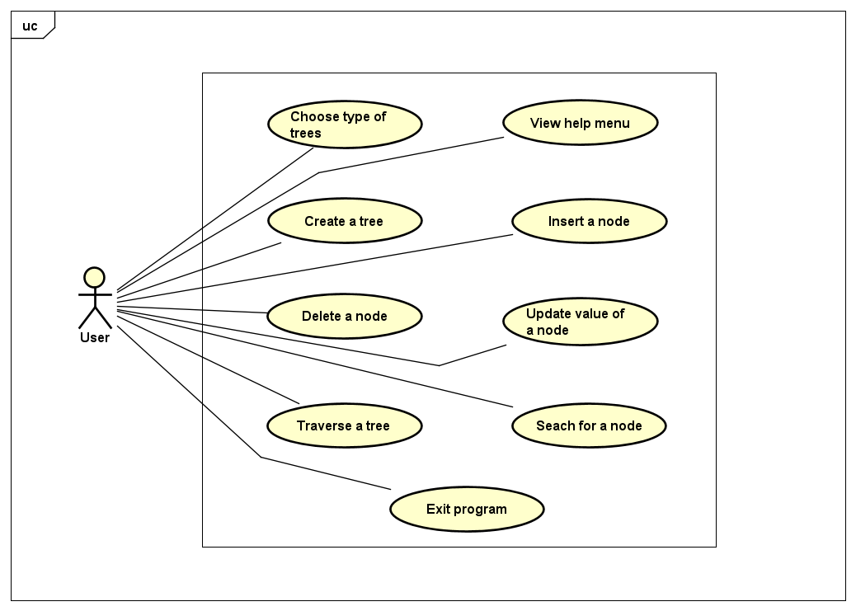
2. Use Case Diagram

Slide 4
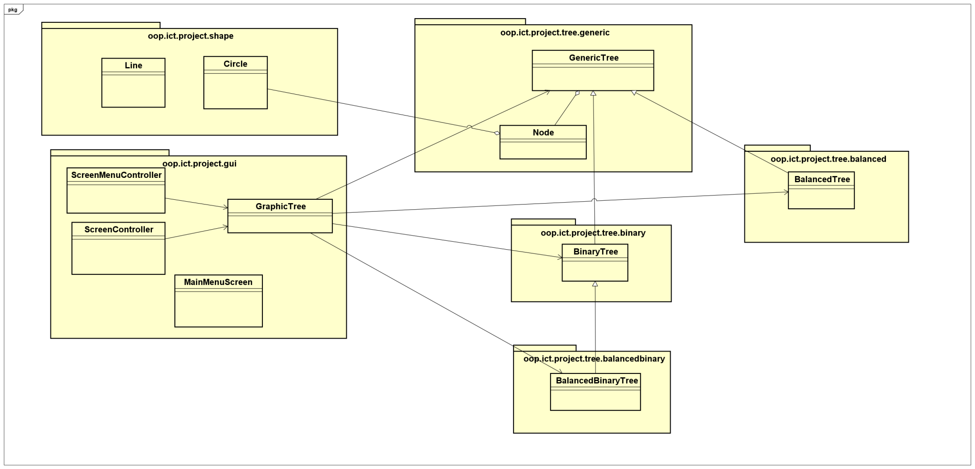
3. General Class Diagram

Slide 5
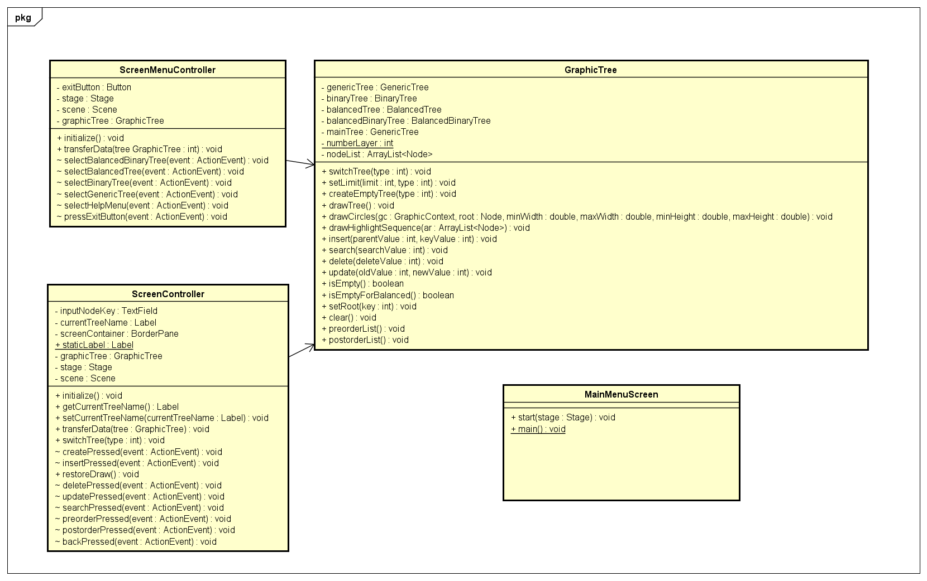
4. Class Diagrams
GUI Class Diagram

Slide 6
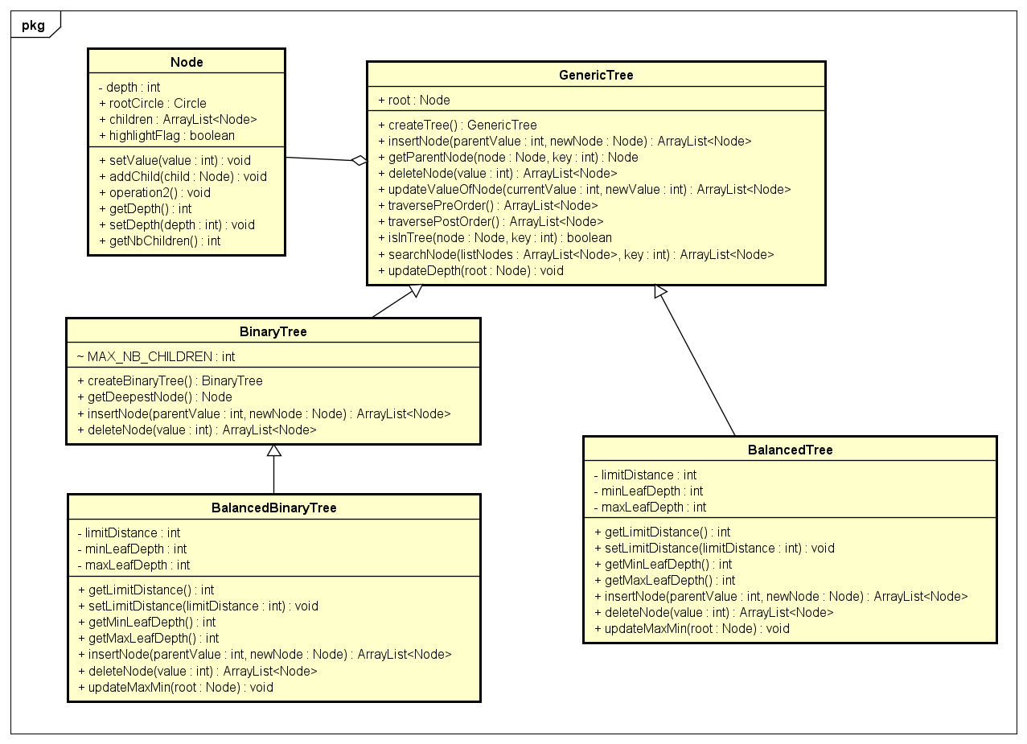
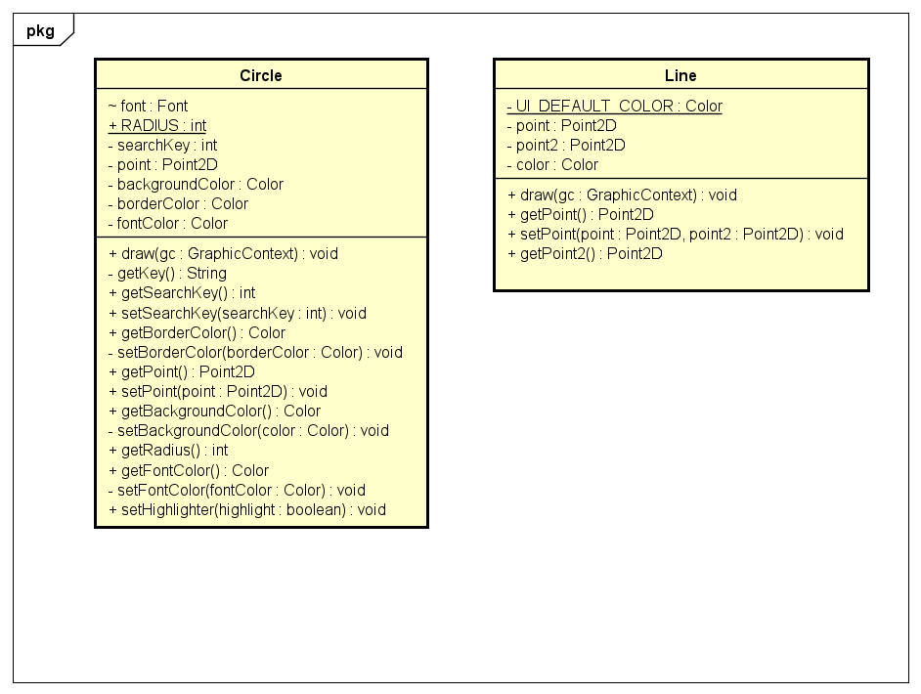
Shape Class Diagram
Tree Class Diagram

Slide 7
5. OOP Techniques
Firstly, we discussed together to build use case and general class diagram to orient and decide which way we need to follow to build our project (in the most object-oriented way).
We applied properties of Object Oriented in build our Trees. Firstly, we used Inheritance property to make Generic Tree is a father of the other three trees.
To build a tree, we created a Node class, followed Aggregation properties. A tree is built from nodes. Here, we designed an ArrayList of Node in each tree.

Slide 8
We also used Polymorphism property to override some methods from Generic Tree when we applied for Binary, Balanced and Balanced Binary Tree.
For GUI, we referred from a github repository and created class Circle and Lines to help us illustrate nodes and the relation among them.
We also designed a class named Graphic Tree to determine which elements need to visualize a tree, and also some methods to help us illustrate operations on each tree data structures.
We designed 2 FMXL files by using Scene Builder as well as 2 Controller classes correspondingly: one for menu screen and one for tree visualization.

Slide 9

6. Demo Video

