Slide 1

OOP Mini Project
Group 13 – Topic: Visualization of Tree Data Structures
Ho Tran Anh Vu – 20194885
Phung Thu Hang – 20194758
Pham Trung Hieu – 20194763
Lecturer: Nguyen Thi Thu Trang

Slide 2
1. Problem Statement
Design a program to display and explain some basic operations of four types of tree: Generic Tree, Binary Tree, Balanced Tree, Balanced Binary Tree.
Some basic operations on tree: create, insert, delete, update, traverse, search.
Design a GUI for the program followed by the instructions:
One main menu to choose type of tree, help menu and exit the program.
One screen for visualizing tree data structures and their operations.

Slide 3
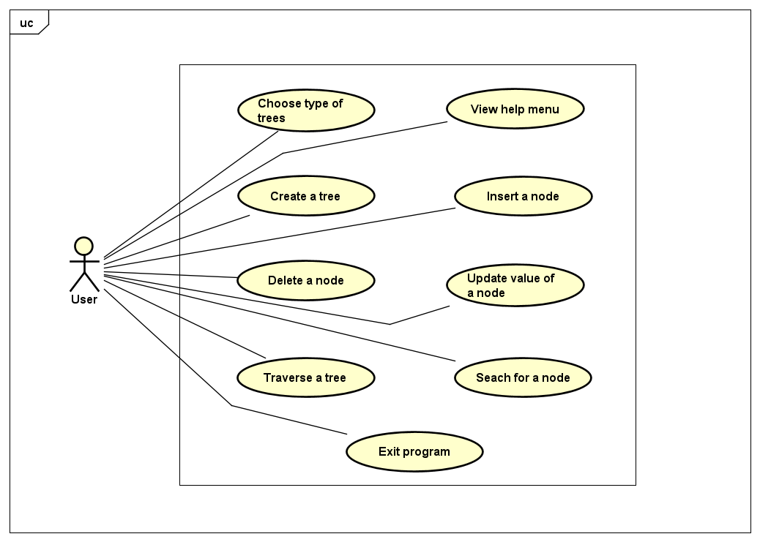
2. Use Case Diagram

Slide 4
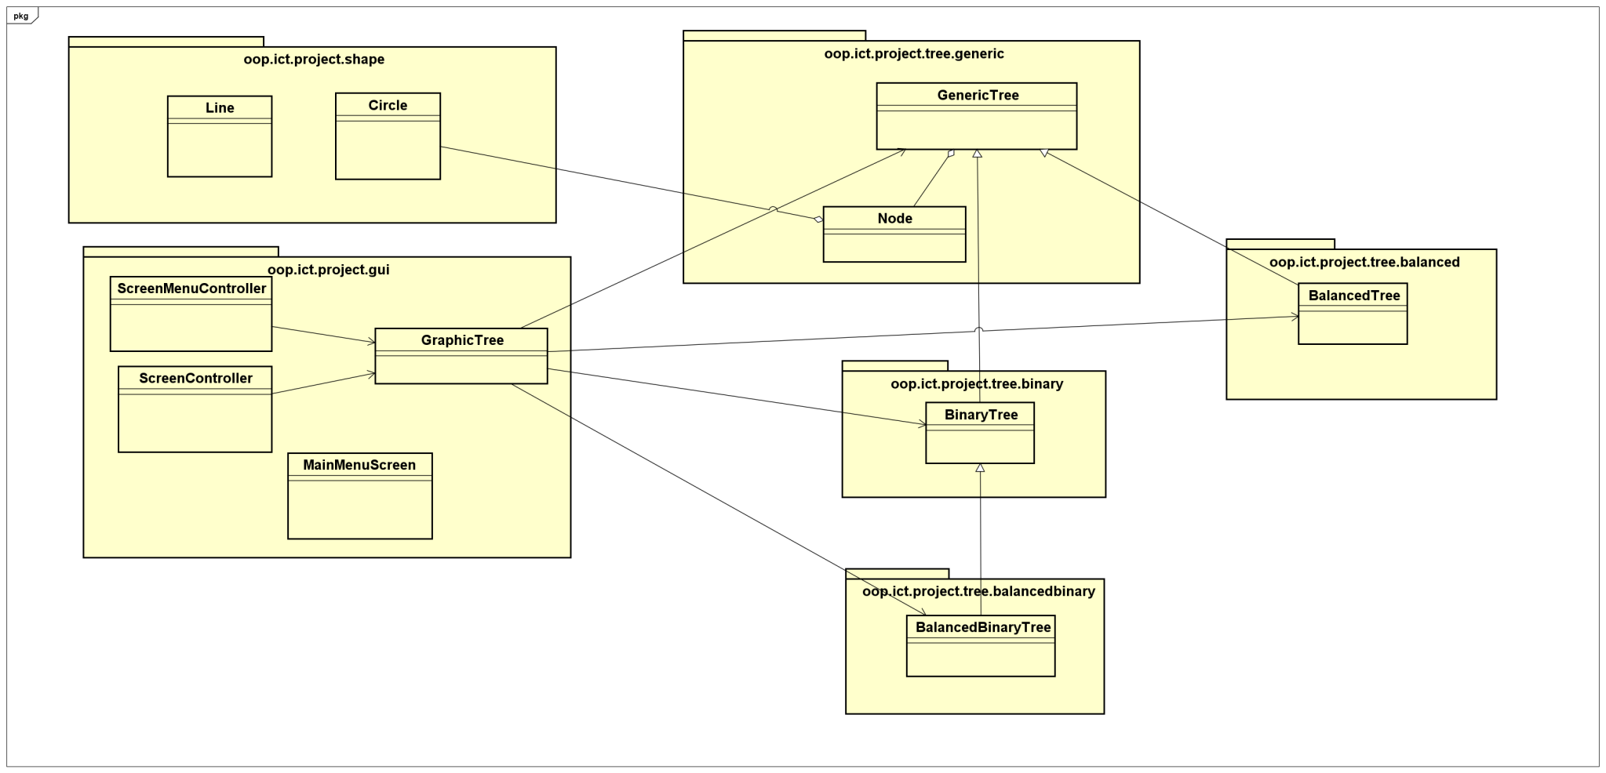
3. General Class Diagram

Slide 5
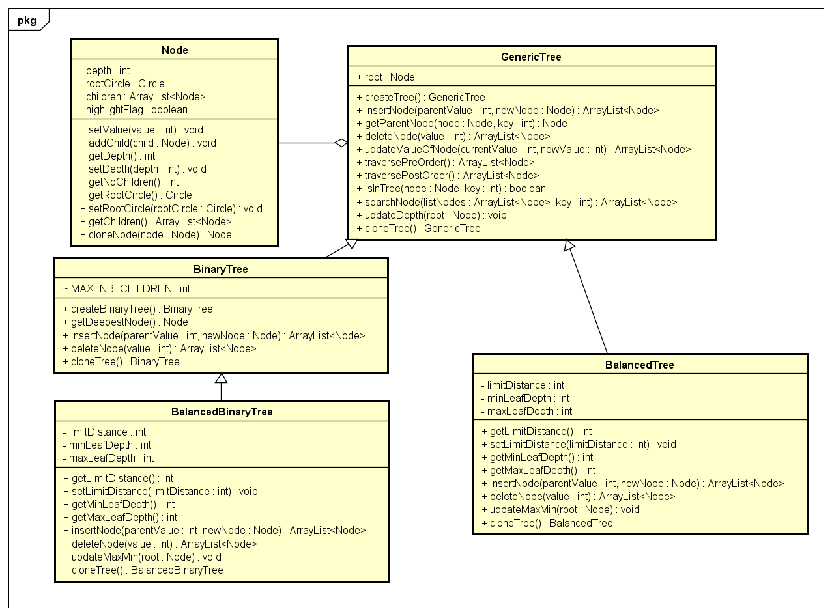
4. Class Diagrams
Tree Class Diagram

Slide 6
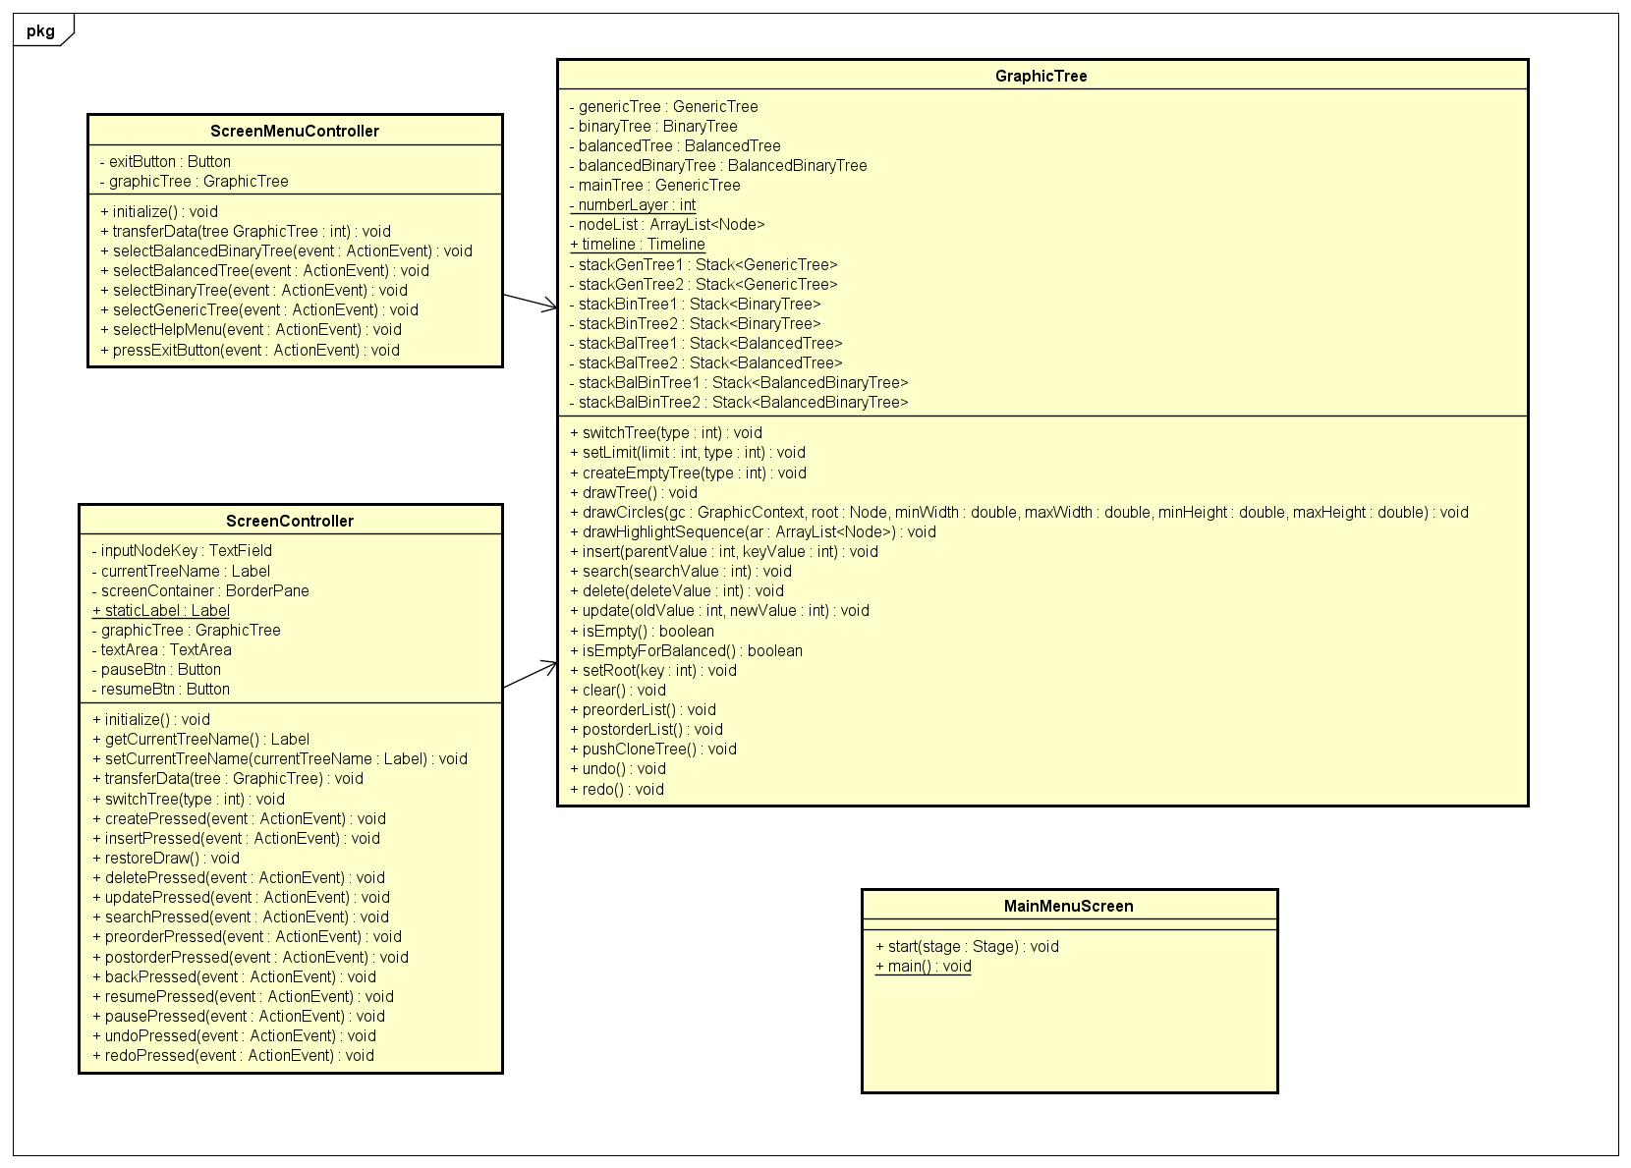
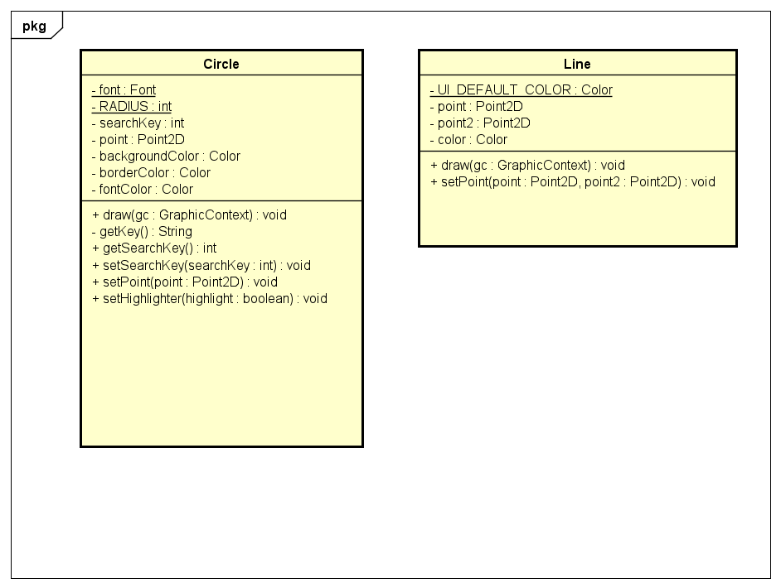
Shapes Class Diagram
GUI CLass Diagram

Slide 7
5. OOP Techniques
We applied properties of Object Oriented in building our Trees. Firstly, we used Inheritance property to make Generic Tree the parent of the other three trees.
Balanced Binary Tree is inherited from Binary Tree.
To build a tree, we created a Node class, followed Aggregation properties. A tree is built from nodes. Here, we designed a root node for each tree. One node can have multiple children so the attribute contains an ArrayList of Node.
We also used override technique to reuse some methods from Generic Tree when we applied for Binary, Balanced and Balanced Binary Tree.

Slide 8
5. OOP Techniques
ScreenMenuController controls MainMenuScreen class and ScreenController controls GraphicTree.
Those two controller classes use GraphicTree class, so Association is used here.
We also designed a class named Graphic Tree to determine which elements need to visualize a tree, and also some methods to help us illustrate operations on each tree data structures. We also applied Polymorphism in Graphic Tree by upcasting the other four trees to the main tree. Then almost all the operations were used in the main tree.

Slide 9
6. Link demo and presentation of program
Link demo: https://drive.google.com/file/d/1JwfXJTkFJlsWE1LxjoE-PRBMKbnlyJwG/view?usp=sharing
Link presentation: https://drive.google.com/file/d/17F9G8yuS4E6pgjpyn_7n5OFYJLcClbzI/view?fbclid=IwAR0k7VHkrDd-vTr_B6MCcUb0bTrOM1Js29STAKU0RFdrLfj-fK4mA-cL3fI

Slide 10


