Slide 1

MPP – project Library system
Group 1:
Huynh Anh Vu Nguyen (Cris)
Anh Tuan Ha

Slide 2
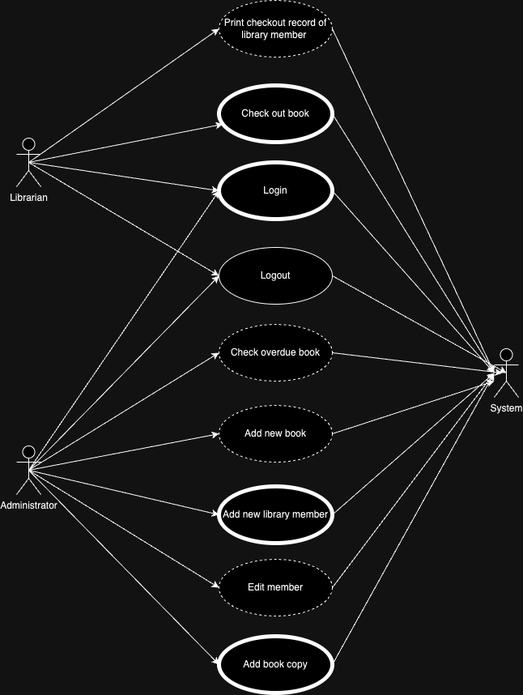
Use case

Slide 3
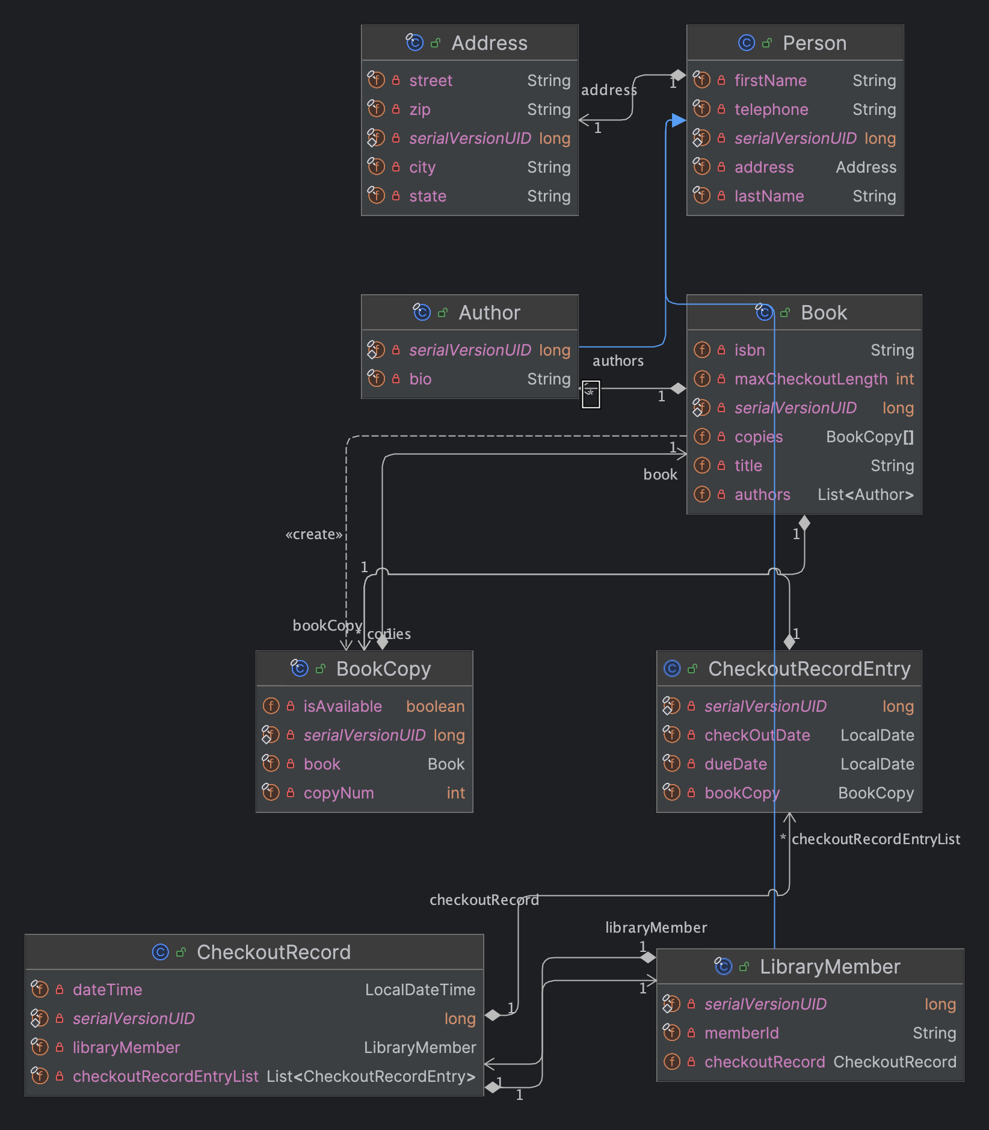
Class diagram

Slide 4
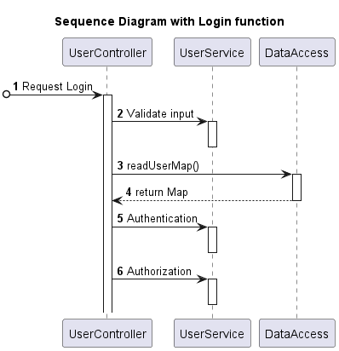
Use case 1: Login

Slide 5
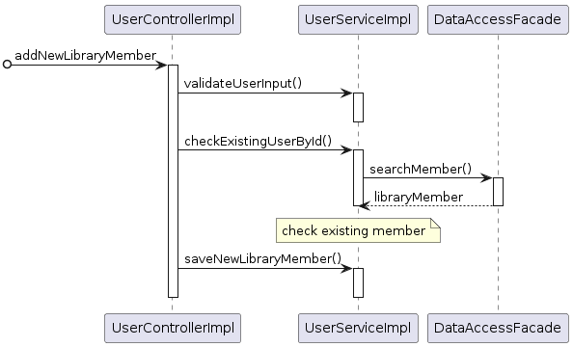
User case 2: Add new library member

Slide 6
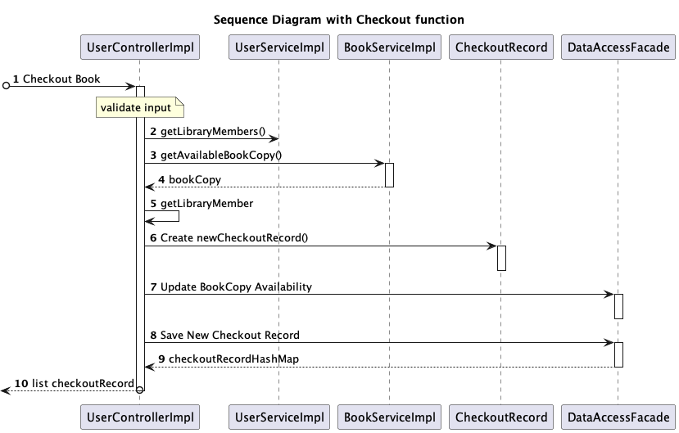
Use case 3: check out

Slide 7
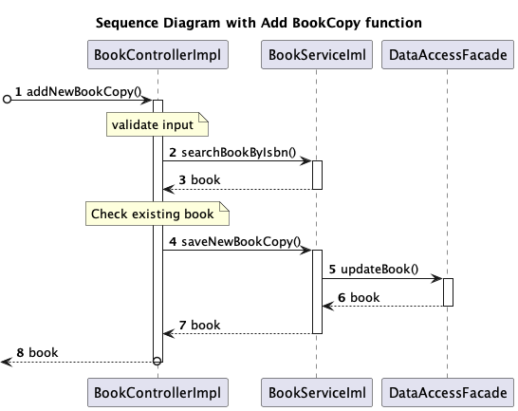
Use case 4: Add a copy of Book

Slide 8

Thank you for your time!

