Slide 1
Click & Transaction
Handling System
Nguyen Anh Vu

Slide 2
TOC
1.Requirements
2.Mapping to real world problem
3.Big picture
4.Components & Technologies
5.Class diagram
6.Database design
7.References
8.Q&A

Slide 3
1.Requirements
1.Functional
    Build a mediator system that can manage banner click & user transaction
2.Technical
    Can handle 10^6 clicks / day
    ~ 11 clicks / second
    ~ 365 M clicks / year

Slide 4
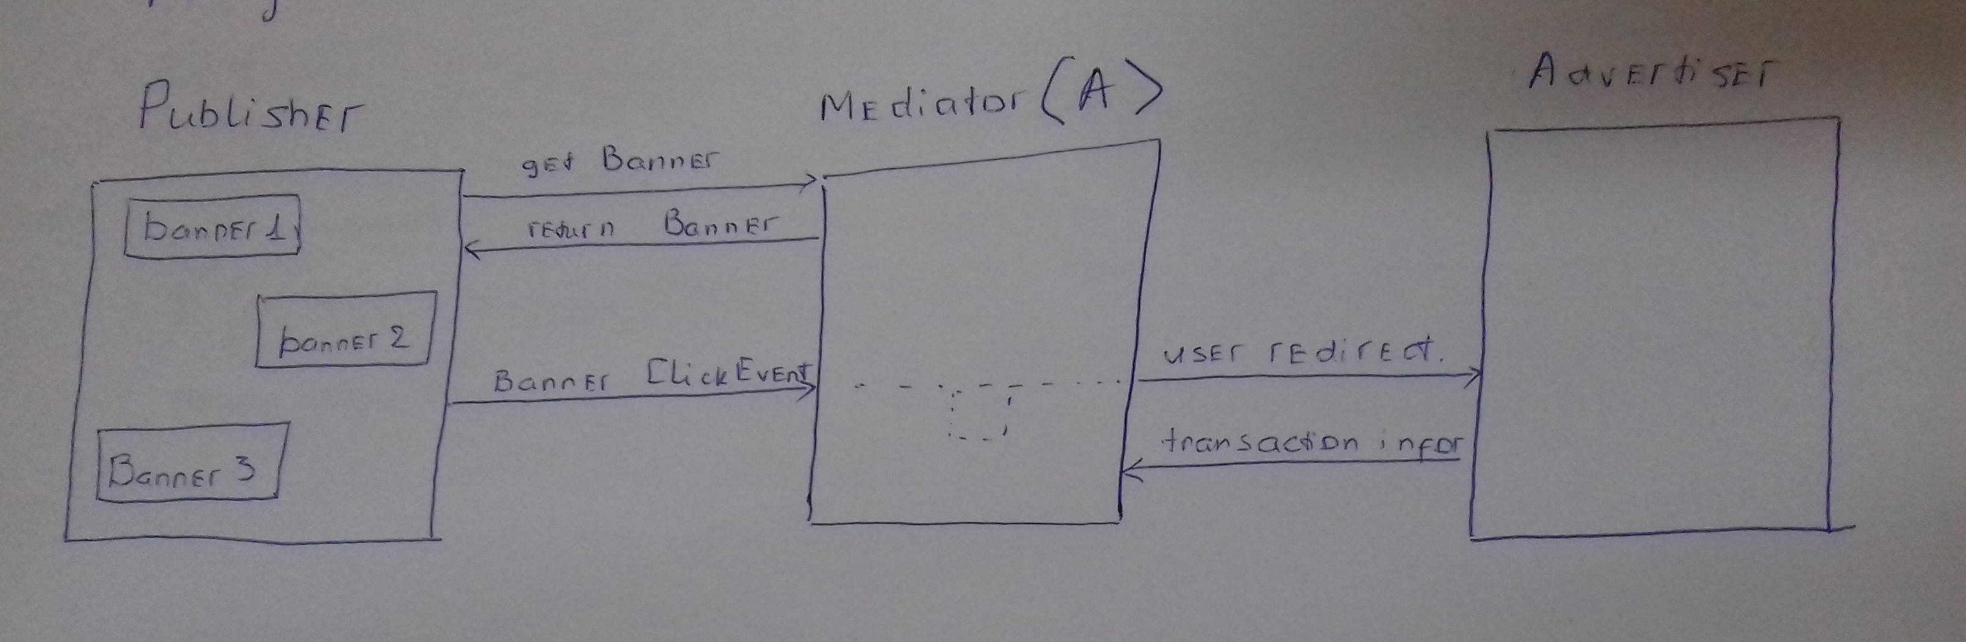
2.Mapping to real wold problem

Slide 5
2.Mapping to real wold problem...
A includes:
  Publisher management system
  Advertiser management system
  Campaign management system (time, money, banner, link)
  Banner suggestion system
  View management system
  Click management system
  Transaction management system

Slide 6
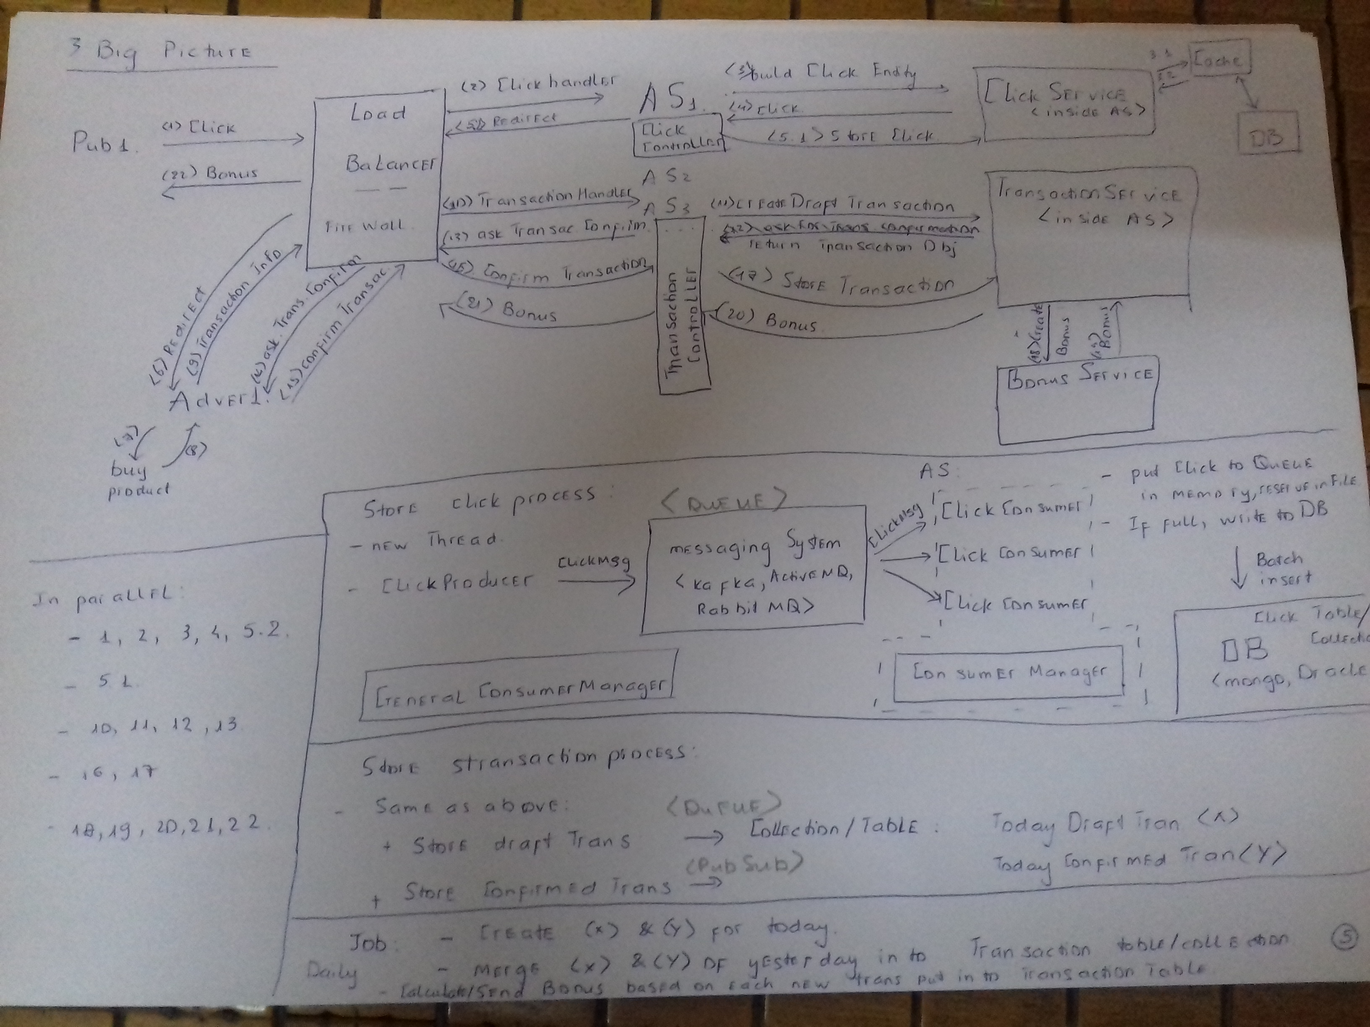
3.Big picture

Slide 7
4.Technologies
Load balancer: nginx
As: Tomcat, spring boot, spring mvc, spring restTemplate, spring data, spring cache, spring kafka
Cache: redis, guava
DB: Mongodb: fast, scalable, no transaction, sharding, replication, cluster
Messaging: Kafka: fast, replication, cluster
Turning params: tomcat maxThreads, consumer count

Slide 8
5.Class diagram

Slide 9
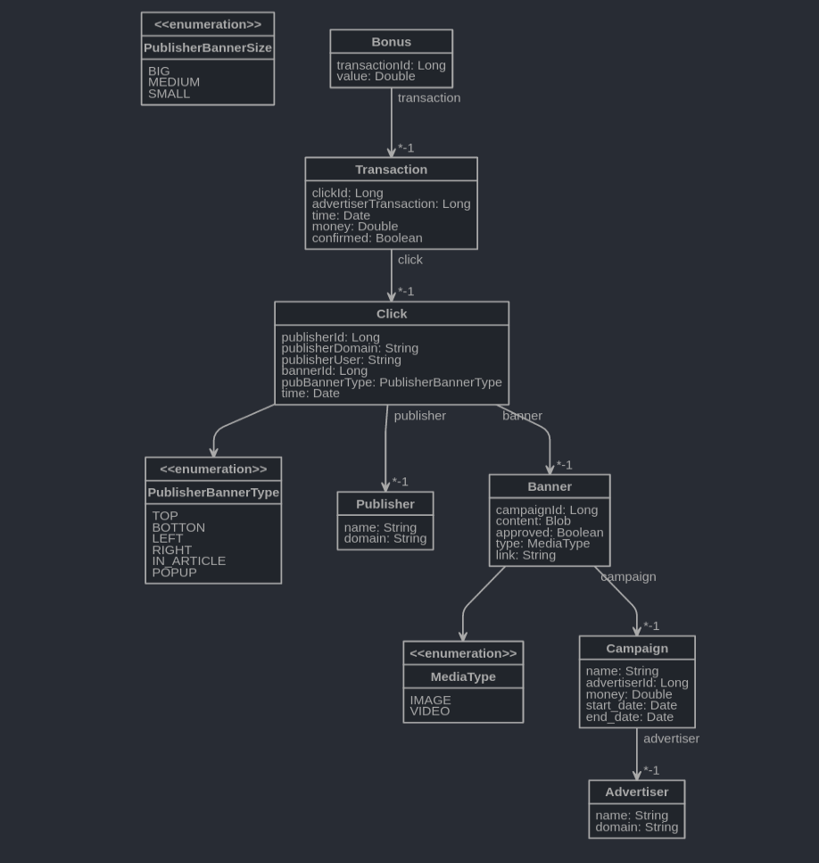
6.Database schema

Slide 10
7.Referenc es
1.Vndirect kafka presentation: https://docs.google.com/presentation/d/1jPU6soIDn7W1F4CtUADuB4r3ujrebwHmxIoDhOLb_ok/edit?usp=sharing
2. https://kafka.apache.org/
3. http://www.baeldung.com/spring-kafka
4. https://www.mongodb.com/
5. https://viblo.asia/p/su-dung-nginx-lam-load-balancer-cho-nhieu-backend-server-gDVK2aJ25Lj
6. https://tomcat.apache.org/tomcat-7.0-doc/config/http.html : maxThreads

Slide 11
8.Q&A

