Slide 1
eXo JCR
Clustering, replication
Notes:
1
1

Slide 2
Table of Contents
2
Notes:
2
2

Slide 3
Table of Contents
Clustering architecture,
Index replication strategies,
Standard settings,
Common issues, troubleshooting, limitations.

Slide 4
Clustering architecture
4
Notes:
4
4

Slide 5
Clustering architecture
Load Balancer
with sticky session disabled
Shared Indexes
Application Server
Replication
based on ISPN
Application Server
Replication
based on ISPN
Application Server
Http Session
Http Session
Http Session
Top Level App Caches
Replication Based on
JBoss Cache
Top Level App Caches
Replication Based on
JBoss Cache
GateIn
GateIn
GateIn
eXo JCR
JCR Cache Replication
Based on JBoss Cache
eXo JCR
JCR Cache Replication
Based on JBoss Cache
eXo JCR
Lucene Indexes
JCR Data

Slide 6
Clustering architecture
Load Balancer
with sticky session disabled
Local Indexes
Application Server
Replication
based on ISPN
Application Server
Replication
based on ISPN
Application Server
Http Session
Http Session
Http Session
Top Level App Caches
Replication Based on
JBoss Cache
Top Level App Caches
Replication Based on
JBoss Cache
GateIn
GateIn
GateIn
eXo JCR
JCR Cache Replication
Based on JBoss Cache
eXo JCR
JCR Cache Replication
Based on JBoss Cache
eXo JCR
Lucene Indexes
Lucene Indexes
JCR Data
Lucene Indexes

Slide 7
Clustering architecture
Load Balancer
with sticky session disabled
Rsync-based Indexes
Application Server
Replication
based on ISPN
Application Server
Replication
based on ISPN
Application Server
Http Session
Http Session
Http Session
Top Level App Caches
Replication Based on
JBoss Cache
Top Level App Caches
Replication Based on
JBoss Cache
GateIn
GateIn
GateIn
eXo JCR
JCR Cache Replication
Based on JBoss Cache
eXo JCR
JCR Cache Replication
Based on JBoss Cache
eXo JCR
JCR Data
Lucene Indexes
Lucene Indexes
Lucene Indexes
Rsync
Rsync

Slide 8
Index replication strategies
8
Notes:
8
8

Slide 9
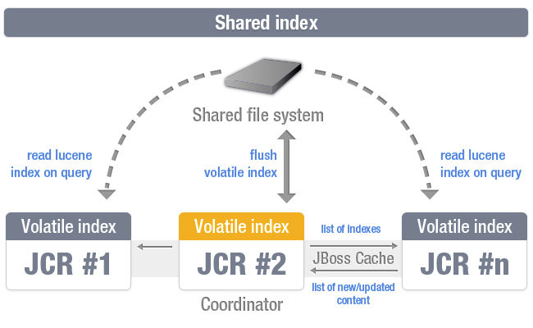
Index replication strategies
Notes:
This indexing strategy combines advantages of in-memory index along with shared persistent index offering "near" real time search capabilities. This means that newly added content is accessible via search practically immediately. This strategy allows nodes to index data in their own volatile (in-memory) indexes, but persistent indexes are managed by single "coordinator" node only. Each cluster instance has a read access for shared index to perform queries combining search results found in own in-memory index also. Take in account that shared folder must be configured in your system environment (i.e. mounted NFS folder). But this strategy in some extremely rare cases can have a bit different volatile indexes within cluster instances for a while. In a few seconds they will be up2date.
Shared index is consistent and stable enough, but slow, while local index is fast, but requires much time for re-synchronization, when cluster node is leaving a cluster for a small period of time. RSync-based index solves this problem along with local file system advantages in term of speed.

Slide 10
Index replication strategies
Pros
Ensures consistency as all nodes read the same index
No index recovery needed when a node joins a running cluster
Only one copy of the indexes is needed (less disc space used)
Cons
Read and Write accesses are slower as they need to access to a remote file system
Relies on a shared file system
Only the master can see the latest changes (no more true since JCR 1.14)

Slide 11
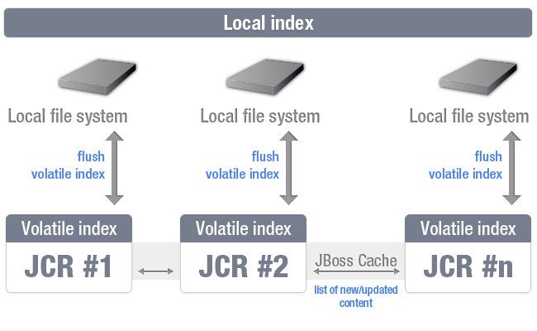
Index replication strategies
Notes:
As this implementation designed for clustered environment it has additional mechanisms for data delivery within cluster. Actual text extraction jobs done on the same node that does content operations (i.e. write operation). Prepared "documents" (Lucene term that means block of data ready for indexing) are replicated withing cluster nodes and processed by local indexes. So each cluster instance has the same index content. When new node joins the cluster it has no initial index, so it must be created. There are some supported ways of doing this operation. The simplest is to simply copy the index manually but this is not intended for use. If no initial index found JCR uses automated sceneries. They are controlled via configuration (see "index-recovery-mode" parameter) offering full re-indexing from database or copying from another cluster node.
For some reasons having a multiple index copies on each instance can be costly. So shared index can be used instead (see diagram below).

Slide 12
Index replication strategies
Pros
Read and Write accesses are faster as they are locals
Cons
Consistency is harder to ensure as each node is responsible for keeping up to date its own copy of indexes, so we can get differences in the indexes content from one cluster node to another.
Index recovery needed when a node joins a running cluster
One copy of the indexes per node

Slide 13
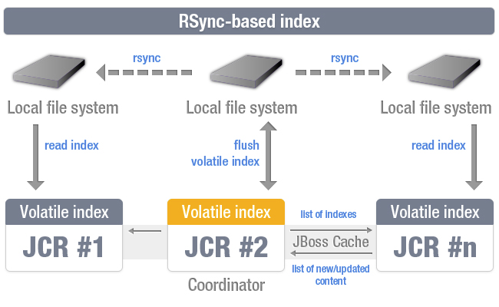
Index replication strategies
Notes:
This strategy is the same shared index, but stores actual data on local file system, instead of shared. Eventually triggering a synchronization job, that woks on the level of file blocks, synchronizing only modified data. Diagram shows it in action. Only single node in the cluster is responsible for modifying index files, this is the Coordinator node. When data persisted, corresponding command fired, starting synchronization jobs all over the cluster.

Slide 14
Index replication strategies
Pros
Read and Write accesses are faster as they are locals
Ensures consistency as each node reads its own copy of indexes based on the indexes of the master
Optimized index recovery when a node joins a running cluster
Cons
One copy of the indexes per node

Slide 15
Standard settings
15
Notes:
15
15

Slide 16
Standard settings
Notes: Whatever the cluster strategy used
The database is shared (Lock Data and JCR Data)
The value storage if enabled is stored into a shared File System
The swap directory is local
The database replication must be managed natively
The file system replication must be managed natively (RAID (http://en.wikipedia.org/wiki/RAID) or SAN (http://en.wikipedia.org/wiki/Storage_area_network))
The supported version of NFS is V3 with locking enabled or higher
Additional JBC instances are used to replicate the indexes
All the properties of the configuration of a component whose name starts with “jbosscache-” or is “jgroups-configuration”, can be injected into JBC configuration file using variables
Notes:
RAID: redundant array of independent disks
NFS: Network File System

Slide 17
Standard settings
Notes: By cluster strategy
Shared Indexes
The lucene indexes are stored in a shared File System
Only the master is in Read and Write mode
Local Indexes
The lucene indexes are stored locally
All the cluster nodes are in Read and Write mode
Rsynch based Indexes
The lucene indexes are stored locally
Only the master is in Read and Write mode

Slide 18
Standard settings
Parameters: Whatever the cluster strategy used - Cache
<cache enabled="true" class="org.exoplatform.services.jcr.impl.dataflow.persistent.jbosscache.JBossCacheWorkspaceStorageCache">
<properties>
<property name="jbosscache-configuration" value="jar:/conf/portal/test-jbosscache-data.xml" />
<property name="jgroups-configuration" value="jar:/conf/portal/udp-mux.xml" />
<property name="jbosscache-cluster-name" value="JCR_Cluster_cache" />
<property name="jgroups-multiplexer-stack" value="false" />
</properties>
</cache>
jbosscache-configuration: path to the JBC configuration used by the JCR cache
jgroups-configuration: path to the JGroups configuration
jbosscache-cluster-name: name of the cluster used for the JCR cache
jgroups-multiplexer-stack: enable or not the JGroups Multiplexer (deprecated)

Slide 19
Standard settings
Parameters: Whatever the cluster strategy used - Lock Manager
<lock-manager class="org.exoplatform.services.jcr.impl.core.lock.jbosscache.CacheableLockManagerImpl">
<properties>
<property name="jbosscache-configuration" value="jar:/conf/portal/test-jbosscache-lock.xml" />
<property name="jgroups-configuration" value="jar:/conf/portal/udp-mux.xml" />
<property name="jbosscache-cluster-name" value="JCR_Cluster_locks" />
<property name="jbosscache-cl-cache.jdbc.table.name" value="jcrlocks"/>
<property name="jbosscache-cl-cache.jdbc.table.create" value="true"/>
<property name="jbosscache-cl-cache.jdbc.table.drop" value="false"/>
<property name="jbosscache-cl-cache.jdbc.table.primarykey" value="jcrlocks_pk"/>
<property name="jbosscache-cl-cache.jdbc.fqn.column" value="fqn"/>
<property name="jbosscache-cl-cache.jdbc.node.column" value="node"/>
<property name="jbosscache-cl-cache.jdbc.parent.column" value="parent"/>
<property name="jbosscache-cl-cache.jdbc.datasource" value="jdbcjcr"/>
<property name="jgroups-multiplexer-stack" value="false" />
</properties>
</lock-manager>
jbosscache-configuration: path to the JBC configuration used by the Lock Manager
jgroups-configuration: path to the JGroups configuration
jbosscache-cluster-name: name of the cluster used for the Lock Manager
jgroups-multiplexer-stack: enable or not the JGroups Multiplexer (deprecated)
jbosscache-cl-*: set of parameters to be injected into the configuration of the cache loader

Slide 20
Standard settings
Parameters: Shared Indexes
<query-handler class="org.exoplatform.services.jcr.impl.core.query.lucene.SearchIndex">
<properties>
<property name="index-dir" value="/PATH/TO/SHARED/FS/index/db1/ws" />
<property name="changesfilter-class" value="org.exoplatform.services.jcr.impl.core.query.jbosscache.JBossCacheIndexChangesFilter" />
<property name="jbosscache-configuration" value="jbosscache-indexer.xml" />
<property name="jgroups-configuration" value="udp-mux.xml" />
<property name="jgroups-multiplexer-stack" value="true" />
<property name="jbosscache-cluster-name" value="JCR-cluster-indexer-ws" />
</properties>
</query-handler>
index-dir: path to the root directory of the indexes. Corresponding to a shared directory
changesfilter-class set to JBossCacheIndexChangesFilter to use the shared mode
jbosscache-configuration: path to the JBC configuration used by the indexer
jgroups-configuration: path to the JGroups configuration
jbosscache-cluster-name: name of the cluster used by the indexer
jgroups-multiplexer-stack: enable or not the JGroups Multiplexer (deprecated)

Slide 21
Standard settings
Parameters: Local Indexes
<query-handler class="org.exoplatform.services.jcr.impl.core.query.lucene.SearchIndex">
<properties>
<property name="index-dir" value="/index/db1/ws" />
<property name="changesfilter-class"
value="org.exoplatform.services.jcr.impl.core.query.jbosscache.LocalIndexChangesFilter" />
<property name="jbosscache-configuration" value="jbosscache-indexer.xml" />
<property name="jgroups-configuration" value="udp-mux.xml" />
<property name="jgroups-multiplexer-stack" value="false" />
<property name="jbosscache-cluster-name" value="JCR-cluster-indexer-ws" />
<property name="index-recovery-mode" value="from-coordinator" />
</properties>
</query-handler>
index-dir: path to the root directory of the indexes. Corresponding to a local directory
changesfilter-class set to LocalIndexChangesFilter to use the local indexes mode
jbosscache-configuration: path to the JBC configuration used by the indexer
jgroups-configuration: path to the JGroups configuration
jbosscache-cluster-name: name of the cluster used for the indexer
jgroups-multiplexer-stack: enable or not the JGroups Multiplexer (deprecated)
index-recovery-mode: mode to use to recover the indexes (from-coordinator or from-indexing)
index-recovery-filter: FQN of the filter to use to know if an index recovery is required

Slide 22
Standard settings
Parameters: Rsynch based Indexes
<query-handler class="org.exoplatform.services.jcr.impl.core.query.lucene.SearchIndex">
<properties>
<property name="index-dir" value="/var/data/index/repository1/production" />
<property name="changesfilter-class"
value="org.exoplatform.services.jcr.impl.core.query.jbosscache.JBossCacheIndexChangesFilter" />
<property name="jbosscache-configuration" value="jar:/conf/portal/cluster/jbosscache-indexer.xml" />
<property name="jgroups-configuration" value="jar:/conf/portal/cluster/udp-mux.xml" />
<property name="jgroups-multiplexer-stack" value="false" />
<property name="jbosscache-cluster-name" value="JCR-cluster-indexer" />
<property name="rsync-entry-name" value="index" />
<property name="rsync-entry-path" value="/var/data/index" />
<property name="rsync-port" value="8085" />
<property name="rsync-user" value="rsyncexo" />
<property name="rsync-password" value="exo" />
</properties>
</query-handler>
index-dir: path to the root directory of the indexes. Corresponding to a local directory
changesfilter-class set to JBossCacheIndexChangesFilter to use the rsynch based mode
jbosscache-configuration: path to the JBC configuration used by the indexer
jgroups-configuration: path to the JGroups configuration
jbosscache-cluster-name: name of the cluster used for the indexer
jgroups-multiplexer-stack: enable or not the JGroups Multiplexer (deprecated)
rsynch-*: set of parameters required to access the rsynch server

Slide 23
Standard settings
Configuration in JPP 6
In standalone/configuration/, standalone-ha.xml and standalone-full-ha.xml already configured to set the system properties:
exo.profiles to “cluster”
gatein.jcr.config.type to “cluster”
gatein.jcr.index.changefilterclass to “LocalIndexChangesFilter”
gatein.jcr.storage.enabled to “false”
In standalone/configuration/gatein/configuration.properties in case you would like to configure the shared approach, you will need to
Set gatein.jcr.index.changefilterclass to JBossCacheIndexChangesFilter by uncommenting a line
Set gatein.jcr.storage.data.dir to the full path of the shared directory that will contain the value storage
Set gatein.jcr.index.data.dir to the full path of the shared directory that will contain the indexes

Slide 24
Common issues, troubleshooting, limitations.
24
Notes:
24
24

Slide 25
Standard settings
Limitations
The replication must be synchronous to ensure consistency
Limited linear scalability due to a replicated base architecture
The configuration must be the same from one node to another, especially the paths (value storage, rsynch config…)
The cluster nodes must be launched one after the other (no more true since JCR 1.14)
The running transactions must be suspended before stopping a node (no more true since JCR 1.15)

Slide 26
Standard settings
Common issues
NoSuchDirectoryException: directory '/gatein-shared-dir/jcr/lucene/wsrp-system/_n' does not exist or IOException: Cannot delete /gatein-shared-dir/jcr/lucene/wsrp-system/redo.log or IOException: Stale NFS file handle: it occurs with the shared mode when jgroups is not properly configured such that the nodes don’t see each other so they are all in Read and Write mode which is not allowed
TimeoutException: Unable to acquire lock on Fqn, this issue could be due to:
Deadlock: We have 2 concurrent threads blocked because the first thread holds the lock on a cache entry locally and wants to acquire the lock of this entry on the second cluster node and the second thread holds the lock on the same cache entry on the second cluster node and wants to acquire the lock on this entry on the first cluster node.
Slow transaction: We have a thread that performs a transaction that lasts more than $ {lockAcquisitionTimeout} (here 20 seconds) and that holds several locks on cache entries and we have concurrent threads that would like to acquire the lock on one or several cache entries already owned by the thread that performs the slow transaction.
org.jboss.cache.ReplicationException: Generally due to a jgroups config or a network issue or an overloaded network

Slide 27
eXo JCR
Clustering, replication
Notes:
27
27

