Slide 1
CRaSH
Notes:
1

Slide 2
CRaSH Introduction
2
Notes:
2

Slide 3
CRaSH
What
A shell for Java Content Repository
Considers the JCR tree as its file system
Basic administration
http://code.google.com/p/crsh
Notes:
3

Slide 4

CRaSH
How
A webapp included in eXo Platform
Written as a Groovy script
Easy to add new commands
Found in WEB-INF/groovy/commands
Annotated with Args4j
Describe switches and arguments
You can extend the language
Notes:
4

Slide 5
CRaSH
Telnet
SSH
Connectors
Shell Engine
JCR
Connector
SCP
Commands
Args4j
Groovy
Notes:
5

Slide 6
Groovy integration: property access
// Iterate over the properties
Node.eachProperty({ property -> out.print(property.name);});
// This code
def foo = null;
if (node.hasProperty(‘foo’)) {
foo = node.getProperty(‘foo’).getString();
}
// Can be replaced by
foo = node.foo;
//
foo = node[‘foo’];

Slide 7
Groovy integration: node child access
// Iterates over the children
def count = 0;
node.each({ node -> count++; })
// This code
def foo = null;
if (node.hasNode(‘foo’)) {
foo = node.getNode(‘foo’);
}
// can be replaced by
foo = node.foo;
// Or
foo = node[‘foo’];

Slide 8
Documentation
http://crsh.googlecode.com
http://crsh.googlecode.com/svn/doc/1.0.0-beta9/index.html

Slide 9
CRaSH Configuration
9
Notes:
9

Slide 10
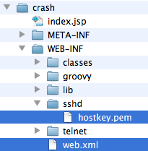
CRaSH Configuration
Configuration
All configuration in /WEB-INF/web.xml
The SSH server key is stored in /WEB-INF/sshd/hostkey.pem
Notes:
10

Slide 11

CRaSH Configuration
Port configuration
Telnet connection is configured for the port 5000, SSH on port 2000
Remove access
To remove the telnet access, remove or comment the listeners from web.xml:
Notes:
11

Slide 12

CRaSH Configuration
SSH server key configuration
The key can be changed by replacing the file WEB-INF/sshd/hostkey.pem.
Alternatively you can configure the server to use an external file by using the ssh.keypath parameter in web.xml. Uncomment the XML section and change the path to the key file.
Notes:
12

Slide 13
CRaSH Commands
13
Notes:
13

Slide 14
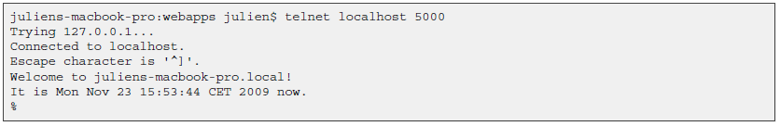
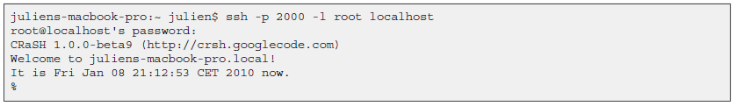
CRaSH How-to
Telnet connection is done on port 5000
SSH connection is done on port 2000 with the password crash :
Notes:
14

Slide 15
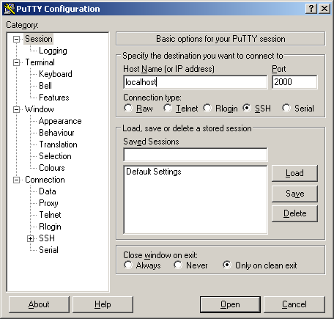
CRaSH How-to
PuTTY:
Notes:
15

Slide 16
Base Commands
Commands
Connect to the container “portal” to the workspace “portal-system”
Like Unix ls, cp, mv, rm
ls list not only folder contents but also details of a single node.
SQL select command for queries on the JCR (-o for offset and -l for length)
“bye” command in order to disconnect
Notes:
16

Slide 17
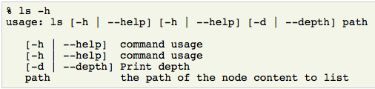
Help Commands
Help and Man
--help -h : Lists the command options. Try “cd -h” or “mv -h”
man : Gives a complete manual. Try “man select”
Notes:
17

Slide 18
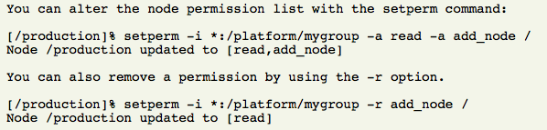
Permission Modification
Permissions
Rights: read, add_node, set_property, remove
Example of permissions, listing role:group and the right : [*:/platform/administrators read,*:/platform/administrators add_node,*:/platform/administrators set_property,*:/platform/administrators remove]
setperm: Modify the permissions for any node
Notes:
18

Slide 19
Session Commands
Commit and rollback
You are working in a CRaSH session, that means that the changes you did in the session are not visible outside of your session!
commit: saves the changes you did in the current session. A node can be provided to save the state of the this nodes and its descendants only. Otherwise they are not visible outside of the current CRaSH session!
rollback: in order to rollback the changes of the current session. A node can be provided to rollback the state of the this nodes and its descendants only.
Notes:
19

Slide 20
Pipe and Distribution Operators
Operators for experts
“|” Pipe Operator: streams a command output stream to a command input stream Example: select * from exo:article | addmixin mix:referenceable
“+” Distributor Operator: Merging(“distributing”) two streams into one stream After the pipe Before the pipe
Be careful when using these operators!
Notes:
20

Slide 21
Telnet Exporting and Importing
Export – Import
It is possible to export a node. The node type is nt:file. The file is in the root folder of the same workspace. Then it is possible to access the file using webdav.
Import, the other way around
Notes:
21

Slide 22
SCP Export and Import
Export
The following command will export the node /gadgets in the repository portal-system of the portal container portal:
scp -P 2000 root@localhost:portal:portal-system:/production/app:gadgets .
The node will be exported as app_gadgets.xml.
Note that the portal container name is used: “portal”. If you do omit it, then the root container will be used. The exported file format use the JCR system view.
Import
scp -P 2000 gadgets.xml root@localhost:portal:portal-system/production/app:gadgets
Notes:
22

Slide 23
CRaSH Exercises
23
Notes:
23

Slide 24
Exercise 1: CRaSH command
Connect to CRaSH by ssh (port 2000) or telnet (port 5000) (ssh password: “crash”)
Type in your shell: connect -c portal -u root -p gtn collaboration
Test the commands: ls, cd, mv, rm,
Use codes for blanks: ls “Sites Content”
Export and import a node. Is it document or system view? Import the node 2 times. What happens?
Add a mix:versionable mixin to an existing node. (syntax: addmixin . mix:versionable)
Test 5 different select use cases as seen in http://wiki.exoplatform.org/xwiki/bin/view/JCR/JCR+Query+Usecases.
For experts: Create a new command and test it
Notes:
24

Slide 25
Exercise 2: CRaSH SCP
login as root/gtn
Create a new site called “mysite”
The configuration of your site is in the workspace portal-system at the path: /production/mop:workspace/mop:portalsites/mop:mysite
Make an SCP export of your site and import using SCP it on a different server
Export: scp -P 2000 root@localhost:portal:portal-system:/production/mop:workspace/mop:portalsites/mop:mysite .
Import: scp -P 2000 mop_mysite.xml root@localhost:portal:portal-system/production/app:gadgets
Experts: Also export/import the content of mysite (articles etc.) : workspace collaboration, path /sites content/live/mysite
CRaSH Documentation: http://crsh.googlecode.com/svn/doc/1.0.0-beta18/html/index.html
Notes:
25

Slide 26
CRaSH
Notes:
26

