Slide 1
IDE and Services
Notes:
1

Slide 2
Table of Content
Interface
Programming Tools
Gadget Operations
Rest Services
Notes:
2

Slide 3
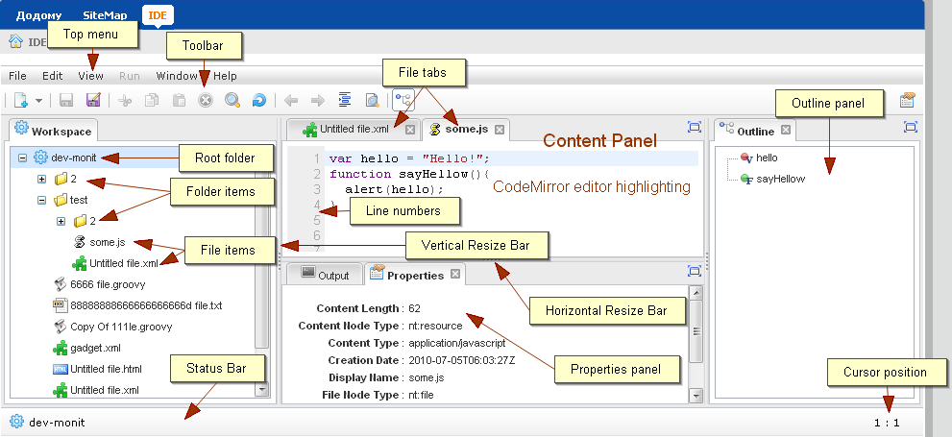
Overview
eXo IDE is a powerful Web application
Provides rich environment for developing different kind of content, scripts and services.
eXo IDE has modular architecture and can will be delivered with eXo Platform 3.0
There is no community version for eXo IDE. This service is not open source.
Notes:
3
3

Slide 4
Interface
4
Notes:
4

Slide 5
Interface
Notes:
5
5

Slide 6
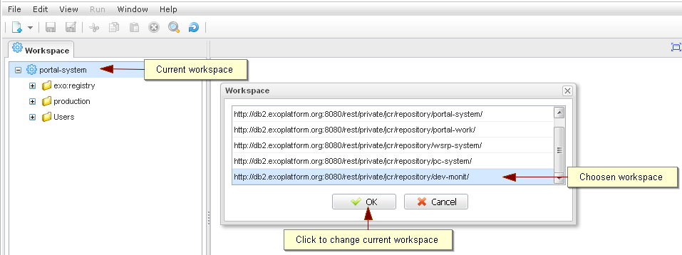
Interface – Select Repository
IDE always works with exactly one workspace
You have to choose one workspace from the list
Notes:
6
6

Slide 7
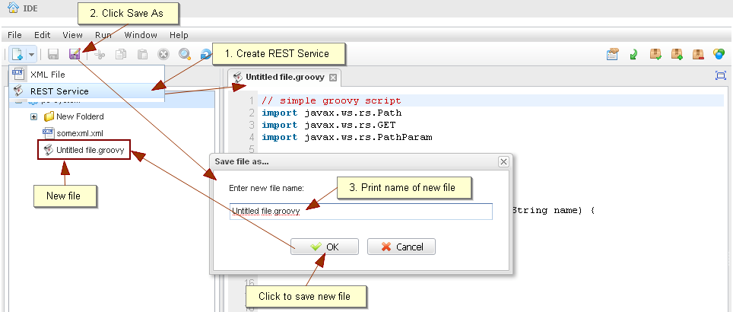
Interface – Create a file
Notes:
7
7

Slide 8
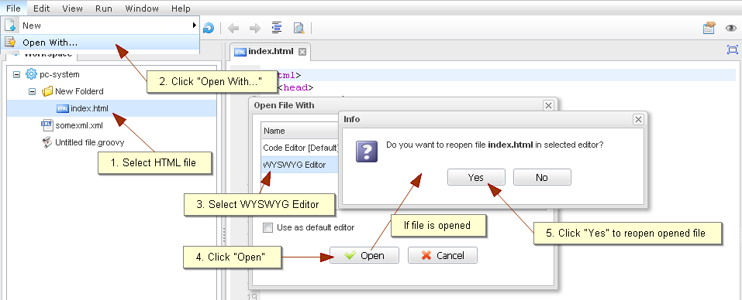
Interface – Open
Code Editor or Wysiwyg
Notes:
8
8

Slide 9
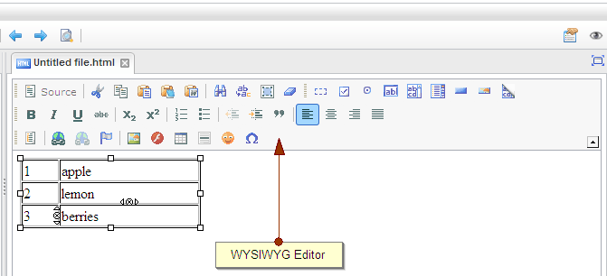
Interface – WYSIWYG
Notes:
9
9

Slide 10
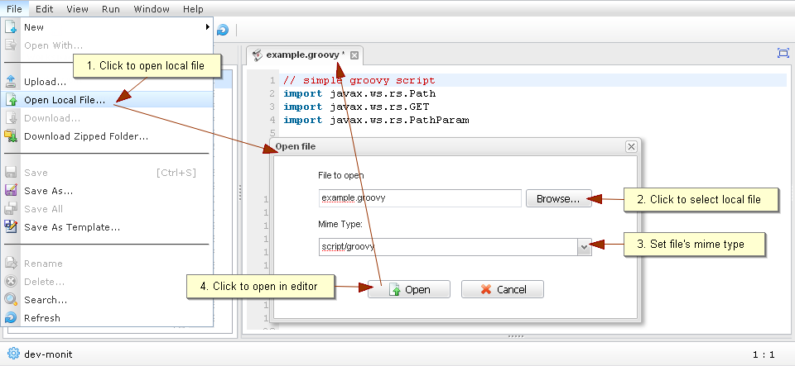
Interface – Choose Mime Type
Notes:
10
10

Slide 11
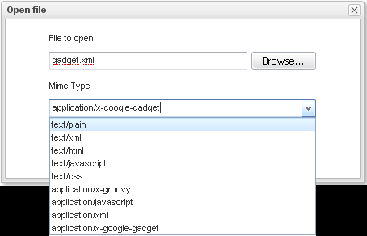
Interface –Mime Types
FileType | MIME Type | Default File Extension (for convenience) | Default Editor
Text | text/plain | .txt | Code Editor
XML | text/xml, application/xml | .xml | Code Editor
REST Service | script/groovy | .groovy | Code Editor
HTML | text/html | .html | Code Editor
Google Gadget | application/x-google-gadget | .xml | Code Editor
JavaScript | text/javascript, application/javascript | .js | Code Editor
CSS | text/css | .css | Code Editor
<unrecognized> | binary/octet-stream |  | -
Notes:
11
11

Slide 12
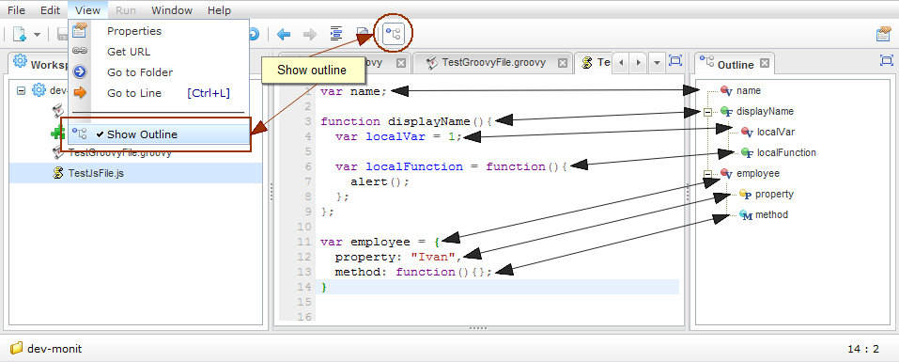
Interface – Outline
global variables and functions and also local variables, functions, methods and properties
refreshes automatically after 2 seconds after stopping typing code
Notes:
12
12

Slide 13
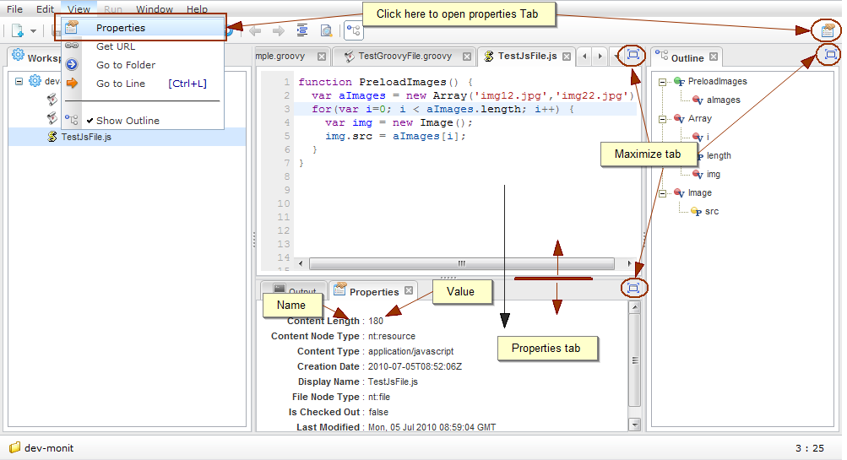
Interface – Properties
Notes:
13
13

Slide 14
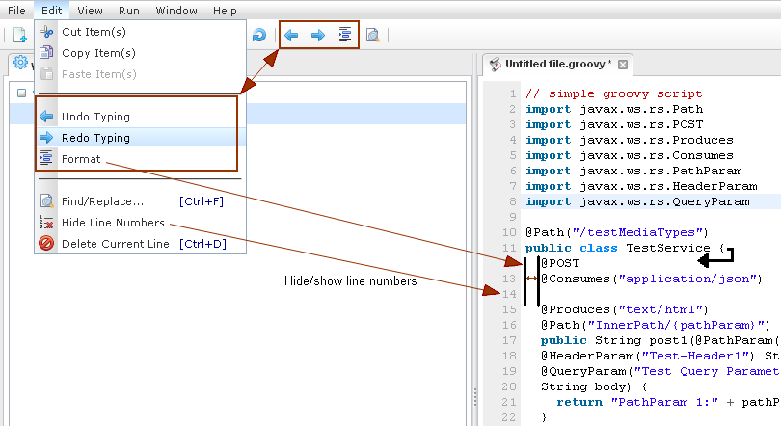
Interface – Undo, Redo, Indent
Notes:
14
14

Slide 15
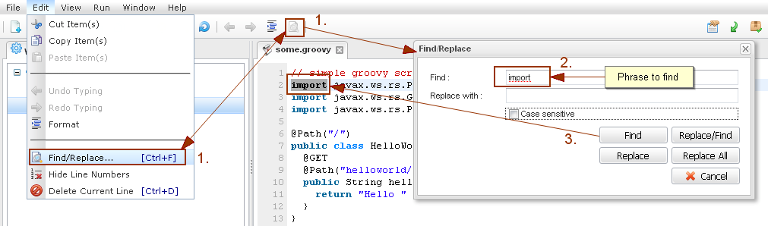
Interface – Find and Replace
Notes:
15
15

Slide 16
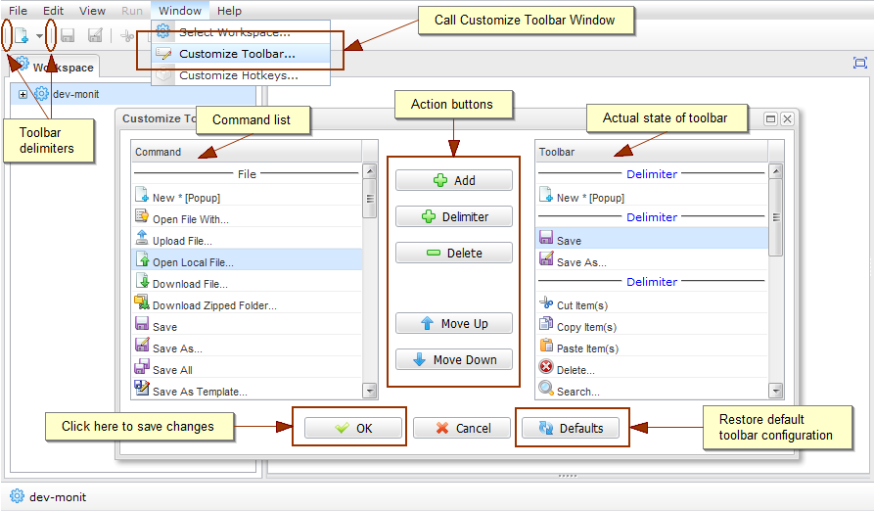
Customization – Toolbars
Notes:
16
16

Slide 17
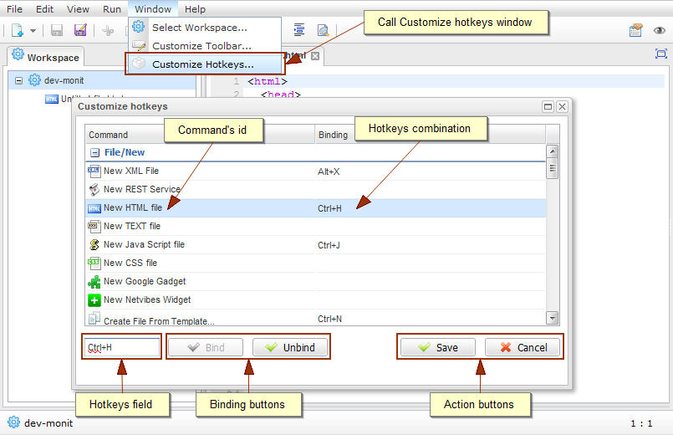
Customization – HotKeys
Notes:
17
17

Slide 18
Programming tools
18
Notes:
18

Slide 19
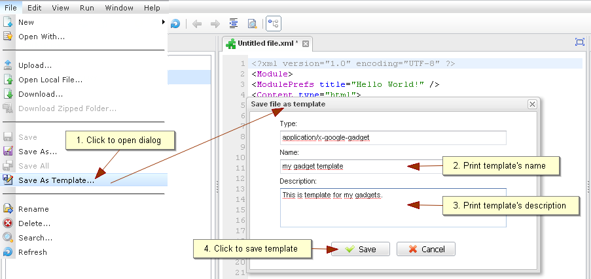
Templates
Create a template
Notes:
19
19

Slide 20
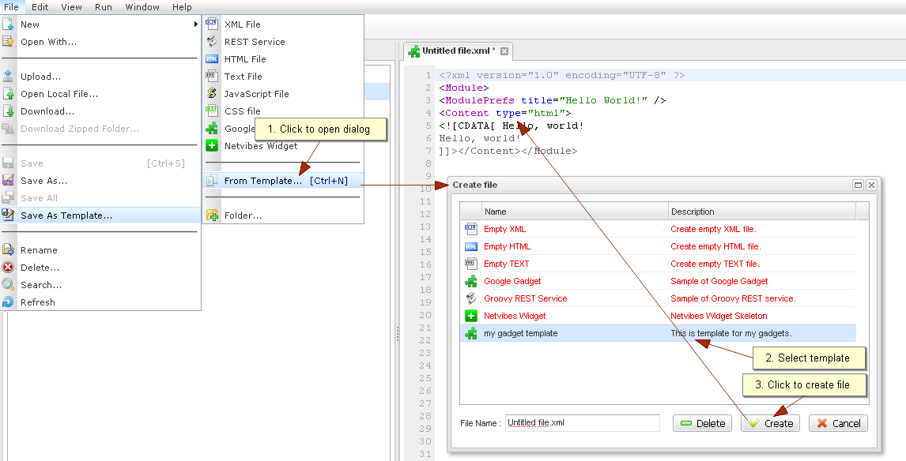
Templates
Use a template
Notes:
20
20

Slide 21
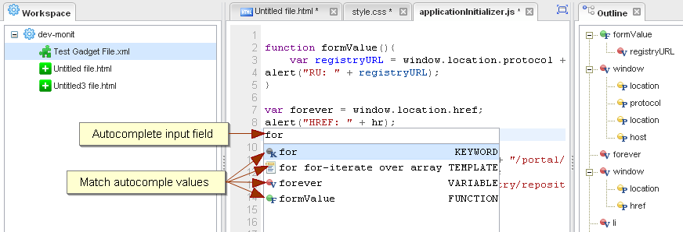
Auto-Complete
“Ctrl+Space“ – On MacBook: Ctrl-Alt-Space
JavaScript, CSS, HTML, Google Gadget, Groovy Template
Tokens for Javascript: Green: function. red: variable, grey: other keyword.
Notes:
21
21

Slide 22
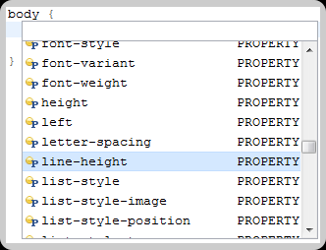
Auto-Complete
CSS
Notes:
22
22

Slide 23
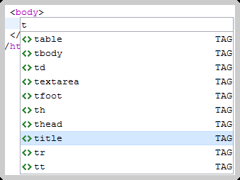
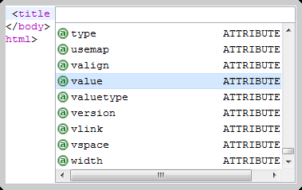
Auto-Complete
HTML
Tag completion
Property completion
Notes:
23
23

Slide 24
Gadget Operations
24
Notes:
24

Slide 25
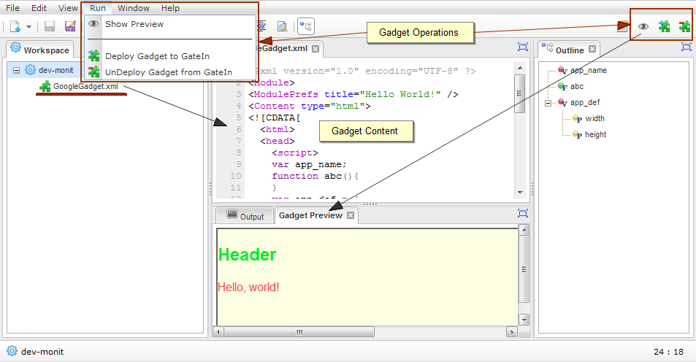
Gadgets
Notes:
25
25

Slide 26
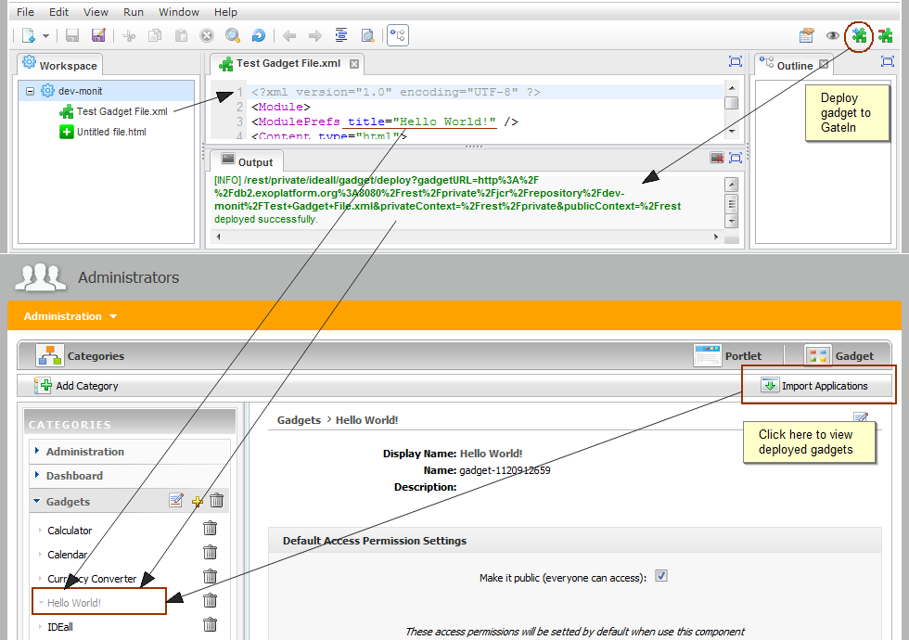
Gadgets
Notes:
26
26

Slide 27
Rest Services
27
Notes:
27

Slide 28
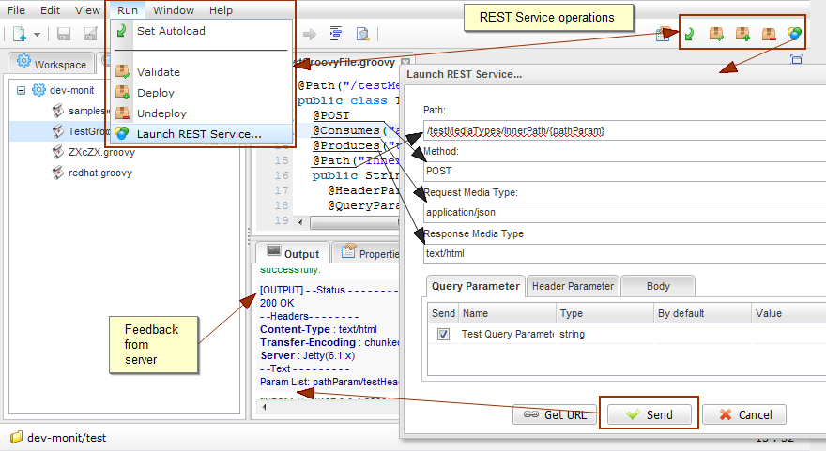
REST Services
eXo IDE gadget provides original approach to operate with REST Service
Ability to validate, deploy, undeploy and launch these applications which are compatible with JSR-311 specification without restating portal, or installing additional programs.
eXo IDE works as client side of GateIn with plugin org.exoplatform.services.jcr.ext.script.groovy.GroovyScript2RestLoaderPlugin.
Due to this application you can validate REST Service before saving, deploy, launch or undeploy service which saved in JCR.
Feedback from server is automatic displayed in the Output Tab.
Notes:
28
28

Slide 29
REST Services
Notes:
29
29

Slide 30
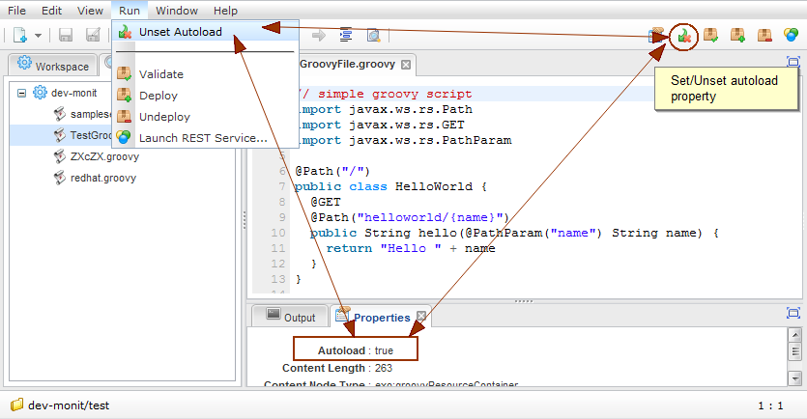
REST Autoload Property
If set, then the service is automatically deployed on the server each time you save the service.
Notes:
30
30

Slide 31
REST Annotations and Dialog elements
REST Service Annotation | Element of "Launch REST Service" dialog
@Path | "Path" field
@GET, @POST,... | "Method" field
@Consumes | "Request Media Type" field
@Produces | "Response Media Type" field
@PathParam | Path parameters figured out in curly braces, e.g. /service/{param}/{paramList: .+}
@HeaderParam | "Header Parameter" tab of bottom table
@QueryParam | "Query Parameter" tab of bottom table
@DefaultValue | "By default" column of bottom table
Notes:
31
31

Slide 32
REST Annotations and Dialog elements
REST Service Annotation | Element of "Launch REST Service" dialog
@Path | "Path" field
@GET, @POST,... | "Method" field
@Consumes | "Request Media Type" field
@Produces | "Response Media Type" field
@PathParam | Path parameters figured out in curly braces, e.g. /service/{param}/{paramList: .+}
@HeaderParam | "Header Parameter" tab of bottom table
@QueryParam | "Query Parameter" tab of bottom table
@DefaultValue | "By default" column of bottom table
Notes:
32
32

Slide 33
Exercise – Service and Gadget (15 min)
Create a new gadget
Modify the title attribute in the gadget xml to “MyGadget”
Save the gadget with any name
Deploy the gadget
Open the application registry and click on import all
Click on acme/overview
Click on “Create a new page”, name the page “GadgetTest
In the page designer step, open the category “gadgets” and drag and drop “MyGadget” to your new page. Save the page.
Test the page.
Create a new service.
Do not modify the helloworld example that you get automatically.
Save and deploy the helloworld service and your rest service a) using the IDE and also by b) copying the URL.
Modify your “MyGadget” so that it uses the helloworld service (XMLHttpRequest).
Redeploy your gadget.
Then test it.
Notes:
33
33

Slide 34
Exercise – Services (15 min)
Create a new rest service that accepts a bike id and returns a price. Deploy and test your rest service using by a) the IDE and also by b) copying the URL
Add a second method to your rest service that returns a bike model, deploy the service and test the second method. Modify the service path, and the method path. Deploy and test again.
Add a third method, that accesses to the forum service which you get from the eXo container: import org.exoplatform.forum.service.ForumService; import org.exoplatform.container.ExoContainerContext; ForumService forumService = (ForumService)ExoContainerContext.getCurrentContainer().getComponentInstanceOfType(ForumService.class); return "Hello " + forumService.class;
Include the forum service in your constructor. The eXo container will automatically return a pointer the service: public HelloWorld(ForumService forumService) { forumService_ = forumService; }
Notes:
34
34

Slide 35
Exercise – Node Access Service (10 min)
Create a new rest service
Copy and paste the the content of the “SimpleNodeService.groovy” from the exercises
Save, deploy and test the service. Do this again after each modification:
Change the query
Show not only the subnode of the root node (of the workspace “collaboration”), but also its subnodes.
Change the workspace
Notes:
35
35

Slide 36
IDE and Services
Notes:
36

