Slide 1
Portal Configuration
& Customization

Slide 2
Folder Structure

Slide 3
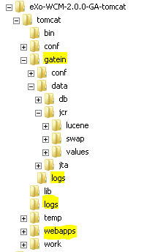
Folder Structure
About
Application configuration files
GateIn configuration files
Temp files
Data files
Log files
WebApps
WebApp structure

Slide 4
Folder Structure
Folder Explanations
Data/jcr/lucene: index Lucene
Data/jcr/values: database values for each workspace

Slide 5
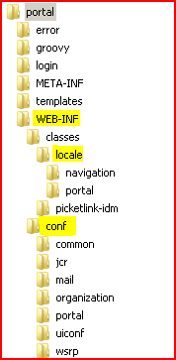
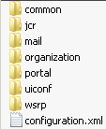
Folder Structure
WebApp
WEB-INF/classes/locale
WEB-INF/conf
WEB-INF/conf/configuration.xml

Slide 6
Configuration

Slide 7
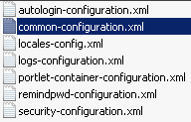
Configuration
Example
Open
...\tomcat\webapps\portal\WEB-INF\conf\common\
You will see the configuration of different services.
  Interface: <key>
  Implementation: <type>
Let’s look out for the cache service

Slide 8
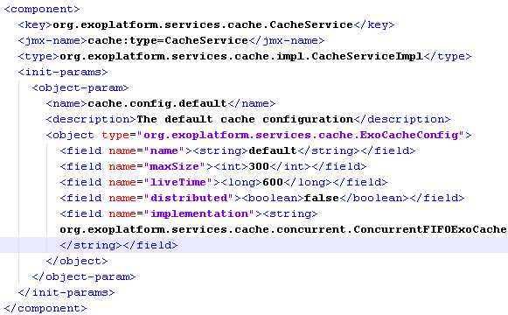
Configuration

Slide 9
Configuration
Central Configuration folder
...\tomcat\gatein\conf\
In this folder you can override any (previous/default) configuration.
Also called “external configuration”.
Documentation: http://www.jboss.org/exojcr/

Slide 10
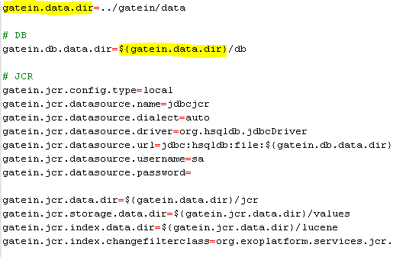
Configuration
Common Configurations
...\tomcat\gatein\conf\configuration.properties

Slide 11
Exercise: Configuration
Central Configuration file
Stop eXo Platform
Open ...\tomcat\gatein\conf\configuration.properties
Modify gatein.data.dir in order to point to a different folder
Restart eXo.

Slide 12
Exercise: Configuration
Replace a configuration
Copy
...tomcat\webapps\portal\WEB-INF\conf\common\locales-config.xml
to
...\tomcat\gatein\conf\portal\portal/custom\locales-config.xml
Create a file ...\tomcat\gatein\conf\portal\portal/custom\custom-locales-def.xml
Add a file...\tomcat\gatein\conf\portal\portal/configuration.xml with an import that points to custom-locales-def.xml
Add Swahili language (“sw”) in ...\tomcat\gatein\conf\portal\portal/custom\locales-config.xml
Restart eXo.

Slide 13
Configuration Profiles
Container Profiles
Configuration Profiles

Slide 14
Customization using the
Extension Mechanism

Slide 15
Extension Mechanism
Goals:
  Define the priority of the war files
  Define the priority of configurations.
  Allow to override javascript, skin, and template files in a customized war. That means calling the http://my-host/portal/any-file accesses in fact a file in any war that is not obligatory in the portal war.
  Resources searched on the class path do also respect the same priorities

Slide 16
Extension Mechanism
Extension Mechanism
Attention: The Extension Mechanism only concerns the priority and the order of these resources but not the order the application server loads the war.
There is a war called „starter.war“ that manages this mecanism. This war file must be loaded in last position. In tomcat in order to load a war in last position, you must unzip it (the other war files must stay in the war format).

Slide 17
Extension Mechanism
Unified Servlet Context (PortalContainerContext)
Examples:
  1. You can overload the standard configurations by placing a different configuration in your customized war.
  2. The resource http://localhost:8080/portal/css/my-skin.css can be located in the portal war file, but also in any other war file that you have defined, for example „customizedWar“.

Slide 18
Extension Mechanism
Unified Classloader
Managed by the Unified Servlet Context
Only for resources, not for java classes.
Each time a resource is loaded (from the classpath), all libs in the war files of the unified servlet context classload are accessible.
The parent classloader of the application server (tomcat/lib) remains the parent classloader.

Slide 19
Extension Mechanism
Extension
Customize eXo Platform
  User Interface
  Menu
  Graphical style
  ECM Templates
  JSPs

Slide 20
Extension Mechanism
Unified Servlet Context
Requirements:
Create your own war file containing all customizations.
In the web.xml declare the listener: PortalContainerConfigOwner
Add the war file to the Unified Servlet Context by configuring the org.exoplatform.container.definition.PortalContainerConfig component. This component has to be configured in the RootContainer :
...\gatein\conf\configuration.xml
Find an example in ecm-wcm-extension.

Slide 21
Extension Mechanism
Futur way of adding a war: AddDependencies of a war.
<external-component-plugins>
<target-component>org.exoplatform.container.definition.PortalContainerConfig</target-component>
<component-plugin>
<name>Change PortalContainer Definitions</name>
<set-method>registerChangePlugin</set-method>
<type>org.exoplatform.container.definition.PortalContainerDefinitionChangePlugin</type>
<init-params>
<object-param>
<name>add-dependency</name>
<object
type="org.exoplatform.container.definition.PortalContainerDefinitionChange$AddDependencies">
<field name="dependencies">
<collection type="java.util.ArrayList">
<value>
<string>myportal-conf</string>
</value>
<value>
<string>forum-override</string>
</value>
</collection>
...

Slide 22
Extension Mechanism
Modules
For each module there is an extension war file. That war contains all necessary configuration and built-in component/services for the module.
You must not touch these war files!
For your own configuration there is a file ...\gatein\conf for the most common configurations
... And a you are invited to create your own extension war file

Slide 23
Extension Mechanism
XPI
  eXo Public Interface
  Public API Java
  Possible Configurations
  Customization by Extensions
Developers are not authorized to modify eXo code and artifacts (jar, war, ear) – otherwise there is no support.
Example : cs-extension.war (do not touch these war files!)
Customization: in gatein/conf/portal/portal/configuration.xml or in a custom extension (recommended way)

Slide 24
Exercise: Extension Mechanism
  Create your own extension called exotraining.war
  Add exotraining to the webapp list in gatein/conf/configuration.xml
  Create your own version of the template
  ...\webapps\xxx\templates\groovy\webui\component\UIHomePagePortlet.gtmpl
  in that extension.
  Modify the css file
  ...\webapps\portal\templates\skin\webui\component\UIHomePagePortlet\DefaultStylesheet.css
  in that extension.
  Modify the javascript file “???” in that extension.
  Restart eXo Platform and test.
  Pitfall: The load order of the wars.

Slide 25
Internationalization

Slide 26
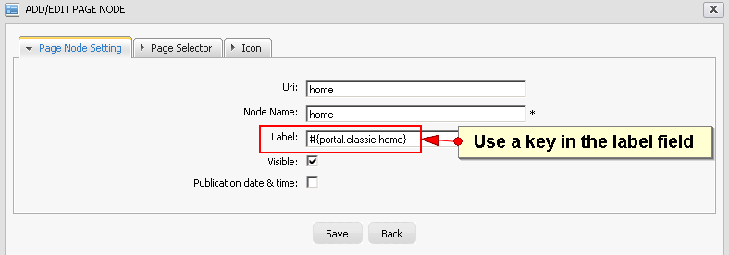
Navigation Internationalisation
Internationalisation
Uses keys in the label fields
Format: #{key}

Slide 27
Navigation Internationalisation
Internationalisation
The corresponding keys are in properties files.
For example, the keys for Italian for the classic site are in:
...\webapps\portal\WEB-INF\classes\locale\navigation\portal\classic_it.properties
Example Content:
portal.classic.home=Home
portal.classic.sitemap=Mappa del Sito
portal.classic.groupnavigation=Navigazione dei Gruppi
portal.classic.portalnavigation=Navigazione del Portale
portal.classic.register=Registrazione
portal.classic.webexplorer=Web Explorer
UIAddNewApplication.label.AddApplication = Aggiungi Applicazione

Slide 28

Internationalization
Keywords
../WEB-INF/conf/common/locales-config.xml
Only external
Reloaded at each startup
In WEB-INF/conf/classes/locale
Property and xml files
Translation
  Site and group navigation
  Common terms in ...\webapps\portal\WEB-INF\classes\locale\portal

Slide 29
Internationalization
Keywords
ResourceBundleService
...\webapps\portal\WEB-INF\conf\common\common-configuration.xml
classpath.resources
Init.resources
portal.resource.names

Slide 30
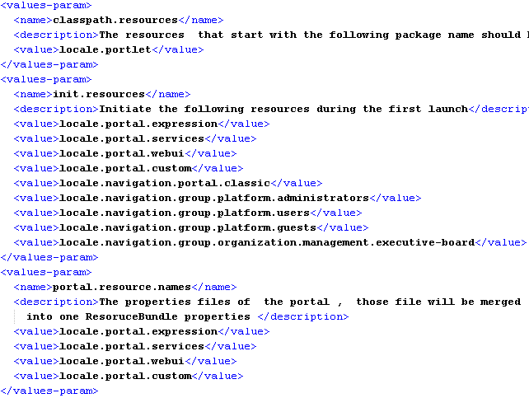
Internationalization

Slide 31
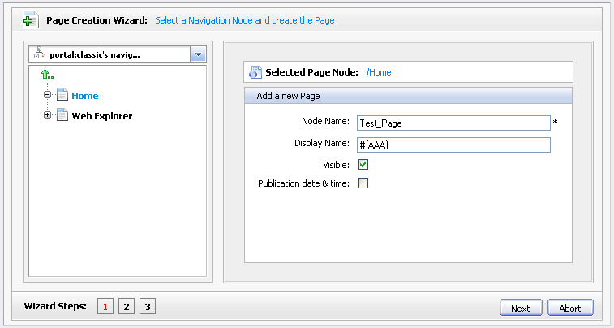
Internationalization

Slide 32

Internationalization
Portlets and WebUI Components
  ...\webapps\formgenerator\WEB-INF\classes\locale\portlet\FormGeneratorPortlet
  classpath.resources

Slide 33
Exercise: Internationalization
Resources
http://wiki.exoplatform.org/xwiki/bin/view/Portal/Internationalization+Configuration
http://wiki.exoplatform.org/xwiki/bin/view/Portal/Internationalization+Guidelines

Slide 34
Exercise: Internationalization
Correct wrong translations
In your custom extension, replace a *.properties file and correct some translations.
New language
In your custom extension add a new language and provide at least one properties file for that language.
New group
For the group “platform/training” create some navigation nodes with some pages. Use a key for the navigation node labels (#myTrainingGroupPage).
Create a properties file for the translations.
Portlet
Replace the properties of a portlet

Slide 35
SOA Overview

Slide 36
Container Configuration

Slide 37
Container Configuration
Distinguish
Root Container.
Portal Container
Load Order (The later configuration overwrites the earlier configuration) :
Jar
War
External

Slide 38
Custom Portal Containers

Slide 39
Custom Portal Containers
Attention
The custom portal container is also an extension.
The standard portal container is “portal”. You cannot delete this container.
The standard unified servlet context is “/portal”.
For your custom portal container the context will be “trdemo”.
The standard container is defined in \tomcat\gatein\conf\configuration.xml
You can add your custom portal container by registering a plugin to PortalContainerConfig in the same configuration file.
You define not only the name of your container but also a rest URL and the realm.

Slide 40
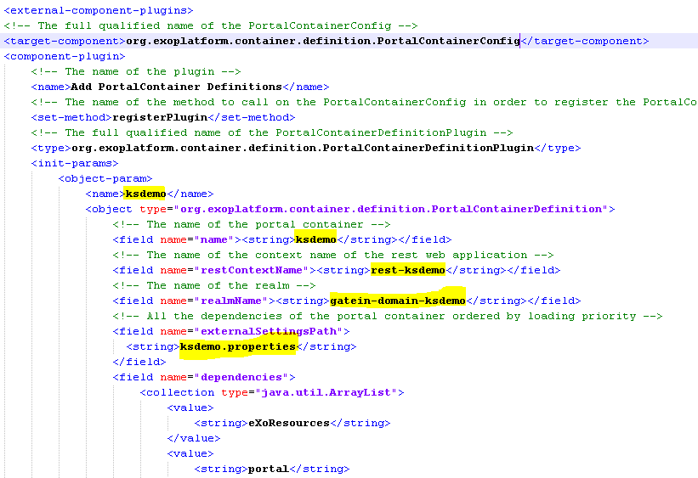
Custom Portal Containers

Slide 41
Exercise: Custom Portal Containers
Create own custom portal container called “trdemo”.
Restart eXo.
Open http://wcm:8080/trdemo/public/classic/
Add a custom extension to “trdemo” but not to portal. Test the differences between “trdemo” and “portal”.

Slide 42
Skin Service

Slide 43
Skin Service
Keywords
Loads skins to the portal container
Stylesheet definition in :
...webapps\portal\WEB-INF\gatein-resources.xml
and
...\webapps\eXoResources\WEB-INF\gatein-resources.xml

Slide 44
Exercise: Skin Service
In your extension, define a different portal skin.
Create your portal skin in your extension.
Restart.

Slide 45
Portal Configuration
& Customization

