Slide 1
eXo Fundamentals Training
Introduction
Sören Schmidt
soren.schmidt@exoplatform.com
Notes:
1

Slide 2

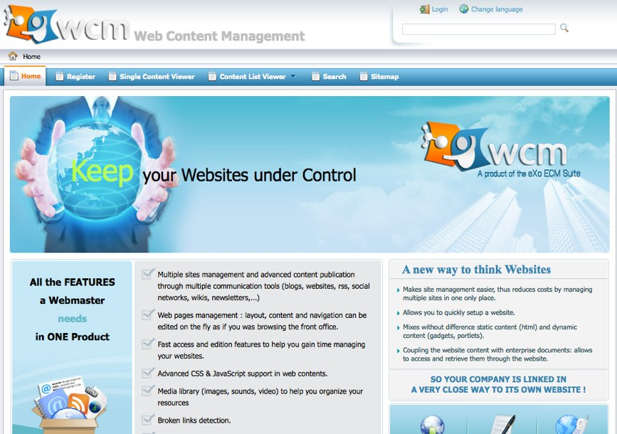

Enterprise Portals
Notes:
2

Slide 3
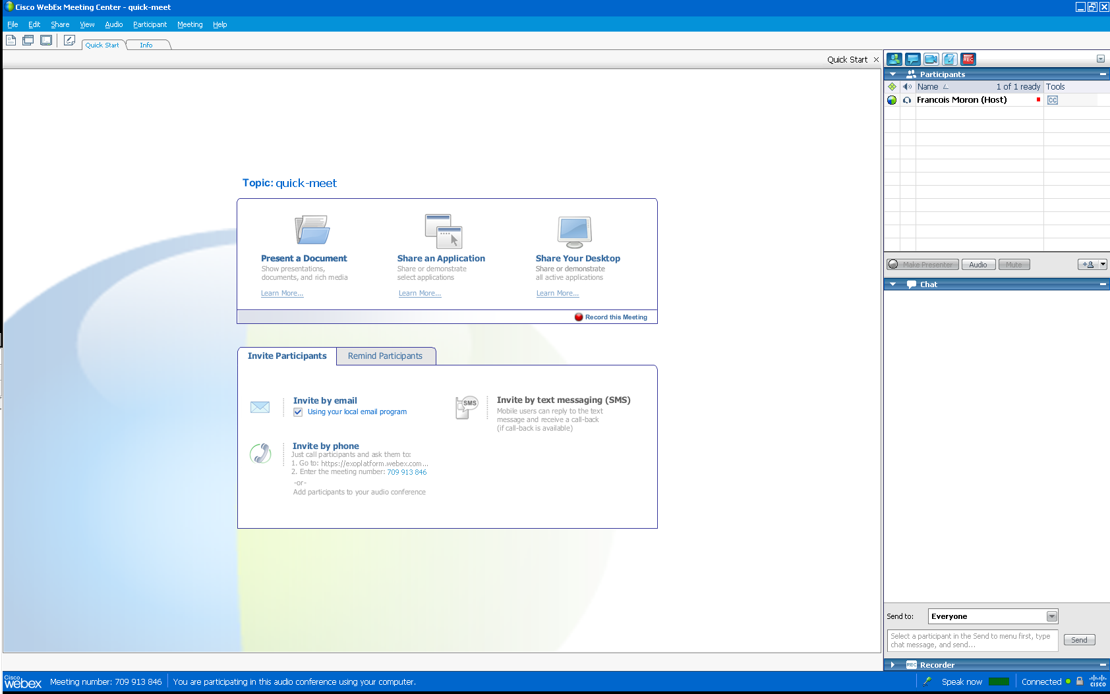
Welcome to eXo Webinar
Our names
Audio
Here you can mute your microphone
Our chat

Slide 4
Program
Program:
Portal: about 100 minutes
eXo Social: about 40 minutes
Questions about eXo Social
Questions about Portal with Julien Viet (Product Manager)

Slide 5
Objectives
At the end of the eXo Fundamentals Training you should know :
What’s GateIn, eXo WCM, eXo DMS, eXo KS, eXo CS?
All functional knowledge about these tools
Use, administrate and configure these tools
No programming!

Slide 6
Agenda
Day 1 | Introduction, eXo Portal/GateIn presentation, GateIn Front Office and Backoffice, WCM Front Office and Back Office, JCR concepts,
Day 2 | DMS, eXo Workflow, eXo Collaboration, eXo Knowledge, eXo Social, WCM and DMS Customization, Getting all work together, Q & A

Slide 7
Training Toolkit
WCM 2.0.0
http://intranet.exoplatform.org/rest/jcr/repository/collaboration/Groups/platform/users/Documents/Releases/ECM/WCM
KS, CS, Social
http://intranet.exoplatform.org/rest/jcr/repository/collaboration/Groups/platform/users/Documents/Releases
Slides
Other Ressources:
http://wiki.exoplatform.com/
http://www.jboss.org/gatein/documentation.html

