Slide 1
Web Content Management
DMS Exercises

Slide 2
WCM Folder Structure

Slide 3
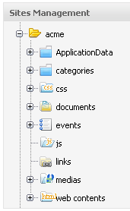
WCM Folder Structure
Application Data: Newsletter details. The newsletter depends on the site.
Categories: contains the taxonomy tree of the site
CSS: Central CSS documents
A js folder: is to store all shared javascripts for a website
A css folder: is to store all shared css for a website
A document folder: is to store all shared documents for all
webpages
A media folder: is to store all shared media content types (images, sounds, video) for a website
A link folder: store all shared links that a webcontent can be referred to.
A webcontent folder: store all webcontents that are used in the webpages or nodes.
A site artifacts folder: is to store all site artifacts like banner, footer.. as webcontent. This folder is a child of webcontent folder

Slide 4
WCM Folder Structure
WCM Folders:
Site artifacts folder: Should not be found by the search, only put artifacts!
Create your own folders in “web contents” or create a folder at the root of your site folder.

Slide 5
Site Explorer
Direct Access of a node:
You can directly open a node using a URL
The URL points to the siteExplorer page, then to the drive name and then to the node path.
Structure: /portal-name/private/site-name/siteExplorer/repository-name/drive-name/relative-node-path
Example: http://wcm:8080/ecmdemo/private/acme/siteExplorer/repository/acme/World/

Slide 6
Exercise: Site Explorer
Direct Access of a node:
Open: http://wcm:8080/ecmdemo/private/acme/siteExplorer/repository/acme/World/
Right click on any node in the file explorer and open the WebDav view.

Slide 7
CSS

Slide 8
Exercise: Site CSS
CSS
Login as root. Open the Acme site.
Open the Site Explorer
Modify the priorities and content of the site css.
Add a new site CSS

Slide 9
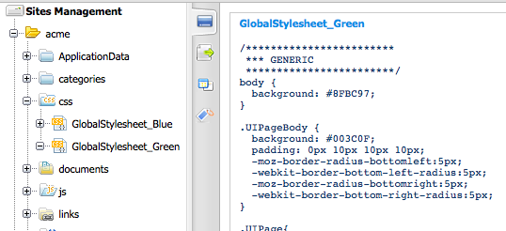
Exercise: Site CSS

Slide 10
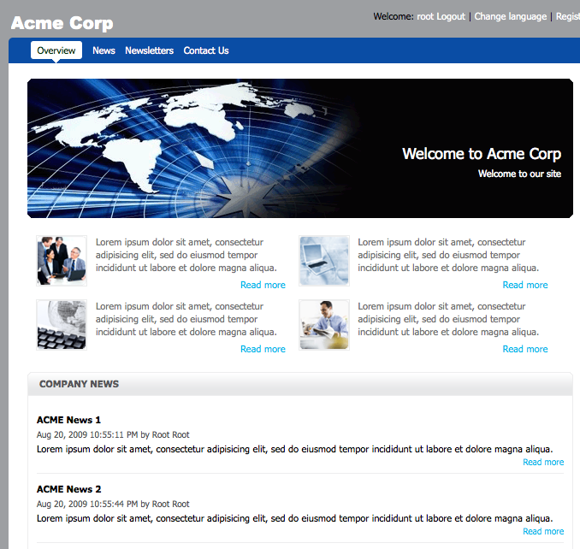
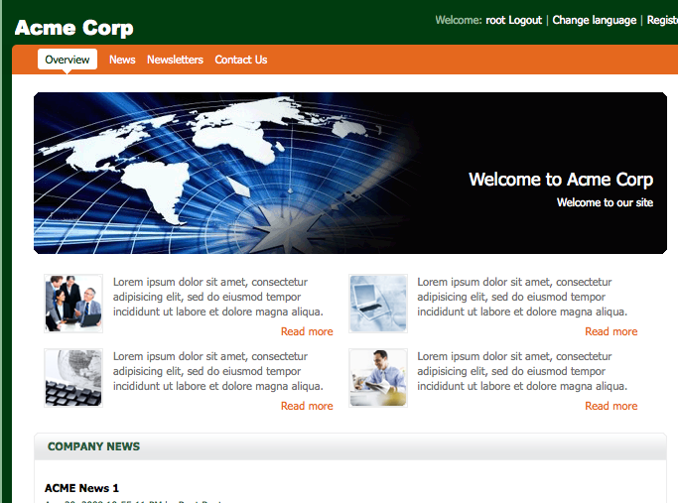

Exercise: Site CSS

Slide 11
List Template

Slide 12
Exercise: List Template
Open
Add and edit a template of the Content List portlet.
exo-tomcat/webapps/portal/WEB-INF/conf/wcm/artifacts/application-templates/content-list-viewer/list-by-folder
Copy DocumentsTemplate.gtmpl to FormationTemplate.gtmpl

Slide 13
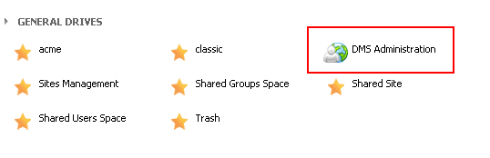
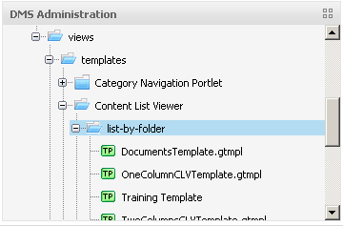
Exercise: List Template
List Template
Login as root. Open the Acme site.
Open the Site Explorer
Open the DMS drive and then
/exo:ecm/views/templates/Content List Viewer/list-by-folder

Slide 14
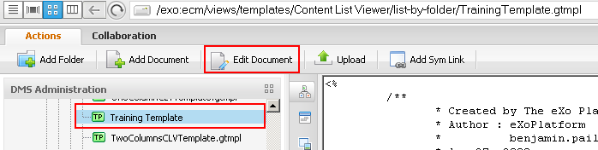
Exercise: List Template
Modify the new template
Copy the DocumentTemplate and call the copy TrainingTemplate.gtmpl
Add a test text like “TEEEESSSSTT” behind the first <div> of the TrainingTemplate.gtmpl in order to if the modification works.

Slide 15
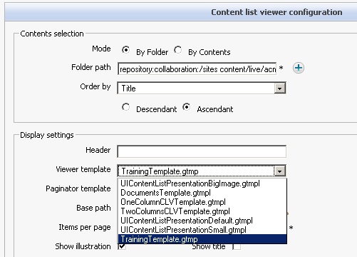
Exercise: List Template
List Template
Use the training template in Content List portlet

Slide 16
Web Content Management
DMS Exercises

