Slide 1
eXo SysAdmin Training
Chat server
Notes:
1

Slide 2
Table of Contents
Openfire Configuration
eXo specific configuration
Ports Configuration
AS configuration
Exercises

Slide 3
Openfire Configuration
3
Notes:
3

Slide 4
Openfire Configuration
eXo Collaboration chat services is a Jabber engine powered by Openfire
eXo will delegate the actual Jabber protocol communication to Openfire
2 possible ways to configure openfire:
-The admin console: http://localhost:9090/.
-The openfire.xml file in $openfirehome/conf/.
The Openfire server has a single configuration file called openfire.xml and located under exo-openfire/conf directory.
Configuration is based on properties expressed in an XML syntax
Openfire has an extensive list of configuration properties
Openfire has an extensive list of configuration properties. You can read a list of all properties on this page : http://www.igniterealtime.org/community/docs/DOC-1061

Slide 5
eXo specific configuration
5
Notes:
5

Slide 6
eXo specific configuration
eXo Collaboration bundle comes with a pre-configured openfire server
It is bundled with some eXo plugins and configurations that allow connectivity with eXo
The key properties for integration are:
provider.auth.className : An implementation of the AuthProvider interface for authentication of users on the chat server.
provider.users.className : An implementation of the UserProvider interface to which openfire will delegate users management.
provider.groups.className : An implementation of the GroupProvider interface to which openfire will delegate groups management.
eXo provides implementations for these 3 interfaces with ExoAuthProvider, ExoUserProvider, ExoGroupProvider

Slide 7
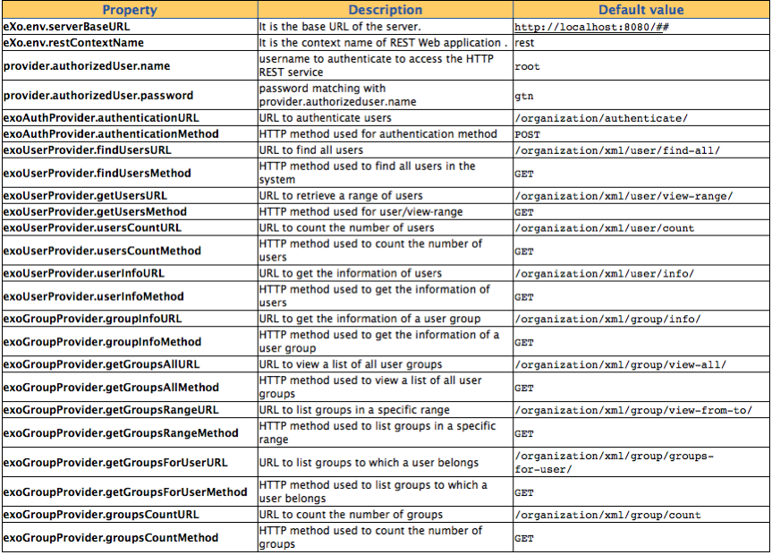
eXo specific configuration
These implementations are based on eXo REST framework
The endpoints can be configured within the openfire.xml:

Slide 8
Ports Configuration
8
Notes:
8

Slide 9
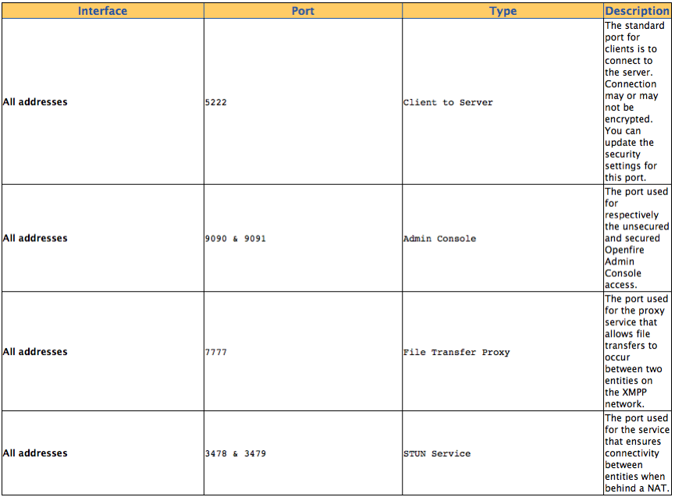
Ports Configuration
Openfire makes use of several ports for communication :

Slide 10
Ports Configuration
Openfire makes use of several ports for communication :
You can view & change port via the admin console

Slide 11
AS configuration
11
Notes:
11

Slide 12
AS configuration
To enable propagation of identity across the chat webapp, it is required that you enable the SSO valve on Tomcat-based Application server.
For jboss server, edit jboss/server/default/deploy/jboss-web.deployer/server.xml
For tomcat server, edit tomcat/conf/server.xml
The valve should already be there, you just need to uncomment it if it is not already done.
<Valve className="org.apache.catalina.authenticator.SingleSignOn"/>
In the case of cluster deployment, you may want to use ClusteredSingleSignOn instead.
<Valve className="org.jboss.web.tomcat.service.sso.ClusteredSingleSignOn"/>

Slide 13
Exercises
13
Notes:
13

Slide 14
Exercises
Open the openfire configuration file (chat-server/conf/openfire.xml)
Check that :
port using by jabber is 9090 (<port> tag)
the exo server is localhost:8080 (<serverBaseURL>)
Open the eXo chat server configuration : (tomcat_home/gatein/conf/configuration.properties)
Check the server host and port:
# IP or hostname for the eXo Chat XMPP server
exo.chat.server=127.0.0.1
# TCP port for where the eXo Chat server listens for XMPP calls
exo.chat.port=5222
# Security domain name: This variable controls the value of "portal.container.realm"
exo.security.domain=gatein-domain
Run the openfire server using chat-server/bin/run.sh or run.bat

Slide 15
Exercises
Start eXo
Run the openfire server using chat-server/bin/run.sh or run.bat
Login to the openfire admin console with root/gtn
Check that jabber users coming from eXo are created (by selecting the user/groups tab)
Check the chat via the eXo intranet site
- you can use 2 differents browsers (ie, firefox, or chrome) to simulate a chat between 2 users)
- Or If your are connected in LAN, you can ask to your colleagues to connect to your eXo using your ip address.

Slide 16
eXo SysAdmin Training
Notes:
16

