Slide 1
eXo JCR
JCR for developers (advanced)
Notes:
1
1

Slide 2
Table of Contents
2
Notes:
2
2

Slide 3
Table of Contents
JCR advanced concepts
eXo Kernel’s advanced concepts
Data structure, storage strategies
Creating unit tests
Common pitfalls
Exercise

Slide 4
JCR advanced concepts
4
Notes:
4
4

Slide 5
JCR advanced concepts
Main Session Read Methods
getRepository(): Returns the Repository object through which this Session was acquired.
getUserID(): Gets the user ID associated with this Session.
getWorkspace() : Returns the Workspace attached to this Session.
getRootNode(): Returns the root node of the workspace
getItem(String): Returns the item at the specified absolute path in the workspace.
itemExists(String): Returns true if an item exists at absPath and this Session has read access to it.
logout(): Releases all resources associated with this Session.
isLive(): Returns true if this Session object is usable by the client.

Slide 6
JCR advanced concepts
Main Workspace Read Methods
The workspace is the entry point to:
The QueryManager -> getQueryManager()
The NamespaceRegistry -> getNamespaceRegistry()
The NodeTypeManager -> getNodeTypeManager()
The ObservationManager -> getObservationManager()
The name of the accessible workspaces -> getAccessibleWorkspaceNames()

Slide 7
JCR advanced concepts
Main Node Read Methods
getNode(String): Returns the node at relPath relative to this node.
getNodes(): Returns all child nodes of this node.
getNodes(String) : Gets all child nodes of this node that match namePattern.
hasNode(String): Returns true if a node exists at relPath and false otherwise.
hasNodes(): Returns true if this node has one or more child nodes. Returns false otherwise.
getProperty(String) : Get the property at relPath relative to this node.
getProperties(): Gets all properties of this node.
getProperties(String): Gets all properties of this node that match namePattern.
hasProperty(String): Returns true if a property exists at relPath and false otherwise.
hasProperties(): Returns true if this node has one or more properties. Returns false otherwise.
getUUID(): Returns the UUID of this node as recorded in the node's jcr:uuid property.
getIndex(): This method returns the index of this node within the ordered set of its same-name sibling nodes.
getReferences(): Returns all REFERENCE properties that refer to this node.

Slide 8
JCR advanced concepts
Main Node Write Methods
addNode(String): Adds a sub node of a default primary node type to the node.
addNode(String, String): Adds a sub node of a specified node type to the node.
setProperty(String,Value): Sets the specified (single value) property of this node to the specified value.
setProperty(String,Value[]) : Sets the specified (multi-value) property to the specified array of values.
setProperty(String,X): Sets the specified (single value) property of this node to the specified value of type X.
setProperty(String,X[]) : Sets the specified (multi-value) property to the specified array of values of type X.

Slide 9
JCR advanced concepts
Main Property Read Methods
getValue(): Returns the value of this property as a Value object.
getValues(): Returns an array of all the values of this property. This method is used to access multi-value properties.
getString() : Returns a String representation of the value of this property. A shortcut for Property.getValue().getString().
getStream()/getLong()/getDouble()/getDate()/getBoolean()/getNode(): Same than above for the corresponding type.
getType(): Returns the type of this Property.

Slide 10
JCR advanced concepts
Node Types: Main API methods
Node.isNodeType(String): Indicates whether the node is of the specified node type.
Node.addMixin(String) : Adds the specified mixin node type to the node.
Node.canAddMixin(String): Indicates whether the specified mixin node type can be added to the node
Node.removeMixin(String): Removes the specified mixin node type from the node.
Node.getPrimaryNodeType(): Returns the primary node type of the node.
Node.getMixinNodeTypes(): Returns an array of NodeType objects representing the mixin node types assigned to this node

Slide 11
JCR advanced concepts
Referenceable Nodes
This node type specifies an auto-created, mandatory, STRING property called jcr:uuid. This property is set automatically by the implementation when the mix:referenceable node is created or when this mixin type is added to an existing node.
A node must be mix:referenceable in order to be the target of a REFERENCE property.
Accessible from Session.getNodeByUUID(String)
<nodeType name="mix:referenceable" isMixin="true" hasOrderableChildNodes="false" primaryItemName="">
<propertyDefinitions>
<propertyDefinition name="jcr:uuid" requiredType="String" autoCreated="true" mandatory="true" onParentVersion="INITIALIZE"
protected="true" multiple="false">
<valueConstraints />
</propertyDefinition>
</propertyDefinitions>
</nodeType>

Slide 12
JCR advanced concepts
Locking
Only nodes with mixin node type mix:lockable (inherited as part of their primary node type or explicitly assigned) may hold locks.
This feature allows a user to temporarily lock nodes in order to prevent other users from changing them.
A lock can be specified as either shallow or deep. A shallow lock applies only to its holding node. A deep lock applies to its holding node and all its descendants.
The user who places a lock on a node is called the lock owner.

Slide 13
JCR advanced concepts
Locking: mix:lockable
<nodeType name="mix:lockable" isMixin="true" hasOrderableChildNodes="false" primaryItemName="">
<propertyDefinitions>
<propertyDefinition name="jcr:lockOwner" requiredType="String" autoCreated="false" mandatory="false" onParentVersion="IGNORE"
protected="true" multiple="false">
<valueConstraints />
</propertyDefinition>
<propertyDefinition name="jcr:lockIsDeep" requiredType="Boolean" autoCreated="false" mandatory="false" onParentVersion="IGNORE"
protected="true" multiple="false">
<valueConstraints />
</propertyDefinition>
</propertyDefinitions>
</nodeType>

Slide 14
JCR advanced concepts
Locking: Main API methods
Node.lock(boolean, boolean): Places a lock on this node.
Node.unlock(): Removes the lock on this node.
Node.holdsLock() : Returns true if this node holds a lock.
Node.isLocked(): Returns true if this node is locked either as a result of a lock held by this node or by a deep lock on a node above this node
Node.getLock(): Returns the Lock object that applies to this node. This may be either a lock on this node itself or a deep lock on a node above this node.
Session.addLockToken(): Adds the specified lock token to this session. Holding a lock token allows the Session object of the lock owner to alter nodes that are locked by the lock specified by that particular lock token.
Session.removeLockToken(): Removes the specified lock token from this session.
Session.getLockTokens(): Returns an array containing all lock tokens currently held by this session.

Slide 15
JCR advanced concepts
Versioning
A node is versionable if and only if it has been assigned the mixin type mix:versionable, otherwise it is nonversionable
The type mix:versionable is a subtype of mix:referenceable, so if a node is versionable it is automatically also referenceable and thus has a UUID
Being versionable means that at any given time the node's state can be saved for possible future recovery. This saved state is called a version and the action of saving it is called checking in.
There is one version storage per repository, though it is exposed in each workspace as a special protected subtree below the node /jcr:system/jcr:versionStorage.

Slide 16
JCR advanced concepts
Versioning: mix:versionable
<nodeType name="mix:versionable" isMixin="true" hasOrderableChildNodes="false" primaryItemName="">
<supertypes>
<supertype>mix:referenceable</supertype>
</supertypes>
<propertyDefinitions>
<propertyDefinition name="jcr:versionHistory" requiredType="Reference" autoCreated="false" mandatory="true" onParentVersion="COPY"
protected="true" multiple="false">
<valueConstraints>
<valueConstraint>nt:versionHistory</valueConstraint>
</valueConstraints>
</propertyDefinition>
<propertyDefinition name="jcr:baseVersion" requiredType="Reference" autoCreated="false" mandatory="true" onParentVersion="IGNORE"
protected="true" multiple="false">
<valueConstraints>
<valueConstraint>nt:version</valueConstraint>
</valueConstraints>
</propertyDefinition>
<propertyDefinition name="jcr:isCheckedOut" requiredType="Boolean" autoCreated="true" mandatory="true" onParentVersion="IGNORE"
protected="true" multiple="false">
<valueConstraints />
<defaultValues>
<defaultValue>true</defaultValue>
</defaultValues>
</propertyDefinition>
<propertyDefinition name="jcr:predecessors" requiredType="Reference" autoCreated="false" mandatory="true" onParentVersion="COPY"
protected="true" multiple="true">
<valueConstraints>
<valueConstraint>nt:version</valueConstraint>
</valueConstraints>
</propertyDefinition>
<propertyDefinition name="jcr:mergeFailed" requiredType="Reference" autoCreated="false" mandatory="false" onParentVersion="ABORT"
protected="true" multiple="true">
<valueConstraints />
</propertyDefinition>
</propertyDefinitions>
</nodeType>

Slide 17
JCR advanced concepts
Versioning: nt:versionHistory
<nodeType name="nt:versionHistory" isMixin="false" hasOrderableChildNodes="false" primaryItemName="">
<supertypes>
<supertype>nt:base</supertype>
<supertype>mix:referenceable</supertype>
</supertypes>
<propertyDefinitions>
<propertyDefinition name="jcr:versionableUuid" requiredType="String" autoCreated="true" mandatory="true" onParentVersion="ABORT"
protected="true" multiple="false">
<valueConstraints />
</propertyDefinition>
</propertyDefinitions>
<childNodeDefinitions>
<childNodeDefinition name="jcr:rootVersion" defaultPrimaryType="nt:version" autoCreated="true" mandatory="true" onParentVersion="ABORT"
protected="true" sameNameSiblings="false">
<requiredPrimaryTypes>
<requiredPrimaryType>nt:version</requiredPrimaryType>
</requiredPrimaryTypes>
</childNodeDefinition>
<childNodeDefinition name="jcr:versionLabels" defaultPrimaryType="nt:versionLabels" autoCreated="true" mandatory="true"
onParentVersion="ABORT" protected="true" sameNameSiblings="false">
<requiredPrimaryTypes>
<requiredPrimaryType>nt:versionLabels</requiredPrimaryType>
</requiredPrimaryTypes>
</childNodeDefinition>
<childNodeDefinition name="*" defaultPrimaryType="nt:version" autoCreated="false" mandatory="false" onParentVersion="ABORT"
protected="true" sameNameSiblings="false">
<requiredPrimaryTypes>
<requiredPrimaryType>nt:version</requiredPrimaryType>
</requiredPrimaryTypes>
</childNodeDefinition>
</childNodeDefinitions>
</nodeType>

Slide 18
JCR advanced concepts
Versioning: nt:version
<nodeType name="nt:version" isMixin="false" hasOrderableChildNodes="false" primaryItemName="">
<supertypes>
<supertype>nt:base</supertype>
<supertype>mix:referenceable</supertype>
</supertypes>
<propertyDefinitions>
<propertyDefinition name="jcr:created" requiredType="Date" autoCreated="true" mandatory="true" onParentVersion="ABORT" protected="true"
multiple="false">
<valueConstraints />
</propertyDefinition>
<propertyDefinition name="jcr:predecessors" requiredType="Reference" autoCreated="false" mandatory="false" onParentVersion="ABORT"
protected="true" multiple="true">
<valueConstraints>
<valueConstraint>nt:version</valueConstraint>
</valueConstraints>
</propertyDefinition>
<propertyDefinition name="jcr:successors" requiredType="Reference" autoCreated="false" mandatory="false" onParentVersion="ABORT"
protected="true" multiple="true">
<valueConstraints>
<valueConstraint>nt:version</valueConstraint>
</valueConstraints>
</propertyDefinition>
</propertyDefinitions>
<childNodeDefinitions>
<childNodeDefinition name="jcr:frozenNode" defaultPrimaryType="" autoCreated="false" mandatory="false" onParentVersion="ABORT"
protected="true" sameNameSiblings="false">
<requiredPrimaryTypes>
<requiredPrimaryType>nt:frozenNode</requiredPrimaryType>
</requiredPrimaryTypes>
</childNodeDefinition>
</childNodeDefinitions>
</nodeType>

Slide 19
JCR advanced concepts
Versioning: nt:frozenNode
<nodeType name="nt:frozenNode" isMixin="false" hasOrderableChildNodes="true" primaryItemName="">
<supertypes>
<supertype>nt:base</supertype>
<supertype>mix:referenceable</supertype>
</supertypes>
<propertyDefinitions>
<propertyDefinition name="jcr:frozenPrimaryType" requiredType="Name" autoCreated="true" mandatory="true" onParentVersion="ABORT"
protected="true" multiple="false">
<valueConstraints />
</propertyDefinition>
<propertyDefinition name="jcr:frozenMixinTypes" requiredType="Name" autoCreated="false" mandatory="false" onParentVersion="ABORT"
protected="true" multiple="true">
<valueConstraints />
</propertyDefinition>
<propertyDefinition name="jcr:frozenUuid" requiredType="String" autoCreated="true" mandatory="true" onParentVersion="ABORT"
protected="true" multiple="false">
<valueConstraints />
</propertyDefinition>
<propertyDefinition name="*" requiredType="undefined" autoCreated="false" mandatory="false" onParentVersion="ABORT" protected="true"
multiple="false">
<valueConstraints />
</propertyDefinition>
<propertyDefinition name="*" requiredType="undefined" autoCreated="false" mandatory="false" onParentVersion="ABORT" protected="true"
multiple="true">
<valueConstraints />
</propertyDefinition>
</propertyDefinitions>
<childNodeDefinitions>
<childNodeDefinition name="*" defaultPrimaryType="" autoCreated="false" mandatory="false" onParentVersion="ABORT" protected="true"
sameNameSiblings="true">
<requiredPrimaryTypes>
<requiredPrimaryType>nt:base</requiredPrimaryType>
</requiredPrimaryTypes>
</childNodeDefinition>
</childNodeDefinitions>
</nodeType>

Slide 20
JCR advanced concepts
Versioning: Main API methods
Node.getVersionHistory(): Returns the VersionHistory object of this node.
Node.getBaseVersion(String): Returns the current base version of this versionable node.
Node.isCheckedOut(): Returns true if the node is versionable and currently checked-out or non-versionable and its nearest versionable ancestor is checked-out or non-versionable and it has no versionable ancestor.
Node.checkin(): Creates a new version with a system generated version name and returns that version.
Node.checkout(): Sets this versionable node to checked-out status by setting its jcr:isCheckedOut property to true and adds to the jcr:predecessors (multi-value) property a reference to the current base version
Node.restore(…): Restores this node to the given state.
VersionHistory.getRootVersion(): Returns the root version of this version history.
VersionHistory.getVersion(String): Retrieves a particular version from this version history by version name.
Version.getSuccessors()/Version.getPredecessors(): Returns the successor/predecessor versions of this version.

Slide 21
JCR advanced concepts
Import/Export
2 XSD schemas for export and import
System View: The system view mapping provides a complete serialization of workspace content to XML without loss of information.
Document View: The document view is designed to be more human-readable than the system view, though it achieves this at the expense of completeness.
The workspace root node is mapped to an XML element with the name jcr:root, because XML elements cannot have empty-string names

Slide 22
JCR advanced concepts
Import/Export: Document View Example
<myapp:document jcr:primaryType="mynt:document" myapp:title="JSR 170" myapp:lead="Content Repository"> <myapp:body jcr:primaryType="mynt:body"> <myapp:paragraph jcr:primaryType="mynt:paragraph" myapp:title="Node Types" myapp:text="An important feature..."/> </myapp:body> </myapp:document>

Slide 23
JCR advanced concepts
Import/Export: Document View Example
<sv:node xmlns:jcr="http://www.jcp.org/jcr/1.0"xmlns:nt="http://www.jcp.org/jcr/nt/1.0"xmlns:mix="http://www.jcp.org/jcr/mix/1.0" xmlns:sv="http://www.jcp.org/jcr/sv/1.0"xmlns:myapp="http://mycorp.com/myapp"xmlns:mynt="http://mycorp.com/mynt" sv:name="myapp:document"> <sv:property sv:name="jcr:primaryType" sv:type="Name"> <sv:value>mynt:document</sv:value> </sv:property> <sv:property sv:name="myapp:title" sv:type="String"> <sv:value>JSR 170</sv:value> </sv:property> <sv:property sv:name="myapp:lead" sv:type="String"> <sv:value>Content Repository</sv:value> </sv:property> <sv:node sv:name="myapp:body"> <sv:property sv:name="jcr:primaryType" sv:type="Name"> <sv:value>mynt:body</sv:value> </sv:property> <sv:node sv:name="myapp:paragraph"> <sv:property sv:name="jcr:primaryType" sv:type="Name"> <sv:value>mynt:paragraph</sv:value> </sv:property> <sv:property sv:name="myapp:title" sv:type="String"> <sv:value>Node Types</sv:value> </sv:property> <sv:property sv:name="myapp:text" sv:type="String"> <sv:value>An important feature...</sv:value> </sv:property> </sv:node>
</sv:node>
</sv:node>

Slide 24
JCR advanced concepts
Import/Export: Encoding
The output XML is encoded in UTF-8
Escaping
Escaping of names: The escape character is the underscore (“_”). Any invalid character is escaped as _xHHHH_, where HHHH is the four-digit hexadecimal UTF-16 code for the character. “My Documents” is converted to “My_x0020_Documents”, “My_Documents” is not encoded
Escaping of XML characters: Ampersand (&), less-than symbol (<), greater-than symbol (>), apostrophe ('), and quotation mark (") are escaped as &amp;, &lt;, &gt;, &apos; and &quot;.
A BINARY property is recorded using Base64 encoding.

Slide 25
JCR advanced concepts
JCR Queries
2 types Xpath and SQL
SQL
SQL queries can be thought of as working against a database view of the workspace being searched.
Each node type (primary or mixin) corresponds to a table.
Each column in the table corresponds to a property defined in or inherited by that node type. Example: Querying the nt:base table will show all nodes in the workspace, but that table will be limited to the columns corresponding to the properties defined by nt:base: jcr:primaryType and jcr:mixinTypes.
Each row corresponds to a node in the workspace.
Use them only if direct API calls cannot fulfill your requirements (slower)

Slide 26
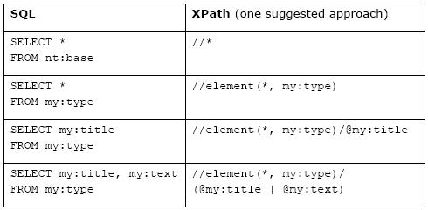
JCR advanced concepts
JCR Queries: Column Specifier

Slide 27
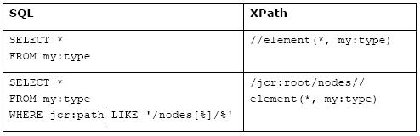
JCR advanced concepts
JCR Queries: Type Constraint

Slide 28
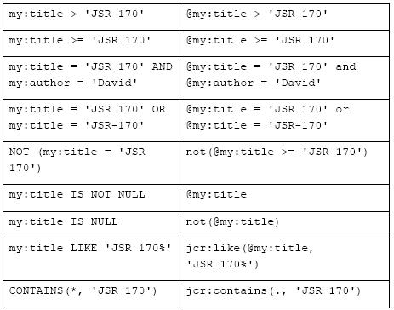
JCR advanced concepts
JCR Queries: Property Constraints

Slide 29
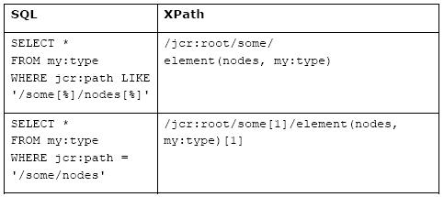
JCR advanced concepts
JCR Queries: Exact Path

Slide 30
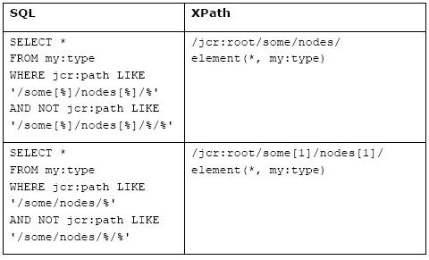
JCR advanced concepts
JCR Queries: Child nodes path

Slide 31
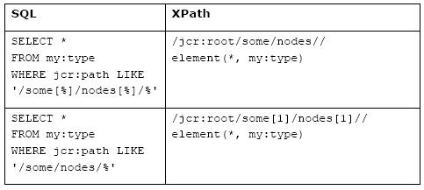
JCR advanced concepts
JCR Queries: Descendants path

Slide 32
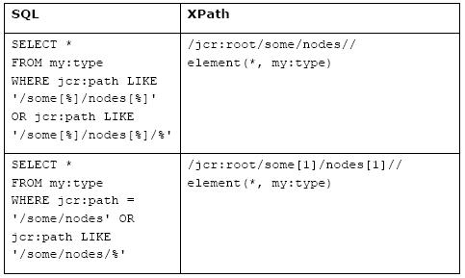
JCR advanced concepts
JCR Queries: Descendants or self path

Slide 33
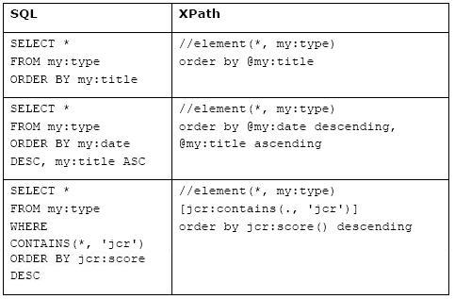
JCR advanced concepts
JCR Queries: Ordering Specifier

Slide 34
JCR advanced concepts
JCR Queries: Like and Contains
Like
SQL: title LIKE '%Java%'
XPATH: jcr:like(@title,'%Java%’)
Contains
SQL
All Node content: contains(*, 'JSR 170')
Single property: contains(@myapp:title, 'JSR 170')
XPATH
All Node content: jcr:contains(., 'JSR 170')
Single property: jcr:contains(@myapp:title, 'JSR 170’)

Slide 35
JCR advanced concepts
JCR Queries: Java Code
QueryManager qm = jcrSession.getWorkspace().getQueryManager();
Query q = qm.createQuery("select * from exo:article", Query.SQL)
NodeIterator ni = q.execute().getNodes();

Slide 36
JCR advanced concepts
Important Classes
CacheableWorkspaceDataManager: Class in which we deal with the cache and the persistence layer
Extended Interfaces: Interfaces that extend the JCR Interfaces to provide advanced features
ExtendedNode: Internal interface that extends Node in which we propose the ACL management and the advanced methods getNodesCount(), getNodesLazily(), getNodesLazily(int pageSize)
QueryImpl: Gives access to the methods setLimit(long limit) and setOffset(long offset)
JCR ExoContainers
RepositoryContainer: One container per repository, it is where we create and initialize the workspaces.
WorkspaceContainer: One container per workspace

Slide 37
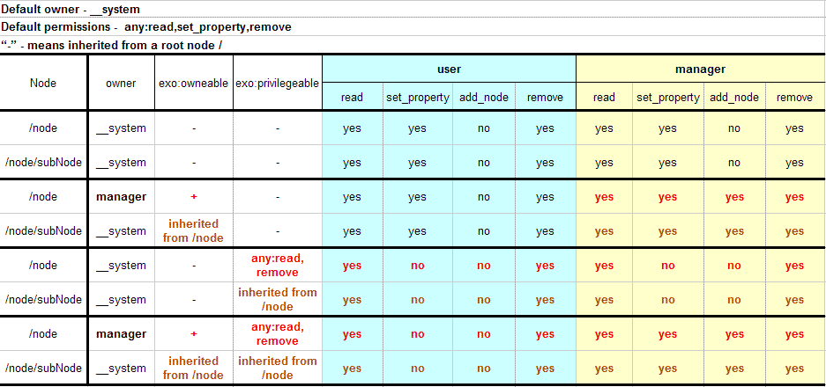
JCR advanced concepts
Understanding the ACL

Slide 38
eXo Kernel’s advanced concepts
ACL: exo:owneable
<nodeType name="exo:owneable" isMixin="true" hasOrderableChildNodes="false" primaryItemName="">
<propertyDefinitions>
<propertyDefinition name="exo:owner" requiredType="String" autoCreated="true" mandatory="true" onParentVersion="COPY" protected="true"
multiple="false">
<valueConstraints />
</propertyDefinition>
</propertyDefinitions>
</nodeType>

Slide 39
eXo Kernel’s advanced concepts
ACL: exo:privilegeable
<nodeType name="exo:privilegeable" isMixin="true" hasOrderableChildNodes="false" primaryItemName="">
<propertyDefinitions>
<propertyDefinition name="exo:permissions" requiredType="Permission" autoCreated="true" mandatory="true" onParentVersion="COPY"
protected="false" multiple="true">
<valueConstraints />
</propertyDefinition>
</propertyDefinitions>
</nodeType>

Slide 40
JCR advanced concepts
ACL: Main Java Methods
ExtendedNode.getACL(): Returns the Access Control List of the node.
ExtendedNode.setPermission(String, String[]): Grants permission to perform several actions for a given identity.
ExtendedNode.removePermission(String) : Removes all the permissions of a given identity.
Session.checkPermission(String absPath, String actions): Indicates whether the session has permission to perform specified actions at the specified absPath

Slide 41
JCR advanced concepts
ACL: Actions
add_node: Add a node.
set_property: Add or change a property
remove: Remove an item.
read: Retrieve an Item
All available from org.exoplatform.services.jcr.access.PermissionType
ACL: Identities
Can be a user id or a group id.
The syntax of a identity based on a group is ${membership}:${group-name}, membership can be * for all memberships. Example *:/platform/administrators
All specific ones available from org.exoplatform.services.security.IdentityConstants such as any and _system

Slide 42
eXo Kernel’s advanced concepts
42
Notes:
42
42

Slide 43
eXo Kernel’s advanced concepts
Loading sequence: Standalone Container
Services default RootContainer configurations from JAR files /conf/configuration.xml
External RootContainer configuration can be found at $AS_HOME/exo-conf/configuration.xml
Services default StandaloneContainer configurations from JAR files /conf/portal/configuration.xml
Web applications configurations from WAR files /WEB-INF/conf/configuration.xml
Then depending on the StandaloneContainer configuration URL initialization:
if configuration URL was initialized to be added to services defaults, as below:
// add configuration to the default services configurations from JARs/WARs. StandaloneContainer.addConfigurationURL(containerConf). Configuration from added URL containerConf will override only services configured in the file
if configuration URL not initialized at all, it will be found at $AS_HOME/exo-configuration.xml. If $AS_HOME/exo-configuration.xml doesn't exist the container will try find it at $AS_HOME/exo-conf/exo-configuration.xml location and if it's still not found and the StandaloneContainer instance obtained with the dedicated configuration ClassLoader the container will try to retrieve the resource conf/exo-configuration.xml within the given ClassLoader.

Slide 44
eXo Kernel’s advanced concepts
Loading sequence: Portal Container
Services default RootContainer configurations from JAR files /conf/configuration.xml
External RootContainer configuration can be found at $AS_HOME/exo-conf/configuration.xml
Services default PortalContainer configurations from JAR files /conf/portal/configuration.xml
Web applications configurations from WAR files /WEB-INF/conf/configuration.xml
External configuration for services of named portal can be found at $AS_HOME/exo-conf/portal/$PORTAL_NAME/configuration.xml

Slide 45
eXo Kernel’s advanced concepts
Loading sequence: AS HOME
$AS_HOME - application server home directory, or user.dir JVM system property value in case of Java Standalone application. The application server home is:
For Jonas, the value of the variable ${jonas.base}.
For Jetty, the value of the variable ${jetty.home}.
For Websphere, the value of the variable ${was.install.root}.
For Weblogic, the value of the variable ${wls.home}.
For Glassfish, the value of the variable ${com.sun.aas.instanceRoot}.
For Tomcat, the value of the variable ${catalina.home}.
For JBoss AS, the value of the variable ${jboss.server.config.url} or ${jboss.server.config.dir} if the exo-conf directory can be found there otherwise it will be the value of the variable ${jboss.home.dir}.

Slide 46
eXo Kernel’s advanced concepts
Loading sequence: Notes
External configuration location can be overridden with System property exo.conf.dir. If the property exists, its value will be used as path to eXo configuration directory, i.e. to $AS_HOME/exo-conf alternative. E.g. put property in command line java -Dexo.conf.dir=/path/to/exo/conf.
The name of the configuration folder that is by default "exo-conf", can be changed thanks to the System property exo.conf.dir.name.

Slide 47
eXo Kernel’s advanced concepts
Extension Mechanism: Motivations
Up to now, to create an application over an GateIn such as DMS, WCM, CS and KS, we need to modify files into the "portal.war". This has many painful consequences, such as:
It is quite hard to manage from the support point of view since we never know if or how the customer changed his eXo product.
It is hard to be able to package several eXo products (WCM, CS...) as we need to merge everything manually which is quite error prone.

Slide 48
eXo Kernel’s advanced concepts
Extension Mechanism: Concepts
PortalContainerDefinition: Defines the main parameters of the portal container (name, rest context, realm) and the dependency order
PortalContainerConfigOwner: ServletContextListener that indicates that the webapp holds potentially configuration files and that it wants to join the Unified ClassLoader and ServletContext used to get resources following the dependency order
PortalContainerInitTask: Used to delay the webapp initialization tasks in order to be able to launch them following the dependency order.
Starter: War/Ear file used to launch the portal containers. It must be launched after all other web applications

Slide 49
eXo Kernel’s advanced concepts
Extension Mechanism: Features
Ability to redefine a resource file from the portal.war (groovy template, login.jsp, resource bundles, configuration files…)
Add new configuration files
Define or redefine a workspace/repository configuration
Add new resource bundles
Add new gatein portal configuration, navigations, pages, portlet preferences
Add new HttpFilers
Add new HttpSessionListeners and/or ServletContextListeners
Provide a specific variable called container.name.suffix to be able to use the same repository configuration for several portal containers.

Slide 50
eXo Kernel’s advanced concepts
Extension Mechanism: Configuration Example
<external-component-plugins>
<target-component>org.exoplatform.container.definition.PortalContainerConfig</target-component>
<component-plugin>
<name>Add PortalContainer Definitions</name>
<set-method>registerPlugin</set-method>
<type>org.exoplatform.container.definition.PortalContainerDefinitionPlugin</type>
<init-params>
<object-param>
<name>portal</name>
<object type="org.exoplatform.container.definition.PortalContainerDefinition">
<field name="name"><string>portal</string></field>
<field name="restContextName"><string>rest</string></field>
<field name="realmName"><string>exo-domain</string></field>
<field name="dependencies">
<collection type="java.util.ArrayList">
<value>
<string>eXoResources</string>
</value>
<value>
<string>portal</string>
</value>
...
<value>
<string>sample-ext</string>
</value>
</collection>
</field>
</object>
</object-param>
</init-params>
</component-plugin>
</external-component-plugins>

Slide 51
eXo Kernel’s advanced concepts
Extension Mechanism: Configuration Locations
PortalContainerConfig for the main portal: In standalone/configuration/gatein/configuration.xml
PortalContainerConfig for the extensions: In a jar file of the extension bundle into conf/configuration.xml. By convention the name of the jar contains “extension.config”
Main configuration parameters: In standalone/configuration/gatein/configuration.properties

Slide 52
eXo Kernel’s advanced concepts
Runtime configuration profiles
An active profile list is obtained during the boot of the root container from the value of the system property exo.profiles which is a comma separated list of profiles and also a server specific profile value (tomcat for tomcat, jboss for jboss, etc...). Example: -Dexo.profiles=foo,bar
Can be defined as an attribute in all the main elements such as component, component-plugin, import, value-param, value, field, container-lifecycle-plugin, component-lifecycle-plugin, external-component-plugins and remove-configuration. (more details here http://www.exoplatform.org/xml/ns/kernel_1_3.xsd)
<component>
<key>Component</key>
<type>Component</type>
</component>
<component profiles="foo">
<key>Component</key>
<type>FooComponent</type>
</component>

Slide 53
Data structure, storage strategies
53
Notes:
53
53

Slide 54
Data structure, storage strategies
JCR Data: DB
SQL files available from https://github.com/exoplatform/jcr/tree/stable/1.15.x/exo.jcr.component.core/src/main/resources/conf/storage/
Syntax of the SQL files jcr-[m|s]jdbc.${dialect}.sql
3 Modes, that can be configured at workspace/container level property db-structure-type:
Single Mode: db-structure-type set to “single”
Multiple Mode: db-structure-type set to “multi”
Isolated Mode: db-structure-type set to “isolated”

Slide 55
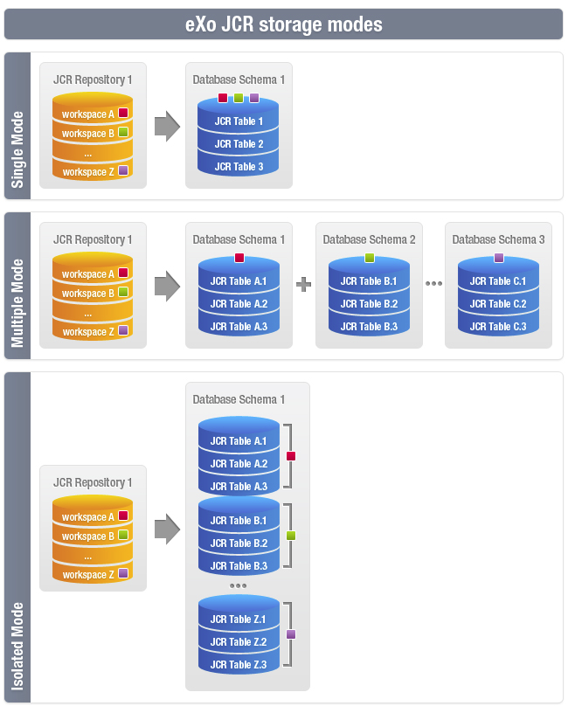
Data structure, storage strategies
Notes:
* The single mode, where all the data of all the workspaces are stored into the same tables.
* The multiple mode, where each workspace has its own tables but in a dedicated DB schema.
The first mode is easy to set up but is not very scalable and
the second mode is much more scalable but much harder to set up, especially when you have a lot of workspaces and you use a database like Oracle.
A new mode has been added, which provides the benefit of both previous modes without any drawback.
This new mode, called isolated, stores the data of each workspace in dedicated tables within the same DB schema which means that it is as easy as the single mode to set up and as scalable as the multiple mode.

Slide 56
Data structure, storage strategies
JCR Data: DB (Single Mode)
CREATE TABLE JCR_SITEM(
ID VARCHAR(96) NOT NULL,
PARENT_ID VARCHAR(96) NOT NULL,
NAME VARCHAR(512) NOT NULL,
VERSION INTEGER NOT NULL,
CONTAINER_NAME VARCHAR(96) NOT NULL,
I_CLASS INTEGER NOT NULL,
I_INDEX INTEGER NOT NULL,
N_ORDER_NUM INTEGER,
P_TYPE INTEGER,
P_MULTIVALUED BOOLEAN,
CONSTRAINT JCR_PK_SITEM PRIMARY KEY(ID),
CONSTRAINT JCR_FK_SITEM_PARENT FOREIGN KEY(PARENT_ID) REFERENCES JCR_SITEM(ID)
);
CREATE UNIQUE INDEX JCR_IDX_SITEM_PARENT ON JCR_SITEM(CONTAINER_NAME, PARENT_ID, NAME, I_INDEX, I_CLASS, VERSION DESC);
CREATE UNIQUE INDEX JCR_IDX_SITEM_PARENT_NAME ON JCR_SITEM(I_CLASS, CONTAINER_NAME, PARENT_ID, NAME, I_INDEX, VERSION DESC);
CREATE UNIQUE INDEX JCR_IDX_SITEM_PARENT_ID ON JCR_SITEM(I_CLASS, CONTAINER_NAME, PARENT_ID, ID, VERSION DESC);
CREATE INDEX JCR_IDX_SITEM_N_ORDER_NUM ON JCR_SITEM(I_CLASS, CONTAINER_NAME, PARENT_ID, N_ORDER_NUM);
CREATE TABLE JCR_SVALUE(
ID BIGINT generated by default as identity (START WITH 2) NOT NULL,
DATA VARBINARY(16777216),
ORDER_NUM INTEGER NOT NULL,
PROPERTY_ID VARCHAR(96) NOT NULL,
STORAGE_DESC VARCHAR(512),
CONSTRAINT JCR_PK_SVALUE PRIMARY KEY(ID),
CONSTRAINT JCR_FK_SVALUE_PROPERTY FOREIGN KEY(PROPERTY_ID) REFERENCES JCR_SITEM(ID)
);
CREATE UNIQUE INDEX JCR_IDX_SVALUE_PROPERTY ON JCR_SVALUE(PROPERTY_ID, ORDER_NUM);
CREATE TABLE JCR_SREF(
NODE_ID VARCHAR(96) NOT NULL,
PROPERTY_ID VARCHAR(96) NOT NULL,
ORDER_NUM INTEGER NOT NULL,
CONSTRAINT JCR_PK_SREF PRIMARY KEY(NODE_ID, PROPERTY_ID, ORDER_NUM)
);
CREATE UNIQUE INDEX JCR_IDX_SREF_PROPERTY ON JCR_SREF(PROPERTY_ID, ORDER_NUM);

Slide 57
Data structure, storage strategies
JCR Data: DB (Multiple Mode)
CREATE TABLE JCR_MITEM(
ID VARCHAR(96) NOT NULL,
PARENT_ID VARCHAR(96) NOT NULL,
NAME VARCHAR(512) NOT NULL,
VERSION INTEGER NOT NULL,
I_CLASS INTEGER NOT NULL,
I_INDEX INTEGER NOT NULL,
N_ORDER_NUM INTEGER,
P_TYPE INTEGER,
P_MULTIVALUED BOOLEAN,
CONSTRAINT JCR_PK_MITEM PRIMARY KEY(ID),
CONSTRAINT JCR_FK_MITEM_PARENT FOREIGN KEY(PARENT_ID) REFERENCES JCR_MITEM(ID)
);
CREATE UNIQUE INDEX JCR_IDX_MITEM_PARENT ON JCR_MITEM(PARENT_ID, NAME, I_INDEX, I_CLASS, VERSION DESC);
CREATE UNIQUE INDEX JCR_IDX_MITEM_PARENT_NAME ON JCR_MITEM(I_CLASS, PARENT_ID, NAME, I_INDEX, VERSION DESC);
CREATE UNIQUE INDEX JCR_IDX_MITEM_PARENT_ID ON JCR_MITEM(I_CLASS, PARENT_ID, ID, VERSION DESC);
CREATE INDEX JCR_IDX_MITEM_N_ORDER_NUM ON JCR_MITEM(I_CLASS, PARENT_ID, N_ORDER_NUM);
CREATE TABLE JCR_MVALUE(
ID BIGINT generated by default as identity (START WITH 2) NOT NULL,
DATA VARBINARY(16777216),
ORDER_NUM INTEGER NOT NULL,
PROPERTY_ID VARCHAR(96) NOT NULL,
STORAGE_DESC VARCHAR(512),
CONSTRAINT JCR_PK_MVALUE PRIMARY KEY(ID),
CONSTRAINT JCR_FK_MVALUE_PROPERTY FOREIGN KEY(PROPERTY_ID) REFERENCES JCR_MITEM(ID)
);
CREATE UNIQUE INDEX JCR_IDX_MVALUE_PROPERTY ON JCR_MVALUE(PROPERTY_ID, ORDER_NUM);
CREATE TABLE JCR_MREF(
NODE_ID VARCHAR(96) NOT NULL,
PROPERTY_ID VARCHAR(96) NOT NULL,
ORDER_NUM INTEGER NOT NULL,
CONSTRAINT JCR_PK_MREF PRIMARY KEY(NODE_ID, PROPERTY_ID, ORDER_NUM)
);
CREATE UNIQUE INDEX JCR_IDX_MREF_PROPERTY ON JCR_MREF(PROPERTY_ID, ORDER_NUM);

Slide 58
Data structure, storage strategies
JCR Data: DB
Name of the tables:
Single Mode: starts with “JCR_S”
Multiple Mode: starts with “JCR_M”
Isolated Mode: starts with “JCR_” followed by the first letter of the table name then the table suffix that is the value of the property db-tablename-suffix if set otherwise the name of the workspace without [^A-Za-z_0-9]
The syntax of the UUID in single mode is ${workspace-name}${uuid-item}
The SQL scripts and java classes used for the isolated mode are the same as for the multiple mode, the objects are only renamed

Slide 59
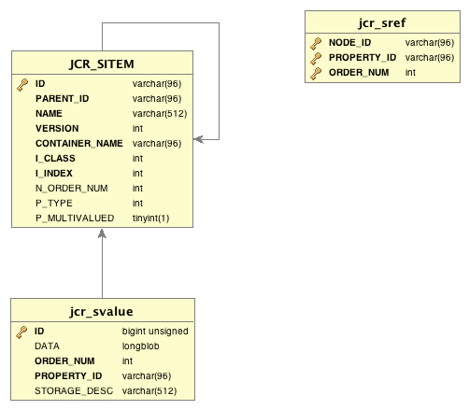
Data structure, storage strategies
JCR Data: DB
I_CLASS = 1 -> Node
I_CLASS = 2 -> Property
STORAGE_DESC -> ID of the VS
An ITEM must have a Parent Item
ITEM.ID <-> VALUE.PROPERTY_ID
ITEM.ID <-> REF.PROPERTY_ID

Slide 60
Data structure, storage strategies
JCR Data: Value Store (TreeFileValueStorage)
Distributes the files using the UUID of the Properties. We use :
the 7 first characters to create a hierachy of folders, the name of each folder of this hierarchy is one of the characters of the uuid.
the rest of the uuid to create the last folder
The entire id followed by the index of the property to create the file that will contain the value of the property
Example: we have a property whose uuid is 005beac8c0a8000b5661279a638c4ce1 and whose index is 0
The content will be stored into ${root-path-vs}/0/0/5/b/e/a/c/8c0a8000b5661279a638c4ce1/005beac8c0a8000b5661279a638c4ce10

Slide 61
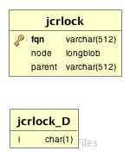
Data structure, storage strategies
JCR Data: Lock (JBC)
Fqn = /${repository}_${workspace}/${LOCKS}/$UUID (if shareable)
Fqn = /${LOCKS}/$UUID (if not shareable)

Slide 62
Creating unit tests
62
Notes:
62
62

Slide 63
Creating Unit Test
Use -Djcr.test.configuration.file=${config-file-path}
Isolated Mode: /conf/standalone/test-configuration-ijdbc-jbc.xml
Single Mode: /conf/standalone/test-configuration-sjdbc-jbc.xml
Multiple Mode: /conf/standalone/test-configuration-mjdbc-jbc.xml
Cluster/Isolated Mode: /conf/standalone/cluster/test-configuration-ijdbc-jbc.xml
Check the exclusions in pom file
Extend org.exoplatform.services.jcr.JcrAPIBaseTest
Prevent error of type “java.lang.NoSuchFieldException: JiBX_bindingList” by building exo.jcr.component.core using “mvn clean install –DskipTests=true”
When launched from the IDE don’t forget to remove the temp directory (usually in the target directory)

Slide 64
Common pitfalls
64
Notes:
64
64

Slide 65
Common pitfalls
getNodes
session leak
queries with //
workspace.copy
sharing nodes
session.save or item.save
nt:unstructured

Slide 66
Exercise
66
Notes:
66
66

Slide 67
Exercise
Create a unit test that shows the results of the slide « Understanding the ACL »
Use RepositoryImpl.getSystemSession(String workspaceName) to create a system session.
Use workspace “ws”

Slide 68
eXo JCR
JCR for developers (advanced)
Notes:
68
68

