Slide 1
eXo Fundamentals Training
Portal Elements and Organization Model
Notes:
1

Slide 2
Discovery
2
Notes:
2

Slide 3
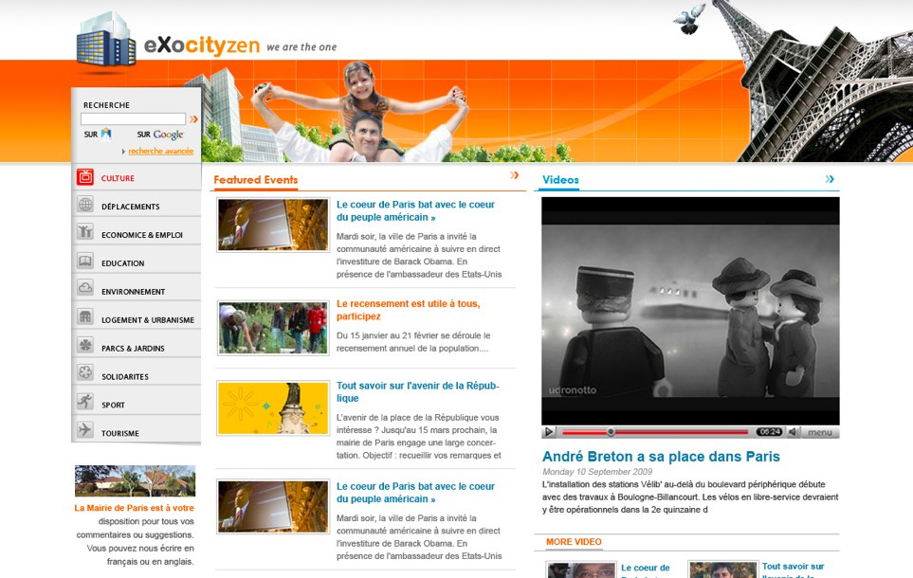
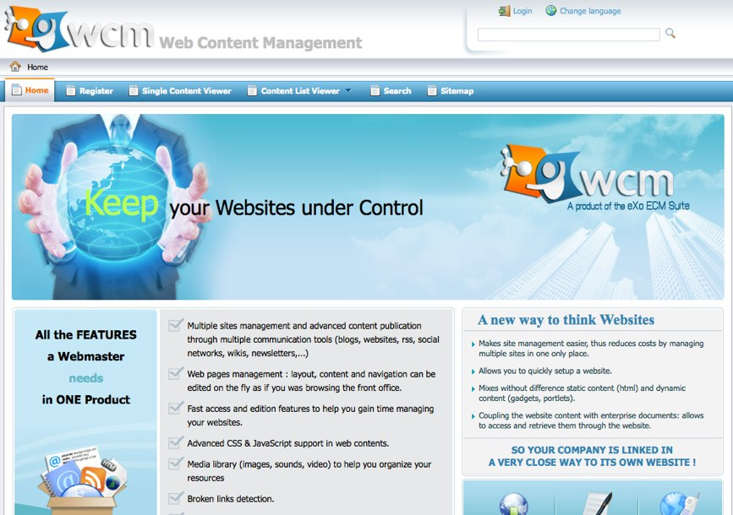

Image Discovery
Notes:
3

Slide 4
Why a portal ?
Improvement of productivity
Single Entry Point
Single Sign-On
Application Integration
Resources leverage
Centralized User Management
Simplified Administration and Deployment

Slide 5
Why eXo Platform ?
Respect for Standards
Professional Open Source
Integrated and Extensible
Customer-driven innovation (ex: cloud IDE, web OS)
Flexible Roadmap

Slide 6
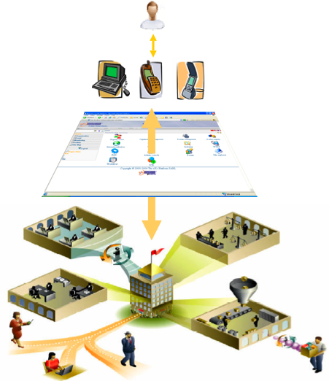

Enterprise Portal
Collaborative
Applications
Workflows
Intranet
Documents

Slide 7

Homepage
Open the this address: http://localhost:8080/portal/
Forwards to the default portal: http://localhost:8080/portal /default/
Notes:
7

Slide 8
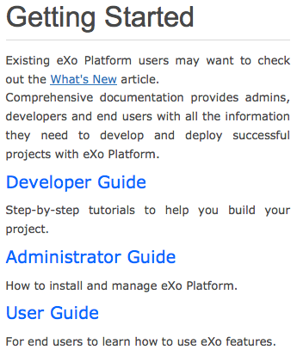
eXo Platform Homepage
Notes:
8

Slide 9
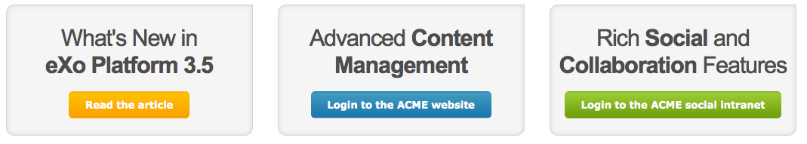
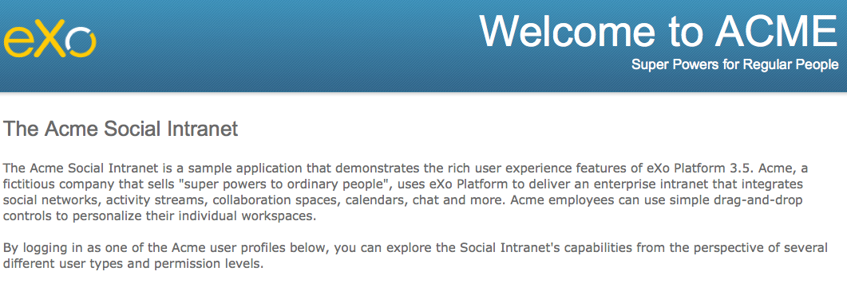
Acme Social Intranet
Notes:
9

Slide 10
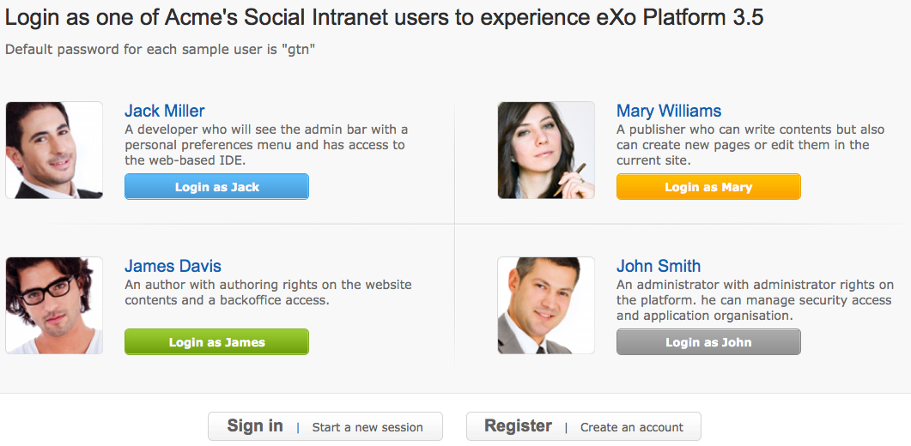
Acme Social Intranet
Notes:
10

Slide 11
Intranet Sample Users
Sample Users:
Jack Miller: A developer who will see the admin bar with a personal preferences menu and has access to the web-based IDE.
James Davis: An author with authoring rights on the website contents and a backoffice access.
Mary Williams: A publisher who can write contents but also can create new pages or edit them in the current site.
John Smith: An administrator with administrator rights on the platform. he can manage security access and application organization.
All have the same default password: “gtn”.
Notes:
11

Slide 12
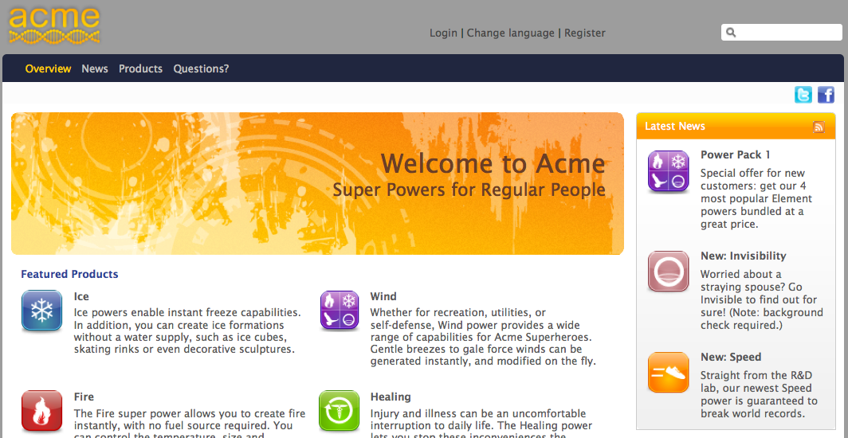
Acme Web Site
Notes:
12

Slide 13
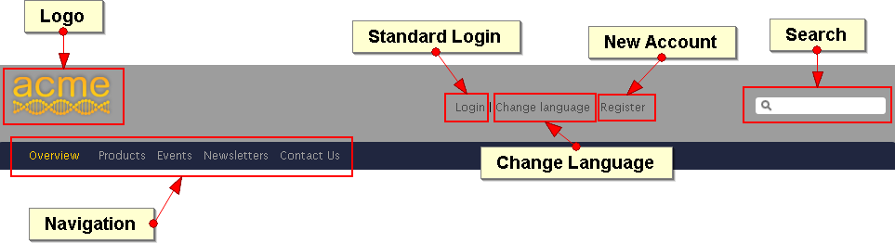
Acme Web Site
Address: http://localhost:8080/portal/acme/
Notes:
13

Slide 14
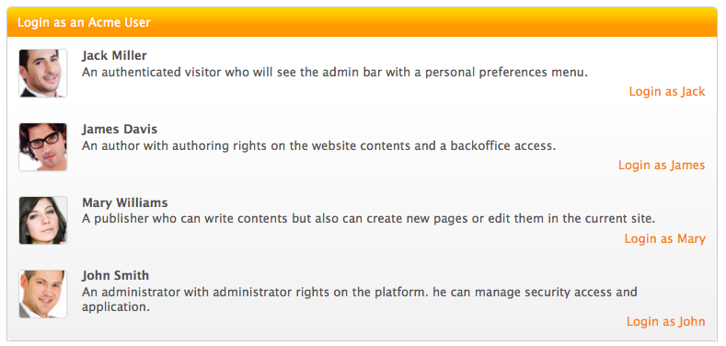
Acme Web Site – Sample Users
Address: http://localhost:8080/portal/acme/
Notes:
14

Slide 15
Admin Tool Bar
15
Notes:
15

Slide 16
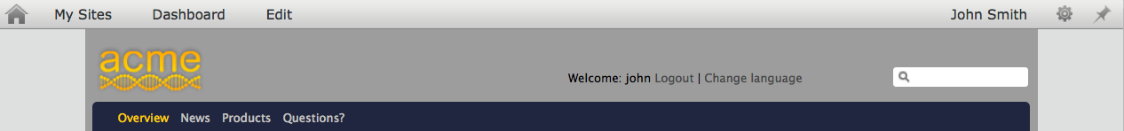
Admin Tool Bar
The Admin Tool Bar contains menu entries for:
Sites
Dashboard
Editor, where you can edit the current page and site.
User Name with account and language preferences
Platform Preferences and Settings, using eXo’s ready-to-use applications
Admin Tool Bar
Notes:
16

Slide 17
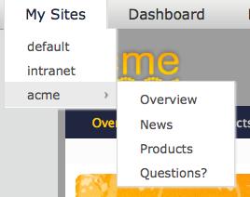
Admin Tool Bar - Sites
Select your public site, for the current site you can directly open a page
Navigation of the site “acme”
All available sites
Notes:
17

Slide 18
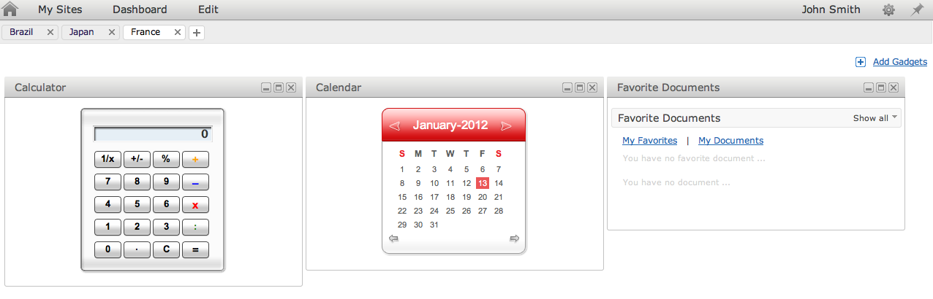
Personal Dashboard
Personal Gadgets, which are private to each user.
Notes:
18

Slide 19
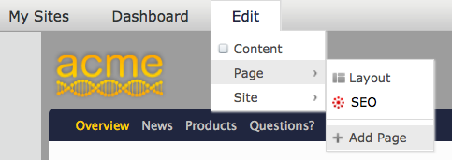
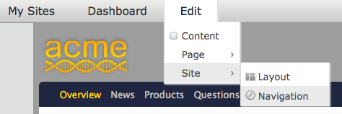
Admin Tool Bar - Editor
You can edit the layout of the current page, add new pages, edit the site layout and modify the navigation. We will see more about this later.
Layout and SEO of the current page.
Add a new page to the current site.
Layout and navigation of the current site
Notes:
19

Slide 20
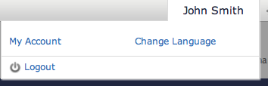
Admin Tool Bar
By clicking on the user name you can
Modify some user data
Change the user language preference
Log out
Notes:
20

Slide 21
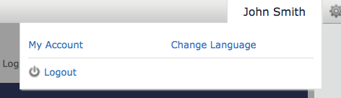
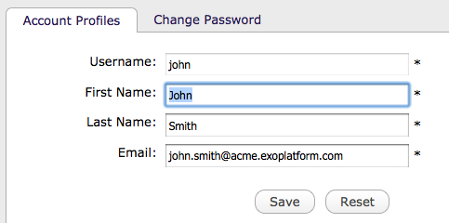
User Account
Notes:
21

Slide 22
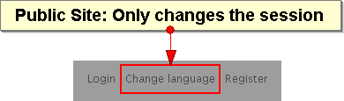
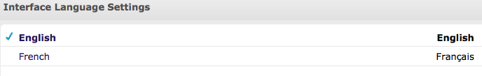
Language Preferences
eXo Platform is available in French and English
Anonymous / public site: the language choice is stored in the temporary session.
After login: The choice is stored in the user preferences.
Notes:
22

Slide 23
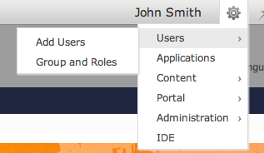
Platform Settings
eXo’s internal applications are available and top right corner.
You have access to settings, administration and monitoring tools.
The choice of applications depend on the user profile. Different users have access to different applications.
Notes:
23

Slide 24
Personal Dashboard and Gadgets
24
Notes:
24

Slide 25
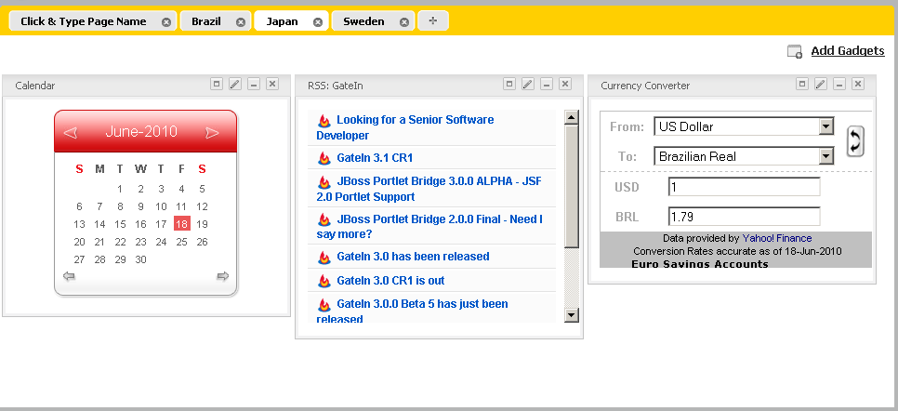
Gadgets
Live user interface
Accessible in Dashboards, WebOS or using a Gadget Wrapper (later more about this)
Many implementations : Google Gadget standard in GateIn
Embeddable chunk of HTML and Javascript, defined in a standard XML file.
Notes:
25

Slide 26
Personal Dashboard
Create a new tab
Personal dashboard of John Smith
Minimize, maximize, delete
Create a new tab
Click for edit the name of a tab of John Smith’s dashboard
Add gadgets from the gadget directory
Notes:
26

Slide 27
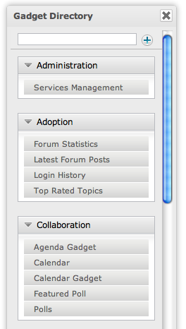
Internal Gadget
Only for external gadgets
Internal gadgets are stored on the eXo server
You can drag it directly to the dashboard
Drag a gadget
Notes:
27

Slide 28
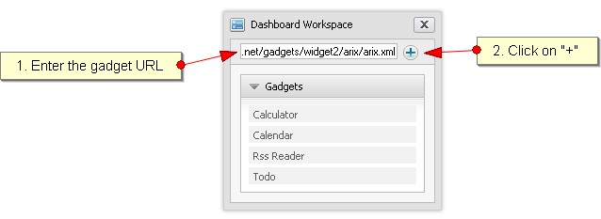
External Gadget
External gadgets are stored on other servers. You need an Internet connection.
You need to enter or copy a complete URL which points to an XML file.
Notes:
28

Slide 29
Exercise 0: Start and Play
Requirement:
Java SDK 6 (For eXo Portal it was Java 5)
Notes:
29

Slide 30
Exercise 0: Start and Play
Start the portal
Create a directory $TRAINING_HOME and unzip eXoPlatform-3.5.2.zip
Search for the binary subfolder:
...\eXoPlatform-3.5.2\bin\tomcat6-bundle
In command line, launch:
Linux / Mac OS : ./start_eXo.sh run
Windows : start_eXo run
Wait
Watch the startup messages.
The startup is finished when you see “INFO: Server startup in 71219 ms”.
Open this page in a browser: http://localhost:8080/portal/
Notes:
30

Slide 31
Exercise 0: Start and Play
How to stop eXo platform
To stop the server, simply type Ctrl+C from the console
You can also use : ./stop_eXo.sh stop
To re-init and get the default configuration (starting from scratch):
Unzip again in order to get a fresh eXo installation.
Notes:
31

Slide 32
Exercise 0: Start and Play
Settings
Switch to Acme Website
Before logging in, change the language
Log in as Mary
Change the language for Mary
Change her email address
Notes:
32

Slide 33
Exercise 0: Start and Play
Dashboard
Log in as “mary” (password: gtn)
Create two dashboards tabs with different names and drag gadgets to it
Log in as “john” (password: gtn)
Verify that his dashboard is empty (remember that the dashboard is personal)
Create a dashboard for John
Add an external gadget to the dashboard: http://shazingo.com/lig/lg/142002.xml
If not otherwise stated, in all following exercises of this training use “john”.
Notes:
33

Slide 34
Organisation Model
34
Notes:
34

Slide 35
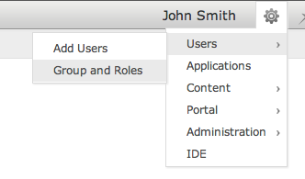
Organisational Model
Access to user organisation tools
Components
Users
Groups
Memberships
Authentication and Authorization
Generalized model for the platform
By default: Database storage (Hibernate)
Possible: Directory storage (LDAP), Microsoft Active Directory, or a custom system.
Notes:
35

Slide 36
Organisational Model - Memberships
Membership are identical with roles: manager, validator, editor.
Membership are shared among all groups.
When a user is added to a group she or he must be assigned with a membership to that group.
The asterisk “*” stands for “all memberships”.
Notes:
36

Slide 37
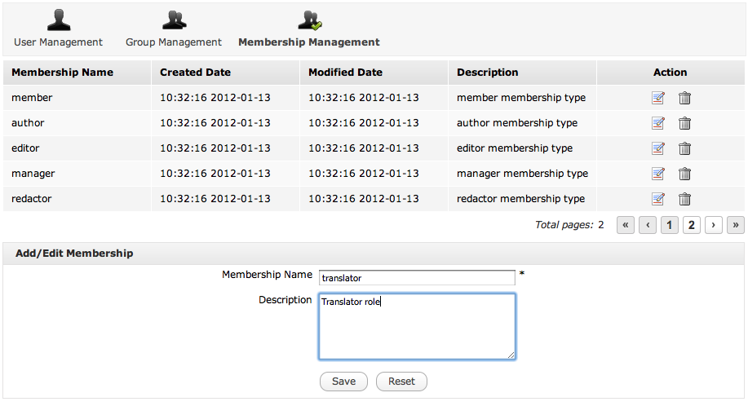
Organisational Model - Memberships
Add or modify memberships tab
Modify memberships
For adding and editing
Notes:
37

Slide 38
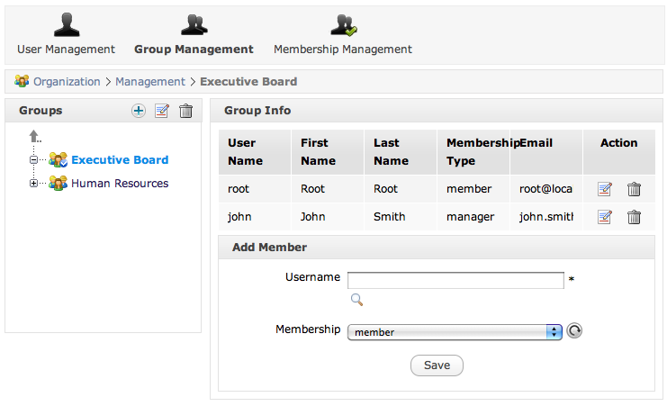
Organisational Model - Groups
Groups are organized in an hierarchy, but there is no inheritance.
A user can be several times in the same group having different memberships.
Add subgroup, modify or delete the current group
Edit or delete a user
Current group
Add or edit a membership
Notes:
38

Slide 39
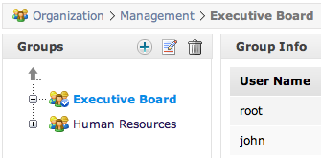
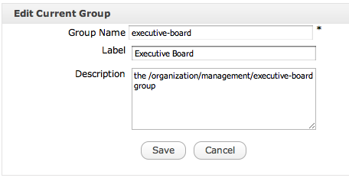
Organisational Model - Groups
Groups have a name. The name is used internally and cannot be modified.
The group label is used for the interfaces and can be modified at will.
Notes:
39

Slide 40
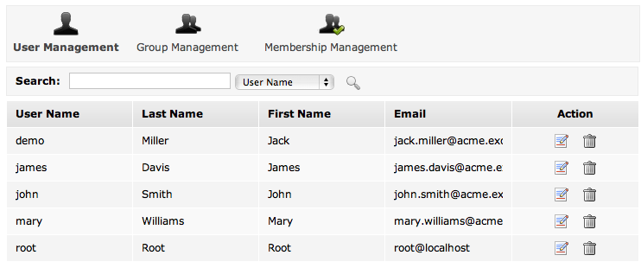
Organisational Model - User
User Management
Editing
Notes:
40

Slide 41
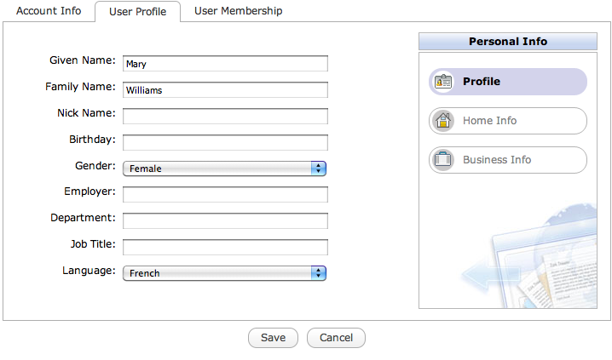

Organisational Model - User
Modify user information, delete memberships
User management tabs
Three info blocs of the user profile
Editing
Notes:
41

Slide 42
General Remarks
Name = ID
Every time you see a field asking for a group, membership or user name, you should think of an ID. Therefore, names cannot be modified. For end users, there is sometimes a second field called „label“ which is used for the interface. You will see this usage of the „name“ field in other areas of eXo.
Case Sensitivity
Everything is case sensitive: user, group and membership name.
Membership Type manager
This is the role of the manager of each group. Each group has to have one member with a role. The administrator who creates a group is automatically added to that group with the membership type “manager”.
Notes:
42

Slide 43
Exercise: Memberships
Create a new member
Login as John.
Open the application “’Add Users” (Menu: Upper right corner)
Create a user called “elena”.
Manage users and groups
Open “Groups and roles” (Menu: Upper right corner)
Search for the user “Elena”. Is she already member of a group?
Create a new membership type “translator”.
Create a new subgroup in platform called “bike”.
Add Elena to the new group with the new membership type.
Add Elena a second time to that group user the “manager” membership type.
Notes:
43

Slide 44
eXo Fundamentals Training
Portal Elements and Organization Model
Q & A
Notes:
44

